Slide 1

FEWSim—
WEAP and LEAP Time Step Control
Adil Mounir
Presentation to: CEE 543
March 20, 2018
Adil Mounir
Presentation to: CEE 543
March 20, 2018

Slide 2
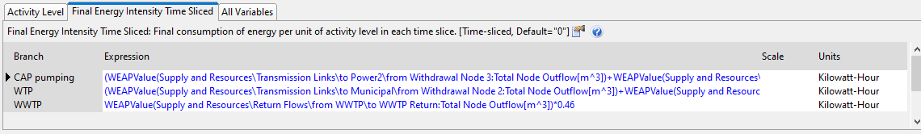
Motivation for Time Step Control
The statistical economical model is running by yearly steps and its results will be used as input to MABIA (WEAP) module. There might be a potential need that we run WEAP and LEAP coupled model by yearly step taking the statistical economical model into the FEWSim system.
There may be other situations we need to run WEAP and LEAP by yearly time steps, such as when we need to update the multipliers for WEAP-LEAP coupled parameters’ formula.

Slide 3
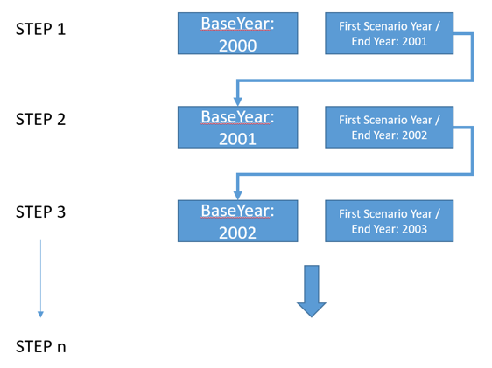
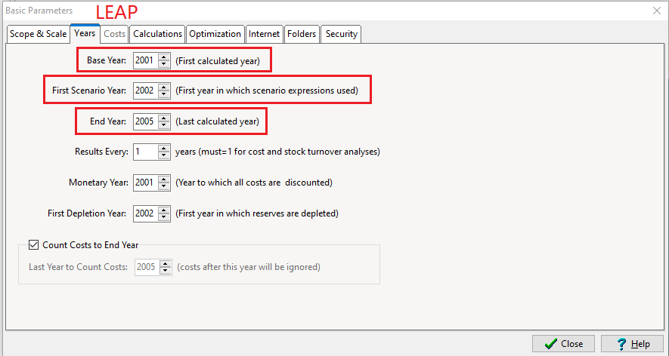
Time Step Control
Why use the span of two(2) years as cycle period?
Because LEAP has three parameters for time step control and they also have to be in a particular order:
Base Year < First Scenario Year <End Year
IF this rule is violated, LEAP software will crash when the setting year API is called through script (Python).

Slide 4
What to be Tested?
Unconstrained source and Unconstrained link Test
Unconstrained source and Constrained link Test
Constrained source and Unconstrained link Test
There may be more complicated combinations of test conditions, such as partially constrained
source or partially constrained links. However it takes more time to build the test condition and
test them. So lets check those three test results first.

Slide 5
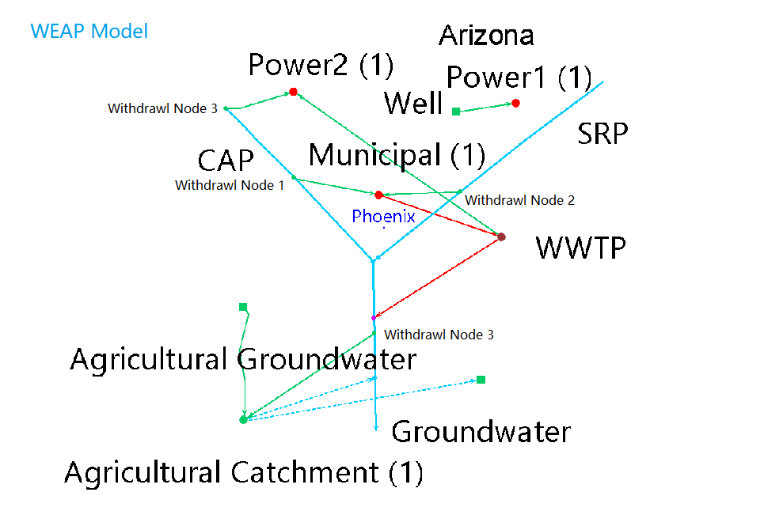
WEAP Model
Coupled Parameters:
Power1 = 2.1 * LEAPValue(Transformation\Electricity generation\Processes\Power1:Average Power Dispatched[MW])* 24 * Days
Power2 = 2.1 * LEAPValue(Transformation\Electricity generation\Processes\Power2:Average Power Dispatched[MW])* 24 * Days

Slide 6
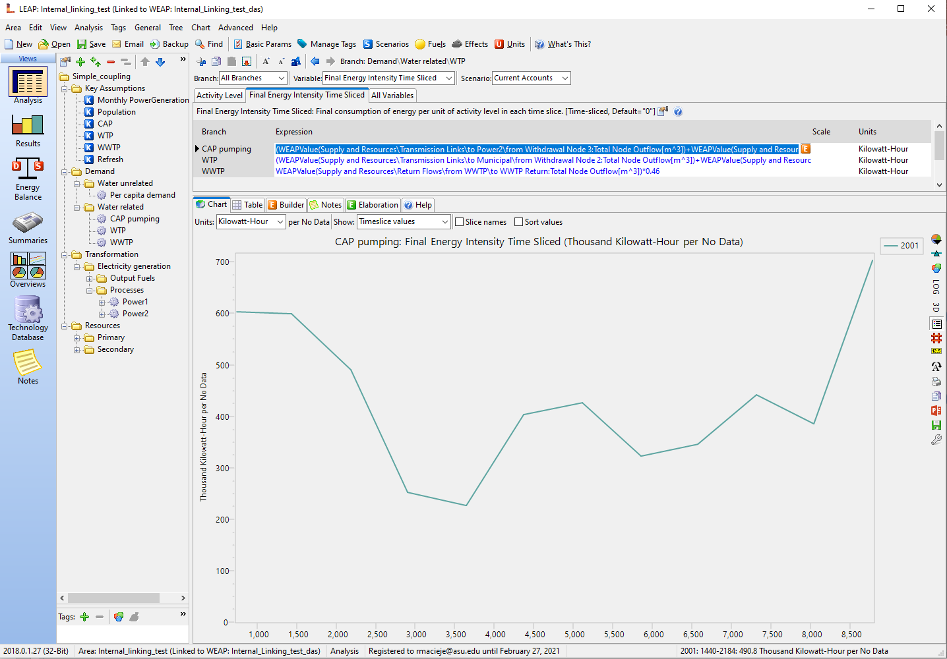
LEAP Model
Coupled Parameters:
CAP pumping = (WEAPValue(Supply and Resources\Transmission Links\to Power2\from Withdrawal Node 3:Total Node Outflow[m^3])+WEAPValue(Supply and Resources\Transmission Links\to Municipal\from Withdrawal Node 1:Total Node Outflow[m^3]))*1.5
WTP = (WEAPValue(Supply and Resources\Transmission Links\to Municipal\from Withdrawal Node 2:Total Node Outflow[m^3])+WEAPValue(Supply and Resources\Transmission Links\to Municipal\from Withdrawal Node 1:Total Node Outflow[m^3]))*0.45
WTP = WEAPValue(Supply and Resources\Return Flows\from WWTP\to WWTP Return:Total Node Outflow[m^3])*0.46

Slide 7
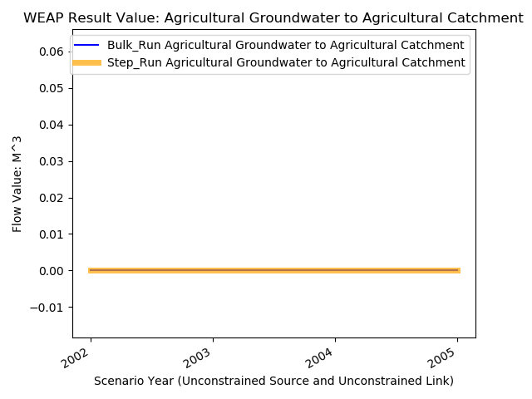
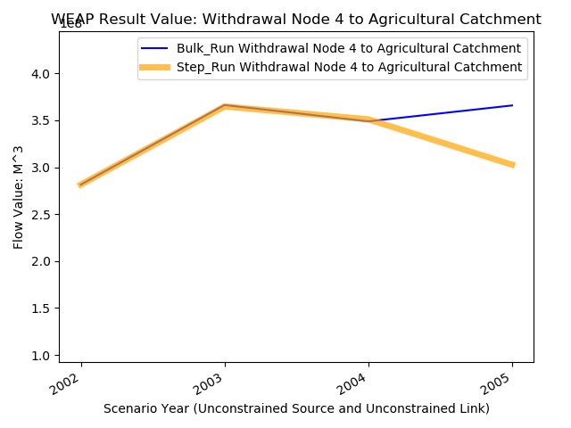
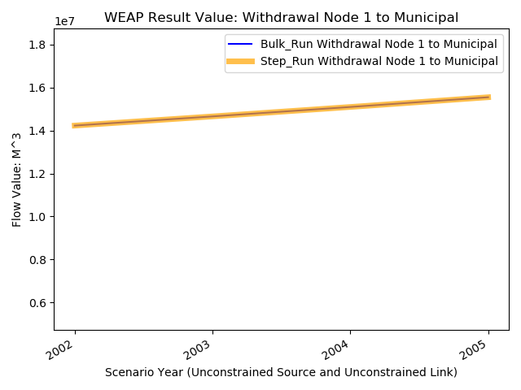
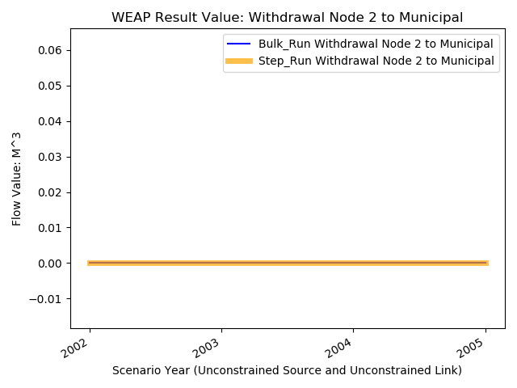
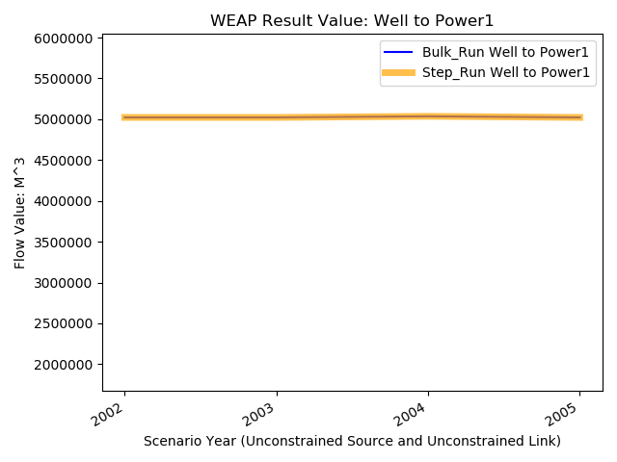
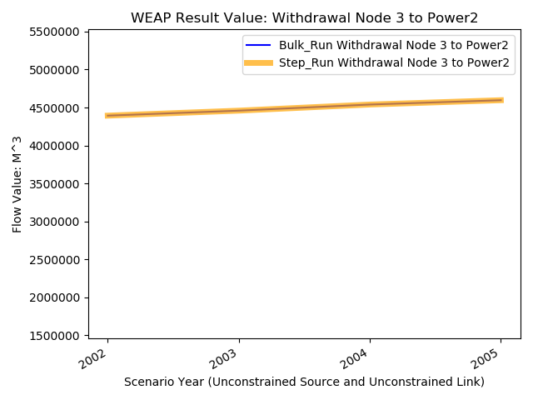
Test Result: Unconstrained Source and Unconstrained Link Test
WEAP

Slide 8
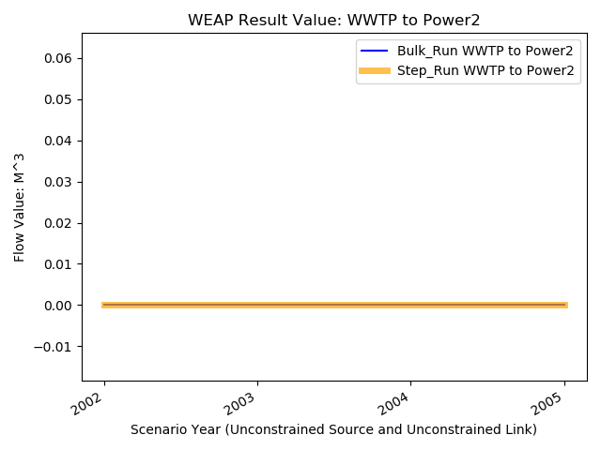
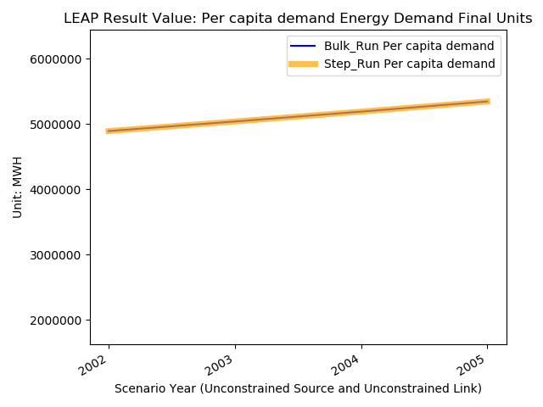
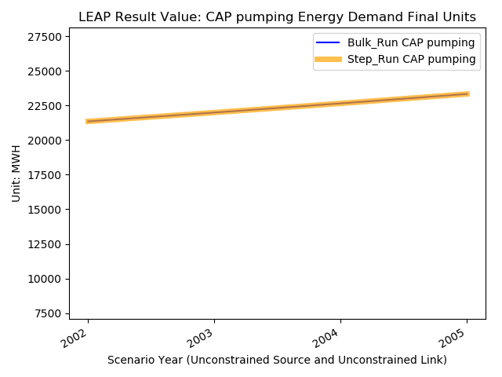
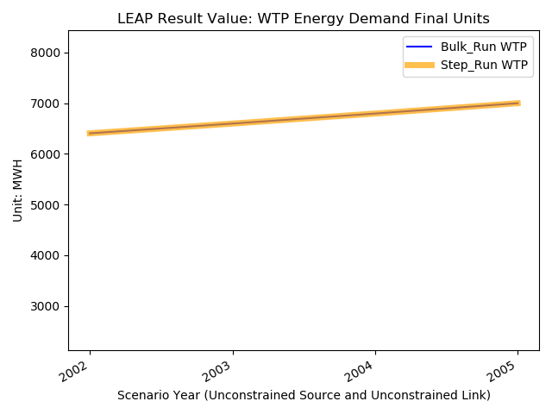
Test Result: Unconstrained Source and Unconstrained Link Test
2. LEAP:

Slide 9
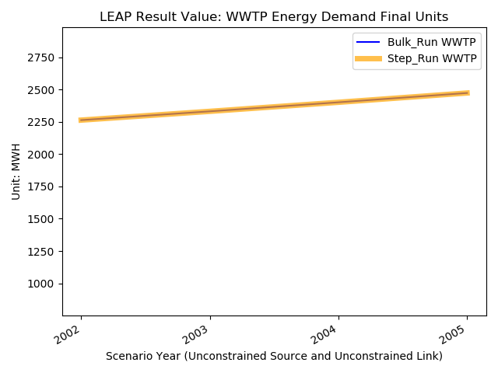
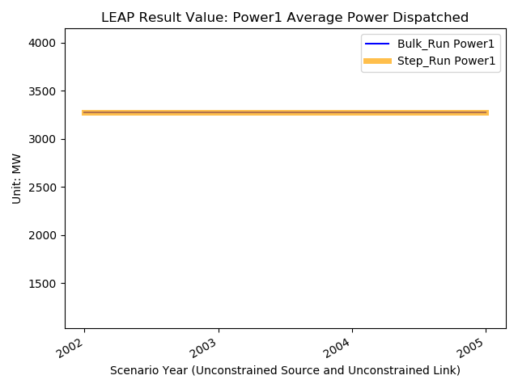
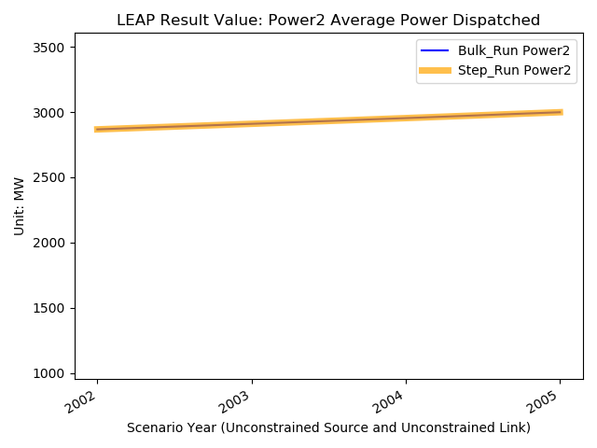
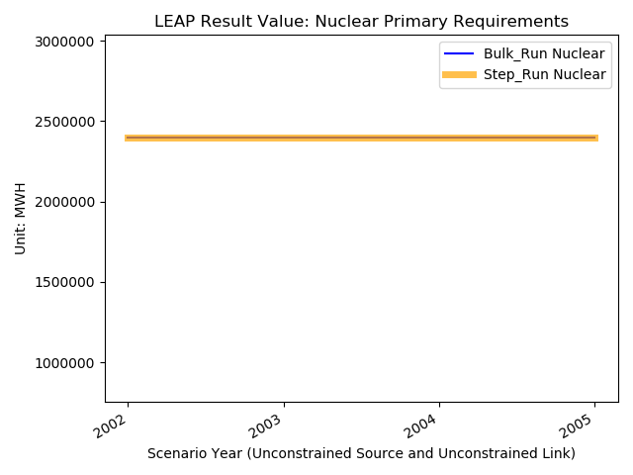
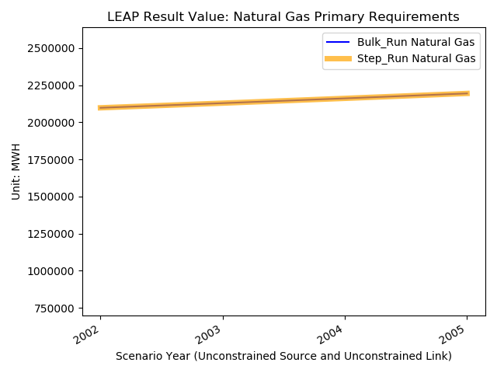
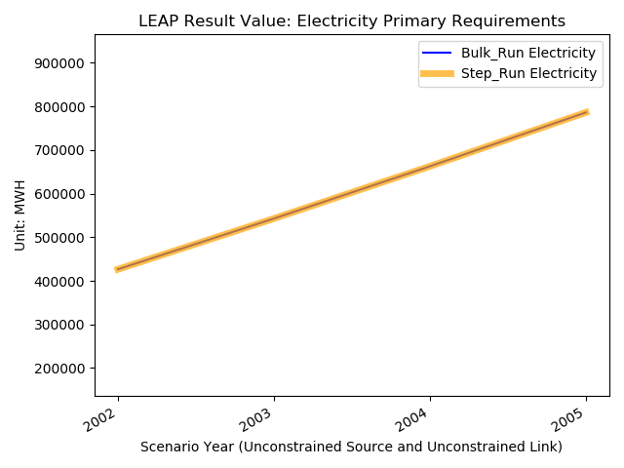
Test Result: Unconstrained Source and Unconstrained Link Test

Slide 10
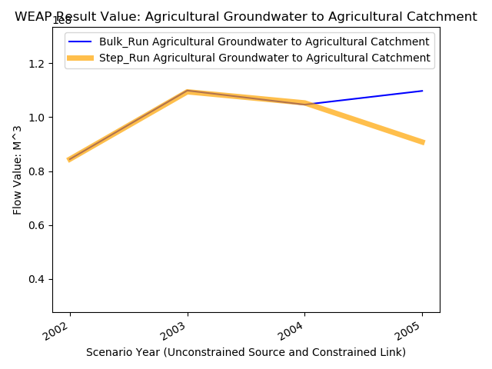
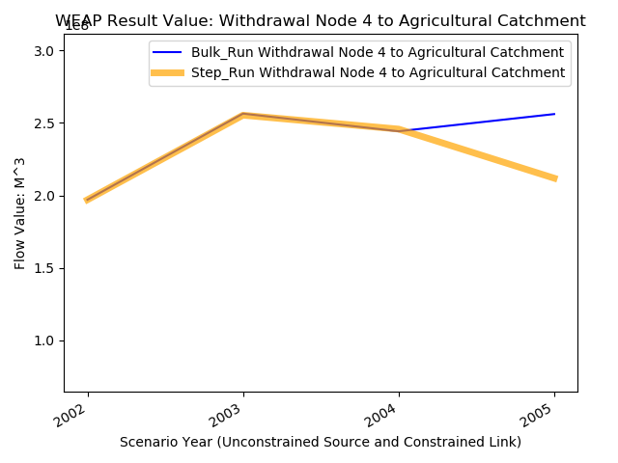
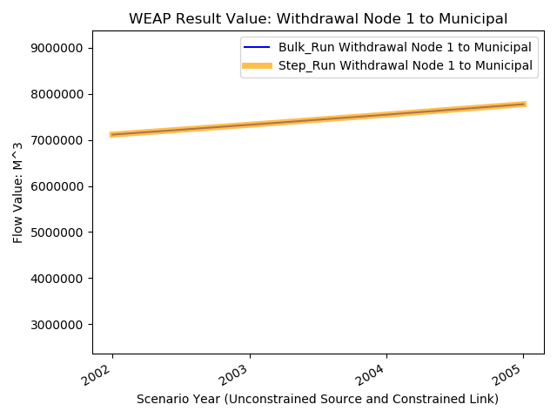
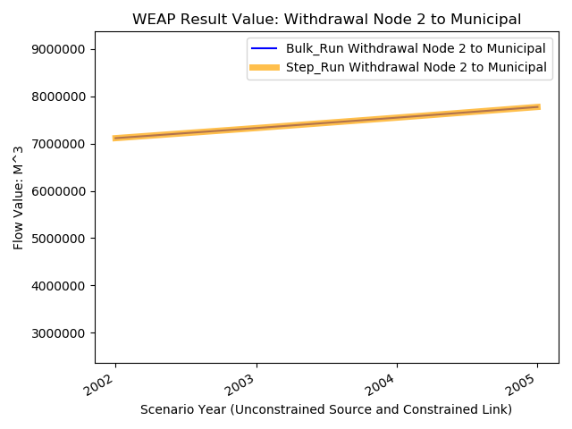

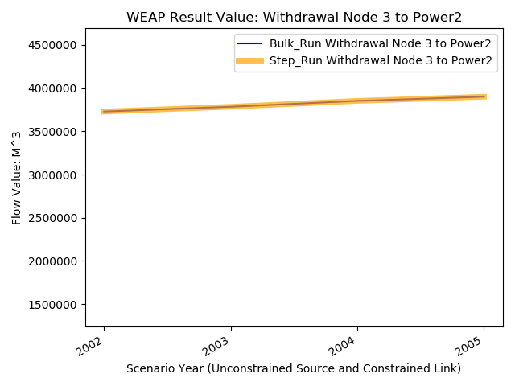
Test Result: Unconstrained Source and Constrained Link Test
1. WEAP:

Slide 11
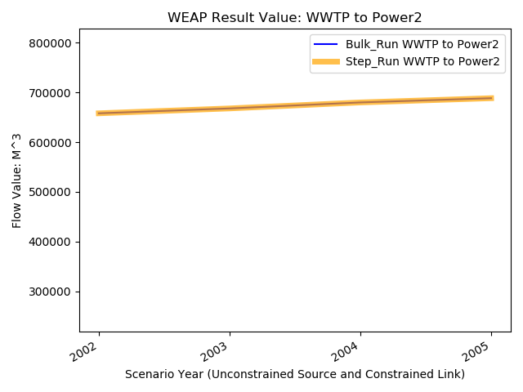

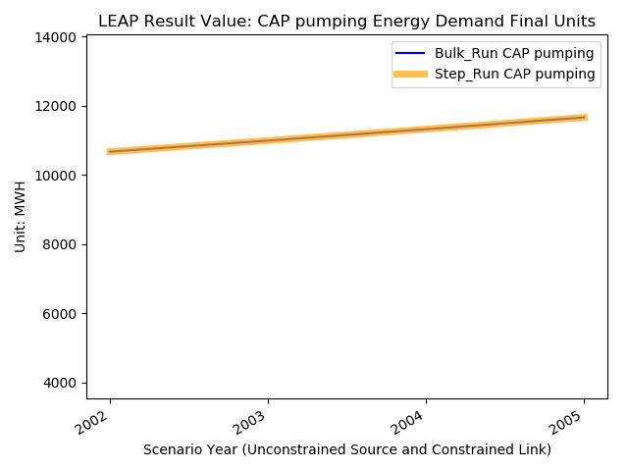

Test Result: Unconstrained Source and Constrained Link Test
2. LEAP:

Slide 12


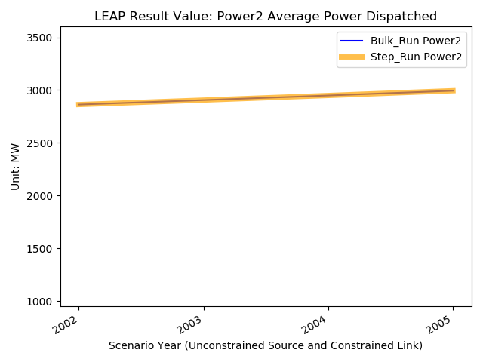

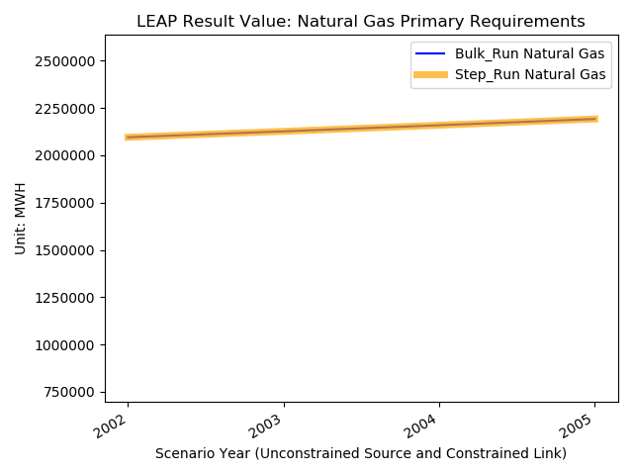
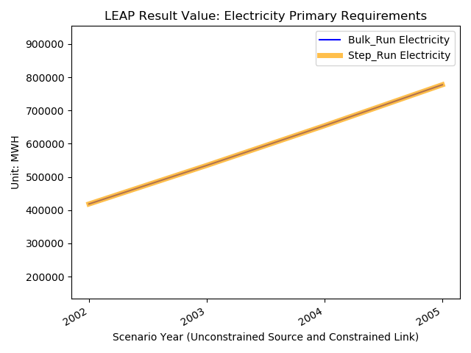
Test Result: Unconstrained Source and Constrained Link Test

Slide 13
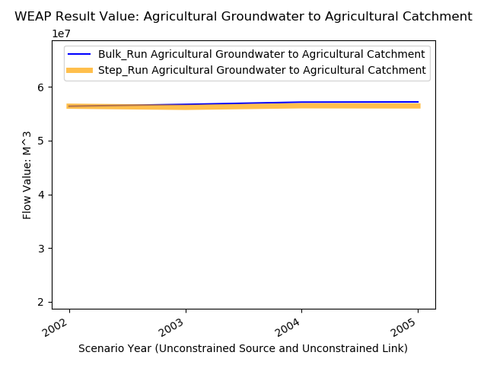
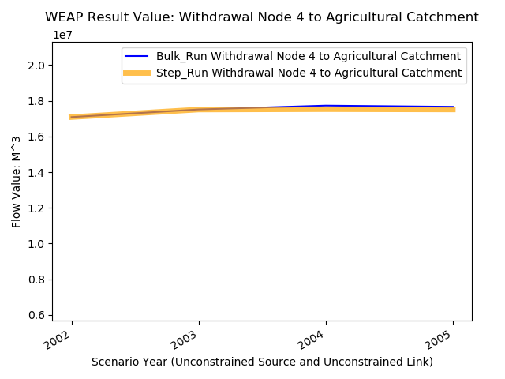
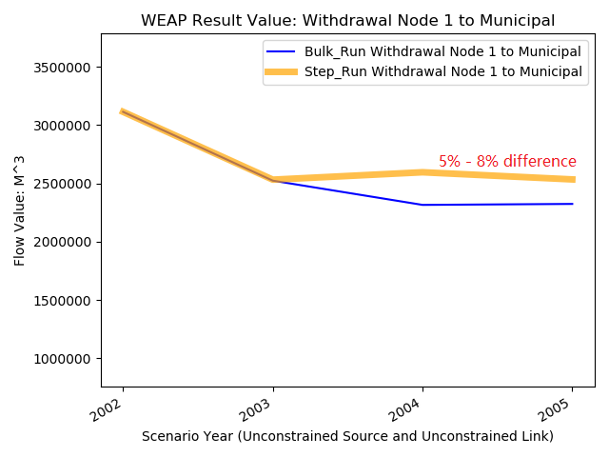
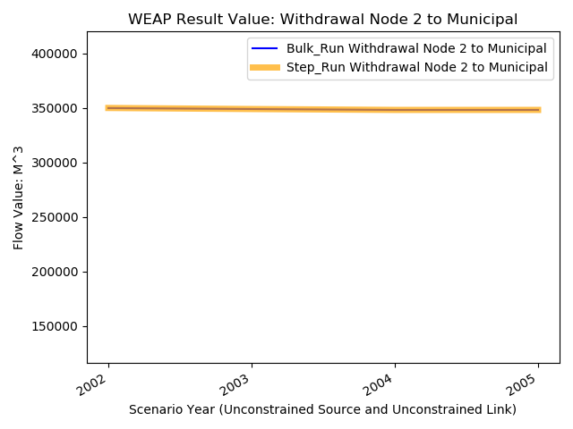
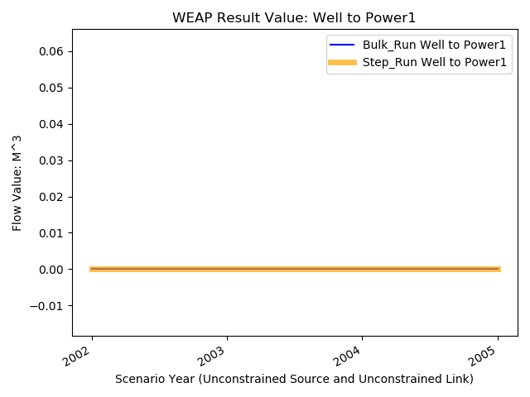
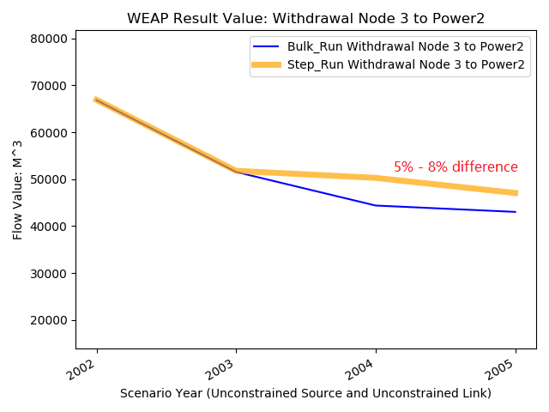
Test Result: Constrained Source and Unconstrained Link Test
1. WEAP:

Slide 14
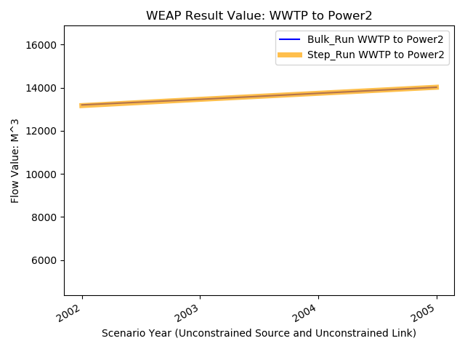
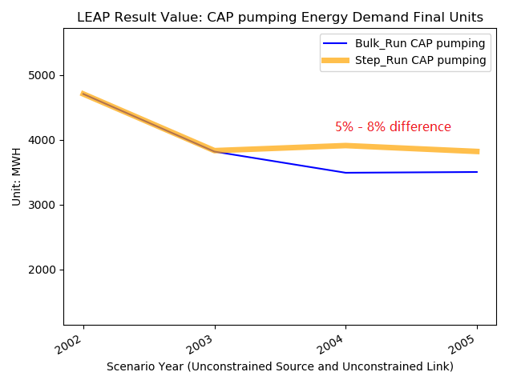
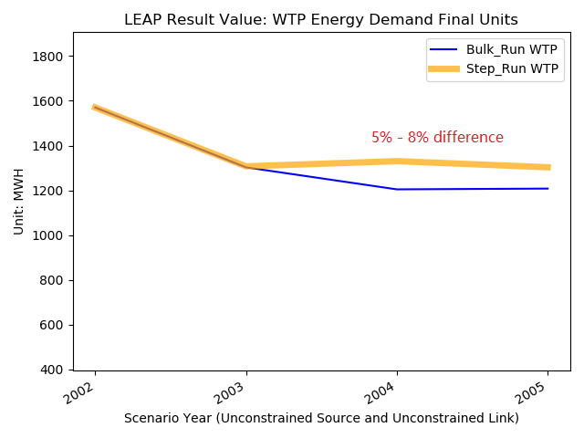
Test Result: Constrained Source and Unconstrained Link Test
2. LEAP:

Slide 15
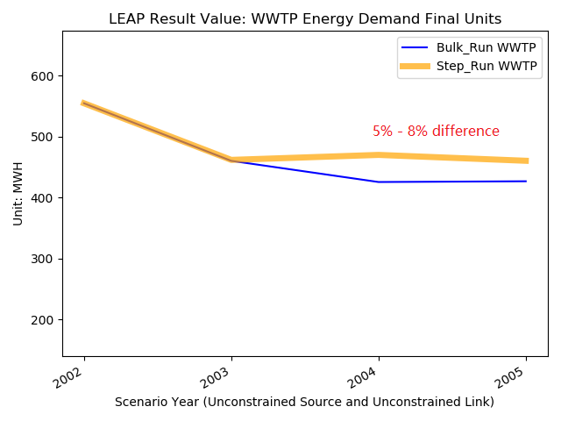
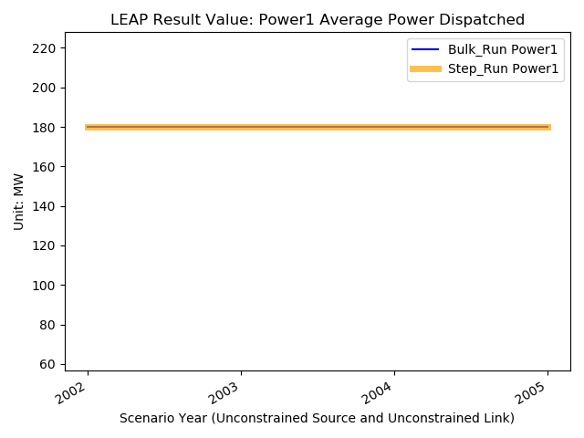

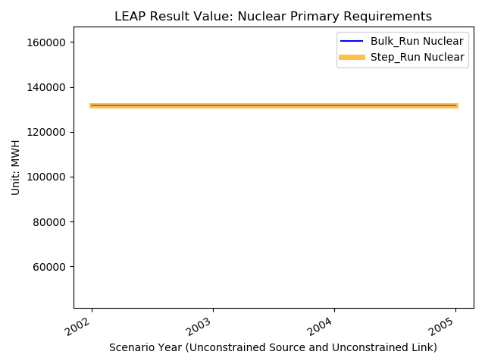
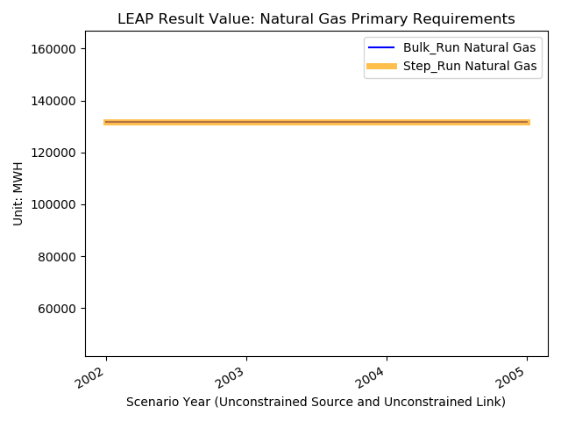
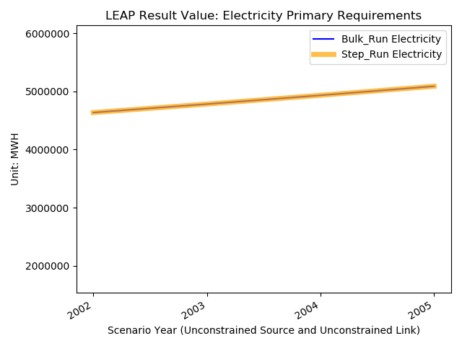
Test Result: Constrained Source and Unconstrained Link Test

Slide 16
Conclusion
For all three test conditions, the majority of the results of step run match the bulk run perfectly.
There may be two reasons that a few results are not matched:
The roundup error when WEAP and LEAP process data
Incorrectly updating the input parameter at each time step
Controlling WEAP and LEAP to run by yearly steps is possible!

Slide 17
Discussion
Pros:
Running by yearly steps gives a lot of flexibility to control over WEAP and LEAP simulation.
The parameters could be updated at each time step. Even the coupled WEAP-LEAP parameter
could also be manipulated. The flexibility enables building more complex models.
Cons:
1. It takes more time to run the simulation since at each step parameters are updated and WEAP
and LEAP has to re-initialize to run the model.
2. It takes a lot more effort to build the script to automate the parameters update process.
3. It is at higher risk that an error may occur in the script when updating the parameters, such as
miss-matched time step, making the simulation less reliable, while the bulk run is more stable
since all the processes are packaged in WEAP and LEAP software.

