Slide 1


Slide 2
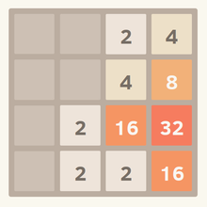
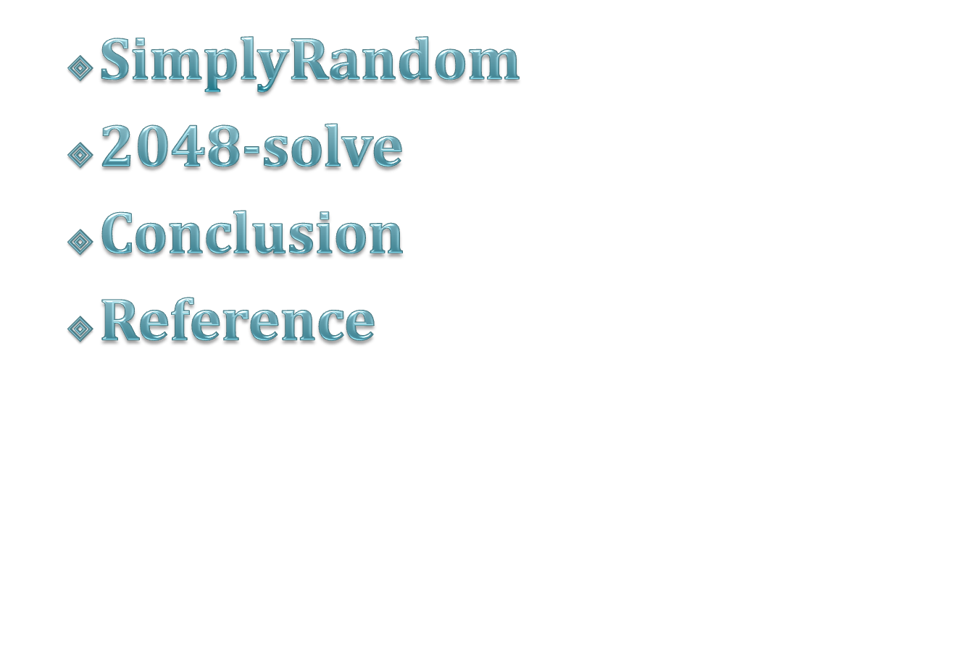
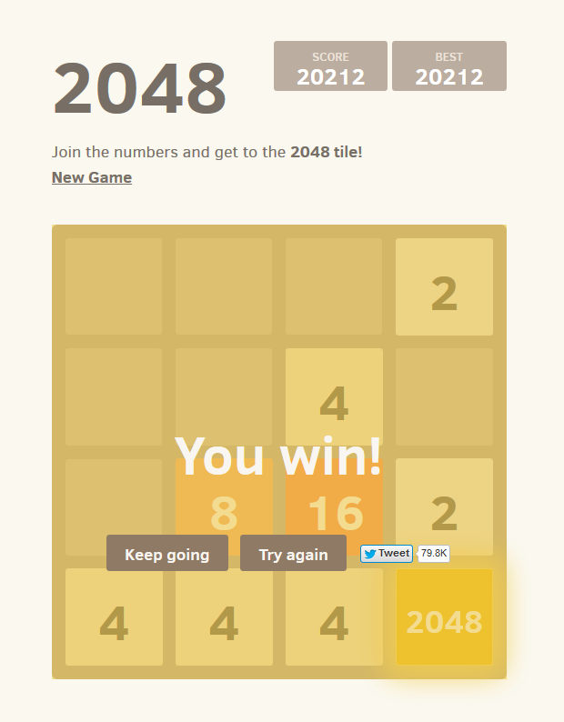
OUTLINE

Slide 3
Background Statistic
Ave.score\tile | 1024 | 2048 | 4096
9000 | *
20000 |  | *
29000 | * | *
40000 |  |  | *
49000 | * |  | *
70000 | * | * | *

Slide 4

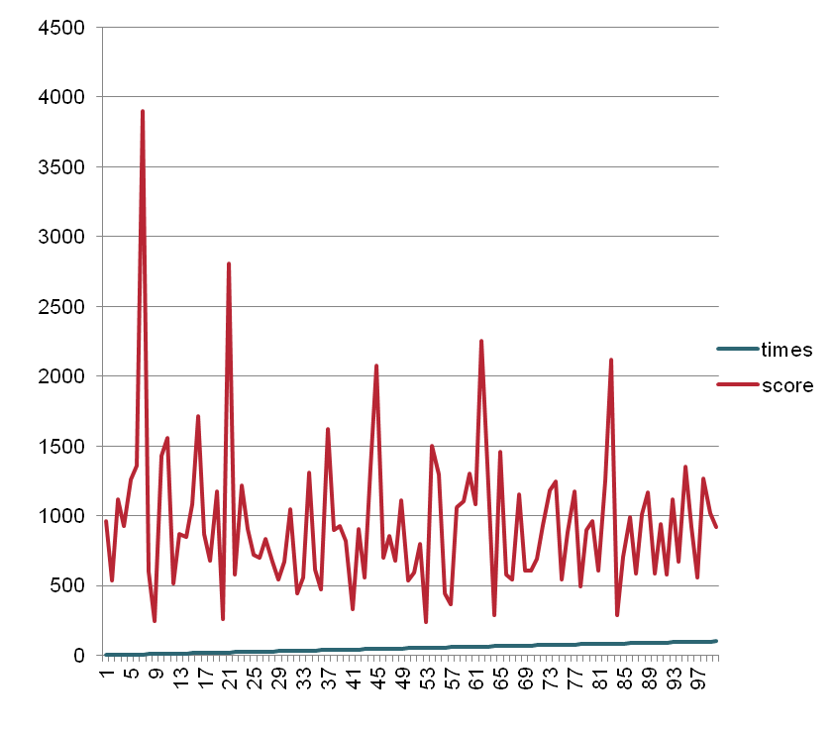
SimplyRandom
  times:10000
  the best Score:3900
  the best tile: 256
  the average score:977
  2048 probability:
  0/10000

Slide 5
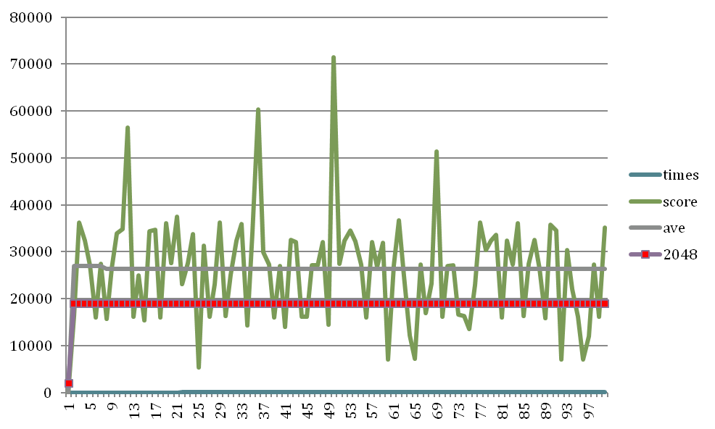
2048-solve
times :100
the best Score : 71392
the best tile : 4096
  the average score:
  26315.43
4096: 5/100
2048 : 62/100
1024 : 27/100
512:6/100

Slide 6
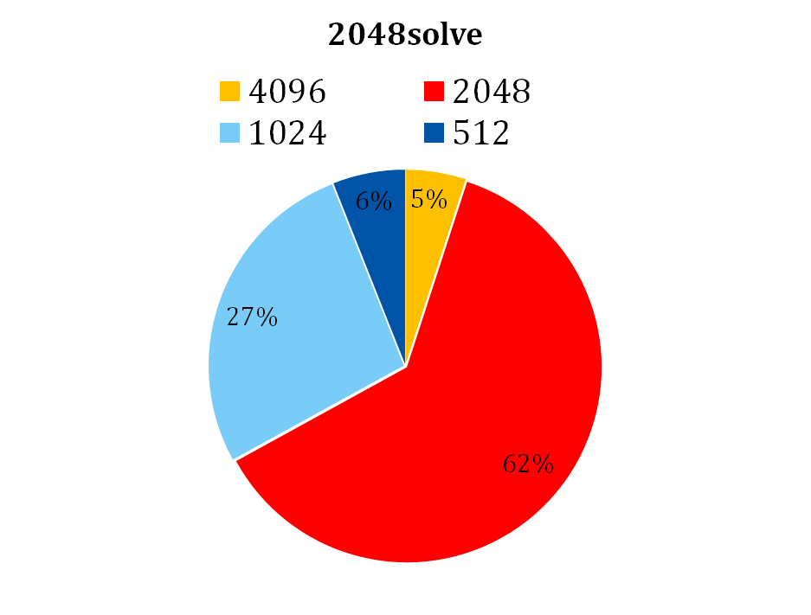
2048-solve
times :100
the best Score : 71392
the best tile : 4096
  the average score:26315.43
4096: 5/100
2048 : 62/100
1024 : 27/100
512:6/100

Slide 7
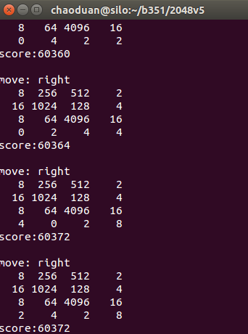
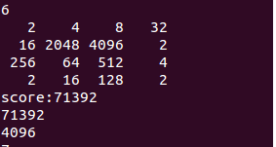
Best Tile

Slide 8
Algorithm-DFS
Best_Move
Left
Right
Up
Down
L
R
U
D
L
R
U
D
L
R
U
D
L
R
U
D
…………………….. ……………………………………..
L
R
U
D
It looks ahead several moves and chooses the move that maximizes the score

Slide 9
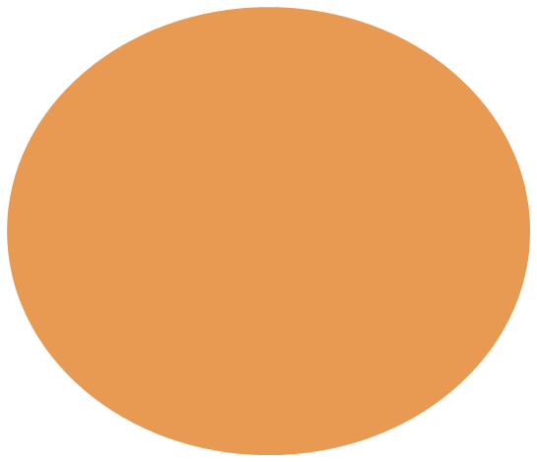
Algorithm-Pruning
If “Down” is invalid, we don’t check its children
Best_Move
Left
Right
Up
Down
L
R
U
D
L
R
U
D
L
R
U
D
L
R
U
D
…………………….. ……………………………………..
R
U
D
this idea is come from Alpha-beta pruning

Slide 10

Algorithm-Rule
Best_Move
The score of going left equals going right, so now we have a best-move-list [“left”, “right”]
Score =10908
Left
Right
Score =10908
L
Rule: it will check # of blank tiles on the board.
In theory, more blank tiles means longer life.
If both “left ” and “right” are same score, and same blank number…….
Unfortunately, It has not other rule,
So random……..
L
R
U
D

Slide 11

pseudocode
if the blank number of game.borad >4:
DFS-Pruning.depth=5
and if it has more than one best move:
  run rule1 rule2 rule3 (if it has)
  esls:
  bestmove = random(best_move_list)
  return bestmove
else :
DFS-Pruning.depth=6
and if it has more than one best move:
  run rule1 rule2 rule3 (if it has)
  esls:
  bestmove = random(best_move_list)
  return bestmove

Slide 12

we tried….
1 Rule Base…
2 MinMax….
3 DFS Pruning…..
……
Now , Let’s play the game
http://youtu.be/OTdeOvET1ys

Slide 13

expectMinMax

Slide 14
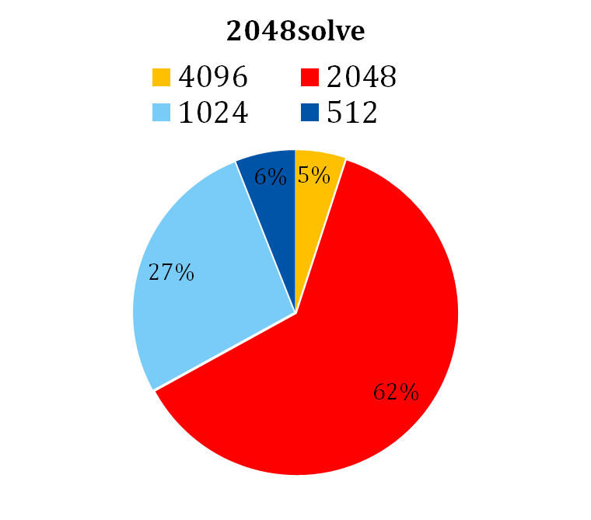
Conclusion
times :100
the best Score : 71392
the best tile : 4096
  the average score:25315.43
4096: 5/100
2048 : 62/100
1024 : 27/100
512:6/100

Slide 15
Reference
http://en.wikipedia.org/wiki/Transposition_table
https://github.com/ov3y/2048-AI/blob/master/README.md
http://stackoverflow.com/questions/22342854/what-is-the-optimal-algorithm-for-the-game-2048/22389702#22389702
http://ov3y.github.io/2048-AI/
http://www.oschina.net/code/snippet_1756807_35638

