Slide 1

Personal Introduction
EN: Duan Zhiwei
CN: 段志威

Slide 2

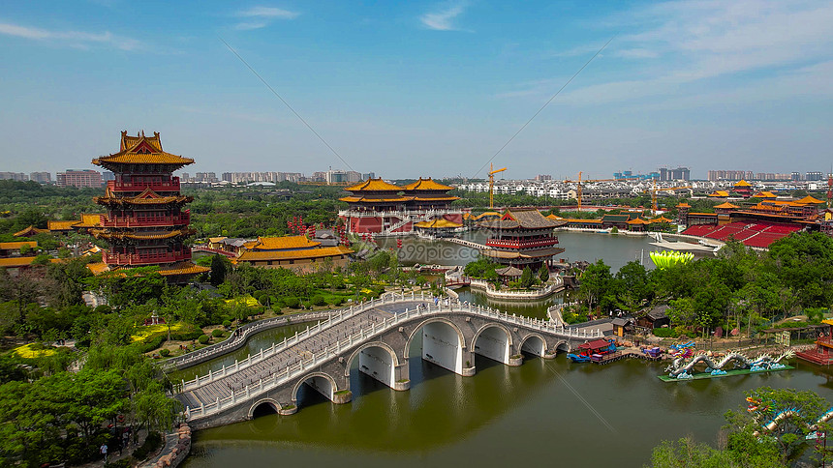
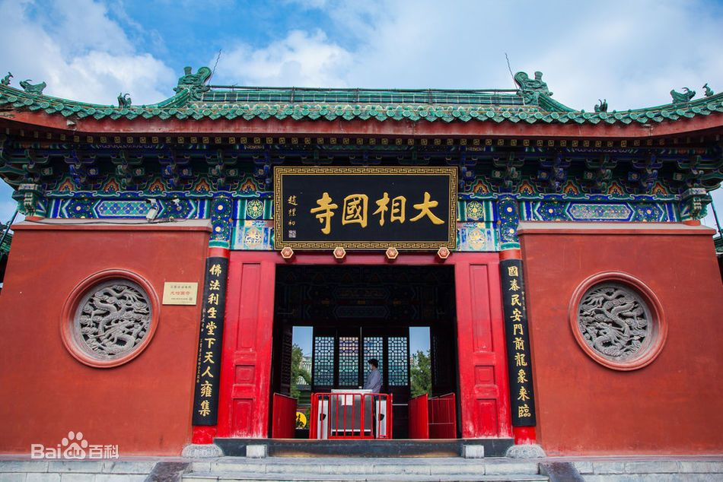
Hometown
Kaifeng City, Henan Province
located along the southern bank of the Yellow River、the ancient capital of the eight dynasties
Millennium City Park, Longting, Great Xiangguo Temple, Kaifeng iron tower, KaiFeng Mansion...

Slide 3

Education Background
Tianjin Agricultural University (2015 - 2019)
Internet Of Things Engineering
Major courses :
Operating System, Computer Organization and Design, Computer Networks, Data Structure
IoT Architecture, Intelligent Information Processing, etc ...

Slide 4
Education Background
Awards:
the first prize in the North China Division of the 2017 National Undergraduate IOT Design Competition
the second prize in the 2017 Tianjin Undergraduate IOT Innovation and Application Design Competition
the National Tianjin Undergraduate Award Innovation and Training Program
published an article in the journal 《Agricultural Technology and Equipment》
school excellence scholarship
etc...

Slide 5

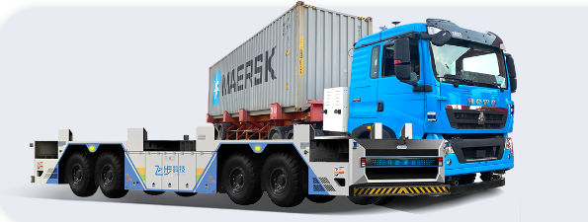
Work Experience
Hangzhou Fabu Technology Company (2019 - now): An artificial intelligence enterprise dedicated to fully automatic driverless driving
Group: System Platform
Work Position: C++ Software Engineer

Slide 6
Work Experience
Responsible Modules: ECS-ctrl、Antenna、Monitor
Development Functions:
1. Clearly define the vehicle operation process, and support multi-scenario operations, such as: MeiShan Port, NanTong Port
2. Access the basic information of gantries and cranes for use by the automatic driving modules.
3. Remote control function: slow braking, emergency braking, movement, human-vehicle interaction, etc...
4. Early warning function: collect abnormal information from vehicles, such as: obstacle warning, parking warning, etc..
5. Monitoring function: the health status of each module of automatic driving modules.
6. Provides data for web application to visualize the current output of related autonomous driving modules.
etc...

Slide 7
Thanks for listening
2023.04.11

