Slide 1

Personal Introduction
EN: Duan Zhiwei
CN: 段志威

Slide 2

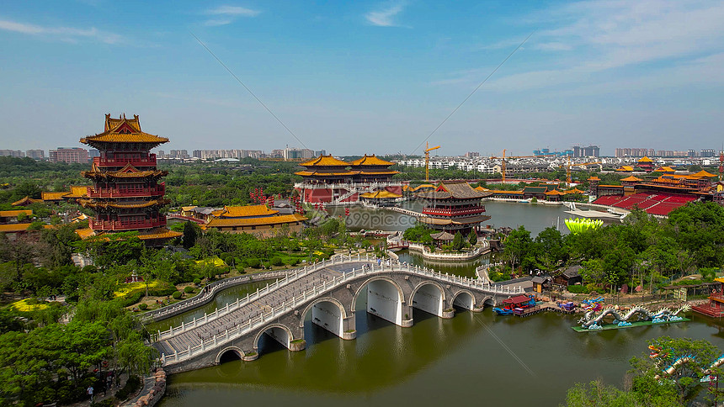
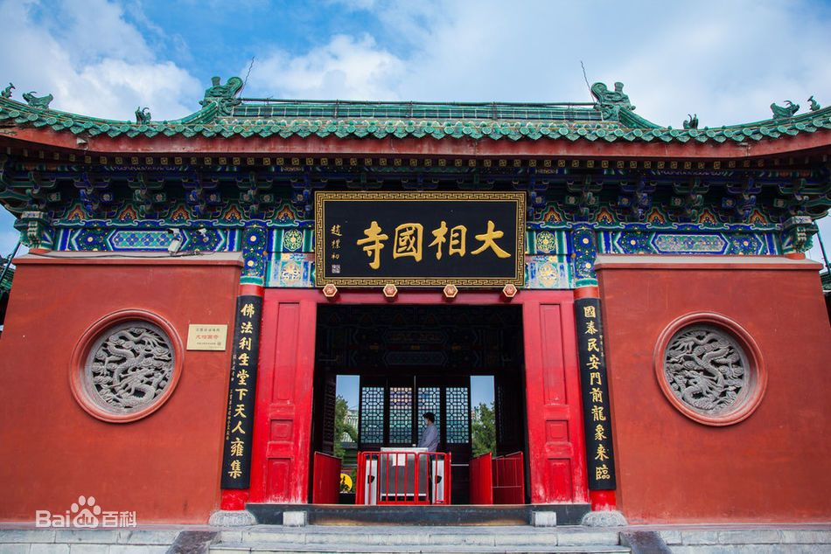
Hometown
Kaifeng, Henan Province
located along the southern bank of the Yellow River、the ancient capital of the eight dynasties
Millennium City Park, Longting, Great Xiangguo Temple, Kaifeng iron tower, KaiFeng Mansion...

Slide 3

Education Background
Graduated School: Tianjin Agricultural University (2015 - 2019)
Honors:
the first prize in the North China Division of the 2017 National Undergraduate IOT Design Competition
the second prize in the 2017 Tianjin Undergraduate IOT Innovation and Application Design Competition
the National Tianjin Undergraduate Award Innovation and Training Program
published an article in the journal 《Agricultural Technology and Equipment》
school excellence scholarship

Slide 4

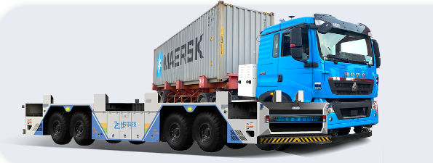
Work Experience
Company: Fabu (2019 - now)
Company Profile: An artificial intelligence enterprise dedicated to fully automatic driverless driving
Work Position: C++ Software Engineer

Slide 5
Work Experience
Responsible Modules: ECS-ctrl、Antenna、Monitor、Notepad
Development Functions:
1. Clearly define the vehicle operation process, and support multi-scenario operations, such as: MeiShan Port, NanTong Port
2. Use TCP protocol to access the basic information of gantries and cranes for use by the automatic driving modules.
3. Development remote control function: slow braking, sudden braking, movement, on and off the line, human-vehicle interaction and other functions.
4. Development early warning function: collect abnormal information from vehiles, such as: obstacle warning, parking warning, etc..
5. Monitoring function: the health status of each module of automatic driving modules.
6. Provides data for web application to visualize the current output of related autonomous driving modules.
etc...

Slide 6
About Me
Professional skill:
C++, Python
Hobby:

Slide 7
Thanks for listening
2023.04.08

