Slide 1


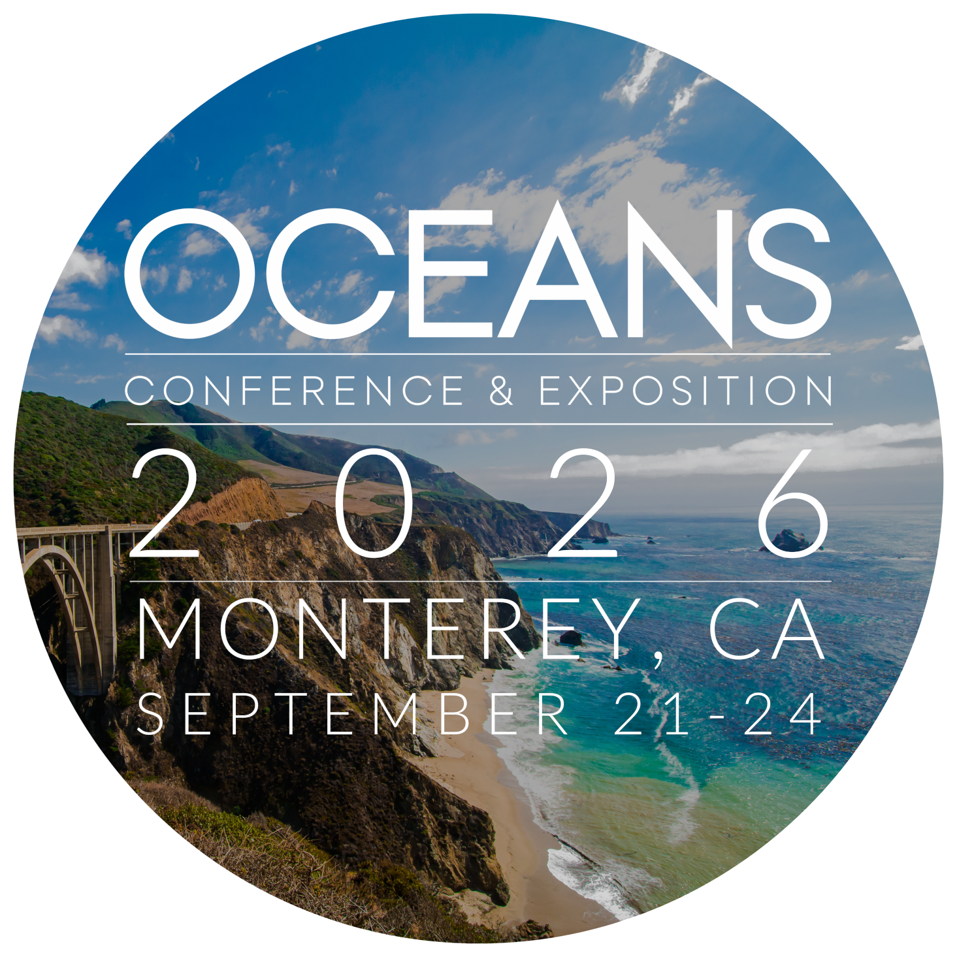

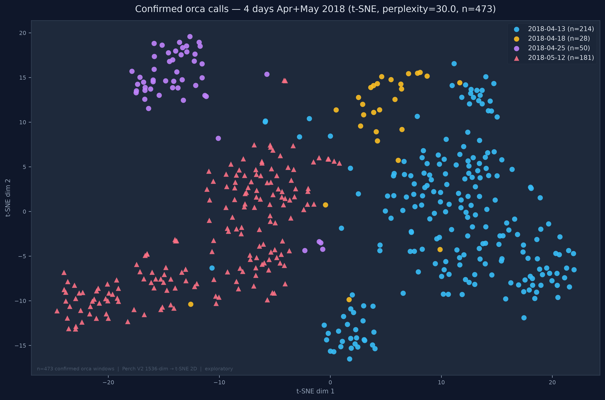
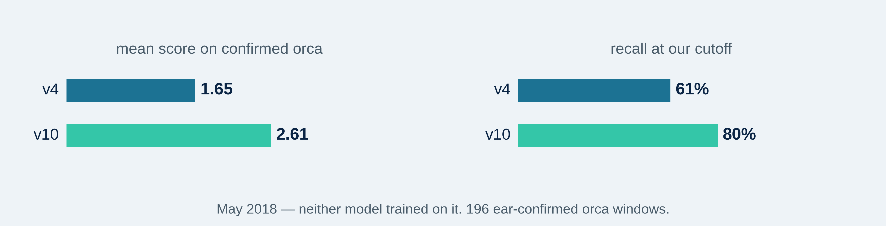
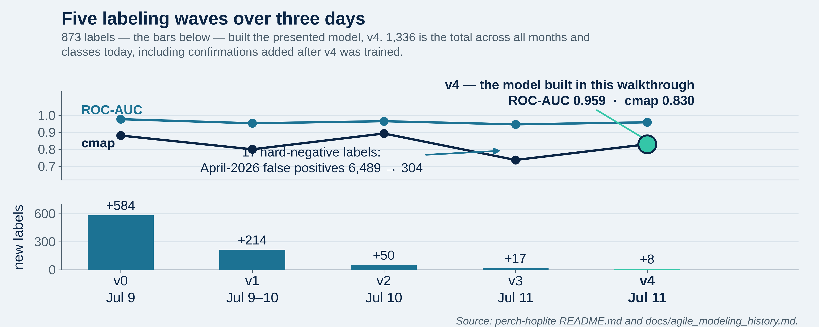
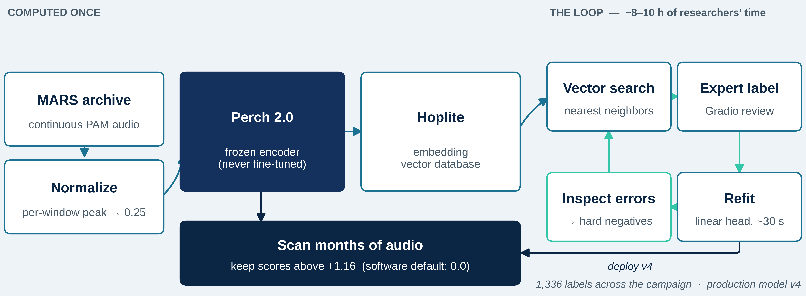
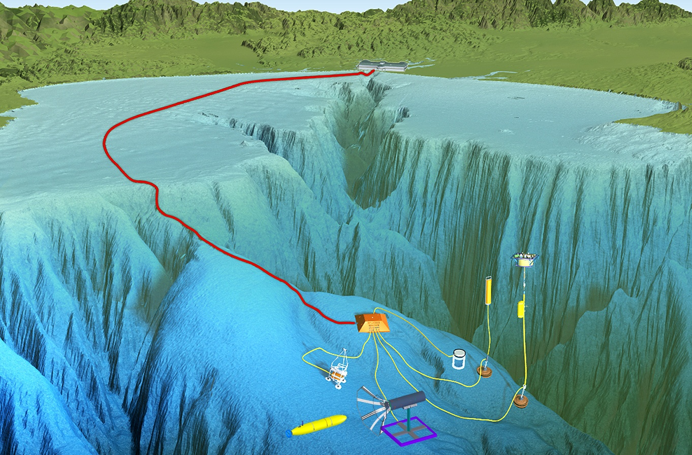
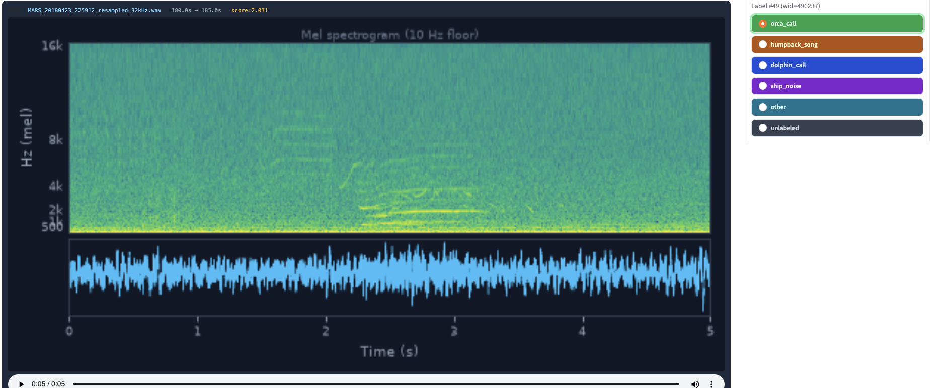
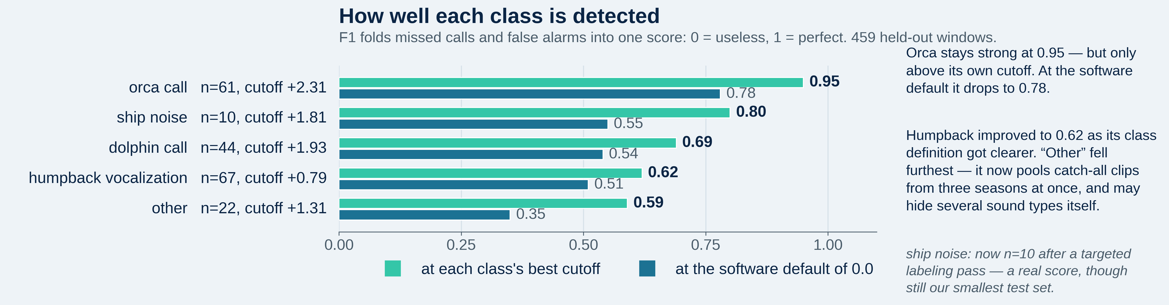
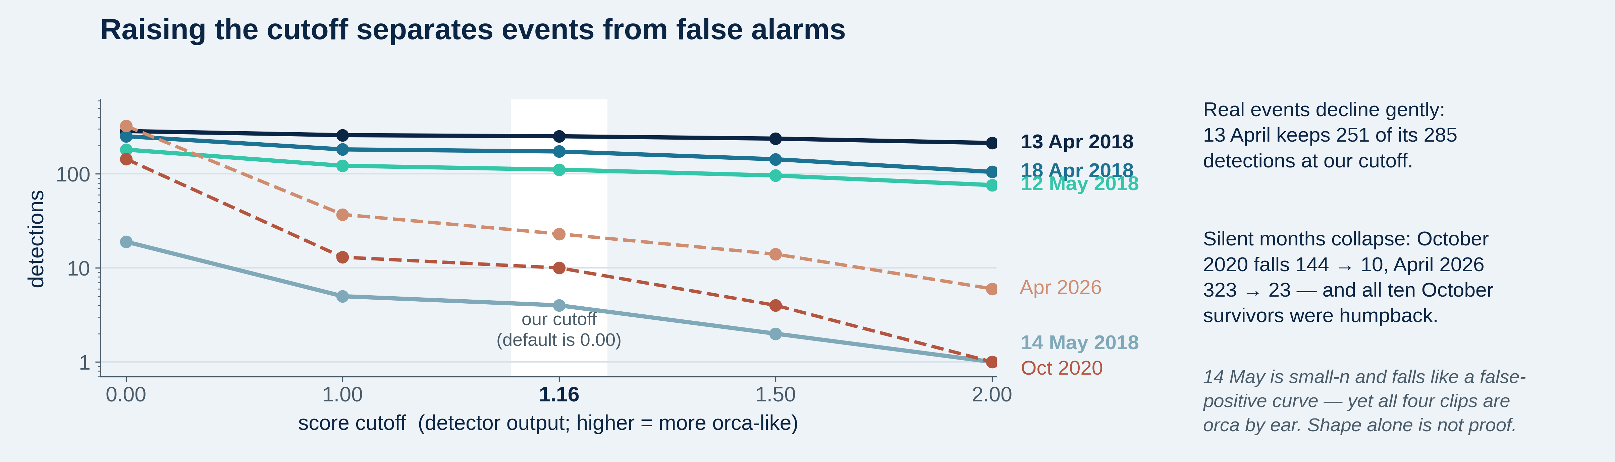
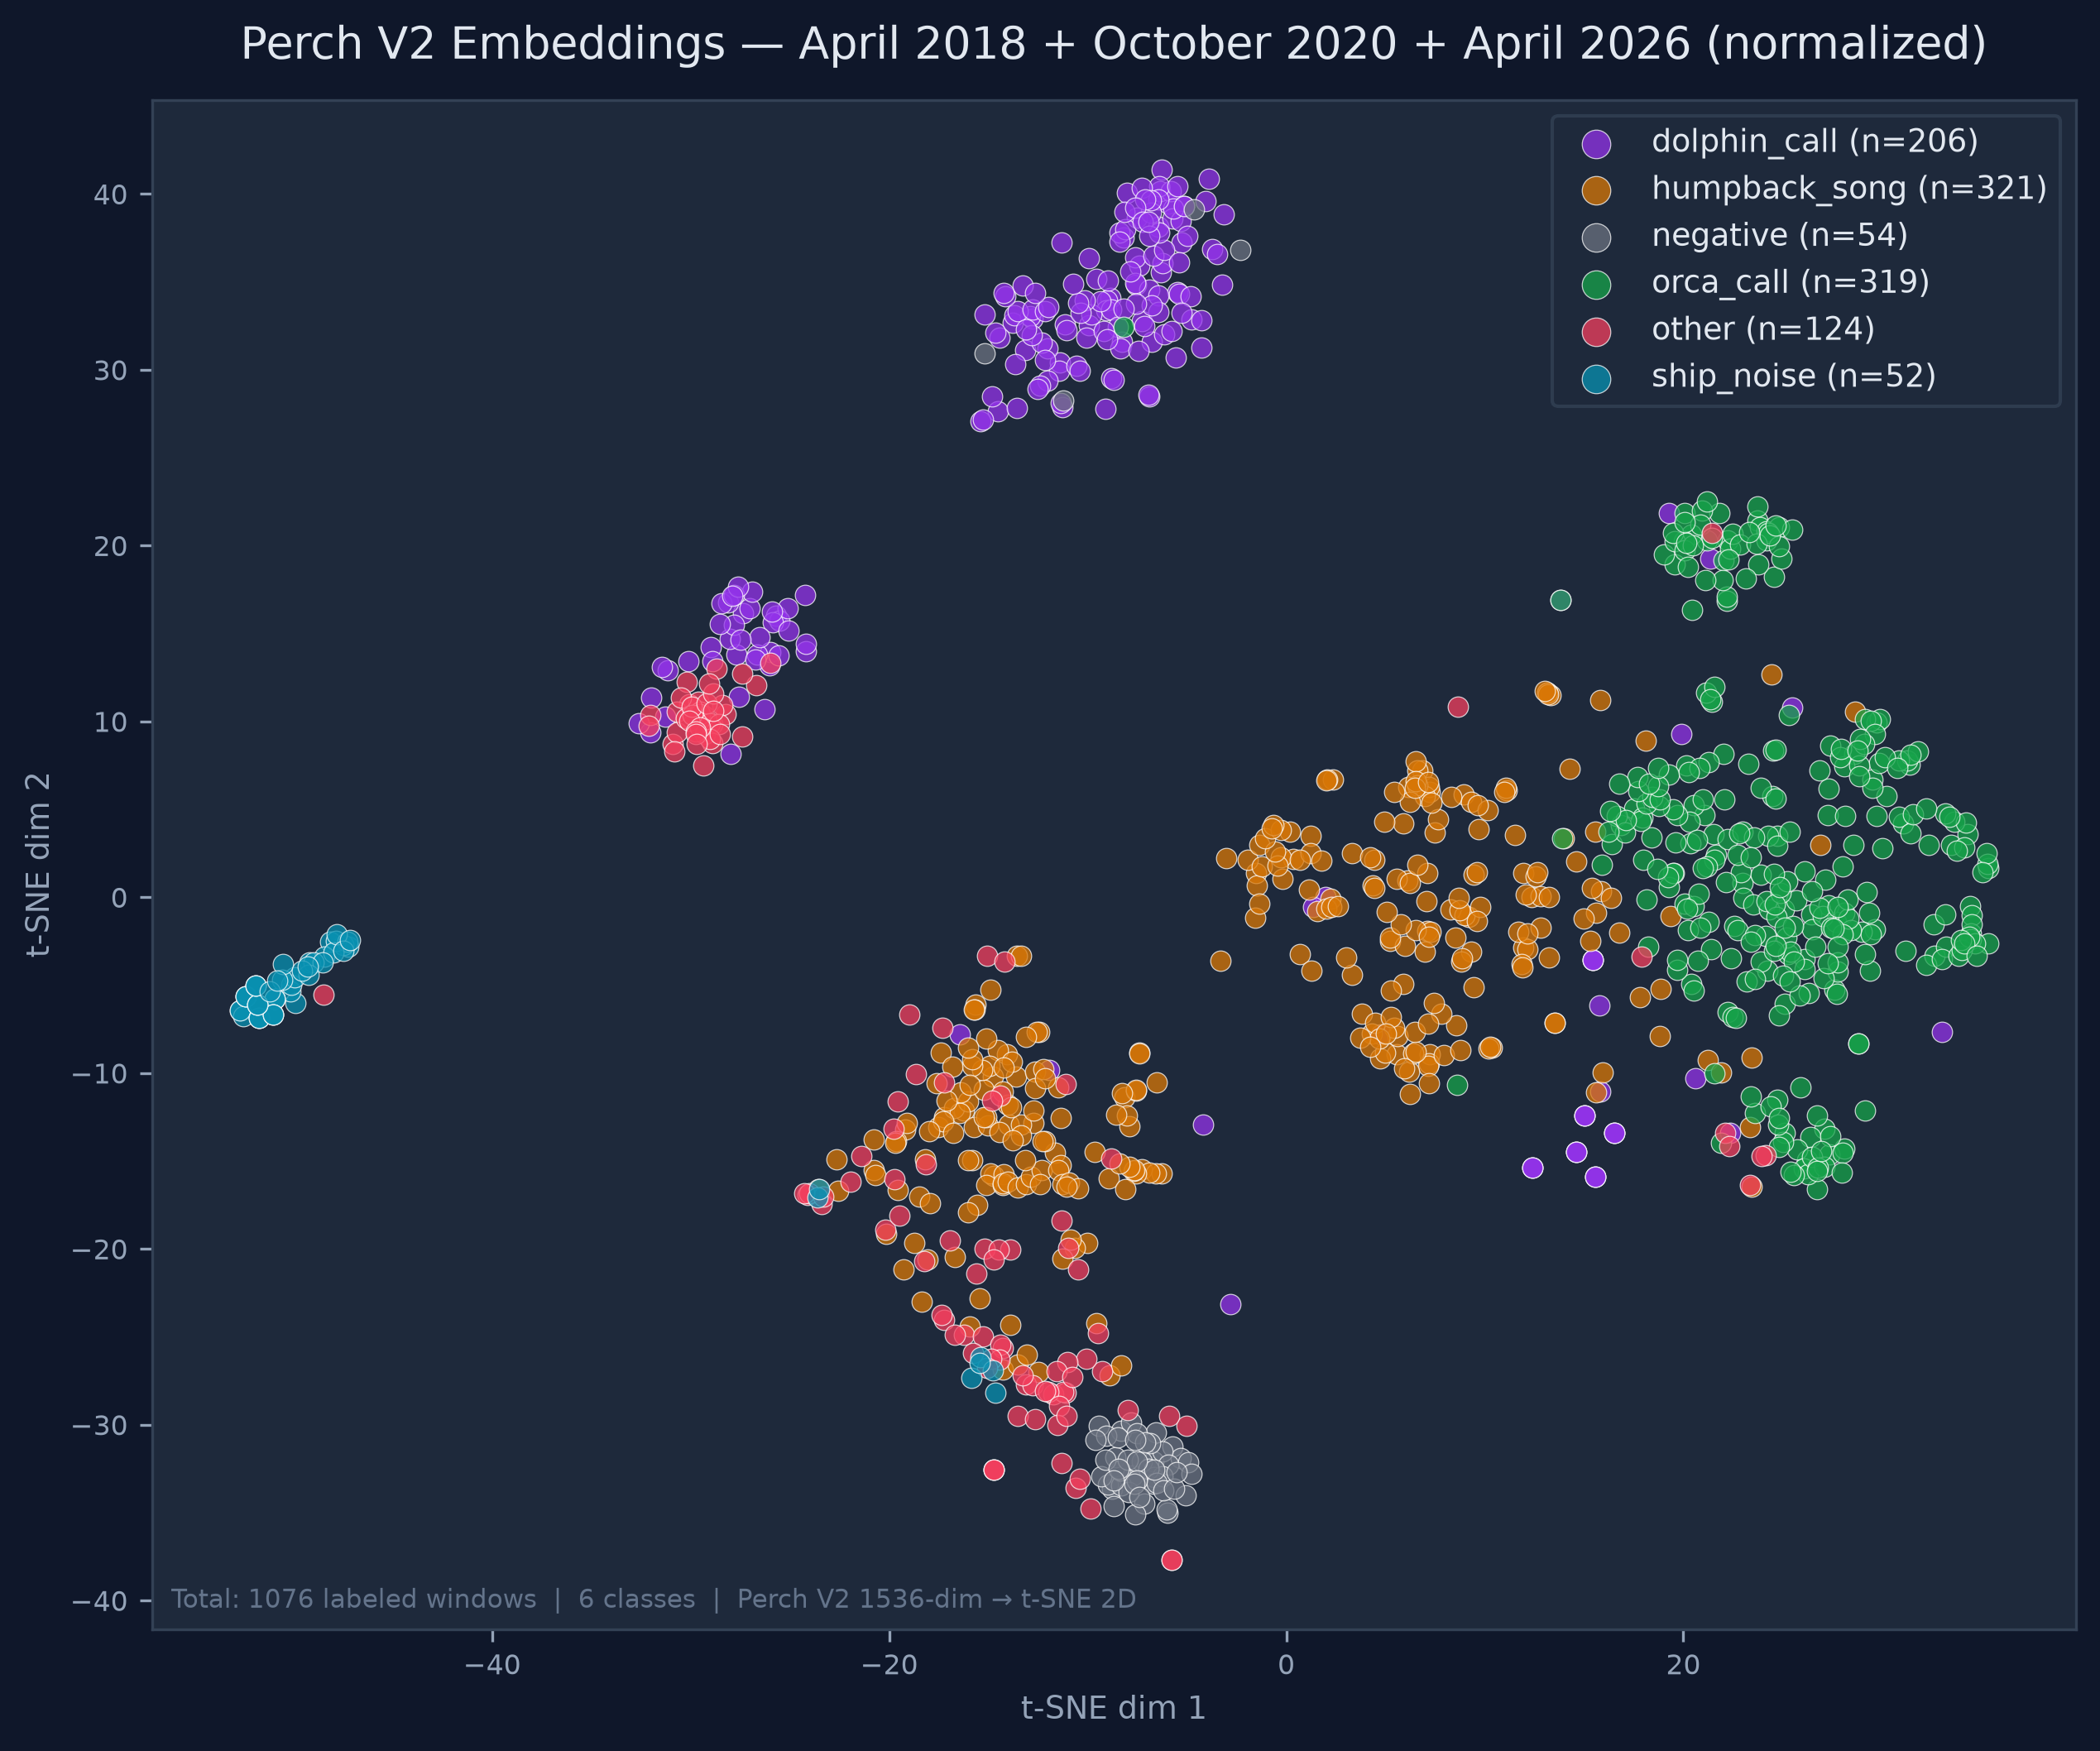
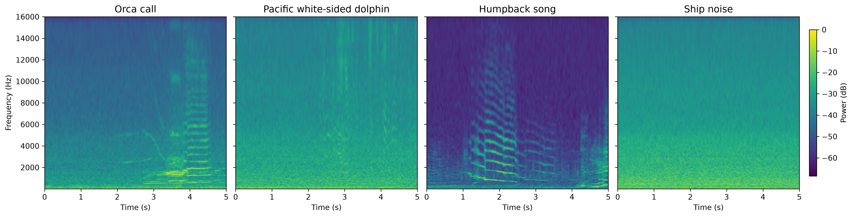
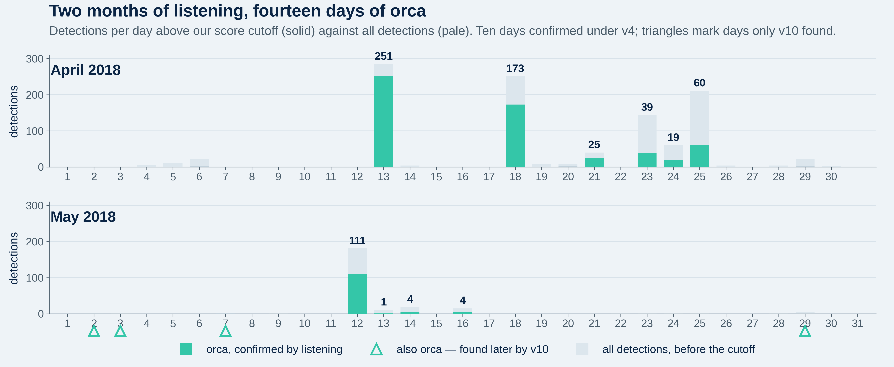
Application of Foundation Model and Agile Modeling to Passive Acoustic Detection of Orcas in Monterey Bay National Marine Sanctuary
Duane R. Edgington and John Ryan · Monterey Bay Aquarium Research Institute (MBARI), Moss Landing, California, USA
A foundation model is a large model pre-trained on masses of data, reusable for new tasks with very little new labeling.
AT A
GLANCE
14 days
95% fewer
1,336 labels
0.95
+19 points
of confirmed orca in April–May 2018: ten from v4,
four more when the loop was re-run
false alarms in a held-out month,
from 17 corrective labels (6,489 → 304)
all in ~8–10 h of researchers’ time;
873 built the presented model
orca detection score (F1: 0 = useless,
1 = perfect) at our chosen cutoff
more of a held-out month’s orca found
when the loop was run again
1
The gap
4
Teaching a big model a new sound
6
v0 → v4: five labeling waves
8
Structure between encounters
10
Running the loop again
Monterey Bay National Marine Sanctuary hosts three killer whale ecotypes: transient (Bigg’s), endangered Southern Resident, and Offshore.
None are yet routinely detected and classified from passive acoustic monitoring (PAM) data.
Detections are rare and manual annotation of thousands of hours is impractical, so labeled MARS training data are scarce.
Goal: turn a continuous PAM archive into an ecologically useful record of orca presence — with its limits measured, not hidden.
Perch 2.0 is a pre-trained bioacoustics model. It turns each 5-second window into an embedding — a 1,536-number fingerprint of the sound. Similar sounds get similar fingerprints, so one labeled example retrieves others like it from the Hoplite database.
The loop: search → label a handful of clips → refit a simple classifier on those fixed fingerprints (~30 s) → look at its mistakes → search again. The big model is never retrained.
Enabling fix: per-window peak normalization to 0.25 before embedding — without it, quiet distant calls were unrecoverable.
The classifier scores every window; higher means more orca-like. We keep scores above +1.16 rather than the software’s 0.0 default, with the cutoff chosen on months the model never trained on.
v0 (584 labels, 5 classes) recovers the known 13 April 2018 event; v1 (+214) adds October 2020; v2 (+50) rebalances dolphin and other.
v3 adds just 17 hard negatives — the detector’s own false alarms, labeled as counter-examples — and April-2026 false alarms fall 6,489 → 304. Eight more corrective labels produce v4, the model built in this walkthrough.
Two further experiments degraded performance and are not presented here; detail in the project repository.
One more turn of the loop, on more labels, produced a second classifier — orca_v10. May 2018 is the referee: neither it nor v4 has ever trained on that month.
2
A continuous listening post
Across the 196 ear-confirmed orca windows in May, v10 scores higher than v4 on 192 of the 195 they share.
Of v10’s above-threshold detections not already confirmed, all 14 were reviewed by ear and all 14 were orca — no false alarms among those reviewed. May is not exhaustively labeled, so this is not a month-wide false-alarm rate.
Four fell on days never previously confirmed — 2, 3, 7 and 29 May. May’s confirmed orca days go from four to eight, and the ten days in panel 7 become fourteen.
The loop does not just produce a detector. Each turn produces a measurably better one.
MARS cabled observatory, Smooth Ridge (36°42.75′ N, 122°11.21′ W), ~30 km offshore at ~900 m depth.
Ocean Sonics icListen HF omnidirectional hydrophone, 10 Hz – 100 kHz, relayed to shore in real time, 24/7.
Archived and public as the Amazon Web Services (AWS) Pacific Ocean Sound recordings; analysis windows here span 2018–2026. registry.opendata.aws/pacific-sound
Before v0: four of those hours — nearly half the project’s total — went on hand review of April 2018 audio. Two 50-clip rounds settled orca-or-not, then three longer sessions worked 25 clips at a time to give dolphin and humpback their own classes, every humpback clip checked by John Ryan. Hence v0’s 584 labels.
Zooming inside the orca cluster: 473 confirmed orca windows, colored by day. The 25 April evening encounter (purple) sits apart from the 13 April morning event (blue), and 12 May holds its own region a month later. The classes separate in the map at left — and within orca, encounters do too. Exploratory; perplexity 30.
The two scores above. ROC-AUC (receiver operating characteristic, area under the curve): how well the classifier ranks a true orca window above a non-orca one — 1.0 is perfect, 0.5 a coin flip. cmap (class mean average precision): the same question asked of each class across all thresholds, then averaged with equal weight, so a rare class counts as much as a common one. Because every class counts equally, weak classes pull it down — which is why it sits below ROC-AUC. Both are measured on held-out data. v4’s 0.959 and 0.830 are strong, and the point of this panel is that it reached them on 873 labels, not tens of thousands.
The split holds however the map is drawn (three t-SNE settings) and is not an artifact of one recording or one passing vessel.
Two pods were documented in the bay that spring; the two clusters are consistent with, not proof of, that pairing.
The fingerprints behave like an instrument — they raise testable questions about who was calling.
7
Spring 2018 was not one encounter
11
Measured limits
Previously known: a single Bigg’s orca event on 13 April 2018.
Above our score cutoff, v4 also flagged 18 April (173 detections), 21 April (25) and 25 April (60). Listening to 25, 25 and 50 of those clips confirmed all 100 as orca, with no false alarms. All 58 detections on 23 and 24 April were then reviewed as well: 55 orca, two humpback, one left unlabeled.
May 2018: 12 May confirmed 181/181; 13 May gives 8 confirmed orca clips on full review, and 14 and 16 May are confirmed too.
Neither v4 nor orca_v10 has trained on May 2018 recordings — these are detections in a month the presented models have never seen.
Ten confirmed orca days across the two months from v4 alone — sustained Bigg’s presence, not one encounter.
Two independent methods agree: regional news and whale-watch reports described record orca sightings that spring, and identified two pods — one Alaskan, one Californian (the CA140 matriline).
9
Seen but not heard
Per-class scores for orca_v10, on 459 held-out windows. Each class has its own cutoff.
The MARS cabled observatory; the hydrophone sits at the science node. Image: MBARI.
What one turn of the loop looks like: a 5-second candidate, its spectrogram and audio, and six one-click labels — orca_call, humpback_song, dolphin_call, ship_noise, other, unlabeled. This detection was surfaced by v4 on 23 April 2018 (MARS_20180423_225912, score 2.03) and confirmed orca by ear. Reviewers also see a 30 s context view, not shown.
3
Off-the-shelf CNNs confuse the bay
5
The classes separate
Each class needs its own cutoff — the best values run from +0.79 to +2.31, so one global setting cannot serve them all. v10’s orca cutoff of +2.31 is its own optimum, not a correction to the +1.16 used with v4 elsewhere here.
Cutoffs are set on months the model did not train on, never on the month being analyzed.
Whale-watch vessels arrive once orcas are sighted, so ship noise tracks orca presence — it can never be evidence of absence.
The Google multispecies whale CNN and OrcAI (Icelandic fish-eating orcas) both produced high-confidence orca detections on MARS recordings.
Both also confused orca calls with Pacific white-sided dolphin (Lagenorhynchus obliquidens) and other signals — confusion, not sensitivity, was the limiting factor.
Their scores were still useful as a bootstrap, ranking candidate clips for the first round of expert labeling.
Two months where orcas were seen from boats but never heard: October 2020 and April 2026.
Every October 2020 detection above our cutoff was listened to, and every one was humpback — false alarms, not missed orca.
Bigg’s orcas are often silent while hunting, so seen-but-not-heard is a real outcome, not a broken detector. Both months now serve as a standing test that the detector stays quiet when it should.
12
Next
Humpback vocalization is one broad class covering song and a wide range of other calls. Separating them is the likeliest route to lifting the weakest scores here.
Each of the two would then need its own score cutoff, as every class already has.
Extending to the Southern Resident and Offshore ecotypes.
Acknowledgements
Mel-scale log-power spectrograms, one confirmed exemplar per class (5 s windows, v4 labels). All four share identical FFT parameters (2048-point FFT, 128 mel bands, 10 Hz–16 kHz) and one color scale, so brightness and detail are directly comparable. Orca and humpback song both carry tonal, harmonically stacked content in overlapping bands — which is why the classifier confuses them.
MARS is operated by MBARI with support from the David and Lucile Packard Foundation. Visual sighting context from the California Killer Whale Project and Monterey Bay vessel reports.
Each dot is one 5-second window, placed so that sounds the model hears as similar sit close together (t-SNE). 1,076 labeled windows, 6 classes, 3 seasons — the three the models trained on; May 2018 is held out and does not appear. The orca cluster holds across all three years, so the embeddings are separable across recording conditions and time. Where classes overlap, orca against humpback, is the same confusion the spectrogram row shows.
Selected references
Every day marked confirmed has been listened to. Bars show detections above the cutoff, and days differ in weight: 12 May rests on 181 reviewed clips. 13 May’s single bar understates it — seven further confirmed orca clips sit below the cutoff. Ten days are confirmed under v4. The four hollow triangles are days only v10 found — 2, 3, 7 and 29 May — marked rather than drawn as bars, because v4 had almost no detections there to plot. Fourteen days in all; see panel 10.
van Merriënboer et al. (2025) Perch 2.0, arXiv:2508.04665 · Burns et al. (2025) Perch 2.0 transfers ‘whale’ to underwater tasks, arXiv:2512.03219 · Google Research, perch-hoplite · Harvey, Allen & Harrell (2024) multispecies-whale, Kaggle · Bonhoeffer et al. (2026) orcAI, Mar. Mamm. Sci. 42(1) e70083, doi:10.1111/mms.70083 · Ryan et al. (2016) OCEANS 2016 MTS/IEEE Monterey, doi:10.1109/OCEANS.2016.7761363 · McInnes et al. (2023) Bigg’s killer whale catalog, NOAA SWFSC, doi:10.25923/0q3f-1812
Duane R. Edgington duane@mbari.org · John Ryan ryjo@mbari.org · Monterey Bay Aquarium Research Institute, Moss Landing, California
Project: mbari.org/project/soundscape-listening-room | Audio: Pacific Ocean Sound recordings (AWS Open Data Registry), MARS cabled observatory, MBNMS.
QR → code, figures and data github.com/duane-edgington/perch-hoplite
QR

