Slide 1
MBARI · PASSIVE ACOUSTIC MONITORING
Agile modeling on frozen Perch 2.0 embeddings
Detecting Bigg's killer whales in the MARS hydrophone archive — and using the detector as an instrument
Duane R. Edgington and John Ryan · Monterey Bay Aquarium Research Institute
Basis of the IEEE OCEANS 2026 Monterey poster · github.com/duane-edgington/perch-hoplite-orcas-MBNMS

Slide 2
THE PROBLEM
Three ecotypes, none routinely detected acoustically
Monterey Bay National Marine Sanctuary hosts transient (Bigg's), endangered Southern Resident, and Offshore killer whales. None is yet routinely detected and classified from PAM data.
MARS: cabled observatory at Smooth Ridge, ~30 km offshore, ~900 m depth. Ocean Sonics icListen HF, 10 Hz – 100 kHz, streamed to shore in real time, archived publicly as the AWS Pacific Ocean Sound recordings. Coverage is near-continuous but not gapless — power and connector failures have cost days to weeks.
The bottleneck is not compute, it is labels. Orca detections are rare, and exhaustive annotation of thousands of hours is not a research plan.
Question for this talk: how far can you get with a frozen foundation model, a vector database, and ten hours of expert listening?

Slide 3
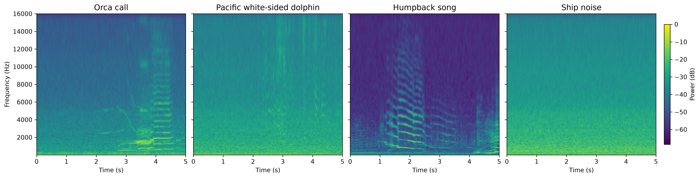
BASELINE
Off-the-shelf CNNs: high confidence, low specificity
Matched exemplars per class — identical FFT parameters (2048-point, 128 mel bands, 10 Hz–16 kHz) and one shared color scale.
Google multispecies whale CNN and OrcAI both produced high-confidence orca detections on MARS audio — and both confused orca with Pacific white-sided dolphin.
Orca and humpback song share tonal, harmonically stacked structure in overlapping bands. Confusion, not sensitivity, was the limiting factor.
Those scores were still useful: they ranked candidates for the first labeling round.

Slide 4
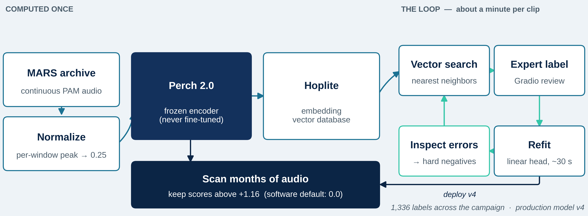
METHOD
Frozen embeddings + vector search + a linear probe
Perch 2.0 maps each 5 s window to a 1,536-dim embedding. Hoplite indexes them for nearest-neighbour retrieval; the classifier is a linear probe refit in ~30 s.
Enabling fix: per-window peak normalization to 0.25 before embedding. Without it, low-SNR distant calls were unrecoverable — this unblocked the whole pipeline.
The foundation model is never fine-tuned. Embeddings are computed once; every iteration is a probe refit.

Slide 5
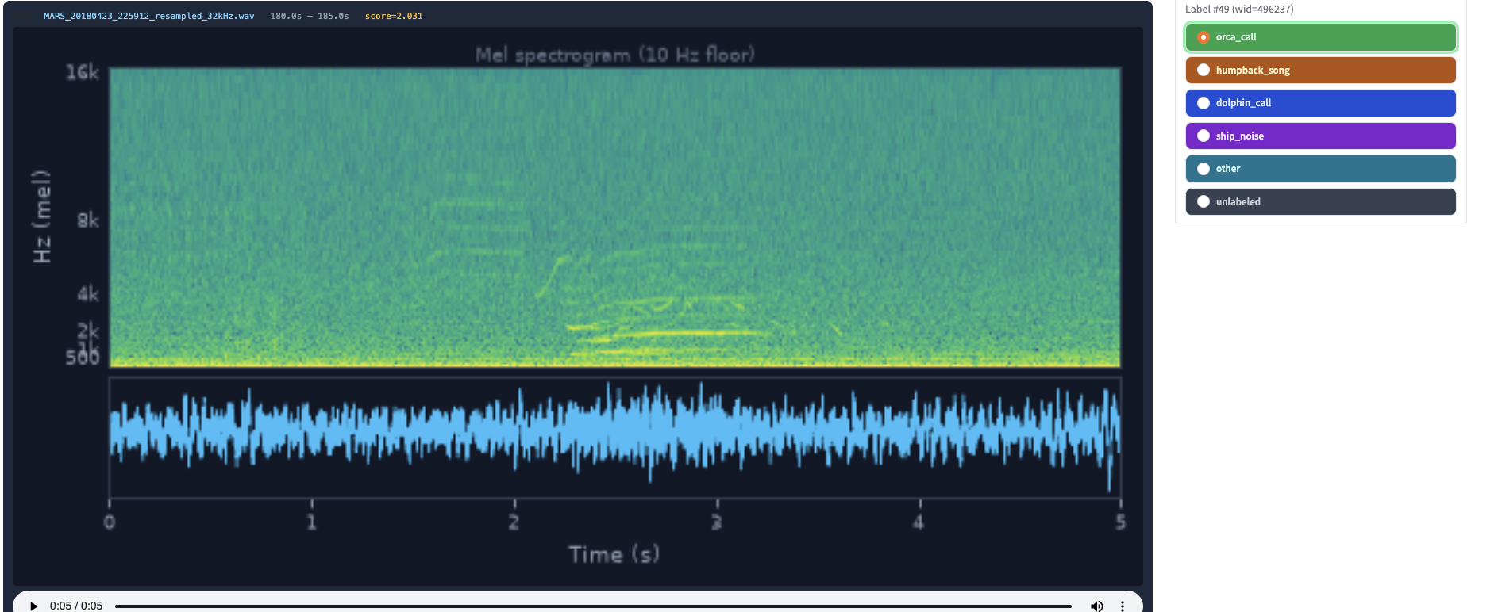
METHOD
The unit of work: one window, one expert decision
Gradio review: spectrogram, audio, 30 s context, six one-click labels. About a minute per clip — examine, listen in context, decide, store, and the probe refits. This clip is 23 April 2018, score 2.03, confirmed orca by ear.
Search → label a handful → refit → inspect errors → search again. ~1,336 labels total, in roughly 8–10 h of researcher time.

Slide 6
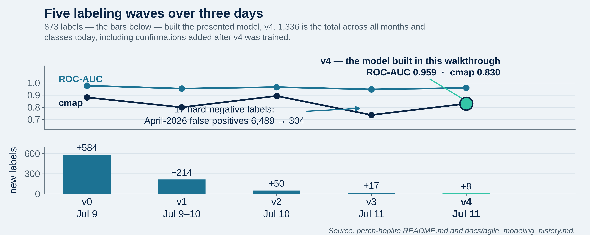
TRAJECTORY
v0 → v4 in five waves, 873 labels
v3 adds 17 hard negatives — the detector's own false alarms as counter-examples — and April-2026 false positives fall 6,489 → 304.
Two later experiments (context-averaged embeddings; a fourth season folded in) degraded performance and are not presented as results.

Slide 7
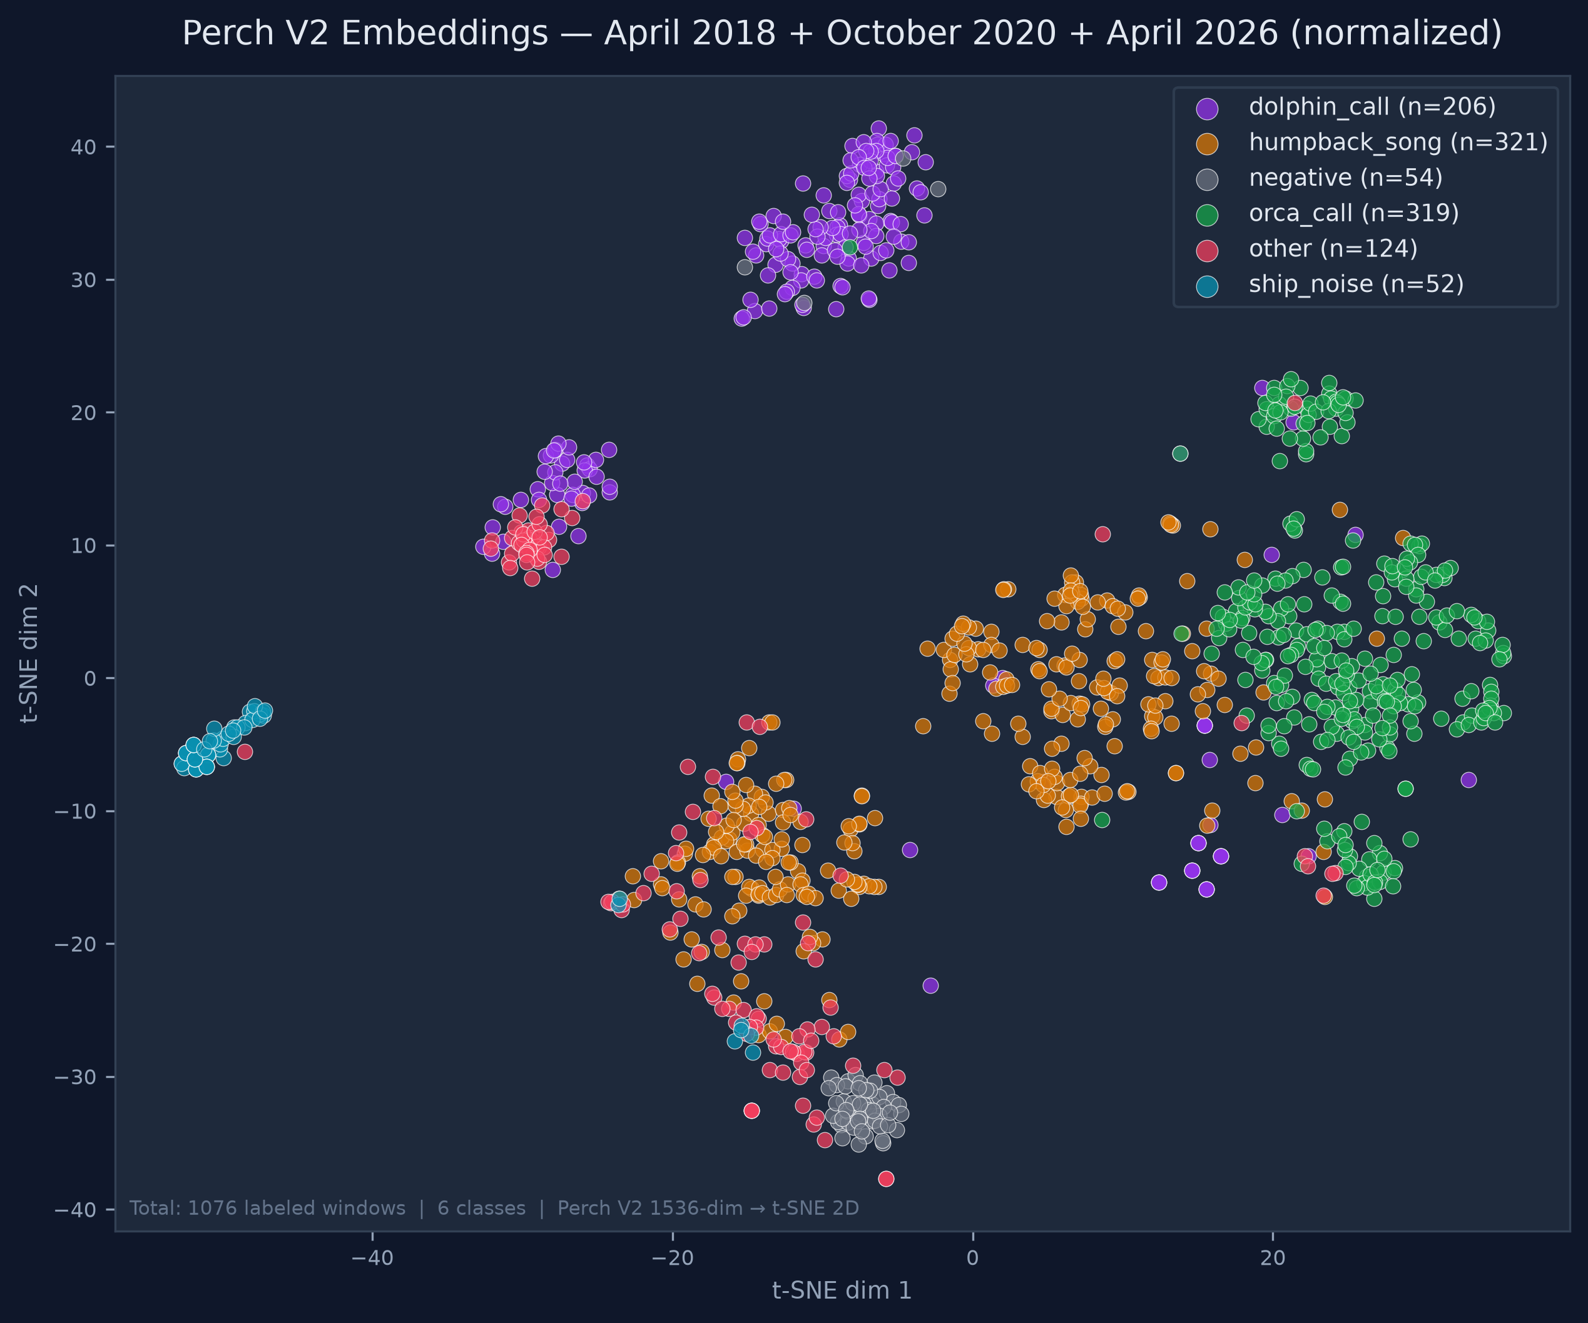
REPRESENTATION
The premise, made visible: classes separate in embedding space
1,076 labeled windows, 6 classes, 3 seasons (April 2018, October 2020, April 2026) — the three the models trained on. May 2018 is held out and absent.
Orca holds as a cluster across all three years: the embeddings are linearly separable across recording conditions and time. Where orca and humpback touch is the confusion the F1 numbers measure.

Slide 8
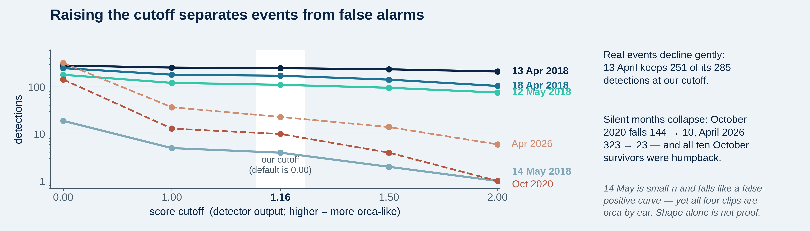
OPERATING POINT
Thresholding separates events from false alarms
Confirmed events decline gracefully: 13 April 2018 keeps 251 of 285 detections at +1.16. Silent months collapse: October 2020 144 → 10, April 2026 323 → 23.
Every October 2020 survivor was reviewed and was humpback. Visually documented orca, acoustically absent — a specificity result, not a miss.
14 May is instructive: small-n, and its curve collapses like a false-positive curve, yet all four clips are orca by ear. Curve shape alone is not proof.

Slide 9
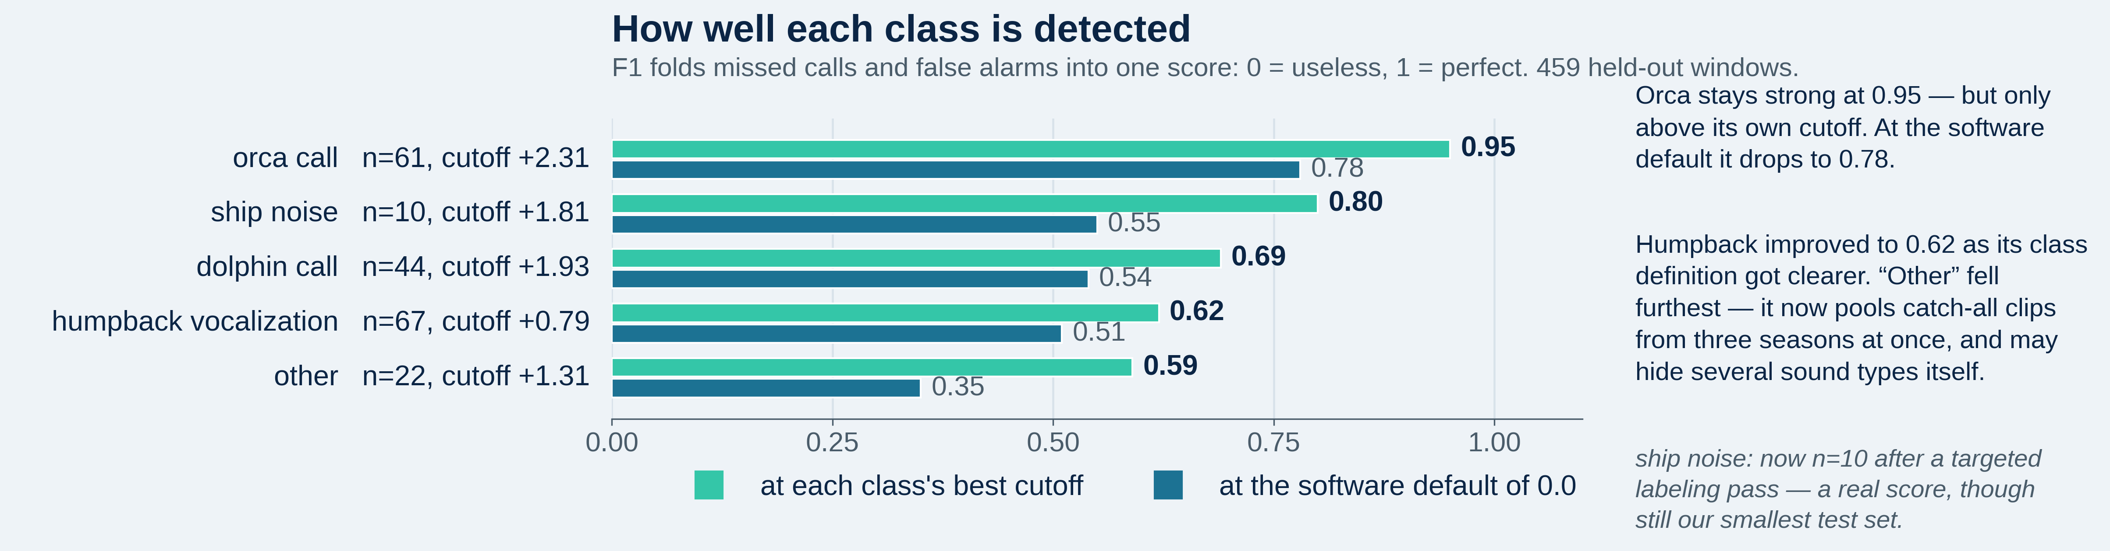
PER-CLASS PERFORMANCE
Where it works, and where it doesn't
orca_v10, 459 held-out windows. Each class at its own F1-optimal cutoff, against the software's 0.0 default.
Optimal cutoffs span +0.79 to +2.31: a single global threshold cannot serve all classes. Cutoffs are tuned on other held-out months, never on the month under analysis.
Humpback vocalization is the weakest credible class — one label spanning song and a wide range of non-song calls. Splitting it is the obvious next move.
'Other' fell furthest as it grew: it now pools catch-all clips from three seasons, and probably hides several acoustic categories.

Slide 10
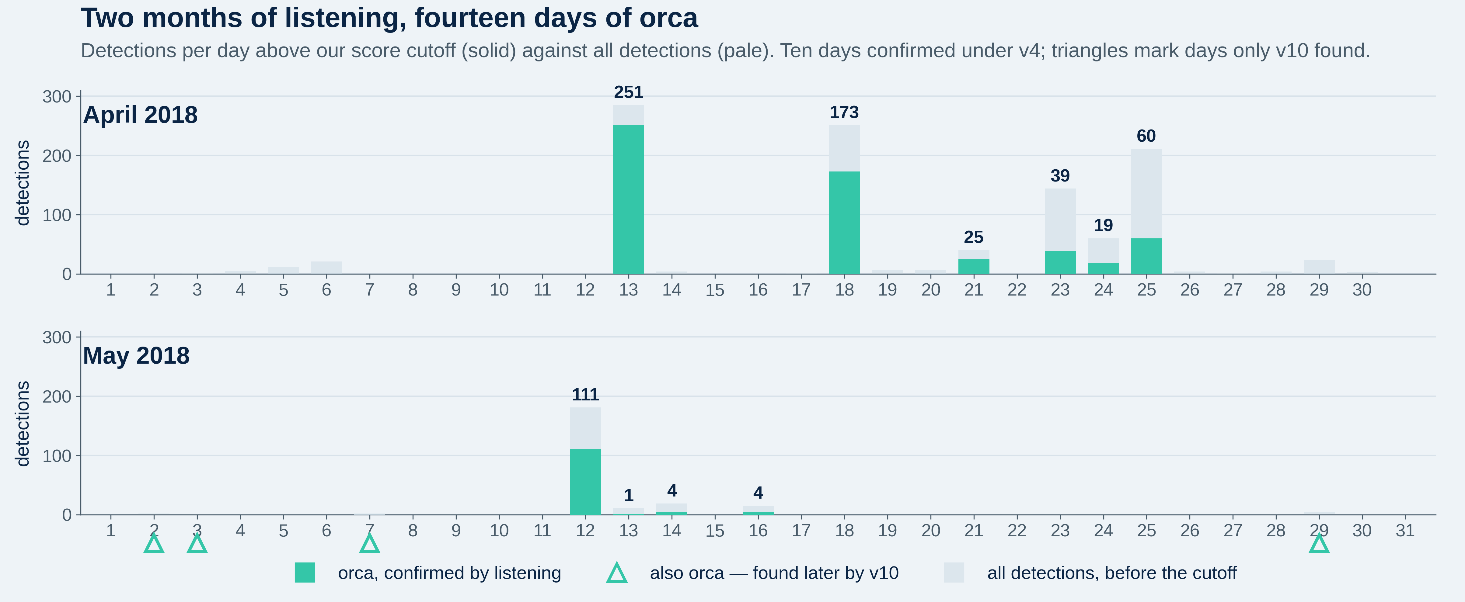
FINDING
Spring 2018 was a sustained presence, not an encounter
April: 13, 18, 21, 23, 24, 25 confirmed by ear. 100 clips reviewed across 18/21/25 with zero false alarms; 58 detections on 23–24 gave 55 orca, 2 humpback, 1 unlabeled.
May: 12 May all 181 detections reviewed and all orca (111 above cutoff); 13, 14, 16 confirmed. Triangles mark four more days only v10 found.
Independent corroboration: regional reports of record orca sightings that spring, and two identified pods — one Alaskan, one Californian (CA140).

Slide 11
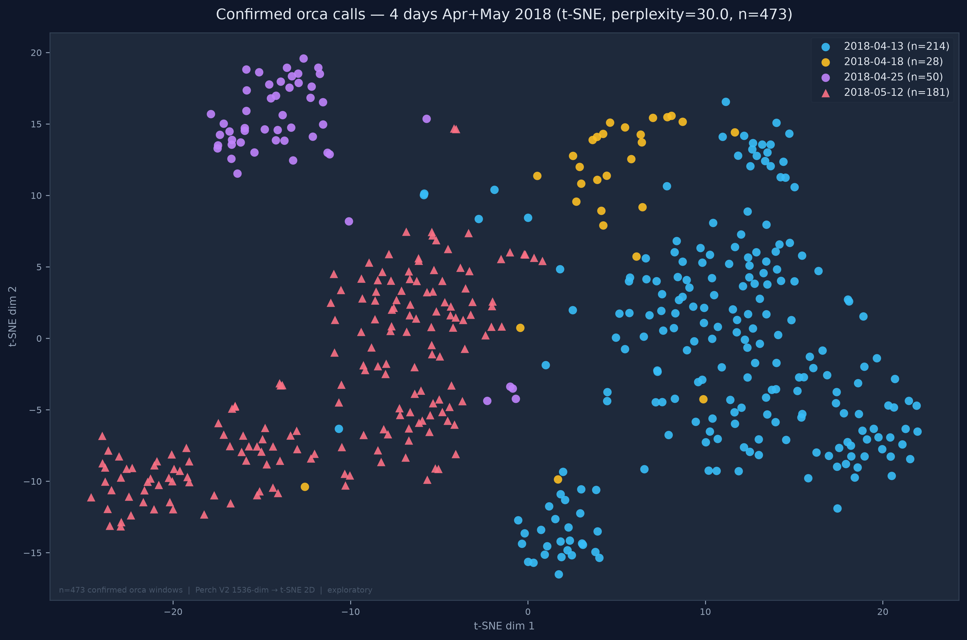
BEYOND DETECTION
Per-encounter structure inside the orca cluster
473 confirmed orca windows by day: the 25 April evening encounter separates from the 13 April morning event, and 12 May holds its own region a month later.
Stable across perplexity 10/30/50, and not a single-recording or vessel artifact. Two pods were documented that spring — consistent with, not proof of, that pairing.

Slide 12
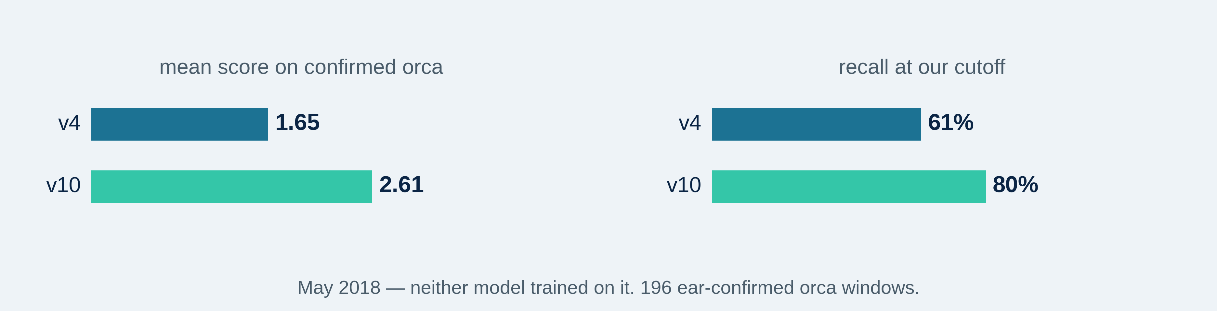
HELD-OUT VALIDATION
Run the loop again: v10 against v4 on a month neither saw
May 2018 was reserved as a clean test: neither v4 nor orca_v10 has trained on it. On the 196 ear-confirmed orca windows, v10 scores higher on 192 of the 195 shared.
Of v10's above-threshold detections not already confirmed, 14 of 14 were orca by ear — no false alarms among those reviewed. May is not exhaustively negative-labeled, so this is not a month-wide FP rate.
Four fell on days never previously confirmed — 2, 3, 7, 29 May. v10 did not merely score better; it surfaced activity v4 was blind to.

Slide 13
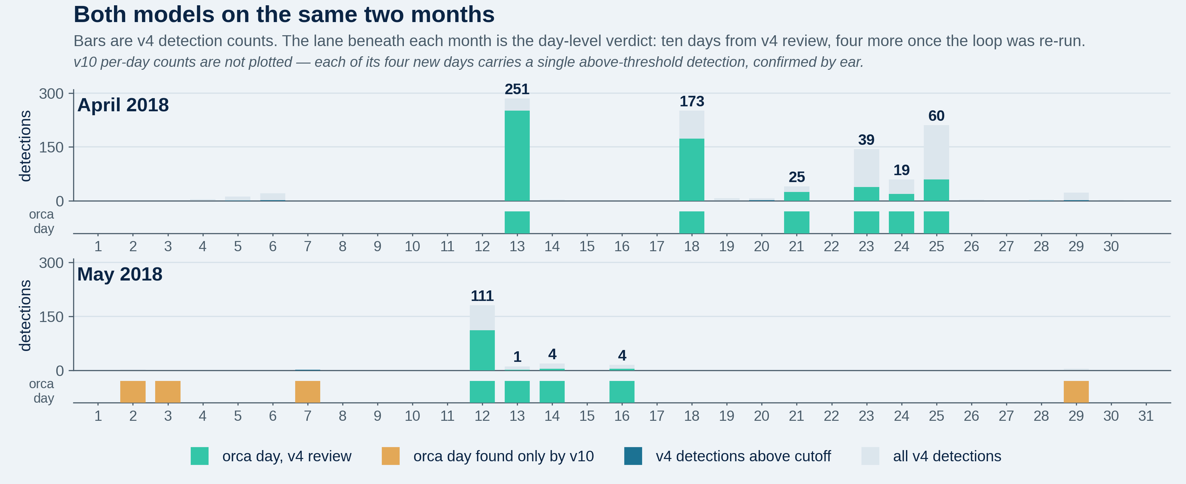
BOTH MODELS, ONE VIEW
The same two months, with v10's contribution filled in
Bars are v4 detection counts; the lane under each month is the day-level verdict. Ten days came from v4 review, four more only after the loop was re-run.
v10's four new days each rest on a single above-threshold detection, confirmed by ear — so counts stay v4-only, and the verdict lane is where the two models are honestly comparable.

Slide 14
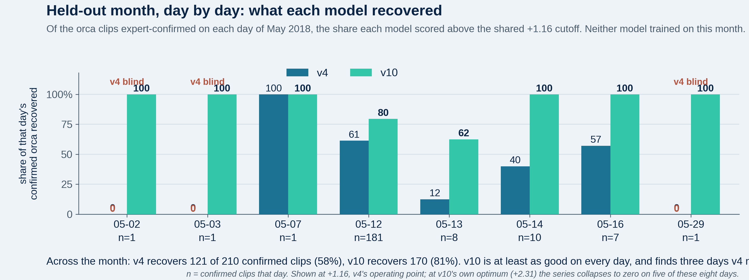
HELD-OUT MONTH, DAY BY DAY
How much of the known orca each model actually recovered
This is recall against expert-confirmed ground truth, not detection counts — one axis, chosen deliberately. The two differ: on 12 May, 181 clips are confirmed orca but only 144 clear +1.16.
v4 recovers 121 of 210 confirmed clips across the month (58%); v10 recovers 170 (81%). v10 is at least as good on every single day.
On 2, 3 and 29 May v4 fires nothing at all. Those days exist in the record only because the loop was run again.

Slide 15
WHAT THE NUMBERS SAY
The case in four figures
14 days
95% fewer
1,336
+19 pts
confirmed orca, April–May 2018: ten from v4, four more after re-running the loop
April-2026 false alarms (6,489 → 304), from 17 hard negatives
labels total, ~8–10 h of researcher time; 873 behind v4
recall on the held-out month, v10 over v4
The claim is not that this is a finished detector. It is that agile modeling on a frozen foundation model converts a modest labeling budget into a usable instrument — and that each turn of the loop measurably improves it.

Slide 16
Limits, and what's next
Run v4 and v10 across the entire 11-year archive to probe seasonality and interannual detection.
Humpback vocalization needs splitting into song and non-song classes; 'other' likely needs decomposing too.
Per-class inference thresholds rather than one global cutoff.
May 2018 stays a hold-out. Its value as an honest referee exceeds its value as training data.
Extension to Southern Resident and Offshore ecotypes.
github.com/duane-edgington/perch-hoplite-orcas-MBNMS · duane@mbari.org · ryjo@mbari.org

