Slide 1
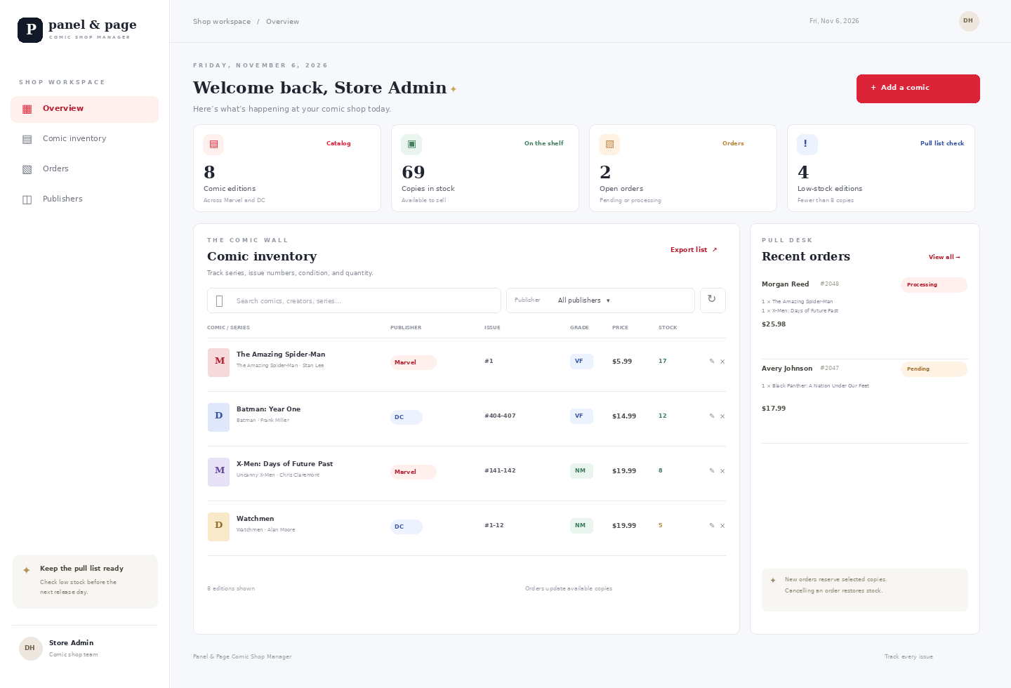
DATABASE SYSTEMS PROJECT
Panel & Page
Comic Shop Manager
A PHP and MySQL system for tracking comic editions, stock, and customer orders.
Duane Harris
Class presentation · November 19, 2026
Sample catalog: real Marvel and DC titles
Notes:
Introduce Panel & Page as a classroom comic shop inventory and order manager. Sample titles include Marvel's The Amazing Spider-Man and X-Men: Days of Future Past, and DC's Batman: Year One and Watchmen. Official title references: https://www.marvel.com/comics/series/32866/the_amazing_spider-man ; https://www.marvel.com/comics/collection/41778/x-men_days_of_future_past_tpb_new_printing_trade_paperback ; https://www.dc.com/graphic-novels/batman-year-one-1987/absolute-batman-year-one ; https://www.dc.com/graphic-novels/watchmen-1986/watchmen

Slide 2
01 / STORE WORKFLOW
Three steps connect the comic wall to orders
01
02
03
Catalog the edition
Place an order
Reconcile stock
Record series, issue range, publisher, creator, format, grade, price, and copies.
Choose a customer and one or more comic editions. The API checks available stock.
The transaction deducts copies. Cancelling the order returns them to inventory.
If a comic is unavailable, the API rolls the entire order back.
PANEL & PAGE | COMIC SHOP MANAGER
02
Notes:
Explain the flow from catalog records through order creation to stock changes. The order and stock updates share a database transaction, so invalid or insufficient-stock orders do not leave partial changes.

Slide 3
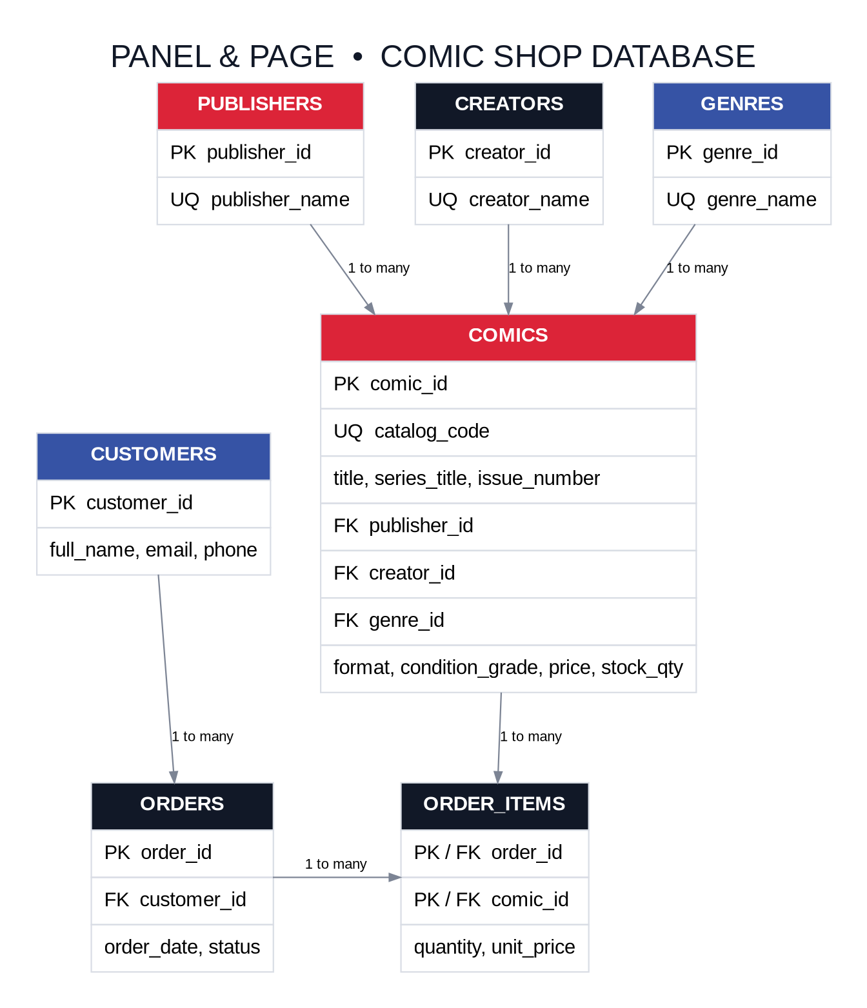
02 / RELATIONAL MODEL
Seven tables describe the shop
Publishers, creators, and genres are stored once and linked to comics.
Customers place orders. Order items connect each order to its comics.
The order_items key is order_id + comic_id. It prevents duplicate lines per comic in an order.
The schema uses foreign keys, unique constraints, and price / quantity checks.
PANEL & PAGE | COMIC SHOP MANAGER
03
Notes:
Walk through the ER diagram. Point out that comic records use a lead creator to keep this class model compact. A production catalog could add a comic_creators junction table for writers, artists, inkers, and colorists.

Slide 4
03 / MINIMAL FRONTEND
The dashboard makes inventory easy to scan
Search by title, series, issue, creator, or store code. Filter by publisher and export the inventory.
PANEL & PAGE | COMIC SHOP MANAGER
04
Notes:
This image is a generated UI preview included with the project. In XAMPP, the live dashboard loads comic records from MySQL through the PHP JSON API. Demonstrate searching, publisher filtering, create or edit, delete, and CSV export.

Slide 5
04 / BACKEND AND CRUD
The API protects inventory during order changes
LOCAL API
1
Validate request
/api/api.php?resource=comics
GET · POST · PUT · DELETE
2
Lock comic stock rows
POST /api/api.php?resource=orders
3
Insert order and lines
{
"customer_id": 1,
"items": [{"comic_id": 5, "quantity": 1}]
}
4
Deduct stock and commit
Prepared PDO statements · JSON validation · HTTP status codes
Insufficient stock? Roll back the whole transaction.
PANEL & PAGE | COMIC SHOP MANAGER
05
Notes:
Show the comics and orders resources in the API. Explain the order transaction: check quantities, lock stock rows, insert order and order_items, decrement stock, then commit. If a comic does not exist or does not have enough copies, the API rolls back.

Slide 6
05 / RECREATE AND PRESENT
Run the project in XAMPP
STACK
HTML · CSS · JavaScript PHP 8 / PDO MySQL 8 XAMPP
LOCAL SETUP
1 Copy the folder into C:\xampp\htdocs
2 Start Apache and MySQL, then import database/schema.sql in phpMyAdmin
3 Copy config.example.php to config.php
4 Open http://localhost/bookstore-management-system/
PROJECT REPOSITORY
github.com/duaneX1504/bookstore-management-system
Marvel and DC title links, full setup steps, schema, API examples, and source screenshots are in the repository.
Class presentation · November 19, 2026
PANEL & PAGE | COMIC SHOP MANAGER
06
Notes:
Close by summarizing the PHP, PDO, MySQL, and XAMPP stack. The project repository includes the source, schema, report, presentation notes, screenshots, and setup instructions. Marvel official catalog: https://www.marvel.com/comics/series/32866/the_amazing_spider-man . DC official title page: https://www.dc.com/graphic-novels/watchmen-1986/watchmen

