Slide 1
Scheduling in Distributed Systems
Gurmeet Singh
CS 599 Lecture

Slide 2
General
Scheduling refers to assigning a resource and a start time end to a task
Much of scheduling research has been done in Operations Research Community e.g Job Shop, Flow shop scheduling etc.
Scheduling is often an overloaded term in Grids.
A related term is mapping that assigns a resource to a task but not the start time.

Slide 3
Systems taxonomy
Parallel Systems
Distributed Systems
Dedicated Systems
Shared Systems
  Time Shared e.g. aludra
  Space Shared e.g. HPCC cluster
Homogeneous Systems
Heterogeneous Systems

Slide 4
Scheduling Regimens
Online/Dynamic Scheduling
Offline/Static Scheduling
Resource level Scheduling
Application level Scheduling

Slide 5
Applications taxonomy
Bag of tasks – Independent tasks
Workflows – dependent tasks
  Generally Directed Acyclic Graphs (DAGs)
Performance criteria
  Completion time (makespan), reliability etc.

Slide 6
Scheduling Bag of Tasks on Dedicated Systems
Min-Min
Max-Min
Sufferage

Slide 7
Min-Min Heuristic
For each task determine its minimum completion time over all machines
Over all tasks find the minimum completion time
Assign the task to the machine that gives this completion time
Iterate till all the tasks are scheduled

Slide 8
Example of Min-Min
 | T1 | T2 | T3
M1 | 140 | 20 | 60
M2 | 100 | 100 | 70
 | T1 | T3
M1 | 160 | 80
M2 | 100 | 70
 | T1
M1 | 160
M2 | 170
Stage 1: Stage 2: Stage 3:
T1-M2 = 100 T1-M2 = 100 T1-M1 = 160
T2-M1 = 20 T3-M2 = 70
T3-M1 = 60
Assign T2 to M1 Assign T3 to M2 Assign T1 to M1
20
160
M1
M2
T2
T1
T3
70

Slide 9
Max-Min Heuristic
For each task determine its minimum completion time over all machines
Over all tasks find the maximum completion time
Assign the task to the machine that gives this completion time
Iterate till all the tasks are scheduled

Slide 10
Example of Max-Min
 | T1 | T2 | T3
M1 | 140 | 20 | 60
M2 | 100 | 100 | 70
 | T2 | T3
M1 | 20 | 60
M2 | 200 | 170
 | T2
M1 | 80
M2 | 200
Stage 1: Stage 2: Stage 3:
T1-M2 = 100 T2-M1 = 20 T2-M1 = 80
T2-M1 = 20 T3-M1 = 60
T3-M1 = 60
Assign T1 to M2 Assign T3 to M1 Assign T2 to M1
60
80
M1
M2
T3
T2
T1
100

Slide 11
Sufferage Heuristic
For each task determine the difference between its minimum and second minimum completion time over all machines (sufferage)
Over all tasks find the maximum sufferage
Assign the task to the machine that gives this sufferage
Iterate till all the tasks are scheduled

Slide 12
Example of Sufferage
 | T1 | T2 | T3
M1 | 140 | 20 | 60
M2 | 100 | 100 | 70
 | T1 | T3
M1 | 160 | 80
M2 | 100 | 70
 | T3
M1 | 80
M2 | 170
Stage 1: Stage 2: Stage 3:
T1 = 40 T1 = 60 T3 = 90
T2 = 80 T3 = 10
T3 = 10
Assign T2 to M1 Assign T1 to M2 Assign T3 to M1
20
80
M1
M2
T2
T3
T1
100

Slide 13
Grid Environments
Time-shared resources
Heterogeneous resources
Tasks require input files that might be shared
Data transfer times are important

Slide 14
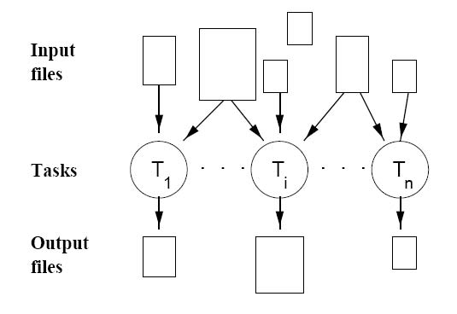
Application Model

Slide 15
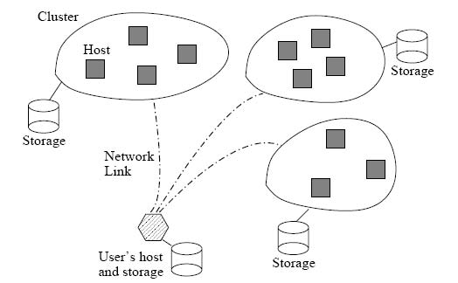
System Model

Slide 16
Scheduling Heuristic
Schedule()
  Compute the next Scheduling event
  Create a Gantt Chart G
  For each computation and file transfer underway
    Compute an estimate of its completion time
    Update the Gantt Chart G
  Select a subset of tasks that have not started execution: T
  Until each host has been assigned enough work
    Heuristically assign tasks to hosts
  Convert G into a plan

Slide 17
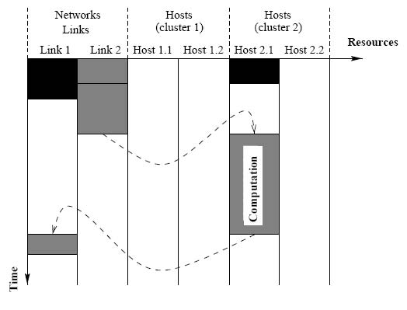
Sample Gantt Chart

Slide 18
Possible Variations
Schedule()
  Compute the next Scheduling event
  Create a Gantt Chart G
  For each computation and file transfer underway
    Compute an estimate of its completion time
    Update the Gantt Chart G
  Select a subset of tasks that have not started execution: T
  Until each host has been assigned enough work
    Heuristically assign tasks to hosts
  Convert G into a plan

Slide 19
XSufferage
Tasks may have little intra-cluster Completion time (CT) variation and large inter-cluster CT variation.
Cluster-level MCT for Sufferage.
 |  | T1
C1 | H1 | 5
 | H2 | 6
C2 | H3 | 30
 | H4 | 32
 |  | T1 | T1
C1 | H1 | 5 | 5
 | H2 | 6
C2 | H3 | 30 | 30
 | H4 | 32

Slide 20
Simulations
1000 Simulated Grids, U(2,12)xU(2,32)
2000 applications, U(2,10)xU(20x1000)
Task runtime U(100,300)
Large Input File, U(400,100000) KBytes
Small Input File, 1 KB
One Output File, 10 KB
Background load on the host machines and network links based on NWS traces
Results over 1000 random Grid/application pairs.

Slide 21
Results
 | Geometric mean (sec) | Average Degradation from Best (%) | Average Rank
Max-min | 2390 | 17.3 | 3.1
Min-min | 2452 | 21.2 | 3.0
Sufferage | 2329 | 14.1 | 2.8
XSufferage | 2174 | 6.2 | 1.8

Slide 22
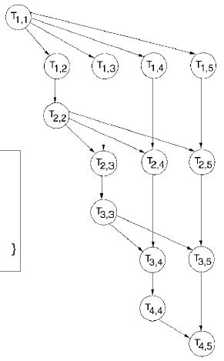
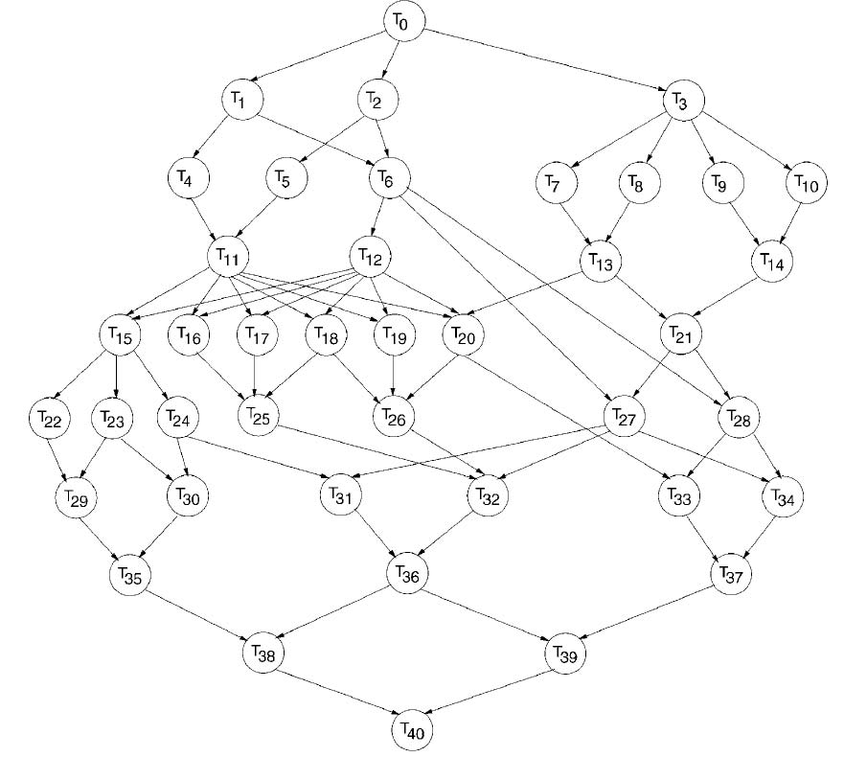
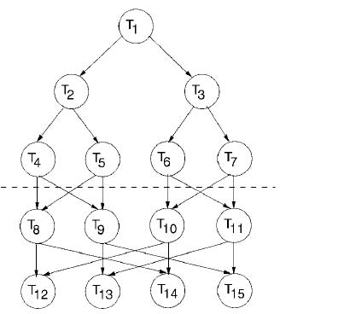
Scheduling Task Graphs
Task Graphs have dependencies between the tasks in the Application
Scheduling methods for bag of task applications cannot be directly applied

Slide 23
Graph Scheduling Algorithms
Guided Random Search Based
Heuristic Based
List Scheduling Heuristics
Task Duplication Heuristics
Level-by-level Heuristics
Clustering Heuristics

Slide 24
Guided Random Search Based
Genetic Algorithms
  A chromosome is an ordering of tasks
  A rule is required to convert it to a schedule
Simulated Annealing
Local Search Techniques, taboo etc

Slide 25
List Scheduling Heuristics
An ordered list of tasks is constructed by assigning priority to each task
Tasks are selected on priority order and scheduled in order to minimize a predefined cost function
Tasks have to be in a topologically sorted order
T1
T1
T2
T4
T3
T5
T6
T7
T4
T3
T5
T1
T4
T3
T5
T6
T2
T7
T2
T1
T4
T3
T5
T2
T6
T7
T6
T1
T3
T4
T2
T5
T6
T7
T1
T5
T4
T3
T2
T6
T7
T7

Slide 26
Level by Level Scheduling
Partition a DAG into multiple levels such that task in each level are independent.
Apply Min-Min, Max-Min or other heuristics to tasks at each level

Slide 27
Clustering Heuristics
Clustering heuristics cluster tasks together
Tasks in the same cluster are scheduled on the same processor
P0 P1
T1
T5
T1
T1
T1
T2
T4
T4
T3
T4
T4
T3
T5
T3
T5
T3
T5
T2
T2
T2
T6
T6
T6
T6
T 7
T7
T7
T7
Time

Slide 28
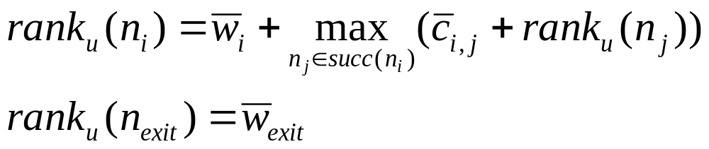
Heterogeneous Earliest Finish Time
List scheduling based heuristic
Do a bottom up traversal of the graph and assign ranks to each task

Slide 29
HEFT- contd
Compute rank for all tasks in the graph
Sort the tasks by non-increasing rank values (ensures topological sort)
While there are unscheduled tasks
  Select the first task in the list
  Assign the task to the processor/machine that minimizes its completion time using insertion based scheduling
endWhile

Slide 30
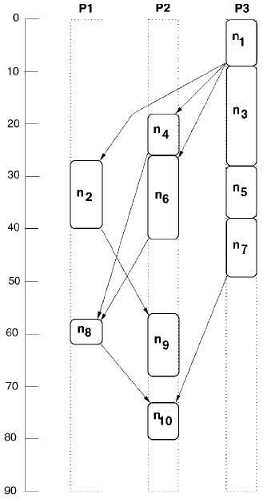
HEFT Order
T1
T1
T3
T4
T2
T5
T6
T7
T8
T9
T10
HEFT Schedule
T2
T3
T4
T5
T6
T7
T8
T9
T10
 | Priority
T1 | 108
T2 | 77
T3 | 80
T4 | 80
T5 | 69
T6 | 63.33
T7 | 42.667
T8 | 35.667
T9 | 44.333
T10 | 14.667

Slide 31
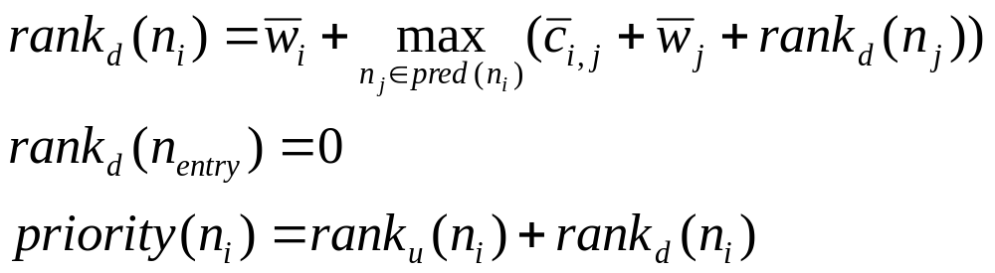
Critical Path on a Processor (CPOP)
Upward ranking
Downward ranking

Slide 32
CPOP
|CP| = priority(n_{entry})
SET_{CP} = {n_{entry}}
n_{k}←n_{entry}
While n_{k} is not the exit task do
Select n_{j} where ((n_{j} Є succ(n_{k}) and priority(n_{j}) == |CP|
SET_{CP} = {SET_{CP} U n_{j}}
n_{k}←n_{j}
endWhile
Select the Critical Path processor p_{cp} that minimizes the sum of runtimes of tasks on the critical path
Go through the task list in priority order, assign tasks in SET_{CP} to p_{cp} and other tasks to any processor that minimizes its finish time

Slide 33
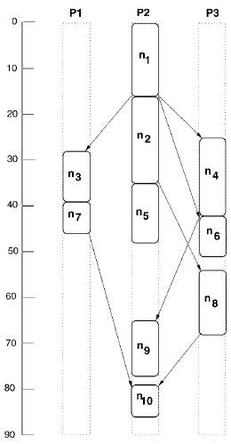
T1
T2
T3
T4
T5
T6
T7
T8
T9
T10
 | Priority
T1 | 108
T2 | 108
T3 | 105
T4 | 102
T5 | 93
T6 | 90.333
T7 | 105
T8 | 102.334
T9 | 108
T10 | 108

Slide 34
Conclusions
Heuristics for scheduling independent and dependent tasks on distributed systems
Rescheduling in order to adapt to dynamic Grid conditions
Partitioning in case of task graphs
Future lecture (Nov 27th) on resource provisioning for applications.

