Slide 1

PhoneGap: Making cross-platform mobile development easier for everyone!

Slide 2
Discussion Overview
Introductions
What is PhoneGap
How does PhoneGap work
When would you want to use PhoneGap
When would you not want to use PhoneGap
What is PhoneGap Build
Demo
Q&A

Slide 3






About Interactive Business Systems
U.S. Headquarters,
Oak Brook, Illinois
200+ Consultants in U.S.
4 Business Units and
2 Development Centers
Strategic Staffing Solutions
Application & Infrastructure
Custom Solutions

Slide 4
The IBS Advantage
Development Expertise
Senior .NET professionals skilled with Web, Mobile, SharePoint and Enterprise Reporting
Domain Expertise
Expertise in various industries and markets
Experienced professionals who know the business and can work with the business users and the team to get results
Flexible Engagement Management
Ability to staff up when necessary
Iterative approach that keeps the business involved and seeing results
Proven development processes that work
Offshore
Onsite
Offsite
We have long term relationship with clients that have similar business challenges

Slide 5
Who am I?
Technical Lead and Principal Consultant at Interactive Business Systems, Inc. with areas of specialization in SharePoint Administration/Development and Mobile App Development. He is a Microsoft Certified Solutions Expert and Microsoft Certified Solutions Developer. A United States Army veteran that has over 10 years of IT experience in networking, systems administration and development. He is also a semi-active blogger regarding new and emerging technologies as well as SharePoint specific issues and resolutions.
Notes:
Born and raised in Cincinnati, Ohio area
Spent roughly 5 years in the US Army
Got Married and that was the end of my service career
Still a geek in the Army
Spent 7 years self-employed as a dog trainer
Been developing for IBS for 4 ½ years
Mostly SharePoint development and administration
Bachelor’s Degree in CIS from DeVry in General Psychology from University of Cincinnati and working on MBA from “The Ohio State University”

Slide 6
PhoneGap vs cordova
In October 2011, PhoneGap was donated to the Apache Software Foundation (ASF) under the name Apache Cordova. Through the ASF, future PhoneGap development will ensure open stewardship of the project. It will remain free and open source under the Apache License, Version 2.0.
PhoneGap is an open source distribution of Cordova. You may see references to both PhoneGap and Cordova and their names used interchangeably. Think about Cordova’s relationship to PhoneGap like WebKit’s relationship to Safari or Chrome.

Slide 7
What is Phonegap?
PhoneGap is a free and open source framework that allows you to create mobile apps using the web technologies you’re already familiar with.
Use standardized web APIs and target the platforms you care about.
Essentially mobile apps with HTML, CSS and JS.
Notes:
This is verbatim from the PhoneGap site…

Slide 8
How does phonegap work
Build your UI with HTML, CSS and JavaScript
Access the native functionality (lower level APIs) through PhoneGap
Package the App for distribution
PhoneGap Build
Notes:
Again…verbatim from the PhoneGap site

Slide 9
PhoneGap Target Platforms
Amazon Fire | Android | BlackBerry 10 | FireFox
iOS | Ubuntu | Windows Phone 8 | Windows
Tizen
Notes:
Touch on the different features that may or may not be available for each device but don’t go into much detail until you hit the API slide.

Slide 10

When to use phone gap
Notes:
Accelerated development effort as you probably already know HTML, CSS and JS
Native look and feel is not very important
Little to no data manipulation (mostly displaying information not necessarily editing a lot of information)
Performance is improved since version 3.0 came out but it still not on par with Xamarin or Native
Google Analytics integration is a breeze as it is just HTML, CSS and JavaScript
WebSQL and Local Storage

Slide 11
Available Api’s
Primary Plugins
Battery Status, Camera, Console, Contacts, Device, Accelerometer, Compass, Dialogs, File System, File Transfer, Geolocation, Globalization, InAppBrowser, Media, Media Capture, Network Information, Splashscreen, Vibration and Status Bar
Custom Plugins
Notes:
19 Native Plug ins to PhoneGap
Show some of the limitations of the Console, Device and Vibration API’s as well as the numerous Custom Plugins that have been developed.
Caution on using the Custom Plugins

Slide 12

When not to use phone gap
Notes:
Intensive resource usage is expected
3D Gaming
Require a completely native look and feel
Kendo UI and some JavaScript libraries do a good job of providing a native look and feel but there are still some nuances to be aware of

Slide 13

PhoneGap Build
PhoneGap Build is a service that allows you to package mobile apps in the cloud for multiple platforms..
Notes:
No more hassles of maintaining SDKs on your computer. You quickly and easily get app-store ready apps for iOS, Android, BlackBerry, and more. PhoneGap Build has a couple of subscription options, including a free subscription to try it out.

Slide 14
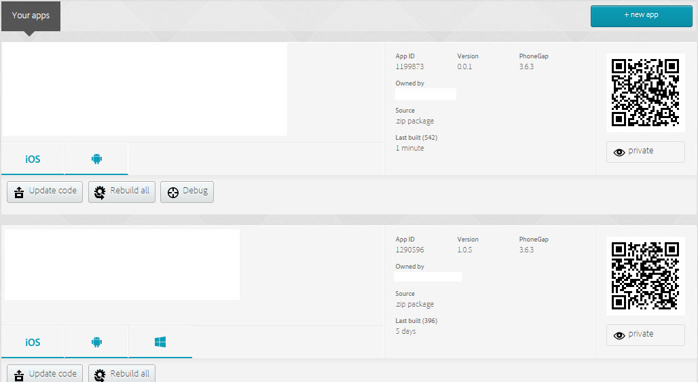
PhoneGap Build Home Page

Slide 15
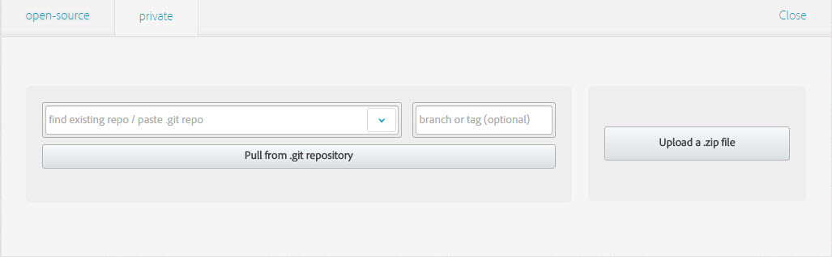
Upload to PhoneGap Build

Slide 16
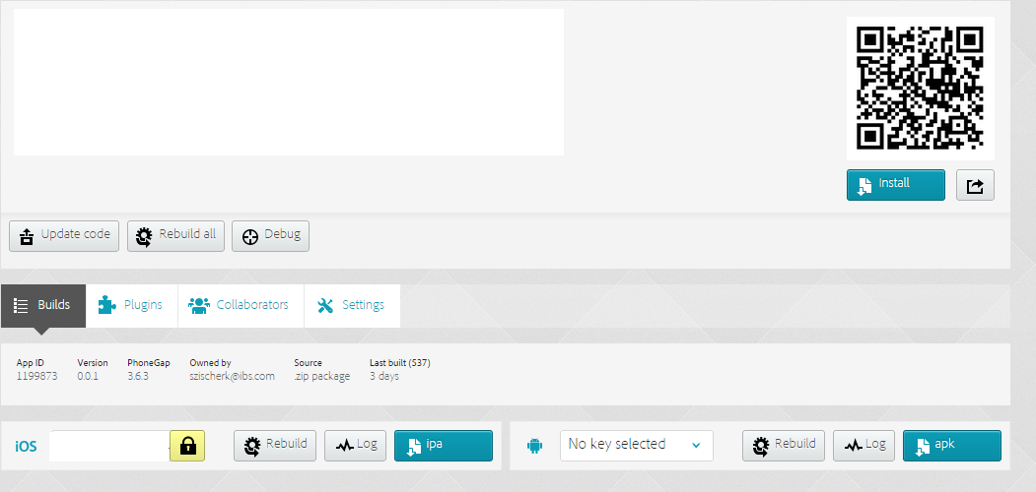
PhoneGap Build Project Home Page
Notes:
Make sure to discuss:
Cost
Integration with GitHub
Certificate Signing

Slide 17
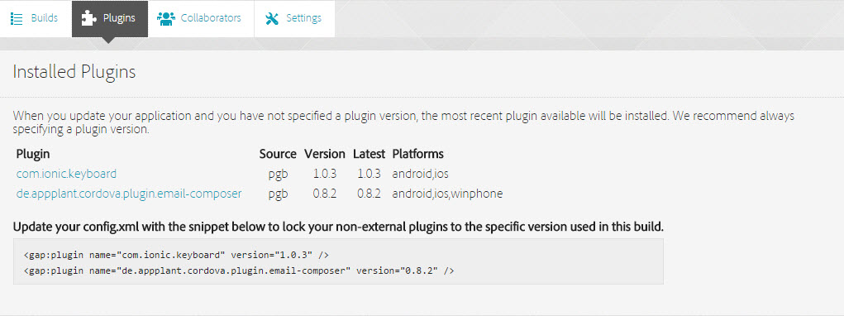
PhoneGap Build Plugins View

Slide 18
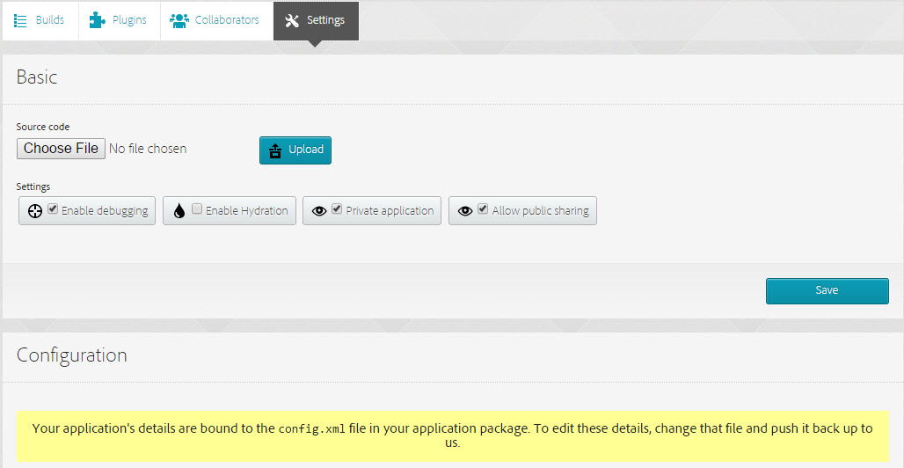
PhoneGap Build Settings View

Slide 19
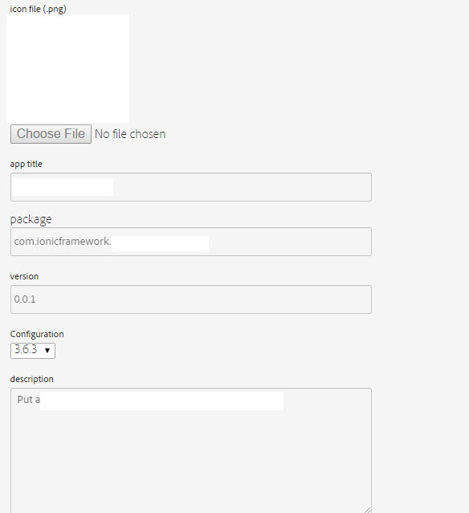
PhoneGap Build Settings View CTD

Slide 20
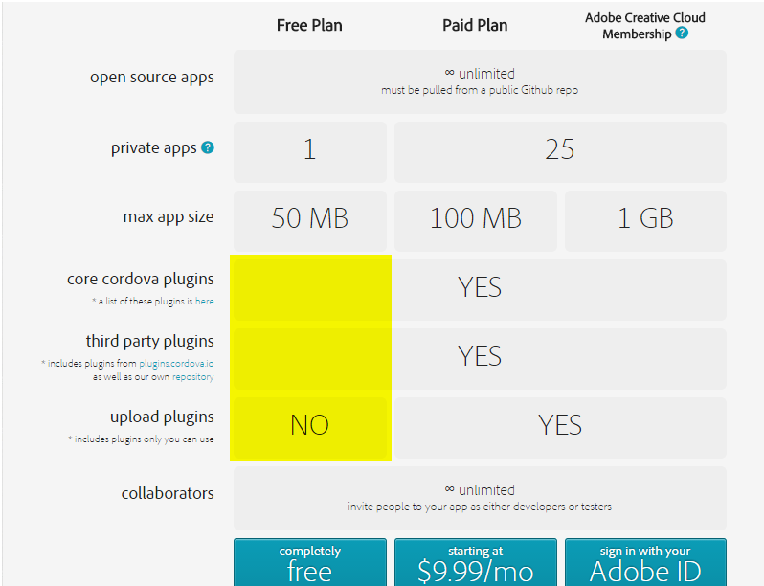
PhoneGap Build Costs
Notes:
If you want to use PhoneGap to build enterprise level apps that have any device interaction you must get on a paid plan!!!

Slide 21
Some “gotchas” we have run into and Basic DEMO
Notes:
Status Bar on iPhone
Flicker and style issues can happen from time to time but there are frameworks that can limit this such as Kendo UI and Ionic
Cross Domain scripting can be challenging when dealing with Enterprise Apps
PhoneGap build can take quite a while to complete

