Slide 1
VR-ENGAGE: A Virtual Reality Educational Game that Incorporates Intelligence
Maria Virvou, Constantinos Manos,
George Katsionis, Kalliopi Tourtoglou
Department of Informatics
University of Piraeus
Piraeus 18534, Greece
mvirvou@unipi.gr; kman@singular.gr;
gkatsion@singular.gr; ktourtog@internet.gr

Slide 2
Virtual Reality Games in Education
Virtual reality games have become an important
part of young peoples entertainment culture.
However, Vr-Games are not welcomed in class
because many educators are alarmed by them.
On the other hand, there are also many
researchers and educators who believe that the
attractiveness of computer games should be
exploited for the benefits of education.

Slide 3
Integrating Vr-Games with ITSs
Vr-Games may provide very attractive educational
environments.
However, a major issue is how to design an
educational system that is beneficial to students.
On the other hand, Intelligent Tutoring Systems
(ITSs) have been quite good at providing dynamic
aspects to the reasoning ability of educational systems.
The integration of the technology of VR-Games
with ITSs can provide effective educational applications.

Slide 4
VR-ENGAGE :
Stands for :
Virtual Reality Educational Negotiation Game
on Geography.
It is an educational software system that
Integrates a virtual reality game with an ITS.

Slide 5
The VR-Environment of the Game
The environment of a game plays a crucial
role for its popularity.
The environment of the game is similar to
that of the popular game called “DOOM”
which has many virtual theme worlds with
castles and dragons that the player has to
navigate through and achieve the goal of
reaching the exit.

Slide 6
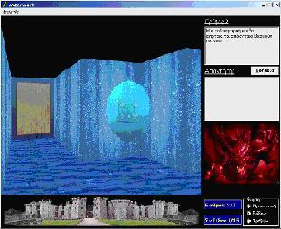
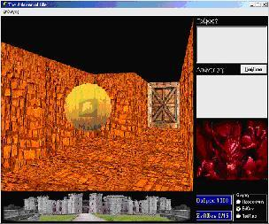
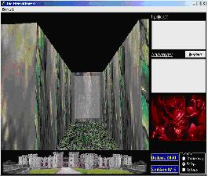
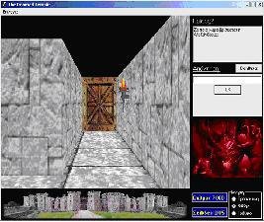
Images…

Slide 7
The VR-Environment of the Game
The user interface employs two types of
animated agent that use synthesized voice:
a) The dragon which is the virtual enemy of the player.
b) The virtual companion of the player.
Background music that may be selected by the user.

Slide 8
The story of VR-ENGAGE
The story of VR-ENGAGE incorporates elements
from adventure games. However, each of these
elements is connected to ideas and pedagogic approaches
from educational software technology.
The ultimate goal of a player is to navigate
through a virtual world and find the book of
wisdom which is hidden.

Slide 9
DRAGONS
To achieve the ultimate goal, the player has
to go through passages of the virtual worlds that
are guarded by dragons.
A guard dragon poses a question to the player
from the domain of geography.
If players give a correct answer then they
receive full points for this question and the
dragon allows them to continue their way
through the door.

Slide 10
Negotiation Mode
If a player is not certain about the correct
answer s/he is allowed to ask the dragon for
a “negotiation”.
The grade that the student is going to receive
in the negotiation made, depends on how close
the student’s answer is to the correct one and/or
how plausible the reasoning that s/he has used is.
Through the negotiation mode, the game provides
an environment where there is opportunity for a
teaching-learning dialogue between the ITS and
the students.

Slide 11
A cognitive theory for the negotiation mode
The reasoning of the game in the negotiation
mode is based on a cognitive theory called
Human Plausible Reasoning (HPR) (Collins & Michalski, 1989))
HPR formalizes the plausible inferences based on
similarities, dissimilarities, generalizations and
specializations that people often use to make plausible
guesses about matters that they know partially.

Slide 12
Example of negotiation
Dragon : “What is the capital town/city of the
geographical compartment called Achaia (in Greece)?”
Student : “My guess is that Rio is the capital of Achaia.
I Know that Rio belongs to Achaia; Rio is an important
town in Achaia; Therefore it is likely that Rio is the
capital of Achaia.”
In general : The student’s guess may be correct or incorrect;
in the case of the example it is incorrect because
Patras is the correct answer. However, the reasoning
that s/he has used may reveal whether the student has
a good knowledge of geography and whether s/he is
able to use it correctly ;

Slide 13
Evaluation
It is not obvious that students consider the
Game more engaging.
1) Students who are very familiar with Vr-Games
may have to high expectations from the games
to be satisfied easily.
2) Students who are not familiar with Vr-Games
may have difficulties in the navigation of the
game itself.

Slide 14
Evaluation
One important aspect of the evaluation
is the reason why educational software is
adopted in the first place , i.e.
what the underlying rationale is (Jones et al.,1993)
In the case of the VR-ENGAGE,
the objective was:
To make educational software more
engaging and motivating than other
forms of software while retaining
and even improving the underlying
reasoning mechanisms.

Slide 15
Evaluation method
Comparison between VR-ENGAGE and
An ITS with a conventional user interface
But with the same underlying reasoning
Methods.

Slide 16
Classroom experiment
A class of 16 school children of
11-12 years old were divided into
two groups: of 8 children.
The first group were given the
the VR-ENGAGE to work with.
The second group were given
educational software with a simple
interface but with the same
underlying mechanisms.

Slide 17
Classroom experiment results
After having interacted with the software,
the players of the VR-ENGAGE
remembered the correct answers to a
higher extent than the other group.
This showed that the game had
achieved its aim of being at least
as effective as conventional educational
software in the learning outcomes
(in fact: slightly better)

Slide 18
Classroom experiment results
Time:
On average, the students who had
used the VR-ENGAGE had
spent more time with the system.
a) More to explore the game.
b) More time to read lessons.
This showed that the VR-ENGAGE was indeed more engaging.

Slide 19
Classroom experiment results
Interviews:
The players of the VR-ENGAGE
were fascinated by the idea of a
game in the classroom.
They were more enthusiastic about the
software they had used than the other
group of students.

Slide 20
Conclusions
Children would be quite happy
to work with a computer game
which represents a more amusing
teaching fashion than that of
conventional educational software.
The educational benefits of the
game are at least as good as
those of conventional educational
software.

