Slide 1
Text Classification:
An Advanced Tutorial
William W. Cohen
Machine Learning Department, CMU

Slide 2
Outline
Part I: the basics
  What is text classification? Why do it?
  Representing text for classification
  A simple, fast generative method
  Some simple, fast discriminative methods
Part II: advanced topics
  Sentiment detection and subjectivity
  Collective classification
  Alternatives to bag-of-words

Slide 3
Text Classification: definition
The classifier:
  Input: a document x
  Output: a predicted class y from some fixed set of labels y₁,...,y_{K}
The learner:
  Input: a set of m hand-labeled documents (x₁,y₁),....,(x_{m},y_{m})
  Output: a learned classifier f:x → y

Slide 4
Text Classification: Examples
Classify news stories as World, US, Business, SciTech, Sports, Entertainment, Health, Other
Add MeSH terms to Medline abstracts
  e.g. “Conscious Sedation” [E03.250]
Classify business names by industry.
Classify student essays as A,B,C,D, or F.
Classify email as Spam, Other.
Classify email to tech staff as Mac, Windows, ..., Other.
Classify pdf files as ResearchPaper, Other
Classify documents as WrittenByReagan, GhostWritten
Classify movie reviews as Favorable,Unfavorable,Neutral.
Classify technical papers as Interesting, Uninteresting.
Classify jokes as Funny, NotFunny.
Classify web sites of companies by Standard Industrial Classification (SIC) code.

Slide 5
Text Classification: Examples
Best-studied benchmark: Reuters-21578 newswire stories
  9603 train, 3299 test documents, 80-100 words each, 93 classes
ARGENTINE 1986/87 GRAIN/OILSEED REGISTRATIONS
BUENOS AIRES, Feb 26
Argentine grain board figures show crop registrations of grains, oilseeds and their products to February 11, in thousands of tonnes, showing those for future shipments month, 1986/87 total and 1985/86 total to February 12, 1986, in brackets:
Bread wheat prev 1,655.8, Feb 872.0, March 164.6, total 2,692.4 (4,161.0).
Maize Mar 48.0, total 48.0 (nil).
Sorghum nil (nil)
Oilseed export registrations were:
Sunflowerseed total 15.0 (7.9)
Soybean May 20.0, total 20.0 (nil)
The board also detailed export registrations for subproducts, as follows....
Categories: grain, wheat (of 93 binary choices)

Slide 6
Representing text for classification
f(
ARGENTINE 1986/87 GRAIN/OILSEED REGISTRATIONS
BUENOS AIRES, Feb 26
Argentine grain board figures show crop registrations of grains, oilseeds and their products to February 11, in thousands of tonnes, showing those for future shipments month, 1986/87 total and 1985/86 total to February 12, 1986, in brackets:
Bread wheat prev 1,655.8, Feb 872.0, March 164.6, total 2,692.4 (4,161.0).
Maize Mar 48.0, total 48.0 (nil).
Sorghum nil (nil)
Oilseed export registrations were:
Sunflowerseed total 15.0 (7.9)
Soybean May 20.0, total 20.0 (nil)
The board also detailed export registrations for subproducts, as follows....
)=y
simplest useful
?
What is the best representation for the document x being classified?

Slide 7
Representing text: a list of words
f(
ARGENTINE 1986/87 GRAIN/OILSEED REGISTRATIONS
BUENOS AIRES, Feb 26
Argentine grain board figures show crop registrations of grains, oilseeds and their products to February 11, in thousands of tonnes, showing those for future shipments month, 1986/87 total and 1985/86 total to February 12, 1986, in brackets:
Bread wheat prev 1,655.8, Feb 872.0, March 164.6, total 2,692.4 (4,161.0).
Maize Mar 48.0, total 48.0 (nil).
Sorghum nil (nil)
Oilseed export registrations were:
Sunflowerseed total 15.0 (7.9)
Soybean May 20.0, total 20.0 (nil)
The board also detailed export registrations for subproducts, as follows....
)=y
f(
)=y
(argentine, 1986, 1987, grain, oilseed, registrations, buenos, aires, feb, 26, argentine, grain, board, figures, show, crop, registrations, of, grains, oilseeds, and, their, products, to, february, 11, in, …
Common refinements: remove stopwords, stemming, collapsing multiple occurrences of words into one….

Slide 8
Text Classification with Naive Bayes
Represent document x as list of words w1,w2,…
For each y, build a probabilistic model Pr(X|Y=y) of “documents” in class y
  Pr(X={argentine,grain...}|Y=wheat) = ....
  Pr(X={stocks,rose,in,heavy,...}|Y=nonWheat) = ....
To classify, find the y which was most likely to generate x—i.e., which gives x the best score according to Pr(x|y)
  f(x) = argmax_{y}Pr(x|y)*Pr(y)

Slide 9
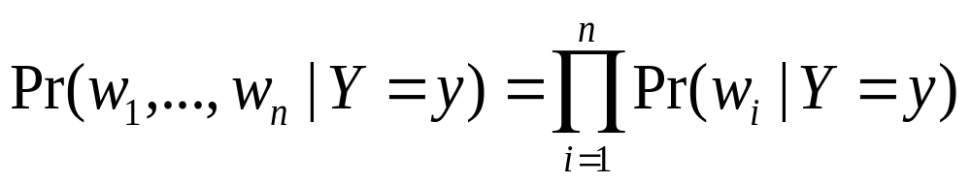
Text Classification with Naive Bayes
How to estimate Pr(X|Y) ?
Simplest useful process to generate a bag of words:
  pick word 1 according to Pr(W|Y)
  repeat for word 2, 3, ....
  each word is generated independently of the others (which is clearly not true) but means
How to estimate Pr(W|Y)?

Slide 10
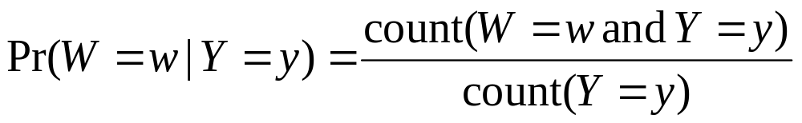
Text Classification with Naive Bayes
How to estimate Pr(X|Y) ?
Estimate Pr(w|y) by looking at the data...
This gives score of zero if x contains a brand-new word w_{new}

Slide 11
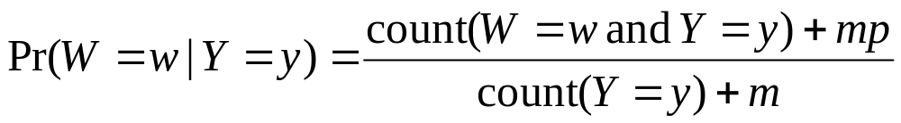
Text Classification with Naive Bayes
How to estimate Pr(X|Y) ?
... and also imagine m examples with Pr(w|y)=p
Terms:
This Pr(W|Y) is a multinomial distribution
This use of m and p is a Dirichlet prior for the multinomial

Slide 12
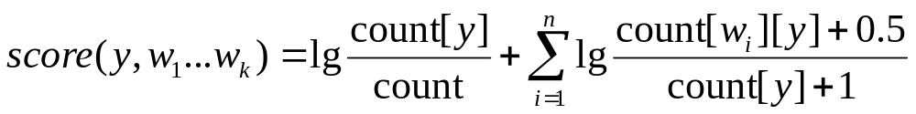
Text Classification with Naive Bayes
Putting this together:
  for each document x_{i} with label y_{i}
    for each word w_{ij} in x_{i}
      count[w_{ij}][y_{i}]++
      count[y_{i}]++
      count++
  to classify a new x=w₁...w_{n}, pick y with top score:
key point: we only need counts for words that actually appear in x

Slide 13
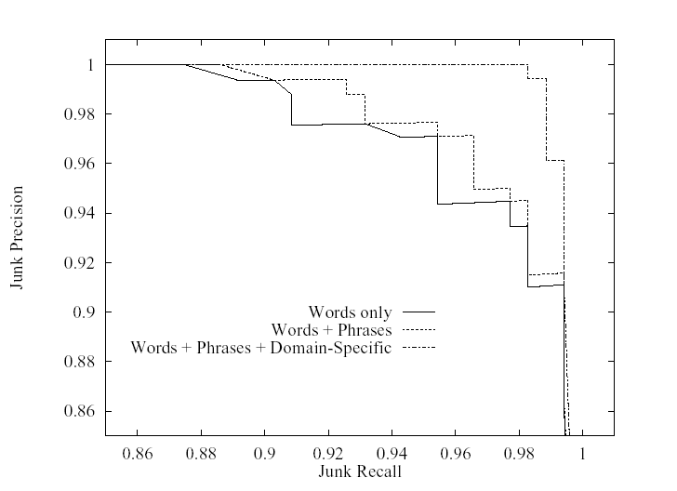
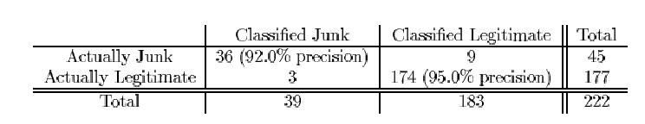
Naïve Bayes for SPAM filtering (Sahami et al, 1998)
Used bag of words, + special phrases (“FREE!”) and + special features (“from *.edu”, …)
Terms: precision, recall
Notes:
SPAM classification, which you might think of as “predicting delete actions”, is pretty well studied, starting from this paper. A little feature engineering led to good results with Naïve Bayes.

Slide 14
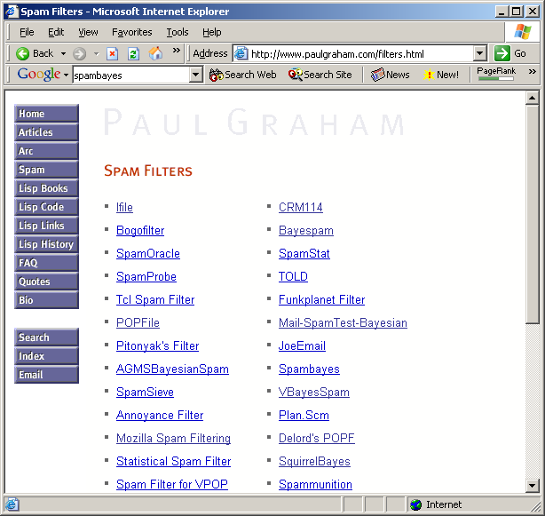
circa 2003…
Notes:
Partly as a result of this, there are now a LOT of freeware spam filters, many based on Naïve Bayes..

Slide 15
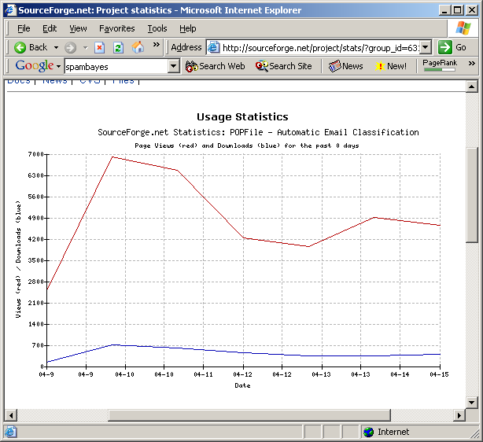
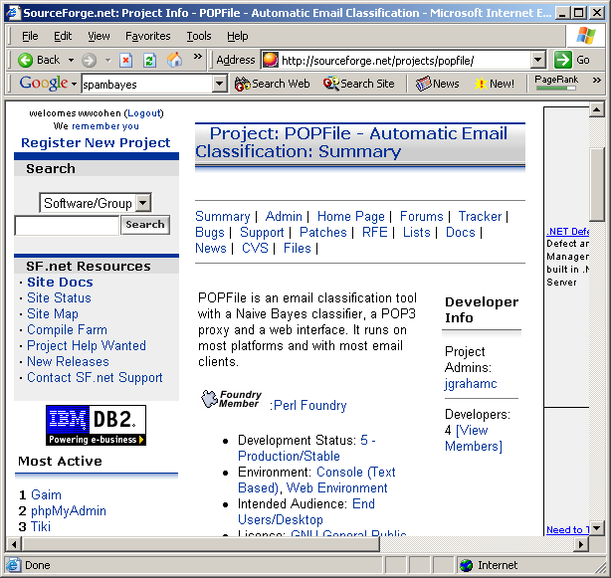
Notes:
…and Paul Graham’s POPFile email classifier is one of the most downloaded systems from Sourceforge.net.
I find this amazingly cool – the same community that did linux is now spending time working on text classification.
POPFile claims 99%+ accuracy. Part of what makes this work is that there is a common definition of what “spam” is, and therefore large datasets to learn from. How good is this really? It’s hard to say – I’ve also heard claims from direct mailers that 15% of legit commercial email gets misclassified as spam, and I’ve had my own email occasionally rejected as spam.

Slide 16
Naive Bayes Summary
Pros:
  Very fast and easy-to-implement
  Well-understood formally & experimentally
    see “Naive (Bayes) at Forty”, Lewis, ECML98
Cons:
  Seldom gives the very best performance
  “Probabilities” Pr(y|x) are not accurate
    e.g., Pr(y|x) decreases with length of x
    Probabilities tend to be close to zero or one

Slide 17
Outline
Part I: the basics
  What is text classification? Why do it?
  Representing text for classification
  A simple, fast generative method
  Some simple, fast discriminative methods
Part II: advanced topics
  Sentiment detection and subjectivity
  Collective classification
  Alternatives to bag-of-words

Slide 18
Representing text: a list of words
f(
ARGENTINE 1986/87 GRAIN/OILSEED REGISTRATIONS
BUENOS AIRES, Feb 26
Argentine grain board figures show crop registrations of grains, oilseeds and their products to February 11, in thousands of tonnes, showing those for future shipments month, 1986/87 total and 1985/86 total to February 12, 1986, in brackets:
Bread wheat prev 1,655.8, Feb 872.0, March 164.6, total 2,692.4 (4,161.0).
Maize Mar 48.0, total 48.0 (nil).
Sorghum nil (nil)
Oilseed export registrations were:
Sunflowerseed total 15.0 (7.9)
Soybean May 20.0, total 20.0 (nil)
The board also detailed export registrations for subproducts, as follows....
)=y
f(
)=y
(argentine, 1986, 1987, grain, oilseed, registrations, buenos, aires, feb, 26, argentine, grain, board, figures, show, crop, registrations, of, grains, oilseeds, and, their, products, to, february, 11, in, …
Common refinements: remove stopwords, stemming, collapsing multiple occurrences of words into one….

Slide 19
Representing text: a bag of words
word
freq
ARGENTINE 1986/87 GRAIN/OILSEED REGISTRATIONS
BUENOS AIRES, Feb 26
Argentine grain board figures show crop registrations of grains, oilseeds and their products to February 11, in thousands of tonnes, showing those for future shipments month, 1986/87 total and 1985/86 total to February 12, 1986, in brackets:
Bread wheat prev 1,655.8, Feb 872.0, March 164.6, total 2,692.4 (4,161.0).
Maize Mar 48.0, total 48.0 (nil).
Sorghum nil (nil)
Oilseed export registrations were:
Sunflowerseed total 15.0 (7.9)
Soybean May 20.0, total 20.0 (nil)
The board also detailed export registrations for subproducts, as follows....
grain(s) | 3
oilseed(s) | 2
total | 3
wheat | 1
maize | 1
soybean | 1
tonnes | 1
... | ...
If the order of words doesn’t matter, x can be a vector of word frequencies.
“Bag of words”: a long sparse vector x=(,…,f_{i},….) where f_{i} is the frequency of the i-th word in the vocabulary
Categories: grain, wheat

Slide 20
The Curse of Dimensionality
First serious experimental look at TC:
  Lewis’s 1992 thesis
    Reuters-21578 is from this, cleaned up circa 1996-7
  Compare to Fisher’s linear discriminant 1936 (iris data)
  Why did it take so long to look at text classification?
Scale:
  Typical text categorization problem: TREC-AP headlines (Cohen&Singer,2000): 319,000+ documents, 67,000+ words, 3,647,000+ word 4-grams used as features.
How can you learn with so many features?
  For efficiency (time & memory), use sparse vectors.
  Use simple classifiers (linear or loglinear)
  Rely on wide margins.

Slide 21
Margin-based Learning
+
+
+
+
+
+
+
+
+
+
+
+
+
+
+
+
+
+
+
-
-
-
-
-
-
-
-
-
-
-
-
-
-
-
-
-
-
-
-
-
-
-
-
-
-
-
-
The number of features matters: but not if the margin is sufficiently wide and examples are sufficiently close to the origin (!!)

Slide 22
The Voted Perceptron
[Freund & Schapire, 1998]
Assume y=±1
Start with v₁ = (0,...,0)
For example (x_{i},y_{i}):
  y’ = sign(v_{k} . x_{i})
  if y’ is correct, c_{k}++;
  if y’ is not correct:
    v_{k+1} = v_{k} + y_{i}x_{k}
    k = k+1
    c_{k+1} = 1
Classify by voting all v_{k}’s predictions, weighted by c_{k}
An amazing fact: if
for all i, ||x_{i}||<R,
there is some u so that ||u||=1 and for all i, y_{i}*(u.x)>δ then the voted perceptron makes few mistakes: less than (R/ δ)²
For text with binary features: ||x_{i}||<R means not too many words.
And yi*(u.x)>δ means the margin is at least δ

Slide 23
The Voted Perceptron: Proof
Theorem: if
for all i, ||x_{i}||<R,
there is some u so that ||u||=1 and for all i, y_{i}*(u.x_{i})>δ then the perceptron makes few mistakes: less than (R/ δ)²
2) “Mistake” also implies y_{i}(v_{k}.x_{i}) < 0
➔ ||v_{k+1}||² = ||v_{k} + y_{i}x_{i}||²
||v_{k+1}||² = ||v_{k}|| + 2y_{i}(v_{k}.x_{i} )+ ||x_{i}||²
||v_{k+1}||² < ||v_{k}|| + 2y_{i}(v_{k}.x_{i} )+ R²
➔ ||v_{k+1}||² < ||v_{k}|| + R²
So v cannot grow too much with each mistake: ||v_{k+1}||² < k R²
1) “Mistake” implies v_{k+1} = v_{k} + y_{i}x_{i}
➔ u.v_{k+1} = u(v_{k} + y_{i}x_{k})
u.v_{k+1} = u.v_{k} + uy_{i}x_{k}
➔ u.v_{k+1} > u.v_{k} + δ
So u.v, and hence v, grows by at least δ: v_{k+1}.u>k δ
Two opposing forces:
||v_{k}|| is squeezed between k δ and k⁻²R
this means that k⁻²R < k δ, which bounds k.

Slide 24
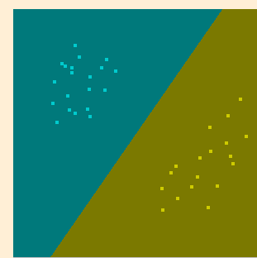
Lessons of the Voted Perceptron
VP shows that you can make few mistakes in incrementally learning as you pass over the data, if the examples x are small (bounded by R), some u exists that is small (unit norm) and has large margin.
Why not look for this u directly?
Support vector machines:
find u to minimize ||u||, subject to some fixed margin δ, or
find u to maximize δ, relative to a fixed bound on ||u||.
quadratic optimization methods

Slide 25
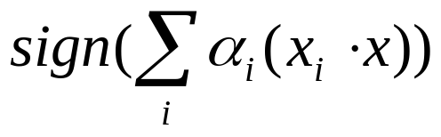
More on Support Vectors for Text
Facts about support vector machines:
  the “support vectors” are the x_{i}’s that touch the margin.
  the classifier sign(u.x) can be written
  where the x_{i}’s are the support vectors.
  the inner products x_{i}.x can be replaced with variant “kernel functions”
  support vector machines often give very good results on topical text classification.

Slide 26
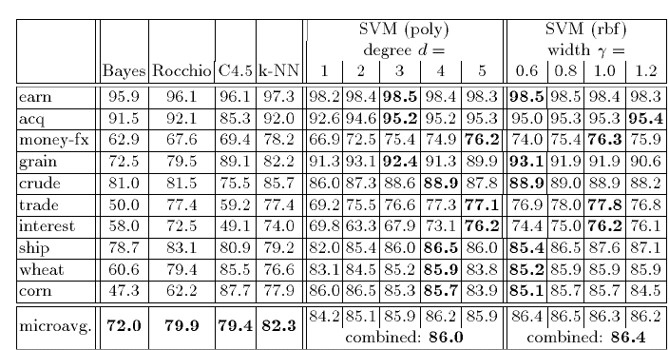
Support Vector Machine Results
[Joacchim ECML 1998]

Slide 27
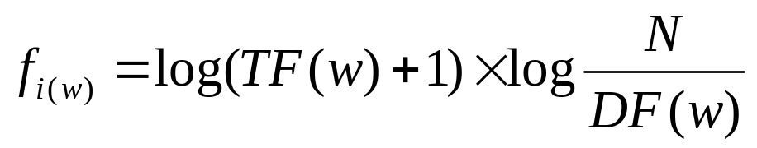
TF-IDF Representation
The results above use a particular way to represent documents: bag of words with TFIDF weighting
  “Bag of words”: a long sparse vector x=(,…,f_{i},….) where f_{i} is the “weight” of the i-th word in the vocabulary
  for word w that appears in DF(w) docs out of N in a collection, and appears TF(w) times in the doc being represented use weight:
  also normalize all vector lengths (||x||) to 1

Slide 28
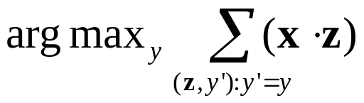
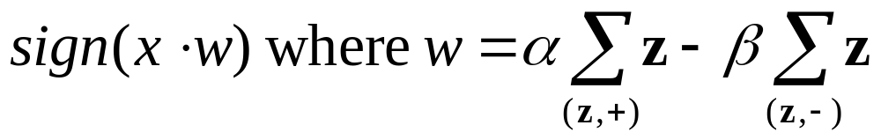
TF-IDF Representation
TF-IDF representation is an old trick from the information retrieval community, and often improves performance of other algorithms:
  Yang: extensive experiments with K-NN on TFIDF
    Given x find K closest neighbors (z₁,y₁) …, (z_{K},y_{K})
    Predict y:
    Implementation: use a TFIDF-based search engine to find neighbors
  Rocchio’s algorithm: classify using distance to centroids

Slide 29
Support Vector Machine Results
[Joacchim ECML 1998]

Slide 30
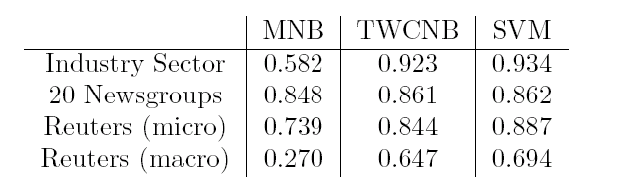
TF-IDF Representation
TF-IDF representation is an old trick from the information retrieval community, and often improves performance of other algorithms:
  Yang, CMU: extensive experiments with K-NN variants and linear least squares using TF-IDF representations
  Rocchio’s algorithm: classify using distance to centroid of documents from each class
  Rennie et al: Naive Bayes with TFIDF on “complement” of class
accuracy
breakeven

Slide 31
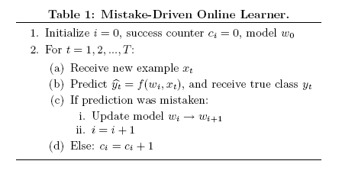
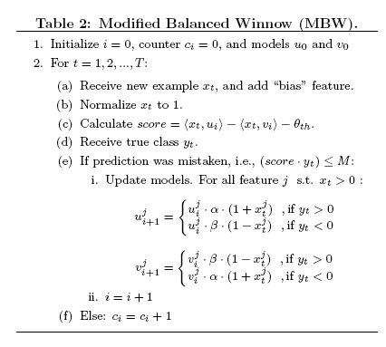
Other Fast Discriminative Methods
[Carvalho & Cohen, KDD 2006]
Perceptron (w/o voting) is an example; another is Winnow.
There are many other examples.
In practice they are usually not used on-line—instead one iterates over the data several times (epochs).
What if you limit yourself to one pass? (which is all that Naïve Bayes needs!)

Slide 32
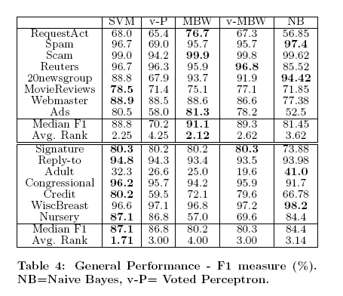
Other Fast Discriminative Methods
[Carvalho & Cohen, KDD 2006]
Sparse, high-dimensional TC problems
Dense, lower dimensional problems

Slide 33
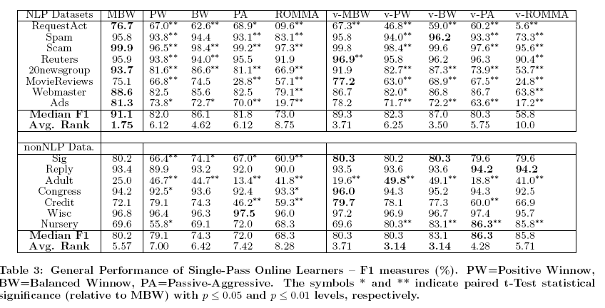
Other Fast Discriminative Methods
[Carvalho & Cohen, KDD 2006]

Slide 34
Outline
Part I: the basics
  What is text classification? Why do it?
  Representing text for classification
  A simple, fast generative method
  Some simple, fast discriminative methods
Part II: advanced topics
  Sentiment detection and subjectivity
  Collective classification
  Alternatives to bag-of-words

Slide 35
Text Classification: Examples
Classify news stories as World, US, Business, SciTech, Sports, Entertainment, Health, Other: topical classification, few classes
Classify email to tech staff as Mac, Windows, ..., Other: topical classification, few classes
Classify email as Spam, Other: topical classification, few classes
  Adversary may try to defeat your categorization scheme
Add MeSH terms to Medline abstracts
  e.g. “Conscious Sedation” [E03.250]
  topical classification, many classes
Classify web sites of companies by Standard Industrial Classification (SIC) code.
  topical classification, many classes
Classify business names by industry.
Classify student essays as A,B,C,D, or F.
Classify pdf files as ResearchPaper, Other
Classify documents as WrittenByReagan, GhostWritten
Classify movie reviews as Favorable,Unfavorable,Neutral.
Classify technical papers as Interesting, Uninteresting.
Classify jokes as Funny, NotFunny.

Slide 36
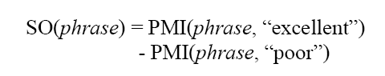
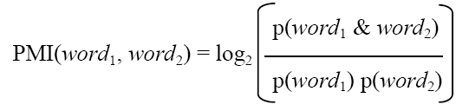
Classifying Reviews as Favorable or Not
[Turney, ACL 2002]
Dataset: 410 reviews from Epinions
  Autos, Banks, Movies, Travel Destinations
Learning method:
  Extract 2-word phrases containing an adverb or adjective (eg “unpredictable plot”)
  Classify reviews based on average Semantic Orientation (SO) of phrases found:
Computed using queries to web search engine

Slide 37
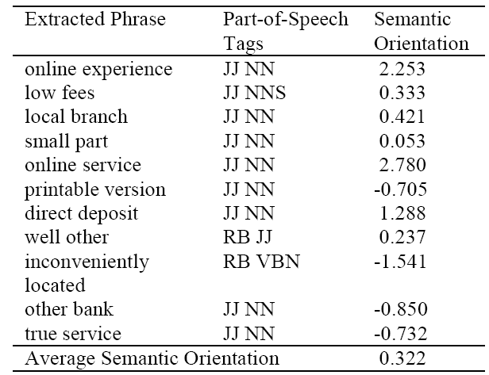
Classifying Reviews as Favorable or Not
[Turney, ACL 2002]

Slide 38
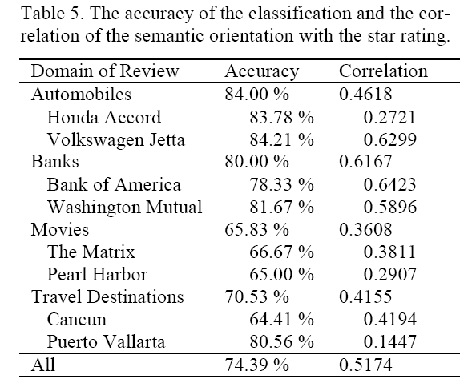
Classifying Reviews as Favorable or Not
[Turney, ACL 2002]
Guess majority class always: 59% accurate.

Slide 39
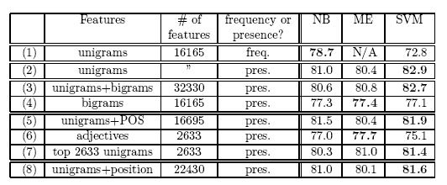
Classifying Movie Reviews
[Pang et al, EMNLP 2002]
700 movie reviews (ie all in same domain); Naïve Bayes, MaxEnt, and linear SVMs; accuracy with different representations x for a document
Interestingly, the off-the-shelf methods work well…perhaps better than Turney’s method.

Slide 40
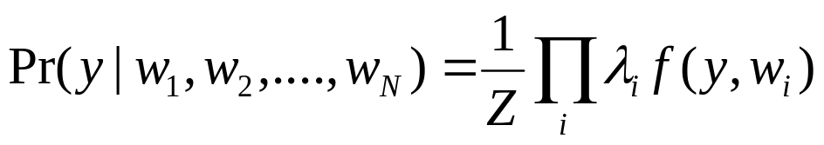
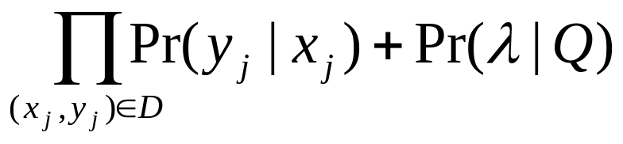
Classifying Movie Reviews
[Pang et al, EMNLP 2002]
MaxEnt classification:
Assume the classifier is same form as Naïve Bayes, which can be written:
Set weights (λ’s) to maximize probability of the training data:
prior on parameters

Slide 41
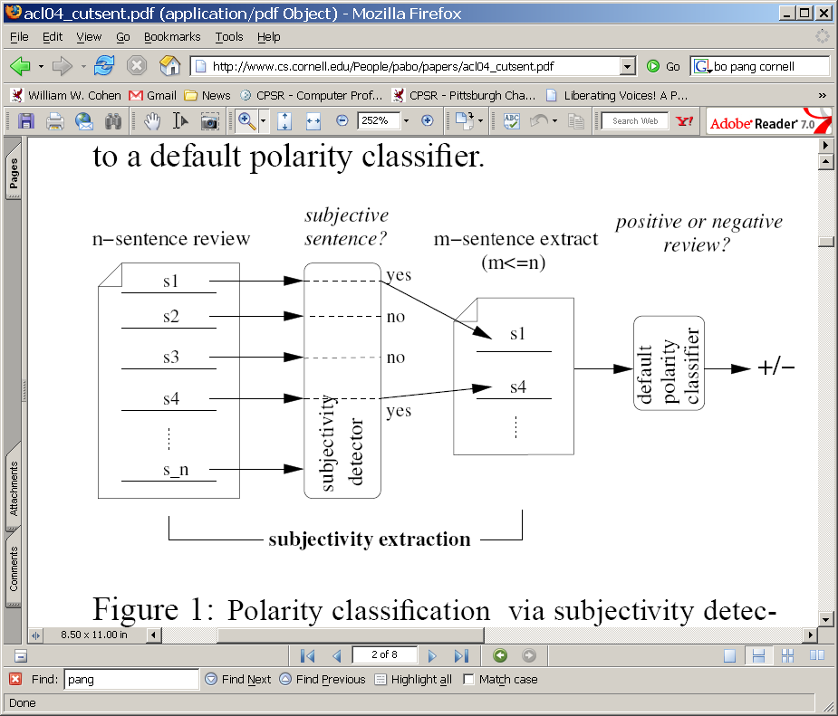
Classifying Movie Reviews
[Pang et al, ACL 2004]
Idea: like Turney, focus on “polar” sections: subjective sentences

Slide 42
Classifying Movie Reviews
[Pang et al, ACL 2004]
Idea: like Turney, focus on “polar” sections: subjective sentences
Dataset for subjectivity: Rotten Tomatoes (+), IMDB plot reviews (-)
Apply ML to build a sentence classifier
Try and force nearby sentences to have similar subjectivity

Slide 43
"Fearless" allegedly marks Li's last turn as a martial arts movie star--at 42, the ex-wushu champion-turned-actor is seeking a less strenuous on-camera life--and it's based on the life story of one of China's historical sports heroes, Huo Yuanjia. Huo, a genuine legend, lived from 1868-1910, and his exploits as a master of wushu (the general Chinese term for martial arts) raised national morale during the period when beleaguered China was derided as "The Sick Man of the East."
"Fearless" shows Huo's life story in highly fictionalized terms, though the movie's most dramatic sequence--at the final Shanghai tournament, where Huo takes on four international champs, one by one--is based on fact. It's a real old-fashioned movie epic, done in director Ronny Yu's ("The Bride with White Hair") usual flashy, Hong Kong-and-Hollywood style, laced with spectacular no-wires fights choreographed by that Bob Fosse of kung fu moves, Yuen Wo Ping ("Crouching Tiger" and "The Matrix"). Dramatically, it's on a simplistic level. But you can forgive any historical transgressions as long as the movie keeps roaring right along.

Slide 44
"Fearless" allegedly marks Li's last turn as a martial arts movie star--at 42, the ex-wushu champion-turned-actor is seeking a less strenuous on-camera life--and it's based on the life story of one of China's historical sports heroes, Huo Yuanjia. Huo, a genuine legend, lived from 1868-1910, and his exploits as a master of wushu (the general Chinese term for martial arts) raised national morale during the period when beleaguered China was derided as "The Sick Man of the East."
"Fearless" shows Huo's life story in highly fictionalized terms, though the movie's most dramatic sequence--at the final Shanghai tournament, where Huo takes on four international champs, one by one--is based on fact. It's a real old-fashioned movie epic, done in director Ronny Yu's ("The Bride with White Hair") usual flashy, Hong Kong-and-Hollywood style, laced with spectacular no-wires fights choreographed by that Bob Fosse of kung fu moves, Yuen Wo Ping ("Crouching Tiger" and "The Matrix"). Dramatically, it's on a simplistic level. But you can forgive any historical transgressions as long as the movie keeps roaring right along.

Slide 45
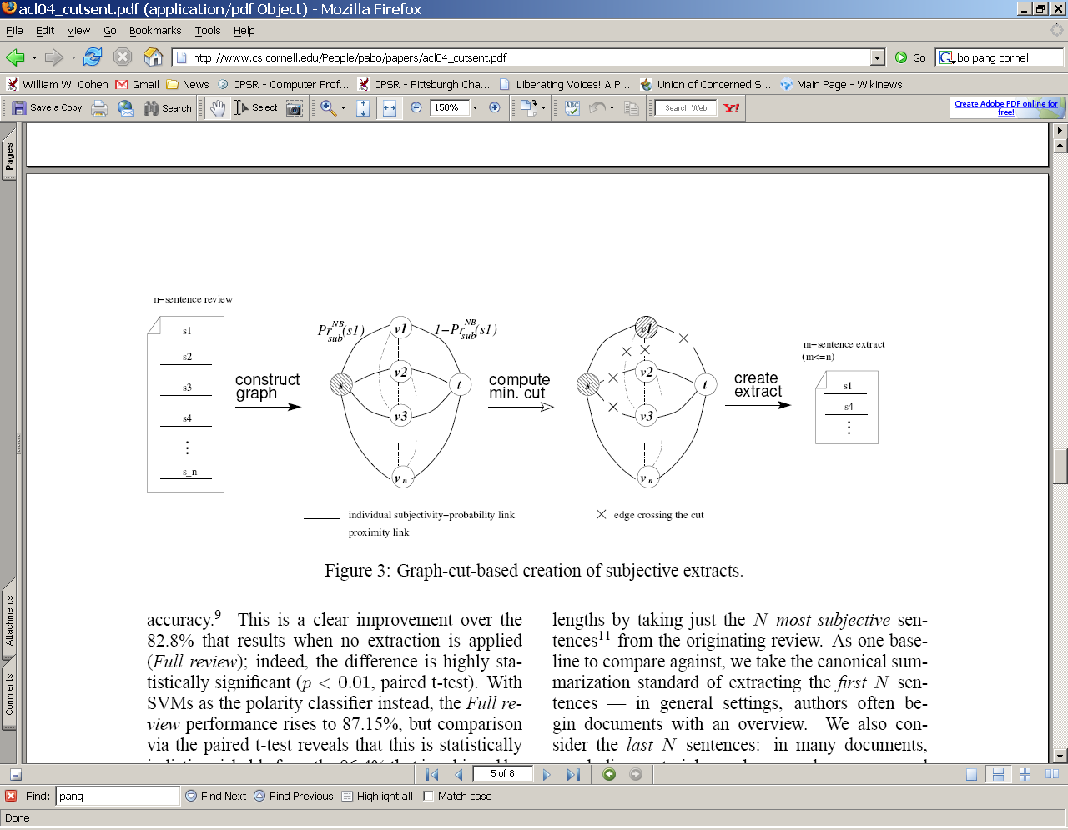
Classifying Movie Reviews
[Pang et al, ACL 2004]
Dataset: Rotten Tomatoes (+), IMDB plot reviews (-)
Apply ML to build a sentence classifier
Try and force nearby sentences to have similar subjectivity: use methods to find minimum cut on a constructed graph

Slide 46
Classifying Movie Reviews
“subjective”
Confidence in classifications
[Pang et al, ACL 2004]
“non subjective”
One vertex for
each sentence
Edges indicate proximity

Slide 47
Classifying Movie Reviews
Pick class + vs – for v1
[Pang et al, ACL 2004]
Pick class - vs + for v2, v3
Retained f(v2)=f(v3), but not f(v2)=f(v1)

Slide 48
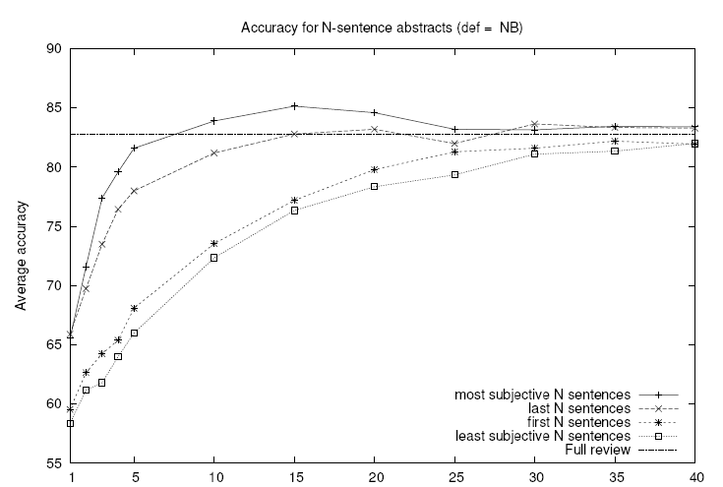
Classifying Movie Reviews
[Pang et al, ACL 2004]

Slide 49
Outline
Part I: the basics
  What is text classification? Why do it?
  Representing text for classification
  A simple, fast generative method
  Some simple, fast discriminative methods
Part II: advanced topics
  Sentiment detection and subjectivity
  Collective classification
  Alternatives to bag-of-words

Slide 50
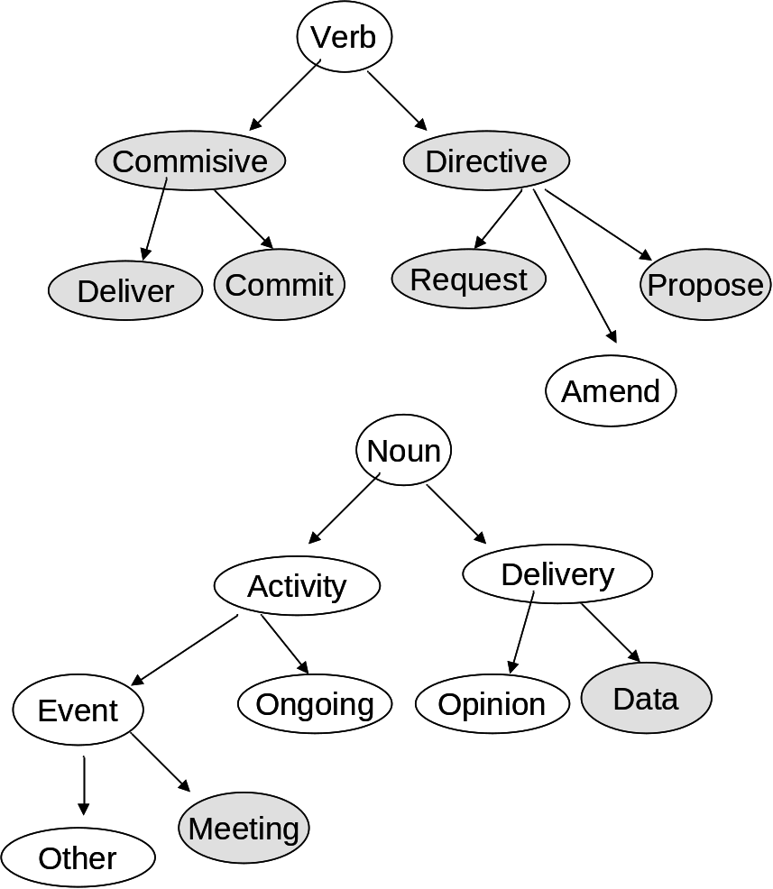
Classifying Email into Acts
From EMNLP-04, Learning to Classify Email into Speech Acts, Cohen-Carvalho-Mitchell
An Act is described as a verb-noun pair (e.g., propose meeting, request information) - Not all pairs make sense. One single email message may contain multiple acts.
Try to describe commonly observed behaviors, rather than all possible speech acts in English. Also include non-linguistic usage of email (e.g. delivery of files)
Verbs
Nouns

Slide 51

Idea: Predicting Acts from Surrounding Acts
Example of Email Sequence
Lots of information about the acts in a message by looking at the acts in the parent & child messages.
Delivery
Request
Request
Proposal
Delivery
Commit
Commit
Acts in parent/child messages do not tend to be the same as acts in message
  So, mincut is not appropriate technique.
Delivery
<<In-ReplyTo>>
Commit

Slide 52
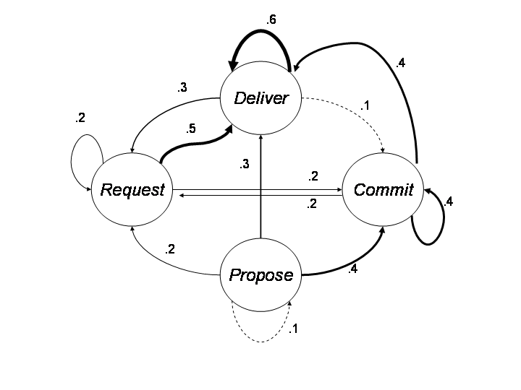
Evidence of Sequential Correlation of Acts
Transition diagram for most common verbs from CSPACE corpus (Kraut & Fussell)
Act sequence patterns: (Request, Deliver+), (Propose, Commit+, Deliver+), (Propose, Deliver+), most common act was Deliver

Slide 53
Data: CSPACE Corpus
Few large, free, natural email corpora are available
CSPACE corpus (Kraut & Fussell)
  Emails associated with a semester-long project for Carnegie Mellon MBA students in 1997
  15,000 messages from 277 students, divided in 50 teams (4 to 6 students/team)
  Rich in task negotiation.
  More than 1500 messages (from 4 teams) were labeled in terms of “Speech Act”.
  One of the teams was double labeled, and the inter-annotator agreement ranges from 72 to 83% (Kappa) for the most frequent acts.

Slide 54
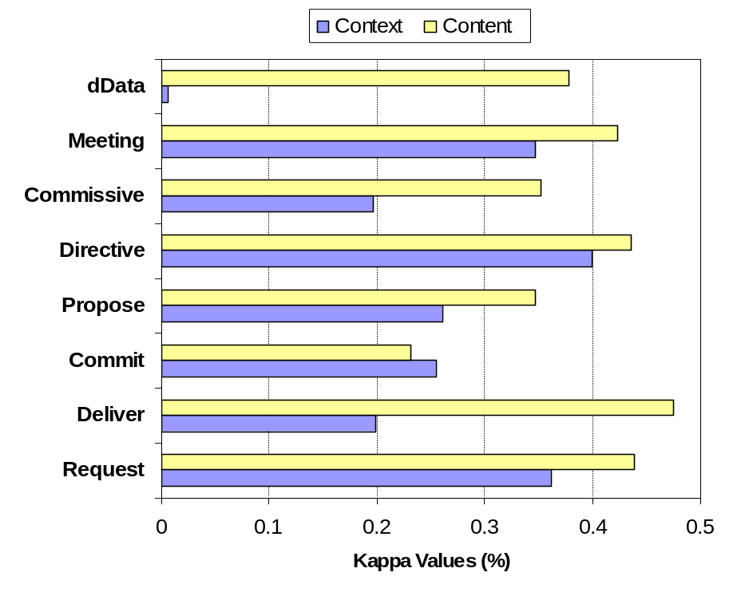
Content versus Context
Content: Bag of Words features only
Context: Parent and Child Features only ( table below)
8 MaxEnt classifiers, trained on 3F2 and tested on 1F3 team dataset
Only 1st child message was considered (vast majority – more than 95%)
Request
Request
???
Proposal
Delivery
Commit
Parent message
Child message
Parent Boolean Features |  | Child Boolean Features
Parent_Request, Parent_Deliver, Parent_Commit, Parent_Propose, Parent_Directive, Parent_Commissive Parent_Meeting, Parent_dData |  | Child_Request, Child_Deliver, Child_Commit, Child_Propose, Child_Directive, Child_Commissive, Child_Meeting, Child_dData
Kappa Values on 1F3 using Relational (Context) features and Textual (Content) features.
Set of Context Features (Relational)
Notes:
Tell me

Slide 55
Content versus Context
Content: Bag of Words features only
Context: Parent and Child Features only ( table below)
8 MaxEnt classifiers, trained on 3F2 and tested on 1F3 team dataset
Only 1st child message was considered (vast majority – more than 95%)
Request
Ok, that’s a nice experiment: but how can we use the parent/child features?
To classify x we need to classify parent(x) and firstChild(x)
To classify firstChild(x) we need to classify parent(firstChild(x))=x
Request
???
Proposal
Delivery
Commit
Parent message
Child message
Parent Boolean Features |  | Child Boolean Features
Parent_Request, Parent_Deliver, Parent_Commit, Parent_Propose, Parent_Directive, Parent_Commissive Parent_Meeting, Parent_dData |  | Child_Request, Child_Deliver, Child_Commit, Child_Propose, Child_Directive, Child_Commissive, Child_Meeting, Child_dData
Set of Context Features (Relational)
Notes:
Tell me

Slide 56
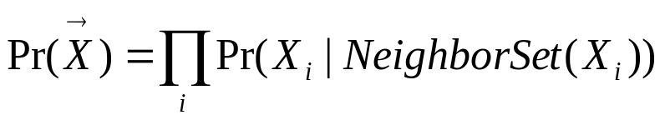
Collective Classification using Dependency Networks
Dependency networks are probabilistic graphical models in which the full joint distribution of the network is approximated with a set of conditional distributions that can be learned independently. The conditional probability distributions in a DN are calculated for each node given its neighboring nodes (its Markov blanket).
Delivery
Request
No acyclicity constraint. Simple parameter estimation – approximate inference (Gibbs sampling)
Closely related to pseudo-likelihood
In this case, NeighborSet(x) = Markov blanket = parent message and child message
Request
Proposal
Delivery
Commit
Delivery
Commit

Slide 57
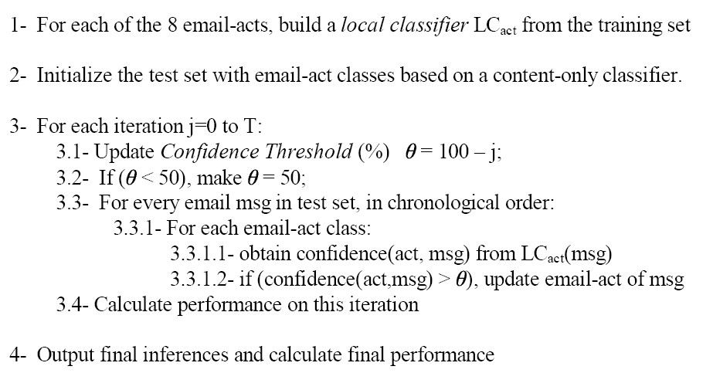
Collective Classification algorithm
(based on Dependency Networks Model)
Learn
Classify

Slide 58
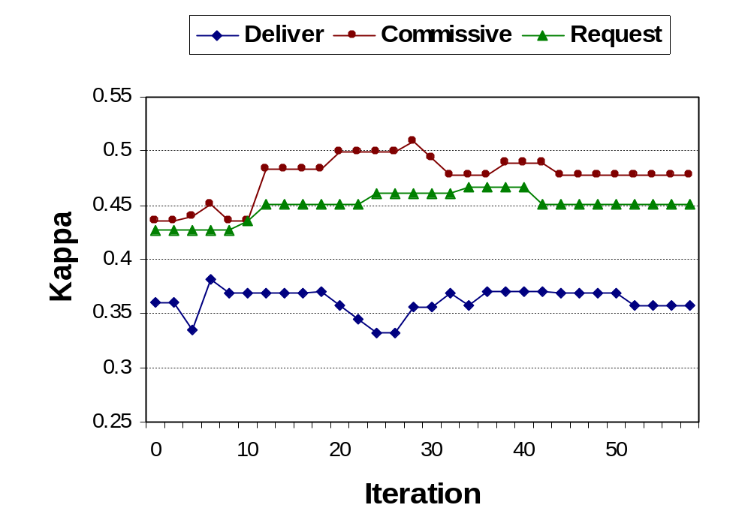
Agreement versus Iteration
Kappa versus iteration on 1F3 team dataset, using classifiers trained on 3F2 team data.

Slide 59
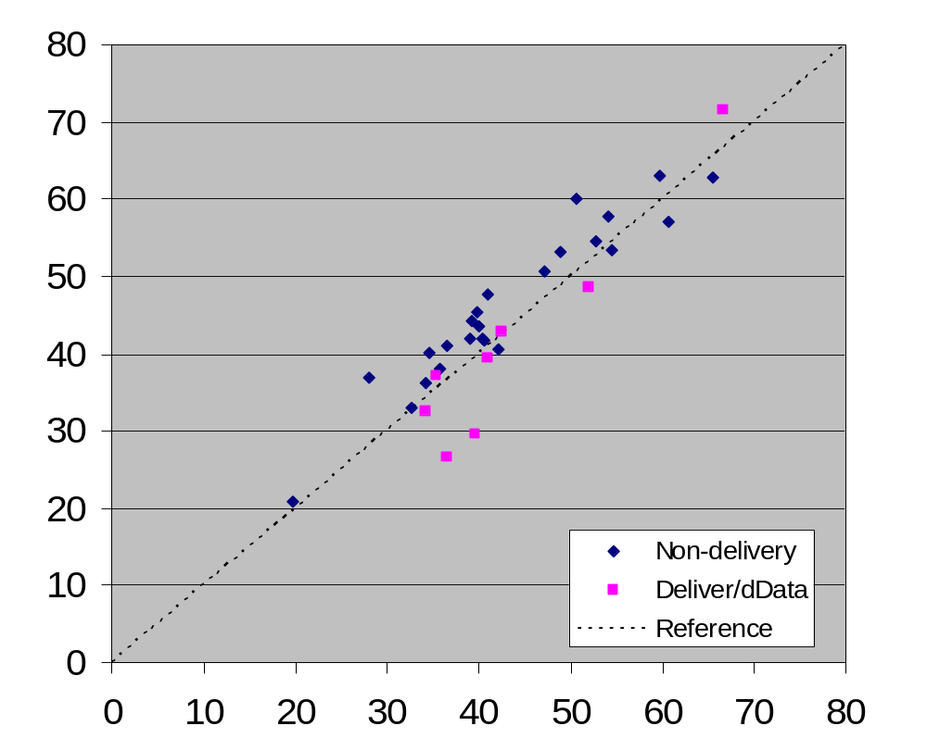
Leave-one-team-out Experiments
Deliver and dData performance usually decreases
Associated with data distribution, FYI, file sharing, etc.
For “non-delivery”, improvement in avg. Kappa is statistically significant (p=0.01 on a two-tailed T-test)
Kappa Values

Slide 60
Outline
Part I: the basics
  What is text classification? Why do it?
  Representing text for classification
  A simple, fast generative method
  Some simple, fast discriminative methods
Part II: advanced topics
  Sentiment detection and subjectivity
  Collective classification
  Alternatives to bag-of-words

Slide 61
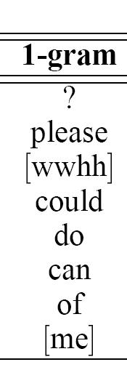
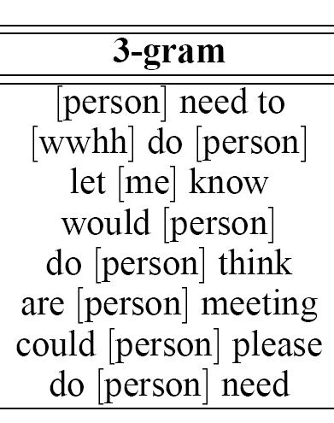
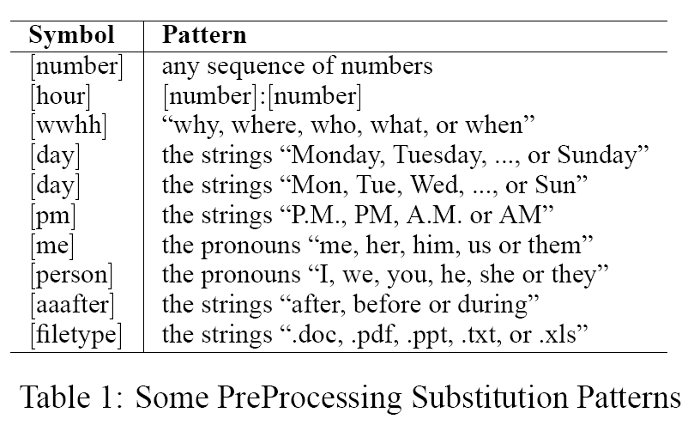
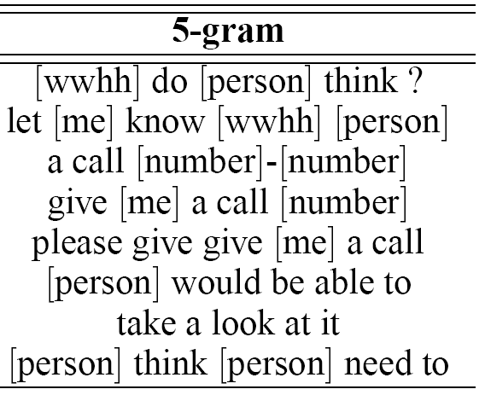
Text Representation for Email Acts
[Carvalho & Cohen, TextActs WS 2006]
Document → Preprocess → Word n-grams → Feature Selection

Slide 62
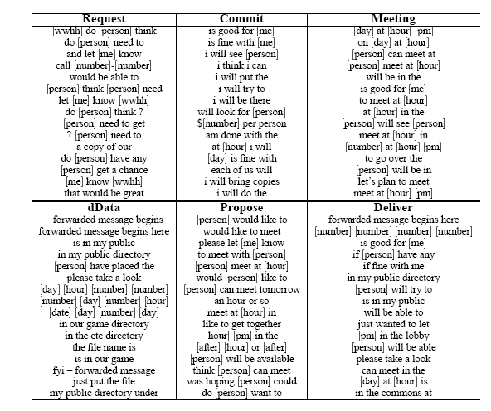

Slide 63
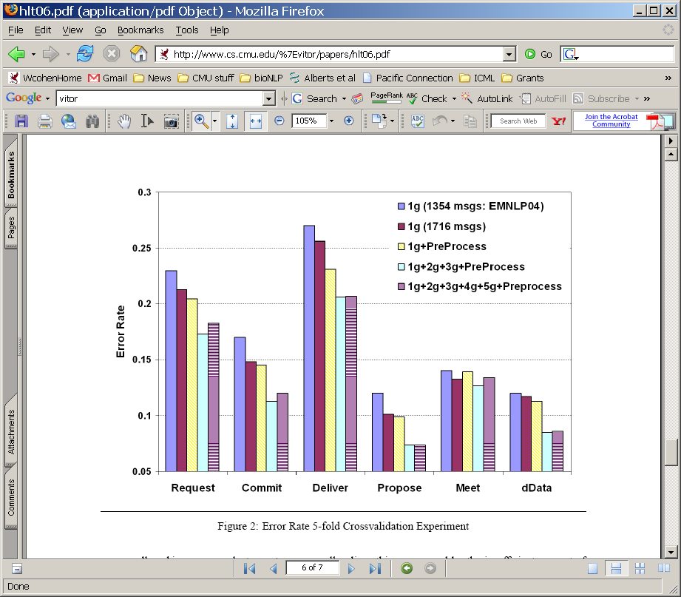
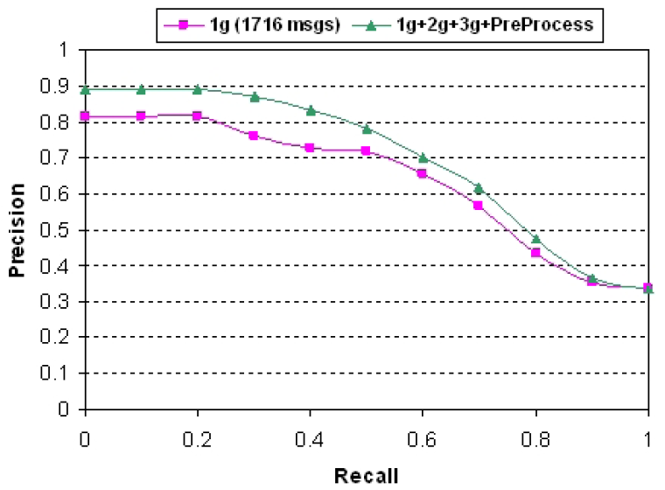
Results
Compare to Pang et al for movie reviews. Do n-grams help or not?

Slide 64
Outline
Part I: the basics
  What is text classification? Why do it?
  Representing text for classification
  A simple, fast generative method
  Some simple, fast discriminative methods
Part II: advanced topics
  Sentiment detection and subjectivity
  Collective classification
  Alternatives to bag-of-words
Part III: summary/conclusions

Slide 65
Summary & Conclusions
There are many, many applications of text classification
Topical classification is fairly well understood
  Most of the information is in individual words
  Very fast and simple methods work well
In many applications, classes are not topics
  Sentiment detection/polarity
  Subjectivity/opinion detection
  Detection of user intent (e.g., speech acts)
In many applications, distinct classification decisions are interdependent
  Reviews: Subjectivity of nearby sentences
  Email: Intent of parent/child messages in a thread
  Web: Topics of web pages linked to/from a page
  Biomedical text: Topics of papers that cite/are cited by a paper
Lots of prior work to build on, lots of prior experimentation to consider
Don’t be afraid of topic classification problems
  Reliably labeled data can be hard to find in some domains
For non-topic TC, you may need to explore different document representations and/or different learning methods.
  We don’t know the answers here
Consider “collective classification” methods when there are strong dependencies.

