Slide 1


Lesson 1
Coordinates, Colours, and Shapes
csinschools.com

Slide 2


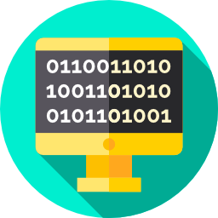
Learning objectives
By the end of this lesson, you should be able to:
understand what graphical programming is
sketch shapes using PyAngelo and its associated coordinate system
use the coordinate system in our graphical environment to draw shapes using code
practice representing colours in RGB format
2

Slide 3

What is Graphical Programming?
As a class, discuss “What is Graphical Programming?”
3

Slide 4
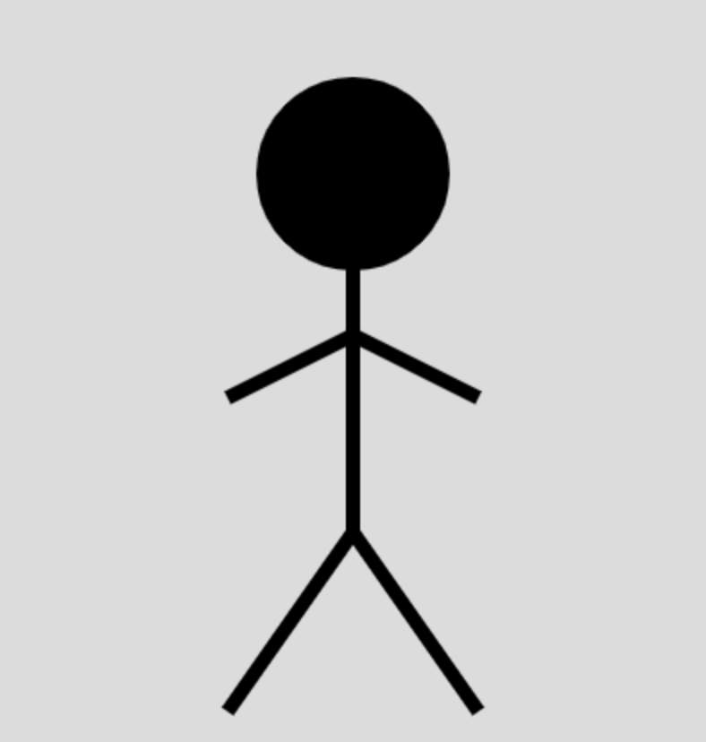
What is Graphical Programming?
A graphic is anything to do with visual art, including:
Paintings
Graphics Interchange Format (GIFs)
Drawings
Graphs
Programming is the act of writing computer programs, typically using code
4

Slide 5
What is Graphical Programming?
Combining graphics and programming, we get graphical programming!
An example of graphical programming is this stick figure (on the right!)
This stick figure was drawn using Python code, using a module called PyAngelo
5

Slide 6
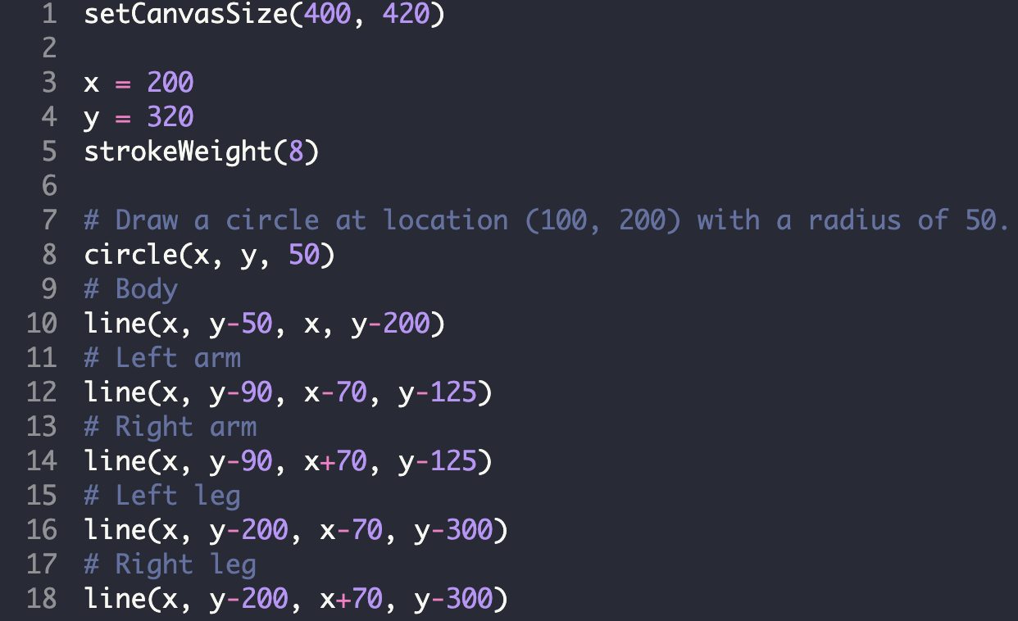
What is Graphical Programming?
You’ll learn how to use PyAngelo throughout this course!
See the code for this stick figure below:
6

Slide 7
What is Graphical Programming?
As a class, discuss “What could you create with graphical programming?”
7

Slide 8
What is Graphical Programming?
What could you create with graphical programming?
Animations (including films and tv shows!)
Video games
Pictures
Digital sketches
Schematics for buildings
Graphs
8

Slide 9
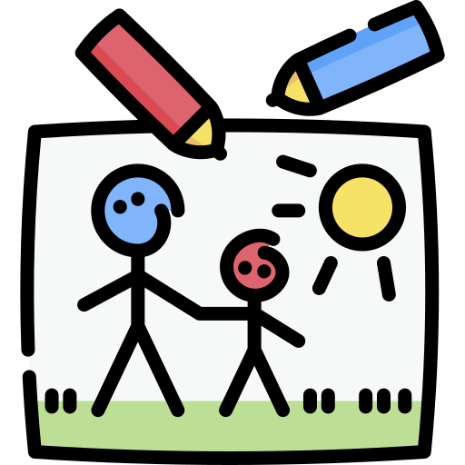


What is Graphical Programming?
Choose one of the programs below and explore what graphical programming is all about!
Sketch
Game
Animation
9

Slide 10

Why Graphical Programming?
PyAngelo is interactive and fun!
It teaches more Python fundamentals
PyAngelo can be done 100% online
You’ll become a better coder!
10

Slide 11
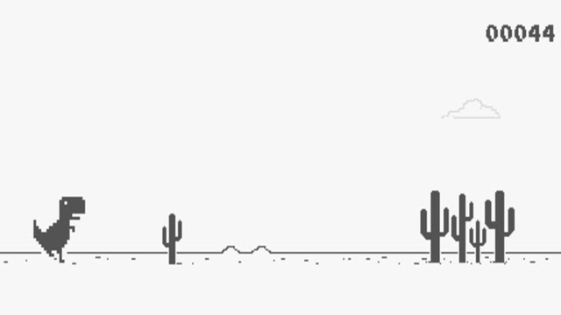
Getting started with PyAngelo…
Before we can create some amazing artwork, games, and animations using PyAngelo, we need to learn some basics
These basics include:
Functions
Coordinate system
Colours
11

Slide 12
Functions
12

Slide 13
Functions
In programming, functions allow coders to condense a lot of code into one line
For example, if you want someone to bake you a cake, you could tell them every single step:
1. Preheat the oven to 180 degrees
2. Crack 2 eggs in a bowl and whisk them
3. Add in 3 cups of flour…
However, this would be much simpler if we just said “bake me a mud cake” and our chef followed their own recipe - this is like a function!
13

Slide 14

Functions
Preheat oven to 180 deg
Crack 2 eggs in a bowl and whisk them
Add 3 cups of flour
Add 50g butter
Add 100g cocoa powder
…
Bake a mud cake
14

Slide 15
Functions
Preheat oven to 180 deg
Crack 2 eggs in a bowl and whisk them
Add 3 cups of flour
Add 50g butter
Add 100g cocoa powder
…
Bake a mud cake
Both of these instructions make a cake, but one is much easier for us to say!
15

Slide 16

Functions
Functions make it much easier for us to communicate with computers. PyAngelo has many functions that make it easier for us to draw shape, some examples include:
circle() | line() | rect()
These functions (and many more) can be found here
16

Slide 17
Functions
bakeCake(‘mud’, 180, 20)
17

Slide 18
Functions
bakeCake(‘mud’, 180, 20)
This is our function name.
18

Slide 19
Functions
bakeCake(‘mud’, 180, 20)
This is our function name.
These are our parameters.
19

Slide 20
Functions
bakeCake(‘mud’, 180, 20)
This is our function name.
These are our parameters.
In this example, ‘mud’ is the type of cake, 180 is the temperature of the oven, 20 is the time to cook the cake for, and the function does the rest of the magic!
20

Slide 21
Activity 01.01 - Functions
Run the following program and try changing some of the numbers, also known as parameters. Also, try adding some new functions from here.
Activity: 01.01 - Functions
21

Slide 22
Exploring the Code
22

Slide 23
Exploring the Code
CODE:
setCanvasSize(640, 360)
background(255, 255, 0)
fill(255, 165, 0)
rect(160, 80, 320, 200)
23

Slide 24
Exploring the Code
CODE:
Here the setCanvasSize() function is called
The canvas is where we construct our graphic
setCanvasSize(640, 360)
background(255, 255, 0)
fill(255, 165, 0)
rect(160, 80, 320, 200)
24

Slide 25
Exploring the Code
CODE:
Here the setCanvasSize() function is called
The canvas is where we construct our graphic
The numbers inside the brackets define the size of the canvas
The numbers represent pixels, so the canvas in this case will be 640 pixels wide and 360 pixels high
setCanvasSize(640, 360)
background(255, 255, 0)
fill(255, 165, 0)
rect(160, 80, 320, 200)
25

Slide 26
Exploring the Code
CODE:
Pixels are tiny little lights in digital screens
They are responsible for all images you see on your TV, laptop, and phone
They are made up of Red, Green, and Blue lights
We can create graphics by defining what pixels we want to light up, and the colour we want them to be
setCanvasSize(640, 360)
background(255, 255, 0)
fill(255, 165, 0)
rect(160, 80, 320, 200)
26

Slide 27

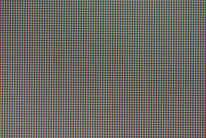

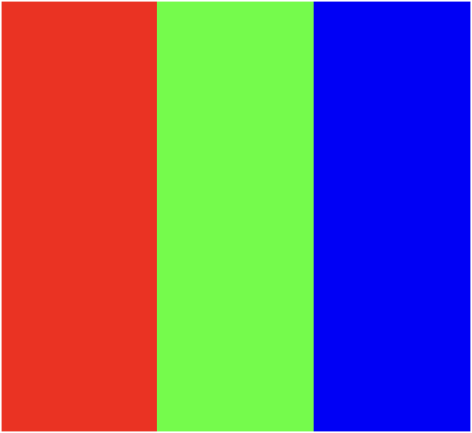
Pixels
27

Slide 28
Exploring the Code
CODE:
The canvas created by this line of code is shown below
setCanvasSize(640, 360)
background(255, 255, 0)
fill(255, 165, 0)
rect(160, 80, 320, 200)
OUTPUT:
640
360
28

Slide 29
Exploring the Code
CODE:
Now the background() function is called
This will change the colour of the canvas
setCanvasSize(640, 360)
background(255, 255, 0)
fill(255, 165, 0)
rect(160, 80, 320, 200)
OUTPUT:
640
360
29

Slide 30
Exploring the Code
CODE:
Now the background() function is called
This will change the colour of the canvas
setCanvasSize(640, 360)
background(255, 255, 0)
fill(255, 165, 0)
rect(160, 80, 320, 200)
OUTPUT:
640
360
30

Slide 31

Exploring the Code
CODE:
Now the background() function is called
This will change the colour of the canvas
setCanvasSize(640, 360)
background(255, 255, 0)
fill(255, 165, 0)
rect(160, 80, 320, 200)
OUTPUT:
640
We will learn how to choose colours in a moment!
360
31

Slide 32
Exploring the Code
CODE:
Now the fill() function is called
It sets the colour for the shapes we will draw next
setCanvasSize(640, 360)
background(255, 255, 0)
fill(255, 165, 0)
rect(160, 80, 320, 200)
OUTPUT:
640
360
32

Slide 33
Exploring the Code
CODE:
Now the fill() function is called
This is like picking up a coloured pencil (in this case, orange)
setCanvasSize(640, 360)
background(255, 255, 0)
fill(255, 165, 0)
rect(160, 80, 320, 200)
OUTPUT:
640
360
33

Slide 34

Exploring the Code
CODE:
Now the fill() function is called
This is like picking up a coloured pencil (in this case, orange)
setCanvasSize(640, 360)
background(255, 255, 0)
fill(255, 165, 0)
rect(160, 80, 320, 200)
OUTPUT:
640
360
34

Slide 35
Exploring the Code
CODE:
Now the rect() function is called
setCanvasSize(640, 360)
background(255, 255, 0)
fill(255, 165, 0)
rect(160, 80, 320, 200)
OUTPUT:
640
360
35

Slide 36

Exploring the Code
CODE:
Now the rect() function is called
These numbers define where the bottom left corner of the rectangle will start
setCanvasSize(640, 360)
background(255, 255, 0)
fill(255, 165, 0)
rect(160, 80, 320, 200)
OUTPUT:
640
360
36

Slide 37
Exploring the Code
CODE:
Now the rect() function is called
These numbers define the width and height of the rectangle
setCanvasSize(640, 360)
background(255, 255, 0)
fill(255, 165, 0)
rect(160, 80, 320, 200)
OUTPUT:
640
320
360
200
37

Slide 38
Exploring the Code
CODE:
Now the rect() function is called
These numbers define the width and height of the rectangle
setCanvasSize(640, 360)
background(255, 255, 0)
fill(255, 165, 0)
rect(160, 80, 320, 200)
OUTPUT:
640
320
360
200
We will learn how to use coordinates in a moment!
38

Slide 39
Exploring the Code
CODE:
The finished product from the code we just ran is below!
setCanvasSize(640, 360)
background(255, 255, 0)
fill(255, 165, 0)
rect(160, 80, 320, 200)
OUTPUT:
39

Slide 40
Colours
40

Slide 41
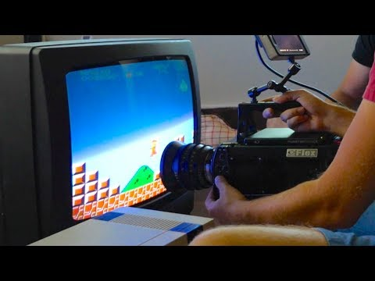
41
Notes:
Play from 06:28 to 8:28

Slide 42
Colours and RGB
As we just saw, each pixel is made up of 3 small lights (called subpixels)
We can control the colour of a pixel by adjusting the amount of light coming from each subpixel
We do this using 3 numbers, called RGB components
42

Slide 43
Colours and RGB
To fully turn on a subpixel, we use the value 255
To fully turn off a subpixel, we use the value 0
Any number in between will partially turn on the subpixel
43

Slide 44
RGB - Red, Green Blue
255 |  | 255 |  | 255
0 |  | 0 |  | 0
 | R |  | G |  | B
Here, each subpixel has a value of 0, hence, they are all off and the screen is black!
44

Slide 45
RGB - Red, Green Blue
255 |  | 255 |  | 255
0 |  | 0 |  | 0
 | R |  | G |  | B
Red is full, Green and Blue are empty
R = 255
G = 0
B = 0
45

Slide 46
RGB - Red, Green Blue
255 |  | 255 |  | 255
0 |  | 0 |  | 0
 | R |  | G |  | B
Green is full, Red and Blue are empty
R = 0
G = 255
B = 0
46

Slide 47
RGB - Red, Green Blue
255 |  | 255 |  | 255
0 |  | 0 |  | 0
 | R |  | G |  | B
Blue is full, Red and Green are empty
R = 0
G = 0
B = 255
47

Slide 48
RGB - Red, Green Blue
255 |  | 255 |  | 255
0 |  | 0 |  | 0
 | R |  | G |  | B
R = 255
G = 255
B = 0
Screen Colour: Yellow
48

Slide 49
RGB - Red, Green Blue
255 |  | 255 |  | 255
0 |  | 0 |  | 0
 | R |  | G |  | B
R = 255
G = 255
B = 255
Screen Colour:
White
49

Slide 50
RGB - Red, Green Blue
255 |  | 255 |  | 255
0 |  | 0 |  | 0
 | R |  | G |  | B
R = 0
G = 0
B = 0
Screen Colour:
Black
50

Slide 51
RGB - Red, Green Blue
255 |  | 255 |  | 255
0 |  | 0 |  | 0
 | R |  | G |  | B
R = 255
G = 0
B = 255
Screen Colour: Magenta
51

Slide 52
Mixing our own colours
255 |  | 255 |  | 255
0 |  | 0 |  | 0
 | R |  | G |  | B
R = 181
G = 40
B = 101
Screen Colour: Plum
181
101
40
52

Slide 53
RGB - Equal Values
If the R, G, and B values are equal, you will get a shade of grey.
The closer to 0 the numbers, the darker the shade, the closer to 255, the lighter the shade.
255 |  | 255 |  | 255
0 |  | 0 |  | 0
 | R |  | G |  | B
164
164
164
53

Slide 54
Exploring the Code
The numbers we just saw replace the R, G and B in the function highlighted
You can choose a colour by varying the numbers between 0 and 255
setCanvasSize(640, 360)
background(R, G, B)
fill(255, 165, 0)
rect(160, 80, 320, 200)
54

Slide 55
Exploring the Code
The numbers we just saw replace the R, G and B in the function highlighted
You can choose a colour by varying the numbers between 0 and 255
setCanvasSize(640, 360)
background(255, 255, 0)
fill(255, 165, 0)
rect(160, 80, 320, 200)
55

Slide 56
Exploring the Code
The numbers we just saw replace the R, G and B in the function highlighted
You can choose a colour by varying the numbers between 0 and 255
setCanvasSize(640, 360)
background(115, 200, 80)
fill(255, 165, 0)
rect(160, 80, 320, 200)
56

Slide 57
Exploring the Code
The numbers we just saw replace the R, G and B in the function highlighted
You can choose a colour by varying the numbers between 0 and 255
setCanvasSize(640, 360)
background(210, 100, 86)
fill(255, 165, 0)
rect(160, 80, 320, 200)
57

Slide 58

Activity 01.02 - Colour me in!
Follow the instructions in the comments of the code to colour in the hidden picture!
Activity: 01.02 - Colour me in!
58

Slide 59
Coordinate Systems
59

Slide 60
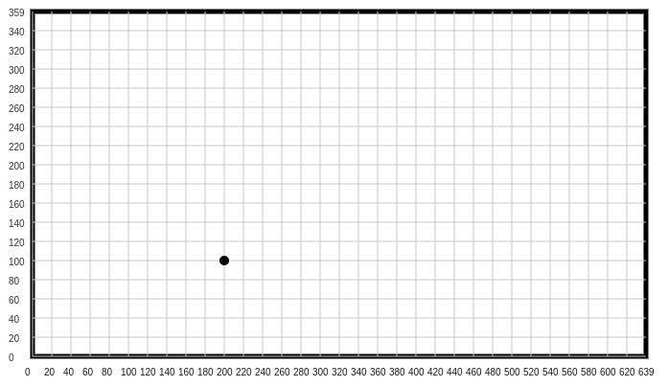
Coordinate Systems
Can you tell me where this point is?
60

Slide 61
Coordinate Systems
Can you tell me where this point is?
Bottom left?
Near the middle, kinda…
Closer to the left than the right, but near the middle too
61

Slide 62
Coordinate Systems
Can you tell me where this point is?
Bottom left?
Near the middle, kinda…
Closer to the left than the right, but near the middle too
This is definitely not accurate enough for a computer!
62

Slide 63
Coordinate Systems
If we used the setCanvasSize() function to draw this, it would have the parameters 640 and 360
640 is the width
360 is the height
setCanvasSize(640,360)
63

Slide 64

Coordinate Systems
If we used the setCanvasSize() function to draw this, it would have the parameters 640 and 360
640 is the width
360 is the height
setCanvasSize(640,360)
The width numbers go from 0 → 639, not 1 → 640! Height works in a similar way
64

Slide 65
Coordinate Systems
If we used the setCanvasSize() function to draw this, it would have the parameters 640 and 360
640 is the width
360 is the height
setCanvasSize(640,360)
65

Slide 66
Coordinate Systems
If we used the setCanvasSize() function to draw this, it would have the parameters 640 and 360
640 is the width
360 is the height
setCanvasSize(640,360)
66

Slide 67
Coordinate Systems
Now, can you tell me where this point is?
(200, 100)
200 is the distance along the x axis (in pixels)
100 is the distance along the y axis (in pixels)
67

Slide 68
Coordinate Systems
Now, can you tell me where this point is?
(200, 100)
200 is the distance along the x axis (in pixels)
100 is the distance along the y axis (in pixels)
200
100
68

Slide 69
Coordinate Systems
Now, can you tell me where this point is?
(420, 300)
420 is the distance along the x axis (in pixels)
300 is the distance along the y axis (in pixels)
69

Slide 70
Coordinate Systems
Now, can you tell me where this point is?
(420, 300)
420 is the distance along the x axis (in pixels)
300 is the distance along the y axis (in pixels)
70

Slide 71
Coordinate System
This coordinate system means:
As you move right, x increases
As you move left, x decreases
As you move to up, y increases
As you move down, y decreases
71

Slide 72
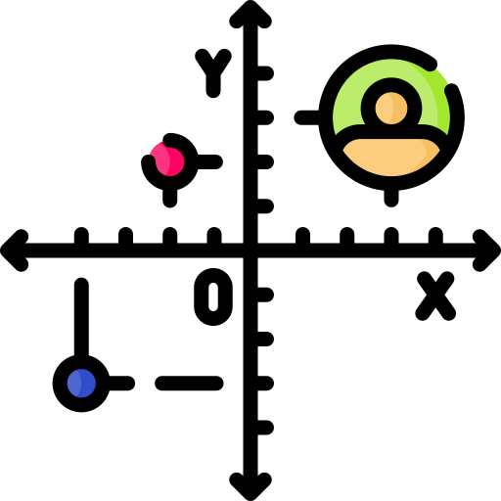
Activity 01.03 - Coordinates
Click on the activity below to see a program that draws an object in PyAngelo.
Activity: 01.03 - Coordinates
72

Slide 73
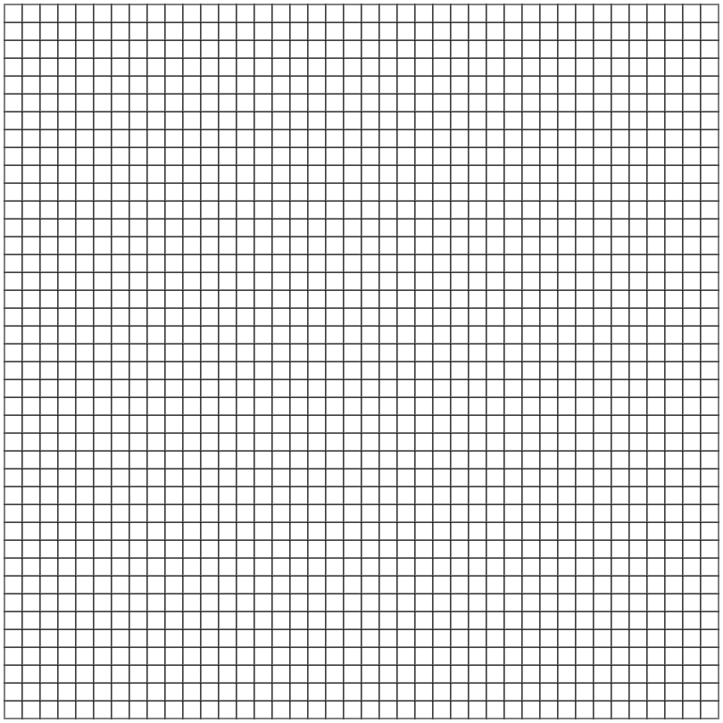
400
350
300
250
200
150
100
50
0
50
100
150
200
250
300
350
400
73

Slide 74
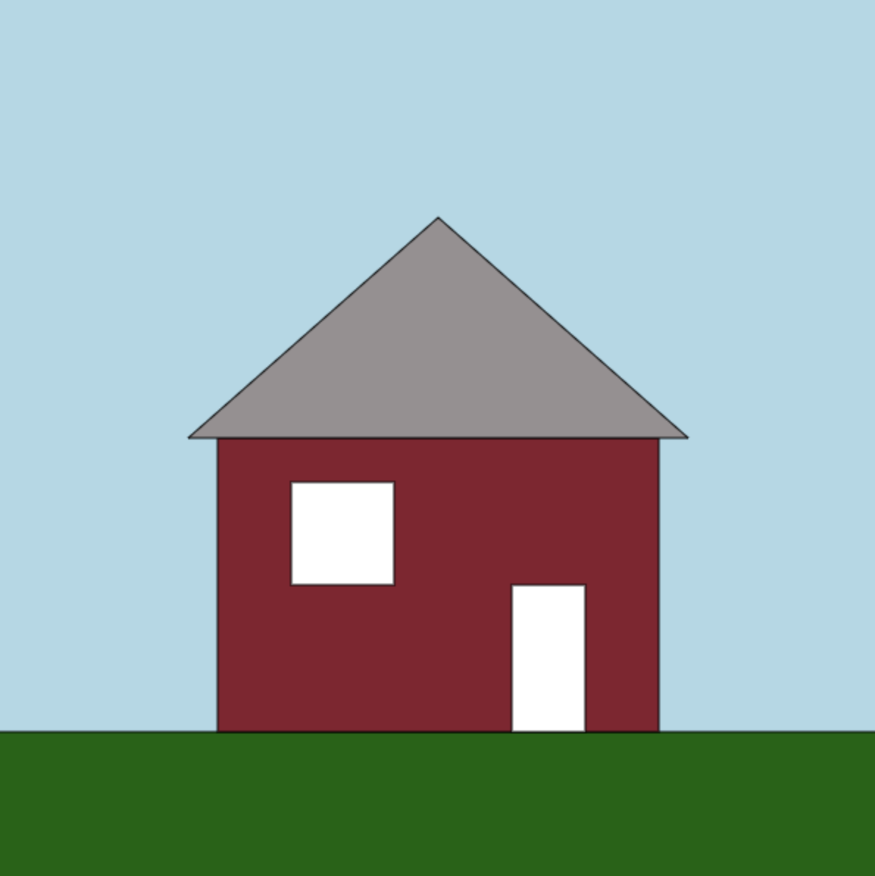
Code your house
To code up the house we just drew using coordinates, you’ll need some functions
Let’s take a look at:
rect()
triangle()
74

Slide 75
rect()
rect(10, 20, 50, 25)
Draw a rectangle at location (10, 20) with a width of 50 pixels and height of 25 pixels
NOTE: (10, 20) is the bottom left corner of the rectangle
75

Slide 76
triangle()
triangle(50, 75, 25, 100, 75, 100)
Draw a triangle by connecting the three points (50, 75), (25, 100), and (75, 100)
76

Slide 77
Activity 1.04 - Code Your House
Using the functions you have just learnt, and your worksheet from before, you should now code up your house.
Activity: 01.04 - Code Your House
77

Slide 78
Other Functions in PyAngelo
78

Slide 79
Drawing Shapes and Adding Text
So far we have only used a function for rectangles, and a function for triangles
Other functions that exist include:
circle()
ellipse()
line()
text()
79

Slide 80
circle()
circle(100, 200, 50)
Draw a circle at location (100, 200) with a radius of 50
NOTE: (100, 200) is the center of the circle
this is different from the rect() function
80

Slide 81
ellipse()
ellipse(100, 200, 100, 50)
Draw an ellipse at location (100, 200) with an X radius of 50 and a Y radius of 100
NOTE: (100, 200) is the center of the ellipse
this is just like the circle() function
81

Slide 82
line()
line(40, 20, 60, 40)
Draw a line starting at (40, 20) and finishing at (60, 40)
82

Slide 83
text()
text("I love to code!", 20, 30, 50, "Arial")
Draws the text “I love to code!” at the point (20, 30) with a font size of 50 pixels and a font of “Arial”
NOTE: (20, 30) is the bottom left corner of the text
I love to code!
83

Slide 84

Activity 1.05 - Free Sketch!
Using the extra functions, experiment with drawing in PyAngelo! Maybe you could draw your favourite animal or hobby?
Activity: 01.05 - Free Sketch
84

Slide 85
Summary
Graphical programming is an interactive way to learn how to code
Functions are a great way of condensing a lot of code into one line
Colours can be set using RGB components
The coordinate system we use let’s us accurately describe where we want to draw
When specifying a coordinate, the x value is listed first and the y value second
You can draw basic shapes using the rect(), triangle(), circle(), ellipse(), line(), and text() functions
85

Slide 86
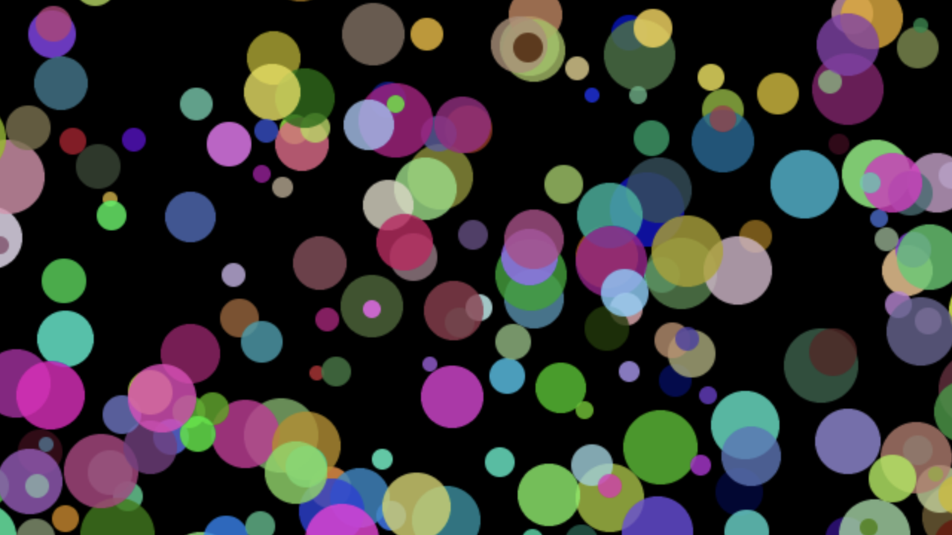
Extension: Screen Saver
Your task is to draw circles in an infinite loop. Each circle should be in a random position, with a random colour, and have a random size!
86

Slide 87
License Information
These CS in Schools lessons plans, worksheets, and other materials were created by the CS in Schools Team. They are licensed under a Creative Commons Attribution-ShareAlike 4.0 International License.
87

