Slide 1


Lesson 3
Functions
csinschools.com

Slide 2



Previously, on CS in Schools...
What is the difference between a variable and a data type?
2
Notes:
Answer: A variable is a named location in memory that stores a value. A data type lets the computer know what type of data is stored in the variable.

Slide 3
Previously, on CS in Schools...
What are the data types of the built in variables mouseX and mouseY?
3
Notes:
Answer: int

Slide 4
Learning objectives
By the end of this lesson, you should be able to:
understand what a function is
create your own function
use your own function
4

Slide 5

03.01d - Circle, Circle, Dot, Dot
Can you modify the program to draw 10 circles across the screen?
Demo: 03.01d - Circle, Circle, Dot, Dot
5

Slide 6

What are functions?
As a class, discuss "What are functions?"

Slide 7
What are functions?
A function is a single instruction that tells the computer to do something
Functions also allow coders to condense a lot of code into one line
7

Slide 8

What are functions?
A function is a single instruction that tells the computer to do something
Functions also allow coders to condense a lot of code into one line
For example, if you want someone to bake you a cake, you could tell them every single step:
1. Preheat the oven to 180 degrees
2. Crack 2 eggs in a bowl and whisk them
3. Add in 3 cups of flour…
However, this would be much simpler if we just said "bake me a mud cake" and our chef followed their own recipe - this is like a function!
8

Slide 9
What are functions?
Preheat oven to 180 deg
Crack 2 eggs in a bowl and whisk them
Add 3 cups of flour
Add 50g butter
Add 100g cocoa powder
…
Bake a mud cake
Both of these instructions leads to a cake, but one is much faster and easier for us to say!

Slide 10
What are functions?
A function we have used already in PyAngelo is the rect(...) function
When we call rect(...), it draws a rectangle on the canvas
Let’s take a look at the rect(...) function in detail…
10

Slide 11
What are functions?
line(10, 30, 10, 70)
line(10, 70, 90, 70)
line(90, 70, 90, 30)
line(90, 30, 10, 30)
rect(10, 30, 80, 40)

Slide 12
What are functions?
line(10, 30, 10, 70)
line(10, 70, 90, 70)
line(90, 70, 90, 30)
line(90, 30, 10, 30)
rect(10, 30, 80, 40)
(10, 70)
(90, 70)
40
(10, 30)
(90, 30)
(10, 30)
80

Slide 13
What are functions?
line(10, 30, 10, 70)
line(10, 70, 90, 70)
line(90, 70, 90, 30)
line(90, 30, 10, 30)
rect(10, 30, 80, 40)
Notice that both of these programs draw the same thing - but rect() is much simpler!
(10, 70)
(90, 70)
40
(10, 30)
(90, 30)
(10, 30)
80

Slide 14
What are functions?
We think of functions as a black box
A black box means we don't know what is inside, but we know what comes out if we put certain things in!
rect()
14

Slide 15
What are functions?
We think of functions as a black box
A black box means we don't know what is inside, but we know what comes out if we put certain things in!
rect()
(10, 30, 80, 40)
15

Slide 16
What are functions?
We think of functions as a black box
A black box means we don't know what is inside, but we know what comes out if we put certain things in!
rect()
16

Slide 17
What are functions?
What we put into a function are called arguments
In some cases, arguments are optional
For many functions, including the rect() function, they are not optional!
rect()
(10, 30, 80, 40)
17

Slide 18
What are functions?
rect(10, 30, 80, 40)
This is our function name.
This is the instruction we are giving to the computer - draw a rectangle!
These are our arguments.
This is the information that we are putting in the function

Slide 19
Why are functions useful?
As a class, discuss "Why are functions useful?"

Slide 20
Why are functions useful?
Functions are useful because they make our code:
shorter
easier to read
easier to understand
more efficient
Functions also mean we can do complicated tasks with one line of code
Imagine if you had to draw a circle without the circle() function!
20

Slide 21
Check your understanding!
Which of the following are functions?
rect()
circle()
print()
input()
str()
21

Slide 22
Check your understanding!
Which of the following are functions?
rect()
circle()
print()
input()
str()
All of these are functions - and one’s that you have used!
22

Slide 23
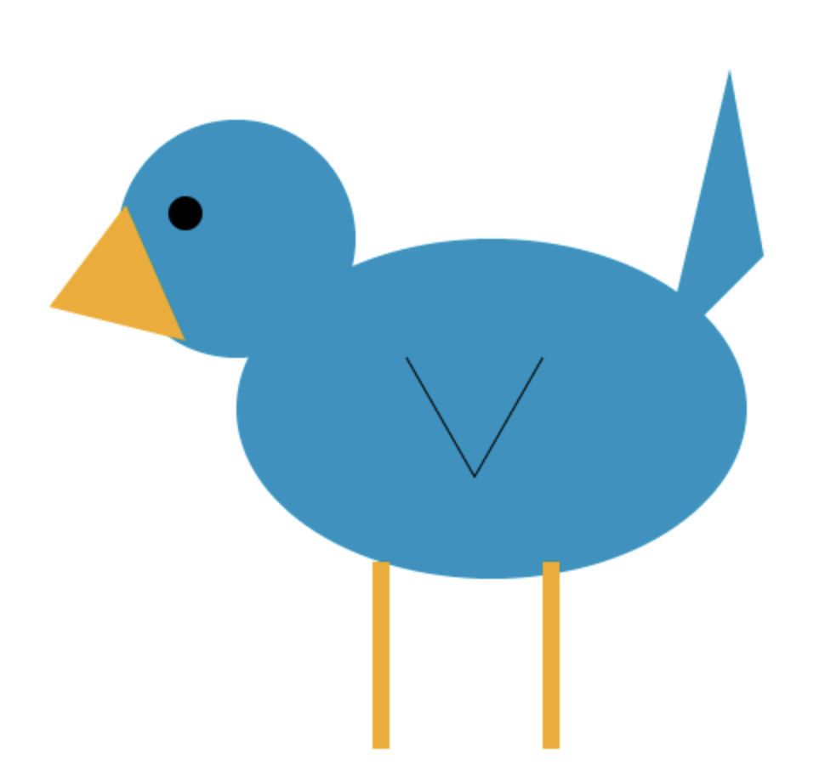
Activity 03.01 - Tweet, Tweet!
Run the following program, after correcting the function names and arguments, make sure the eye and legs are attached to the bird.
Activity: 03.01 - Tweet, Tweet
23

Slide 24
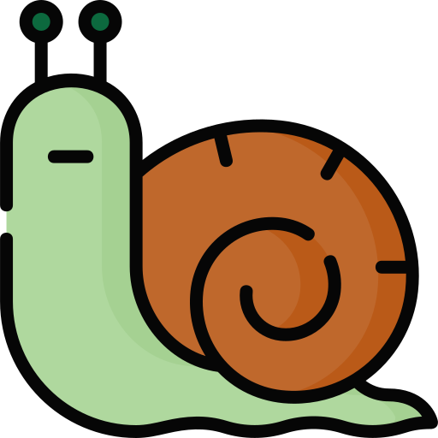
03.02d - One Step at a Time
Before you run this program:
Tick "Run in debug mode"
Click "Run"
Click "Step Into" to run one line at a time
Demo: 03.02d - One Step at a Time
24

Slide 25
03.02d - One Step at a Time
What did you notice about the program?
Did it run from top to bottom as per usual?
What if you write face() twice?
Demo: 03.02d - One Step at a Time
25

Slide 26

Writing your own function
We have seen that we can use functions predefined by PyAngelo - e.g. rect(...), circle(...)
What if you wanted to draw a tree? Is there a function for this?
There isn’t a function for this - but we could make one!
Functions are useful because we can define our own
In the demo, we defined a function that draws a smiley face
This means we can draw complicated shapes with one line of code
26

Slide 27
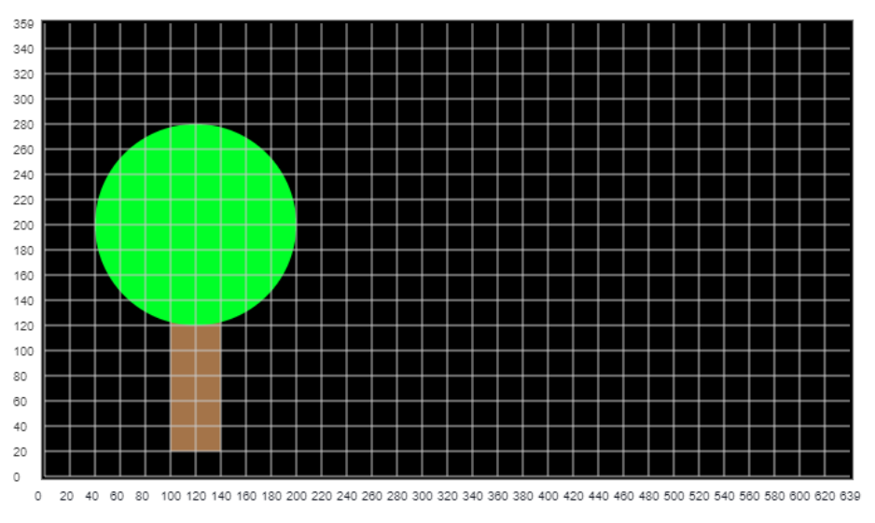
Writing your own function
Because we now know we can write our own functions, let’s explore a function that lets us draw a tree
The tree will be:
A brown rectangle and;
A green circle

Slide 28

Defining our own Tree Function (version 1)
fill(164, 116, 73)
noStroke()
rect(100, 20, 40, 120)
fill(0, 255, 40)
circle(120, 200, 80)
What do you think this code does?

Slide 29
Defining our own Tree Function (version 1)
fill(164, 116, 73)
noStroke()
rect(100, 20, 40, 120)
fill(0, 255, 40)
circle(120, 200, 80)
What do you think this code does?
Sets the fill to brown

Slide 30
Defining our own Tree Function (version 1)
fill(164, 116, 73)
noStroke()
rect(100, 20, 40, 120)
fill(0, 255, 40)
circle(120, 200, 80)
What do you think this code does?
Removes the border from drawings

Slide 31
Defining our own Tree Function (version 1)
fill(164, 116, 73)
noStroke()
rect(100, 20, 40, 120)
fill(0, 255, 40)
circle(120, 200, 80)
What do you think this code does?
Draws a rectangle at (100, 20) with a width of 40 and a height of 120

Slide 32
Defining our own Tree Function (version 1)
fill(164, 116, 73)
noStroke()
rect(100, 20, 40, 120)
fill(0, 255, 40)
circle(120, 200, 80)
What do you think this code does?
Sets the fill to green

Slide 33
Defining our own Tree Function (version 1)
fill(164, 116, 73)
noStroke()
rect(100, 20, 40, 120)
fill(0, 255, 40)
circle(120, 200, 80)
What do you think this code does?
Draws a circle with radius 80 at (120, 200)

Slide 34
Defining our own Tree Function (version 1)
fill(164, 116, 73)
noStroke()
rect(100, 20, 40, 120)
fill(0, 255, 40)
circle(120, 200, 80)
What do you think this code does?

Slide 35
Defining our own Tree Function (version 1)
fill(164, 116, 73)
noStroke()
rect(100, 20, 40, 120)
fill(0, 255, 40)
circle(120, 200, 80)
Great!
Now we have code that draws a tree - but this isn’t a function yet
35

Slide 36
Defining our own Tree Function (version 1)
fill(164, 116, 73)
noStroke()
rect(100, 20, 40, 120)
fill(0, 255, 40)
circle(120, 200, 80)
Great!
Now we have code that draws a tree - but this isn’t a function yet
We need to add a bit of code and rearrange some things…
36

Slide 37
Defining our own Tree Function (version 1)
def tree():
fill(164, 116, 73)
noStroke()
rect(100, 20, 40, 120)
fill(0, 255, 40)
circle(120, 200, 80)
Great!
Now we have code that draws a tree - but this isn’t a function yet
We need to add a bit of code and rearrange some things…
37

Slide 38
Defining our own Tree Function (version 1)
def tree():
fill(164, 116, 73)
noStroke()
rect(100, 20, 40, 120)
fill(0, 255, 40)
circle(120, 200, 80)
Notice the "def"?
This means "write a definition"...
38

Slide 39
Defining our own Tree Function (version 1)
def tree():
fill(164, 116, 73)
noStroke()
rect(100, 20, 40, 120)
fill(0, 255, 40)
circle(120, 200, 80)
… and call it "tree"
39

Slide 40
Defining our own Tree Function (version 1)
def tree():
fill(164, 116, 73)
noStroke()
rect(100, 20, 40, 120)
fill(0, 255, 40)
circle(120, 200, 80)
We can’t forget the brackets ( ) and colon : either!
40

Slide 41
Defining our own Tree Function (version 1)
def tree():
fill(164, 116, 73)
noStroke()
rect(100, 20, 40, 120)
fill(0, 255, 40)
circle(120, 200, 80)
Anything indented and underneath is included in the function
41

Slide 42
Defining our own Tree Function (version 1)
def tree():
fill(164, 116, 73)
noStroke()
rect(100, 20, 40, 120)
fill(0, 255, 40)
circle(120, 200, 80)
If we were to run this program, nothing would happen
42

Slide 43
Defining our own Tree Function (version 1)
def tree():
fill(164, 116, 73)
noStroke()
rect(100, 20, 40, 120)
fill(0, 255, 40)
circle(120, 200, 80)
We need to call the function
43

Slide 44
Defining our own Tree Function (version 1)
def tree():
fill(164, 116, 73)
noStroke()
rect(100, 20, 40, 120)
fill(0, 255, 40)
circle(120, 200, 80)
setCanvasSize(640, 360)
tree()
Like this!
44

Slide 45
Defining our own Tree Function (version 1)
def tree():
fill(164, 116, 73)
noStroke()
rect(100, 20, 40, 120)
fill(0, 255, 40)
circle(120, 200, 80)
setCanvasSize(640, 360)
tree()
Remember - We need to set the canvas size before calling our function!
45

Slide 46
Defining our own Tree Function (version 1)
def tree():
fill(164, 116, 73)
noStroke()
rect(100, 20, 40, 120)
fill(0, 255, 40)
circle(120, 200, 80)
setCanvasSize(640, 360)
tree()
When we call the function, we leave out def and :
46

Slide 47
Defining our own Tree Function (version 1)
def tree():
fill(164, 116, 73)
noStroke()
rect(100, 20, 40, 120)
fill(0, 255, 40)
circle(120, 200, 80)
setCanvasSize(640, 360)
tree()
The brackets are empty here, meaning there are no arguments.
47

Slide 48
Defining our own Tree Function (version 1)
def tree():
fill(164, 116, 73)
noStroke()
rect(100, 20, 40, 120)
fill(0, 255, 40)
circle(120, 200, 80)
setCanvasSize(640, 360)
tree()
If we run this program - we get our tree!

Slide 49
Defining our own Tree Function (version 1)
def tree():
fill(164, 116, 73)
noStroke()
rect(100, 20, 40, 120)
fill(0, 255, 40)
circle(120, 200, 80)
setCanvasSize(640, 360)
tree()
Our program will still run from top to bottom
When python runs this program, it will:
Define the tree() function
Set the canvas size
Call the tree() function

Slide 50
Defining our own Tree Function (version 1)
def tree():
fill(164, 116, 73)
noStroke()
rect(100, 20, 40, 120)
fill(0, 255, 40)
circle(120, 200, 80)
setCanvasSize(640, 360)
tree()
Calling the tree() function will make Python go inside the function and run the code inside line by line
This is just like the demo!
Take another look if you need to
Run this demo again and see the order the program runs in!

Slide 51

Activity 03.02 - Do you want to draw a snowman?
Create a function called snowman that draws a white snowman! Hint: It should draw 3 circles of different sizes. Can you add eyes?
Activity: 03.02 - Do you want to draw a snowman?
51

Slide 52
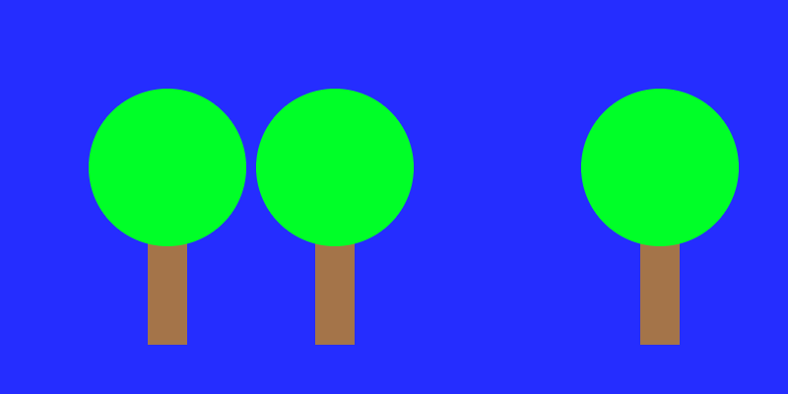
03.03d - Grow an orchard
Try changing the numbers, what happens to the trees?
Demo: 03.03d - Grow a Plantation
52

Slide 53
Why are functions useful?
As a class, discuss "What was different about this demo compared to tree() (version 1)?"

Slide 54
Defining our own Tree Function (version 2)
The tree function (version 1) had no arguments, where as in the demo, the tree function (version 2) now uses arguments
arguments are the numbers in the brackets → circle(20, 20, 5)
def tree(): # Version 1
fill(164, 116, 73)
noStroke()
rect(100, 20, 40, 120)
fill(0, 255, 40)
circle(120, 200, 80)
def tree(x, y): # Version 2
fill(164, 116, 73)
noStroke()
rect(x, y, 40, 120)
fill(0, 255, 40)
circle(x + 20, y + 180, 80)

Slide 55
Defining our own Tree Function (version 2)
The arguments make our function dynamic - this means the tree can move
Version 1 was static, meaning that the tree did not move
def tree(): # Version 1
fill(164, 116, 73)
noStroke()
rect(100, 20, 40, 120)
fill(0, 255, 40)
circle(120, 200, 80)
def tree(x, y): # Version 2
fill(164, 116, 73)
noStroke()
rect(x, y, 40, 120)
fill(0, 255, 40)
circle(x + 20, y + 180, 80)

Slide 56
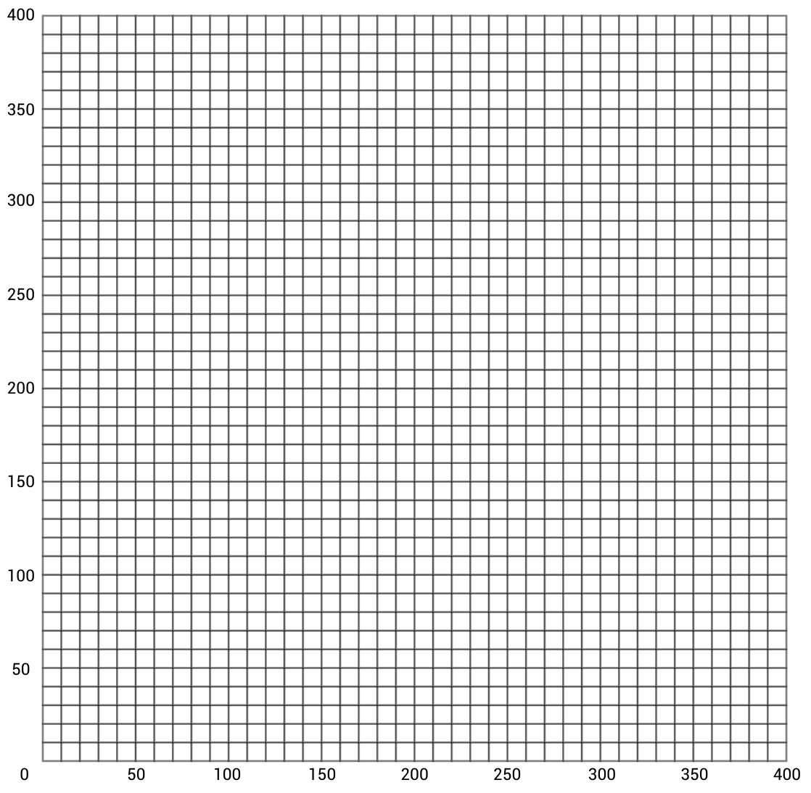
Why "+ 20" and "+ 180"?
def tree(x,y): # Version 2 (wrong)
...
rect(x, y, 40, 120)
circle(x, y, 80)
Y
Suppose x = 100 and y = 50
X

Slide 57
Why "+ 20" and "+ 180"?
def tree(x,y): # Version 2 (wrong)
...
rect(x, y, 40, 120)
circle(x, y, 80)
Y
Suppose x = 100 and y = 50
The rectangle would be drawn here
X

Slide 58
Why "+ 20" and "+ 180"?
def tree(x,y): # Version 2 (wrong)
...
rect(x, y, 40, 120)
circle(x, y, 80)
Y
Suppose x = 100 and y = 50
The rectangle would be drawn here
And the circle here
100
X

Slide 59
Why "+ 20" and "+ 180"?
def tree(x,y): # Version 2 (wrong)
...
rect(x, y, 40, 120)
circle(x, y, 80)
Y
Suppose x = 100 and y = 50
The rectangle would be drawn here
And the circle here
This doesn’t look right! Let’s fix it…
100
X

Slide 60
Why "+ 20" and "+ 180"?
def tree(x,y): # Version 2
...
rect(x, y, 40, 120)
circle(x + 20, y + 180, 80)
Y
Now, x = 100 and y = 50
X

Slide 61
Why "+ 20" and "+ 180"?
def tree(x,y): # Version 2
...
rect(x, y, 40, 120)
circle(x + 20, y + 180, 80)
Y
Now, x = 100 and y = 50
The rectangle would be drawn here
X

Slide 62
Why "+ 20" and "+ 180"?
def tree(x,y): # Version 2
...
rect(x, y, 40, 120)
circle(x + 20, y + 180, 80)
230
Y
Now, x = 100 and y = 50
The rectangle would be drawn here
And the circle here
120
X

Slide 63
Why "+ 20" and "+ 180"?
def tree(x,y): # Version 2
...
rect(x, y, 40, 120)
circle(x + 20, y + 180, 80)
230
Y
Now, x = 100 and y = 50
The rectangle would be drawn here
And the circle here
All fixed!
120
X

Slide 64
Defining our own Tree Function (version 2)
The parameters, in this new and improved tree function let us tell the function where to draw the tree!
def tree(x, y): # Version 2
fill(164, 116, 73)
noStroke()
rect(x, y, 40, 120)
fill(0, 255, 40)
circle(x + 20, y + 180, 80)

Slide 65
Defining our own Tree Function (version 2)
The parameters, in this new and improved tree function let us tell the function where to draw the tree! c
Take a look at this circle function that we have used before:
circle(30, 100, 10)
def tree(x, y): # Version 2
fill(164, 116, 73)
noStroke()
rect(x, y, 40, 120)
fill(0, 255, 40)
circle(x + 20, y + 180, 80)

Slide 66
Defining our own Tree Function (version 2)
The parameters, in this new and improved tree function let us tell the function where to draw the tree! c
Take a look at this circle function that we have used before:
circle(30, 100, 10)
What do these numbers tell the function to do?
def tree(x, y): # Version 2
fill(164, 116, 73)
noStroke()
rect(x, y, 40, 120)
fill(0, 255, 40)
circle(x + 20, y + 180, 80)

Slide 67
Defining our own Tree Function (version 2)
The parameters, in this new and improved tree function let us tell the function where to draw the tree! c
Take a look at this circle function that we have used before:
circle(30, 100, 10)
This is the x location of the circle
def tree(x, y): # Version 2
fill(164, 116, 73)
noStroke()
rect(x, y, 40, 120)
fill(0, 255, 40)
circle(x + 20, y + 180, 80)

Slide 68
Defining our own Tree Function (version 2)
The parameters, in this new and improved tree function let us tell the function where to draw the tree! c
Take a look at this circle function that we have used before:
circle(30, 100, 10)
This is the y location of the circle
def tree(x, y): # Version 2
fill(164, 116, 73)
noStroke()
rect(x, y, 40, 120)
fill(0, 255, 40)
circle(x + 20, y + 180, 80)

Slide 69
Defining our own Tree Function (version 2)
The parameters, in this new and improved tree function let us tell the function where to draw the tree! c
Take a look at this circle function that we have used before:
circle(30, 100, 10)
And, this is the radius
def tree(x, y): # Version 2
fill(164, 116, 73)
noStroke()
rect(x, y, 40, 120)
fill(0, 255, 40)
circle(x + 20, y + 180, 80)

Slide 70
Defining our own Tree Function (version 2)
The parameters, in this new and improved tree function let us tell the function where to draw the tree! c
Take a look at this circle function that we have used before:
circle(30, 100, 10)
All together, these arguments tell the function where and how big the circle should be
def tree(x, y): # Version 2
fill(164, 116, 73)
noStroke()
rect(x, y, 40, 120)
fill(0, 255, 40)
circle(x + 20, y + 180, 80)

Slide 71
The difference between Parameters and Arguments…
REMEMBER:
Parameters - the variables written inside the function definitions c
def circle(x, y, rad):
line(x,y,x + 1,y + 1)
...
circle(85, 810, 43)

Slide 72
The difference between Parameters and Arguments…
REMEMBER:
Parameters - the variables written inside the function definitions c
Arguments - the numbers we put into a function when we call it
def circle(x, y, z):
line(x,y,x + 1,y + 1)
...
circle(85, 810, 43)

Slide 73
Defining our own Tree Function (version 2)
The parameters, in this new and improved tree function let us tell the function where to draw the tree! c
Now, take a look at our tree function definition:
tree(x, y)
def tree(x, y): # Version 2
fill(164, 116, 73)
noStroke()
rect(x, y, 40, 120)
fill(0, 255, 40)
circle(x + 20, y + 180, 80)

Slide 74
Defining our own Tree Function (version 2)
The parameters, in this new and improved tree function let us tell the function where to draw the tree!
Now, take a look at our tree function definition:
tree(x, y)
The x and y parameters are ‘placeholders’ in the definition so that Python knows you will give it arguments when you call the function
def tree(x, y): # Version 2
fill(164, 116, 73)
noStroke()
rect(x, y, 40, 120)
fill(0, 255, 40)
circle(x + 20, y + 180, 80)

Slide 75
Defining our own Tree Function (version 2)
The parameters, in this new and improved tree function let us tell the function where to draw the tree!
Finally, let’s look at the code to call the tree function:
tree(120, 50)
def tree(x, y): # Version 2
fill(164, 116, 73)
noStroke()
rect(x, y, 40, 120)
fill(0, 255, 40)
circle(x + 20, y + 180, 80)

Slide 76
Defining our own Tree Function (version 2)
The parameters, in this new and improved tree function let us tell the function where to draw the tree!
Finally, let’s look at the code to call the tree function:
tree(120, 50)
x and y are replaced with integers, which tells our tree function where to draw the tree!
def tree(x, y): # Version 2
fill(164, 116, 73)
noStroke()
rect(x, y, 40, 120)
fill(0, 255, 40)
circle(x + 20, y + 180, 80)

Slide 77
Parameters in Action
def tree(x, y): # Version 2
fill(164, 116, 73)
noStroke()
rect(x, y, 40, 120)
fill(0, 255, 40)
circle(x + 20, y + 180, 80)
setCanvasSize(400, 800)
tree(120, 60)
Let’s run this code line by line…

Slide 78
Parameters in Action
def tree(x, y): # Version 2
fill(164, 116, 73)
noStroke()
rect(x, y, 40, 120)
fill(0, 255, 40)
circle(x + 20, y + 180, 80)
setCanvasSize(400, 800)
tree(120, 60)
This gives Python a definition for the tree() function

Slide 79
Parameters in Action
def tree(x, y): # Version 2
fill(164, 116, 73)
noStroke()
rect(x, y, 40, 120)
fill(0, 255, 40)
circle(x + 20, y + 180, 80)
setCanvasSize(400, 800)
tree(120, 60)
This gives Python a definition for the tree() function
Everything indented and underneath is the definition

Slide 80
Parameters in Action
def tree(x, y): # Version 2
fill(164, 116, 73)
noStroke()
rect(x, y, 40, 120)
fill(0, 255, 40)
circle(x + 20, y + 180, 80)
setCanvasSize(400, 800)
tree(120, 60)
This tells python what size to make the canvas

Slide 81
Parameters in Action
def tree(x, y): # Version 2
fill(164, 116, 73)
noStroke()
rect(x, y, 40, 120)
fill(0, 255, 40)
circle(x + 20, y + 180, 80)
setCanvasSize(400, 800)
tree(120, 60)
This calls the tree() function

Slide 82
Parameters in Action
def tree(x, y): # Version 2
fill(164, 116, 73)
noStroke()
rect(x, y, 40, 120)
fill(0, 255, 40)
circle(x + 20, y + 180, 80)
setCanvasSize(400, 800)
tree(120, 60)
This calls the tree() function
Python now realises we are calling a function, and because of our def, it knows what to do
Python will jump to the function definition, and execute the code underneath - but before that…

Slide 83
Parameters in Action
def tree(x, y): # Version 2
fill(164, 116, 73)
noStroke()
rect(x, y, 40, 120)
fill(0, 255, 40)
circle(x + 20, y + 180, 80)
setCanvasSize(400, 800)
tree(120, 60)
What about those arguments?

Slide 84
Parameters in Action
def tree(x, y): # Version 2
fill(164, 116, 73)
noStroke()
rect(120, y, 40, 120)
fill(0, 255, 40)
circle(120 + 20, y + 180, 80)
setCanvasSize(400, 800)
tree(120, 60)
What about those arguments?
Python replaces the x parameter in the function definition with the argument in the x position of the function call

Slide 85
Parameters in Action
def tree(x, y): # Version 2
fill(164, 116, 73)
noStroke()
rect(120, 60, 40, 120)
fill(0, 255, 40)
circle(120 + 20,60 + 180, 80)
setCanvasSize(400, 800)
tree(120, 60)
What about those arguments?
Python replaces the x parameter in the function definition with the argument in the x position of the function call
And does the same for y

Slide 86
Parameters in Action
def tree(x, y): # Version 2
fill(164, 116, 73)
noStroke()
rect(120, 60, 40, 120)
fill(0, 255, 40)
circle(140, 240, 80)
setCanvasSize(400, 800)
tree(120, 60)
What about those arguments?
Python replaces the x parameter in the function definition with the argument in the x position of the function call
And does the same for y
Then, it executes the function code!

Slide 87
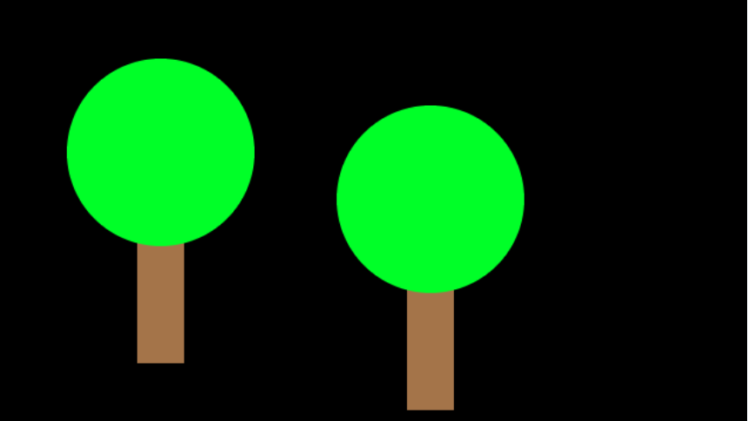
Parameters in Action
def tree(x, y): # Version 2
fill(164, 116, 73)
noStroke()
rect(120, 60, 40, 120)
fill(0, 255, 40)
circle(140, 240, 80)
setCanvasSize(400, 800)
tree(120, 60)
Now we have our tree at (120, 60)

Slide 88
Parameters in Action
def tree(x, y): # Version 2
fill(164, 116, 73)
noStroke()
rect(450, 20, 40, 120)
fill(0, 255, 40)
circle(470, 200, 80)
setCanvasSize(400, 800)
tree(450, 20)
If we change the numbers, our tree will move!

Slide 89
Parameters in Action
def tree(x, y): # Version 2
fill(164, 116, 73)
noStroke()
rect(x, y, 40, 120)
fill(0, 255, 40)
circle(x + 20, y + 180, 80)
setCanvasSize(400, 800)
tree(120, 60)
Once Python executes the function code, it will reset the values back to x and y

Slide 90
Parameters in Action
def tree(x, y): # Version 2
fill(164, 116, 73)
noStroke()
rect(x, y, 40, 120)
fill(0, 255, 40)
circle(x + 20, y + 180, 80)
setCanvasSize(400, 800)
tree(120, 60)
tree(450, 20)
Once Python executes the function code, it will reset the values back to x and y
This means we can call the function twice…

Slide 91
Activity 03.03 - Move it, snowman!
Create a function with parameters so that your snowman can move!
Activity: 03.03 - Move it, snowman
91

Slide 92
Extension: Improving the Snowman Function
As a class, discuss "How can we make our snowman() even better?"
92

Slide 93
Extension: Improving the Snowman Function
We could add a parameter so that we can tell Python how big to draw our snowman!
Let’s see how this works for tree()…
93

Slide 94
Extension: Improving the Snowman Function
def tree(x, y, height, width):
fill(164, 116, 73)
noStroke()
rect(x, y, 40, 120)
fill(0, 255, 40)
circle(x + 20, y + 180, 80)
setCanvasSize(400, 800)
tree(450, 20)
Notice the height and width parameter?
How would we include these inside the function code?
94

Slide 95
Extension: Improving the Snowman Function
def tree(x, y, height, width):
fill(164, 116, 73)
noStroke()
rect(x, y, 40, height)
fill(0, 255, 40)
circle(x+40, y+height+width, width)
setCanvasSize(400, 800)
tree(450, 20, 200, 50)
Like this!
Now when we call our function, we have to write in two more numbers…
This gives us a tree at (450, 20), with a height of 200 and a width of 50

Slide 96
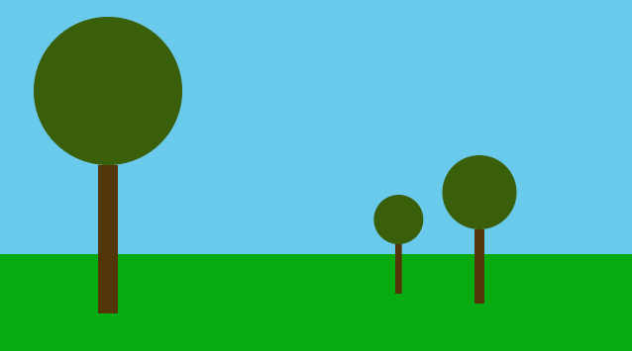
Extension: Improving the Snowman Function
def tree(x, y, height, width):
fill(164, 116, 73)
noStroke()
rect(x, y, 40, height)
fill(0, 255, 40)
circle(x+20, y+height+width, width)
setCanvasSize(400, 800)
tree(100, 20, 400, 70) tree(350, 50, 100, 10) tree(400, 40, 150, 30)
With three calls, we’d get…

Slide 97
Extension 03.03 - Move it, (and grow it) snowman!
Create a function with parameters so that your snowman can move AND change in size! Maybe you can get the snowman to follow your mouse…?
Activity: 03.03 - Move it, (and grow it) snowman
97

Slide 98
Summary
Functions allow us to execute many lines of code as a single statement
We can define our own functions, with or without parameters
Functions make our code more readable
We can call functions many times, with different arguments too!
98

Slide 99
License Information
These CS in Schools lessons plans, worksheets, and other materials were created by the CS in Schools Team. They are licensed under a Creative Commons Attribution-ShareAlike 4.0 International License.
99

