Slide 1


Lesson 4
For Loops
csinschools.com

Slide 2
Previously, on CS in Schools...
def tree(x, y):
fill(164, 116, 73)
noStroke()
rect(x, y, 40, 120)
fill(0, 255, 40)
circle(x + 20, y + 180, 80)
setCanvasSize(400, 800)
tree(450, 20)
tree(120, 60)
What lines of code are part of the tree() function?
How do you know where the function definition ends?
2
Notes:
Answer: The function starts with the def keyword and all lines indented and underneath.

Slide 3
Previously, on CS in Schools...
def tree(x, y):
fill(164, 116, 73)
noStroke()
rect(x, y, 40, 120)
fill(0, 255, 40)
circle(x + 20, y + 180, 80)
setCanvasSize(400, 800)
tree(450, 20)
tree(120, 60)
What is a parameter?
What are the 2 parameters defined by the tree() function?
3
Notes:
Answer:
Parameters are used within a function definition (eg/ in def tree(x, y), x and y are parameters)
x, y

Slide 4
Previously, on CS in Schools...
def tree(x, y):
fill(164, 116, 73)
noStroke()
rect(x, y, 40, 120)
fill(0, 255, 40)
circle(x + 20, y + 180, 80)
setCanvasSize(400, 800)
tree(450, 20)
tree(120, 60)
What is an argument?
What are 2 examples of an argument?
4
Notes:
Answer:
An argument is passed into a function call (eg/ in the setCanvasSize(...), 400 and 800 are both arguments)
400, 800
450, 20
120, 60

Slide 5



Learning objectives
By the end of this lesson, you should be able to:
understand the range() function
understand the for loop in Python
write for loops that include the range() function
5

Slide 6
for loops
Editor
This is a for loop
It tells the computer to loop through some code
It works in a similar way to a while loop
for i in range(3):
print("hello world")
Console

Slide 7
for loops
Editor
This for loop will print hello world three times
How do we know this?
for i in range(3):
print("hello world")
Console

Slide 8
for loops
Editor
This for loop will print hello world three times
How do we know this?
Because of the range function!
for i in range(3):
print("hello world")
Console

Slide 9
for loops
Editor
This for loop will print hello world three times
How do we know this?
Because of the range function!
When we pass 3 as an argument into range(), we get a list of 3 numbers out
for i in range(3):
print("hello world")
Console

Slide 10
for loops
Editor
This for loop will print hello world three times
How do we know this?
Because of the range function!
When we pass 3 as an argument into range(), we get a list of 3 numbers out
The list is [0, 1, 2] - 3 numbers!
for i in range(3):
print("hello world")
Console

Slide 11
for loops
Editor
This for loop will print hello world three times
The list is [0, 1, 2]
The for loop runs once per item in the list, hence, 3 times!
for i in range(3):
print("hello world")
Console

Slide 12
for loops
Editor
This for loop will print hello world three times
The list is [0, 1, 2]
The for loop runs once per item in the list, hence, 3 times!
for i in range(3):
print("hello world")
Console
hello world
hello world
hello world

Slide 13
for loops - making use of ‘i’
Editor
What is i doing there? Let’s take a look.
for i in range(3):
i = str(i)
print("enter player " + i)
Console

Slide 14
for loops - making use of ‘i’
Editor
What is i doing there? Let’s take a look.
Remember, range gives us the list [0, 1, 2]
Each time the loop runs, i takes on a value from the list
It will start at 0, then change to 1, then change to 2
for i in range(3):
i = str(i)
print("enter player " + i)
Console

Slide 15
for loops - making use of ‘i’
Editor
What is i doing there? Let’s take a look.
Remember, range gives us the list [0, 1, 2]
Each time the loop runs, i takes on a value from the list
It will start at 0, then change to 1, then change to 2
for 0 in range(3):
i = str(i)
print("enter player " + i)
Console
enter player 0

Slide 16
for loops - making use of ‘i’
Editor
What is i doing there? Let’s take a look.
Remember, range gives us the list [0, 1, 2]
Each time the loop runs, i takes on a value from the list
It will start at 0, then change to 1, then change to 2
for 1 in range(3):
i = str(i)
print("enter player " + i)
Console
enter player 0
enter player 1

Slide 17
for loops - making use of ‘i’
Editor
What is i doing there? Let’s take a look.
Remember, range gives us the list [0, 1, 2]
Each time the loop runs, i takes on a value from the list
It will start at 0, then change to 1, then change to 2
for 2 in range(3):
i = str(i)
print("enter player " + i)
Console
enter player 0
enter player 1
enter player 2

Slide 18
for loops - making use of ‘i’
Editor
What is i doing there? Let’s take a look.
Remember, range gives us the list [0, 1, 2]
Each time the loop runs, i takes on a value from the list
It will start at 0, then change to 1, then change to 2
for i in range(3):
i = str(i)
print("enter player " + i)
Console
enter player 0
enter player 1
enter player 2
All done!

Slide 19

for loops - making use of ‘i’
Editor
for i in range(3):
i = str(i)
print("enter player " + i)
We can’t print strings and integers together, so we cast i to an string
Console
enter player 0
enter player 1
enter player 2

Slide 20

Activity 04.01 - Time is ticking!
Fill in the blanks and fix the code to create a timer that counts from 0 to 9!
Activity: 04.01 - Time is ticking!
20

Slide 21
range(start, stop, step)
We can pass more than one argument into the range function
If we pass one argument, we get a list that starts at 0 and ends at the number before the one you enter
Eg/ range(4) → [0, 1, 2, 3]
Editor
range(4)
Console
[0, 1, 2, 3]

Slide 22
range(start, stop, step)
We can pass more than one argument into the range function
If we pass one argument, we get a list that starts at 0 and ends at the number before the one you enter
Eg/ range(4)
If we pass two arguments, we get a list that starts at the first input and ends at the number before the second
Eg/ range(4, 10)
Editor
range(4, 10)
Console
[4, 5, 6, 7, 8, 9]

Slide 23
range(start, stop, step)
We can pass more than one argument into the range function
If we pass three arguments, we get a list that starts at the first input and ends at the number before the second, with a step of the third number you entered
Eg/ range(1, 6, 2)
Editor
range(1, 12, 2)
Console
[1, 3, 5, 7, 9, 11]

Slide 24
Test yourself!
range(start, stop, step)
input | output | input | output
range(5) |  | range(1,6,2)
range(4) |  | range(2,11,2)
range(1,5) |  | range(0,25,5)
range(10,13) |  | range(5,12,2)

Slide 25
Test yourself!
range(start, stop, step)
input | output | input | output
range(5) | [0,1,2,3,4] | range(1,6,2) | [1,3,5]
range(4) | [0,1,2,3] | range(2,11,2) | [2,4,6,8,10]
range(1,5) | [1,2,3,4] | range(0,25,5) | [0,5,10,15,20]
range(10,13) | [10,11,12] | range(5,12,2) | [5,7,9,11]

Slide 26

Drawing Multiple Circles
circle(50, 50, 20)
circle(100, 50, 20)
circle(150, 50, 20)
circle(200, 50, 20)
circle(250, 50, 20)
circle(300, 50, 20)
circle(350, 50, 20)
circle(400, 50, 20)
circle(450, 50, 20)
circle(500, 50, 20)
If I wanted to draw 10 circles across the canvas, my first attempt might look like this
26

Slide 27

Drawing Multiple Circles
circle(50, 50, 20)
circle(100, 50, 20)
circle(150, 50, 20)
circle(200, 50, 20)
circle(250, 50, 20)
circle(300, 50, 20)
circle(350, 50, 20)
circle(400, 50, 20)
circle(450, 50, 20)
circle(500, 50, 20)
What is a better way to do this?
27

Slide 28
Drawing Multiple Circles
circle(50, 50, 20)
circle(100, 50, 20)
circle(150, 50, 20)
circle(200, 50, 20)
circle(250, 50, 20)
circle(300, 50, 20)
circle(350, 50, 20)
circle(400, 50, 20)
circle(450, 50, 20)
circle(500, 50, 20)
The x position is the only value changing, so let’s rewrite this
28

Slide 29
Drawing Multiple Circles
for x in range(50, 501, 50):
circle(x, 50, 20)
This does the same thing - and is much simpler to write!
29

Slide 30
Drawing Multiple Circles
for x in range(50, 501, 50):
circle(x, 50, 20)
See this code in action here
30

Slide 31
Drawing Multiple Circles
for x in range(50, 501, 50):
circle(x, 50, 20)
The list produced by range(...) is…
[50,100,150,200,250,300,350,400,450,500]
The for loop will run once for each item in this list, replacing x with the value from the list!
Therefore we get 10 circles!

Slide 32
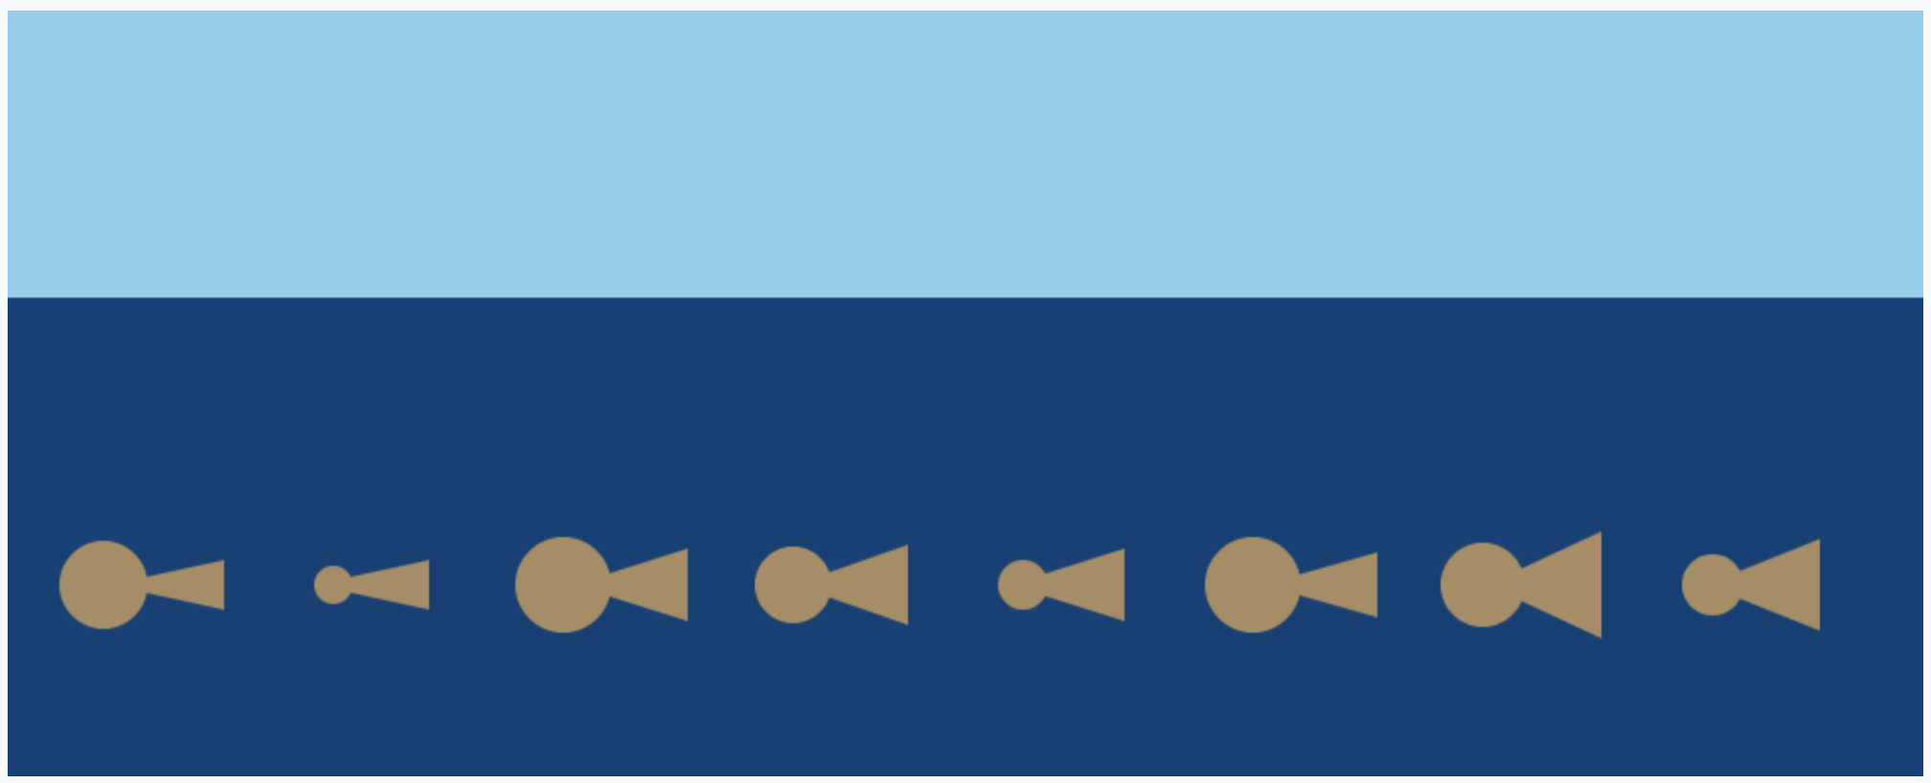
Activity 04.02 - Under the sea
Fill in the blanks and fix the code to fill the ocean with fish!
Activity: 04.02 - Under the sea
32

Slide 33
Random Level Generation in Video Games
Games that have multiple levels often employ a technique called random level generation
This technique allows the programmer to create unique levels each time the game is played
Say we have a platform the player can walk on but we want there to be gaps they can fall through unless they jump to a higher platform, in this case we can randomly generate the gaps
33

Slide 34
Random Level Generation in Video Games
for x in range(0, 1001, 50):
level = randint(0, 9)
if level == 0:
rect(x,50,50,20)
else:
rect(x,10,50,20)
This code uses randint() to generate our random levels!
if the random number is 0, the floor will be drawn in the air, otherwise, it will be drawn on the ground
See this in action here
Can you make it so more of the levels appear in the air?

Slide 35
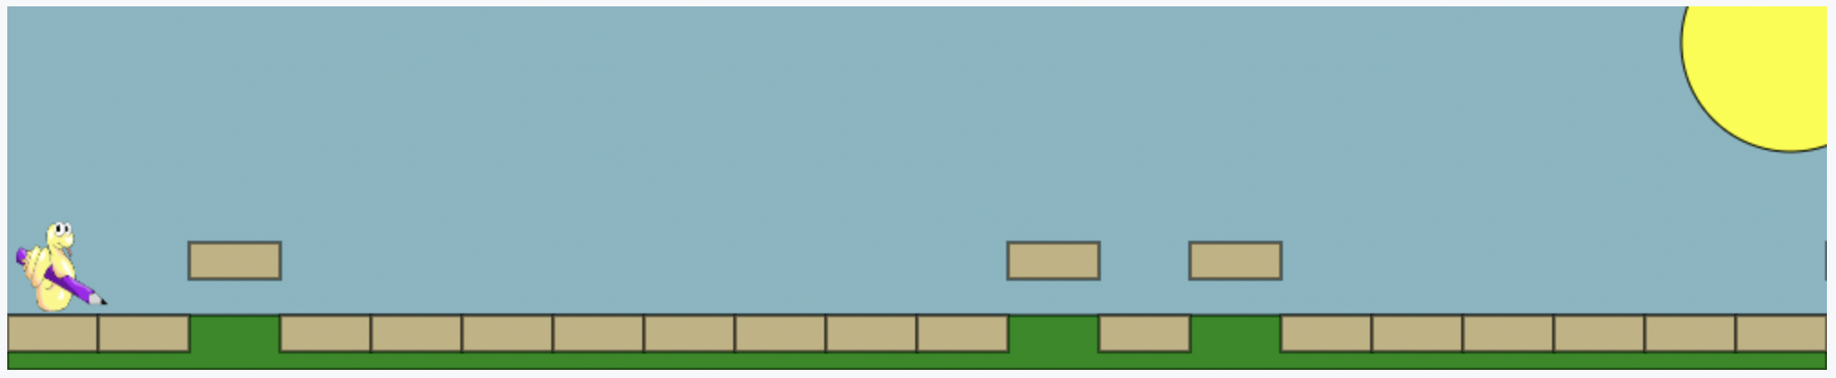
Activity 04.03 - My first level generator
Draw a series of rectangles that act as the floor for a platformer game
90% of the time draw the rectangle on the floor
10% of the time draw the rectangle in the air
Activity: 04.03 - My first level generator
35

Slide 36
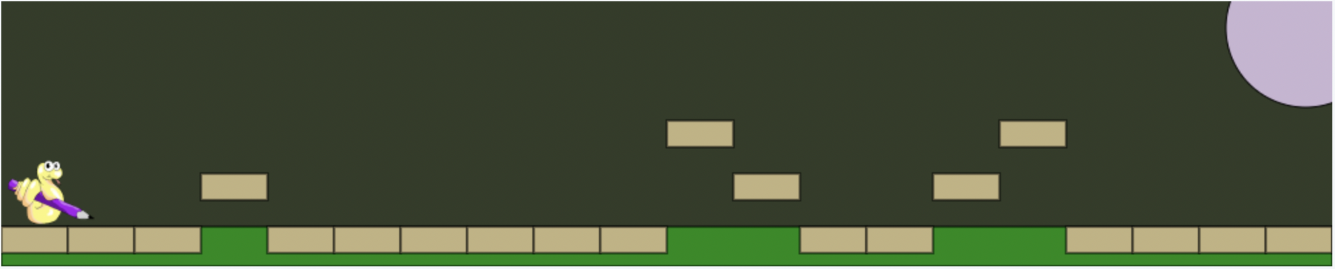
Extension - Up, Up and Up!
Make it so your level generator from before produces 3 levels - one ground, one a bit higher, and one even higher than that!
Change the scene to something different (ie/ change the background colours to make the scene look like the moon)
36

Slide 37
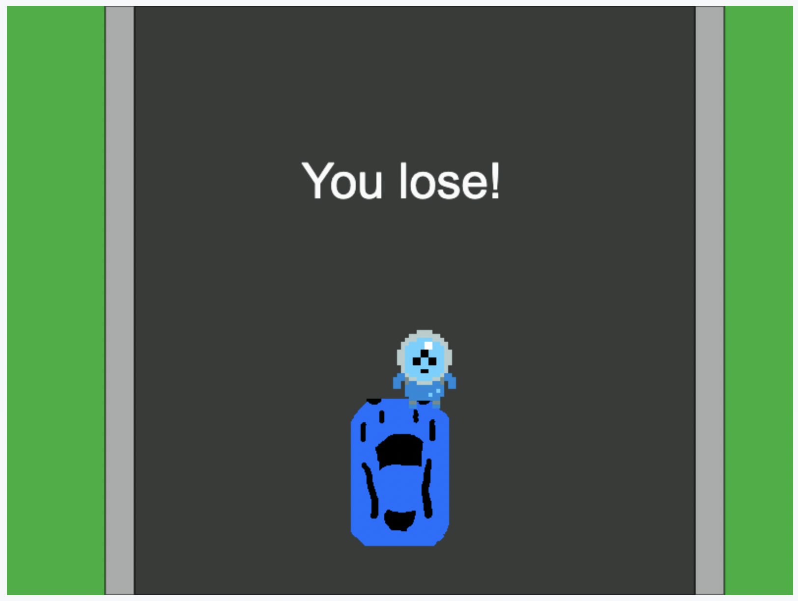
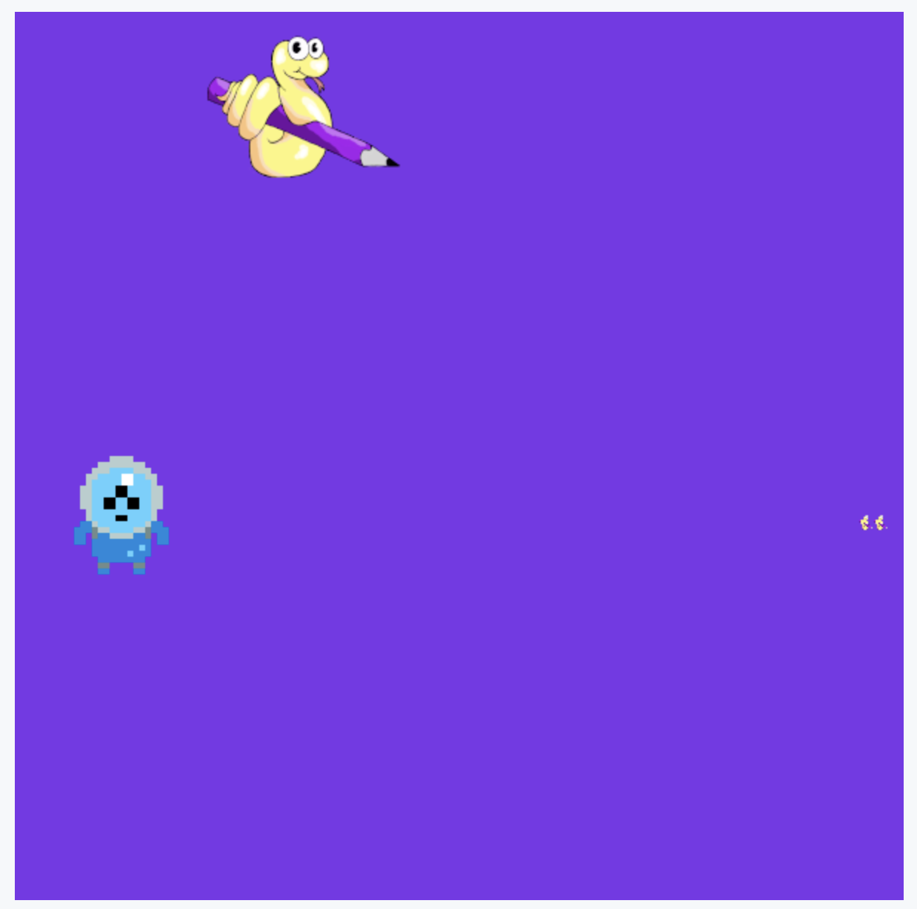
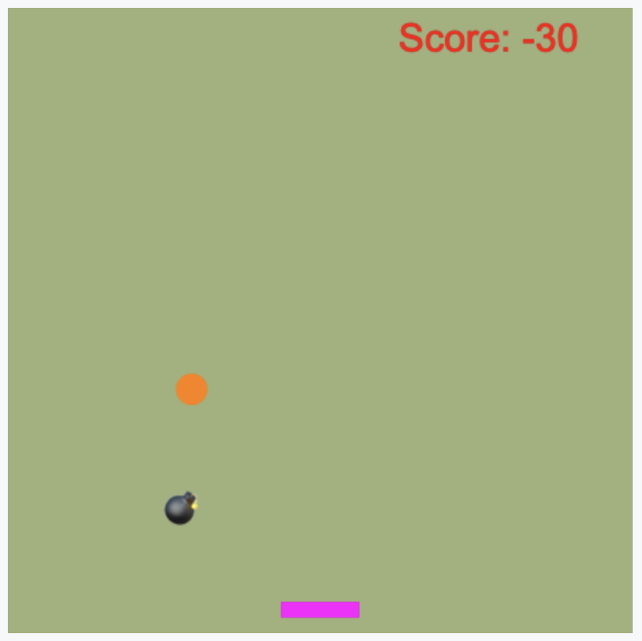
Extension - Play a game!
Open up these games and have a go at playing them!
Take a look through the code and try to make some improvements
There are comments at the top to guide you - some of these are a challenge!
Avoid the Alien
Space Hunter
Catch the Ball

Slide 38
Summary
The range() function generates a list of numbers
You can provide start, stop and step arguments to the range() function
A for loop in Python can be used in combination with the range() function
for loops in Python create a variable that takes on a different value each time the loop repeats
38

Slide 39
License Information
These CS in Schools lessons plans, worksheets, and other materials were created by the CS in Schools Team. They are licensed under a Creative Commons Attribution-ShareAlike 4.0 International License.
39

