Slide 1


Lesson 5
Object Oriented Programming
csinschools.com

Slide 2



Previously, on CS in Schools...
for myNum in range(10):
print(myNum)
What variable is created by this program?
What is the data type of the variable created?
What numbers will the program print?
2
Notes:
Answers: myNum, int, 0 1 2 3 4 5 6 7 8 9

Slide 3
Previously, on CS in Schools...
for i in range(5, 20, 5):
print(i)
What variable is created by this program?
What numbers will the program print?
3
Notes:
Answer: 5, 10, 15

Slide 4
Learning objectives
By the end of this lesson, you should be able to:
explain the broad concept of Object Oriented Programming (OOP)
create your own objects from existing classes
identify the differences between attributes and methods
4

Slide 5

Demo 05.01 - A Simple Ball Animation
Run this program! Can you make the ball move faster? Can you add a second ball?
A Simple Ball Animation
5

Slide 6
Unpacking the code…
setCanvasSize(400, 400)
fill(255, 0, 255)
ballX = 0
ballY = 0
ballRadius = 20
while True:
background(0, 0, 0)
circle(ballX, ballY, ballRadius)
ballX = ballX + 1
ballY = ballY + 1
sleep(0.005)

Slide 7
Unpacking the code…
setCanvasSize(400, 400)
fill(255, 0, 255)
ballX = 0
ballY = 0
ballRadius = 20
while True:
background(0, 0, 0)
circle(ballX, ballY, ballRadius)
ballX = ballX + 1
ballY = ballY + 1
sleep(0.005)
These are all the variables that define the position and size of the ball

Slide 8
Unpacking the code…
setCanvasSize(400, 400)
fill(255, 0, 255)
ballX = 0
ballY = 0
ballRadius = 20
while True:
background(0, 0, 0)
circle(ballX, ballY, ballRadius)
ballX = ballX + 1
ballY = ballY + 1
sleep(0.005)
This is where we update and use the variables to move the ball
circle(...) draws the ball
The other two highlighted lines move the balls x and y coordinates

Slide 9
Unpacking the code…
setCanvasSize(400, 400)
fill(255, 0, 255)
ballX = 0
ballY = 0
ballRadius = 20
while True:
background(0, 0, 0)
circle(ballX, ballY, ballRadius)
ballX = ballX + 1
ballY = ballY + 1
sleep(0.005)
Having so many variables can get confusing
What if we wanted to add another ball?
We would have to change the variables to something like:
ball1X
ball2X
ball1Y
…

Slide 10
Unpacking the code…
setCanvasSize(400, 400)
fill(255, 0, 255)
ballX = 0
ballY = 0
ballRadius = 20
while True:
background(0, 0, 0)
circle(ballX, ballY, ballRadius)
ballX = ballX + 1
ballY = ballY + 1
sleep(0.005)
Objects are a useful tool Python provides that lets us bundle code together
We could use an object to store attributes of the ball, such as:
Size
Location
We could also store methods, such as:
Draw ball

Slide 11
Unpacking the code…
setCanvasSize(400, 400)
fill(255, 0, 255)
ballX = 0
ballY = 0
ballRadius = 20
while True:
background(0, 0, 0)
circle(ballX, ballY, ballRadius)
ballX = ballX + 1
ballY = ballY + 1
sleep(0.005)
Let's rewrite this code using an object

Slide 12
How to Create an Object

Slide 13
Creating an object using CircleSprite
from sprite import *
ball = CircleSprite(100, 200, 20)
To create an object, we need to use a class
A class tells Python what information to store inside the object
Here the class is CircleSprite(...)
We need to import the sprite library to use this class

Slide 14
Creating an object using CircleSprite
from sprite import *
ball = CircleSprite(100, 200, 20)
We are using the CircleSprite(...) class to create the ball object
The arguments we are providing to CircleSprite(...) define the position and size of the ball object
100 is the x position
200 is the y position
20 is the radius

Slide 15
Creating an object using CircleSprite
from sprite import *
ball = CircleSprite(100, 200, 20)
print(ball.x)
print(ball.y)
print(ball.radius)
By adding these print statements, we can view the attributes of the ball object that we just set
100
200
20

Slide 16
Creating an object using CircleSprite
from sprite import *
ball = CircleSprite(100, 200, 20)
print(ball.x)
print(ball.y)
print(ball.radius)
There are other attributes that we haven't set yet
There are also other methods we haven't used!
These are all stored inside ball and can be accessed using the dot notation
eg/ ball.x
100
200
20

Slide 17
Creating an object using CircleSprite
from sprite import *
setCanvasSize(400, 400)
ball = CircleSprite(100, 200, 20)
ball.draw()
Now that we have set some of the ball's attributes, we can use a method to draw it
We can see this method in use here!
Note that we don't pass any arguments to the draw method
We also need to draw the canvas first

Slide 18

Activity 05.01 - Kickin’ Goals!
Correct the code and fill in the blanks so that the ball is on target for a goal!
SIUUUUU!
05.01 - Kickin’ Goals!
18

Slide 19
More Methods
The code you just wrote to help Ronaldo score his goal used a method
This method is called draw() - this method drew the ball on the canvas
Other methods that are part of the ball object you created include:
setColour(r, g, b)
moveTo(x, y)
moveBy(x, y)

Slide 20

setColour(R, G, B)
This method changes the colour of the object you have created
Specify the red, green, and blue components like you do with fill(...)
from sprite import *
setCanvasSize(150, 150)
ball = CircleSprite(100, 50, 20)
ball.setColour(100, 150, 175)
ball.draw()

Slide 21

moveTo(x, y)
This method updates the object.x and object.y attributes to the x and y you specify (NOTE: you must use .draw() after this method)
from sprite import *
setCanvasSize(150, 150)
ball = CircleSprite(100, 50, 20)
ball.draw()
ball.moveTo(50, 100)
ball.draw()

Slide 22
moveBy(x, y)
This method adds the numbers you specify to the current object.x and object.y attributes (NOTE: you must use .draw() after this method)
from sprite import *
ball = CircleSprite(100, 50, 20)
print(ball.x + ', ' + ball.y)
ball.moveBy(5, 10)
print(ball.x + ' ' + ball.y)
100, 50
105, 60

Slide 23

Demo 05.02 - Ball Object Animation
Run this program! Can you make the ball move faster? Can you change the colour of the ball?
Ball Object Animation
23

Slide 24
Unpacking the code…
from sprite import *
setCanvasSize(400, 400)
background(120, 120, 120)
ball = CircleSprite(-20, -20, 20)
ball.setColour(25, 130, 200)
while True:
background(120, 120, 120)
ball.moveBy(2, 2)
ball.draw()
sleep(0.005)

Slide 25
Unpacking the code…
from sprite import *
setCanvasSize(400, 400)
background(120, 120, 120)
ball = CircleSprite(-20, -20, 20)
ball.setColour(25, 130, 200)
while True:
background(120, 120, 120)
ball.moveBy(2, 2)
ball.draw()
sleep(0.005)
This code sets the canvas and background colour

Slide 26
Unpacking the code…
from sprite import *
setCanvasSize(400, 400)
background(120, 120, 120)
ball = CircleSprite(-20, -20, 20)
ball.setColour(25, 130, 200)
while True:
background(120, 120, 120)
ball.moveBy(2, 2)
ball.draw()
sleep(0.005)
This code creates the ball object and changes its colour

Slide 27
Unpacking the code…
from sprite import *
setCanvasSize(400, 400)
background(120, 120, 120)
ball = CircleSprite(-20, -20, 20)
ball.setColour(25, 130, 200)
while True:
background(120, 120, 120)
ball.moveBy(2, 2)
ball.draw()
sleep(0.005)
This creates an infinite loop, which is essential for an animation!
All animation loops work in the same way
Clear the background
Move the object
Draw the moved object
Sleep

Slide 28
Unpacking the code…
from sprite import *
setCanvasSize(400, 400)
background(120, 120, 120)
ball = CircleSprite(-20, -20, 20)
ball.setColour(25, 130, 200)
while True:
background(120, 120, 120)
ball.moveBy(2, 2)
ball.draw()
sleep(0.005)
This creates an infinite loop, which is essential for an animation!
All animation loops work in the same way
Clear the background
Move the object
Draw the moved object
Sleep

Slide 29
Unpacking the code…
from sprite import *
setCanvasSize(400, 400)
background(120, 120, 120)
ball = CircleSprite(-20, -20, 20)
ball.setColour(25, 130, 200)
while True:
background(120, 120, 120)
ball.moveBy(2, 2)
ball.draw()
sleep(0.005)
Time to give this a go yourself!

Slide 30
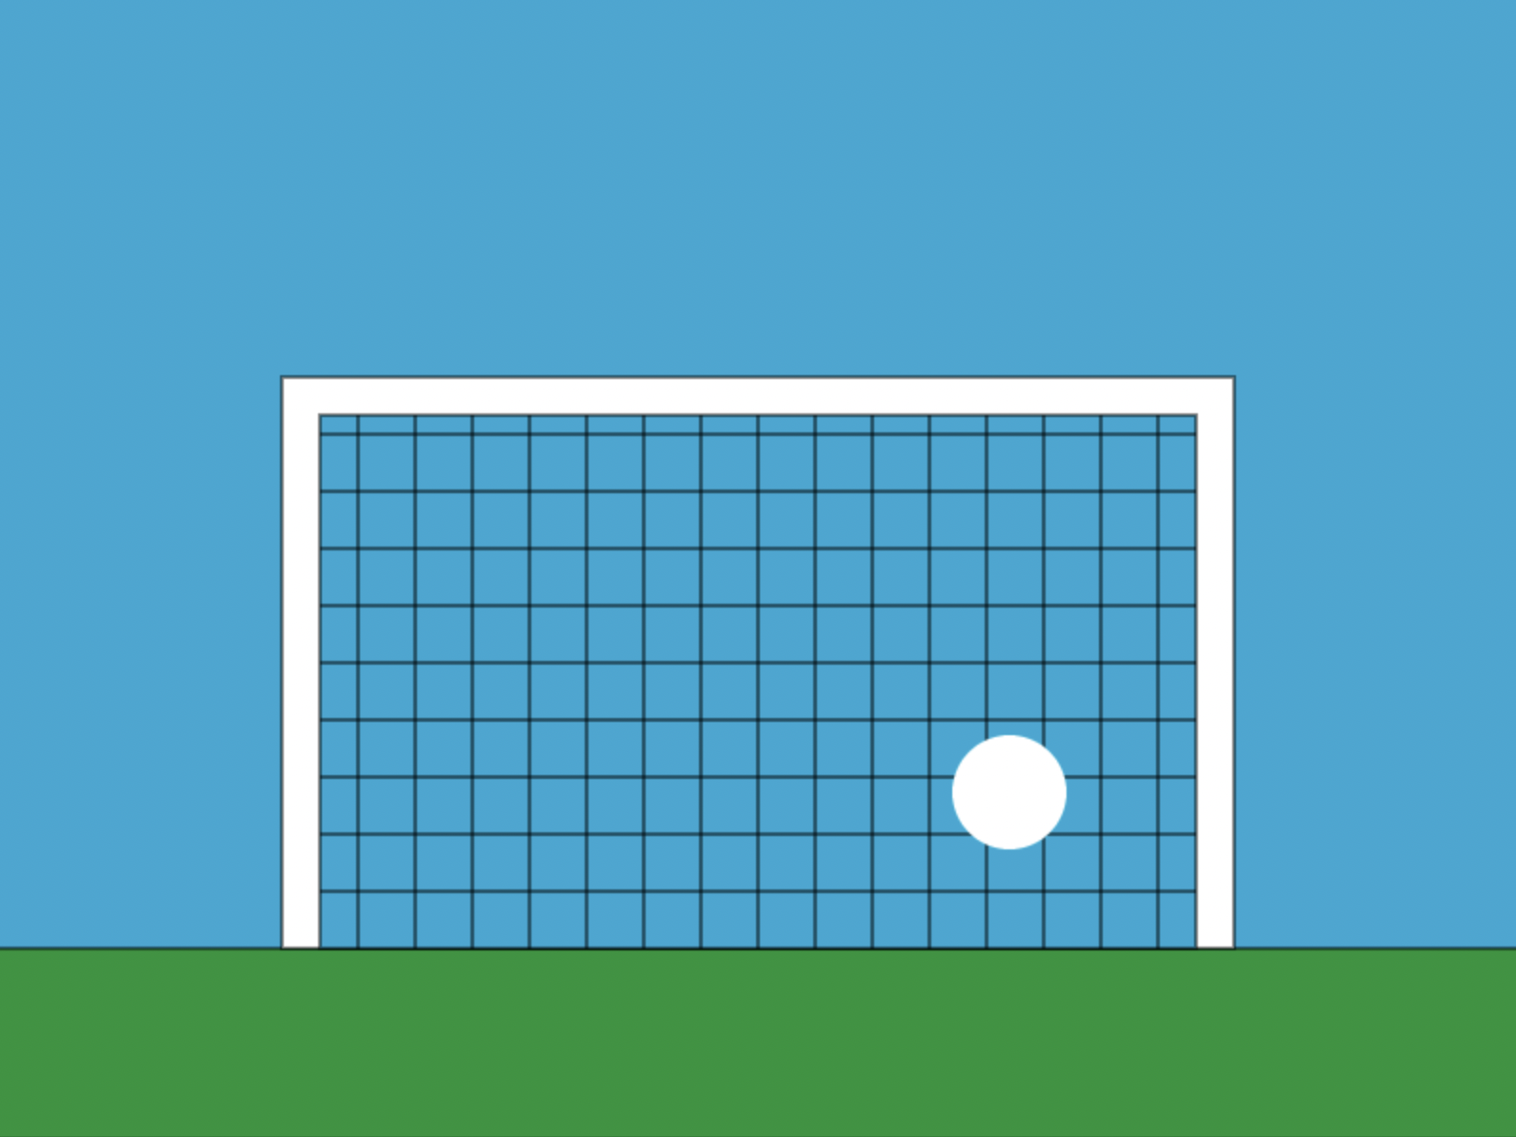
Activity 05.02 - Penalty kick
Correct the code and fill in the blanks so that the ball goes from the ground into the goal - but can you get it to stop in the goal?
05.02 - Penalty kick
30

Slide 31
Recap - Class vs Object
What is the class in this code?
What is the object in this code?
from sprite import *
setCanvasSize(400, 400)
background(120, 120, 120)
ball = CircleSprite(-20, -20, 20)
ball.setColour(25, 130, 200)
while True:
background(120, 120, 120)
ball.draw()
ball.moveBy(2, 2)
sleep(0.005)
Notes:
Answer:
Class - CircleSprite
Object - ball

Slide 32
Recap - Attribute vs Method
What is an attribute of the ball object?
What is a method we are using in this code?
from sprite import *
ball = CircleSprite(100, 50, 20)
print(ball.x + ', ' + ball.y)
ball.moveBy(5, 10)
print(ball.x + ' ' + ball.y)
Notes:
Answer:
Attribute - x, y
Method - moveBy(...)

Slide 33

Demo: Bouncing DVD Logo
33

Slide 34

Demo 05.03 - Bouncing DVD Logo
Run this program! Can you make the logo move faster?
Bouncing DVD Logo
34

Slide 35

Demo 05.03 - Bouncing DVD Logo
There was a lot of code to make this demo work
The main code we will focus on is the if statements

Slide 36
Bouncing Ball
from sprite import *
setCanvasSize(400, 400)
background(120, 120, 120)
ball = CircleSprite(-20, -20, 20)
ball.setColour(25, 130, 200)
while True:
background(120, 120, 120)
ball.draw()
ball.moveBy(2, 2)
sleep(0.005)
When we ran this code earlier, the ball would move out of the screen and never return
How could we get it to stay inside the screen?

Slide 37
Bouncing Ball
from sprite import *
setCanvasSize(400, 400)
background(120, 120, 120)
ball = CircleSprite(-20, -20, 20)
ball.setColour(25, 130, 200)
while True:
background(120, 120, 120)
ball.draw()
ball.moveBy(2, 2)
sleep(0.005)
When we ran this code earlier, the ball would move out of the screen and never return
How could we get it to stay inside the screen?
When the ball touches an edge, we make it go back the other way - so it bounces off the walls!

Slide 38
Bouncing Ball
Let's say our orange ball was moving to the right
The line of code to do this would be
ball.moveBy(1,0)

Slide 39
Bouncing Ball
When it hits the right-side wall, we want it to go back the other way
We can do that with this line of code
ball.moveBy(-1,0)
The -1 makes it move left!
But how can we tell when it hit the wall?

Slide 40
Bouncing Ball
But how can we tell when it hit the wall?
We know the width of the canvas - it's stored in a variable called width
PyAngelo creates width whenever we use setCanvasSize(...)
It also stores the height of the canvas in height

Slide 41
Bouncing Ball
But how can we tell when it hit the wall?
The point PyAngelo uses to keep track of our ball is in the centre of the circle
So we know the ball touches the right-side wall when
ball.x + ball.radius = width
ball.radius
ball.x
width

Slide 42
Bouncing Ball
We can use maths and if statements to check if the ball collides with any wall
Use the if statements on the next page to help you make sure the ball always stays on the screen!
radius

Slide 43
Bouncing Ball - Left Wall Collision
We will create new attributes to store the direction of the ball, let’s call them speedX and speedY
This tells PyAngelo to make the ball move right
if (ball.x - ball.radius) <= 0:
ball.speedX = 1

Slide 44
Bouncing Ball - Right Wall Collision
This tells PyAngelo to make the ball move left
if (ball.x + ball.radius) >= width:
ball.speedX = -1

Slide 45
Bouncing Ball - Top Wall Collision
This tells PyAngelo to make the ball move down
if (ball.x + ball.radius) >= height:
ball.speedY = -1

Slide 46
Bouncing Ball - Bottom Wall Collision
This tells PyAngelo to make the ball move up
if (ball.x - ball.radius) <= 0:
ball.speedY = 1

Slide 47

Demo 05.04 - Bouncing Ball
Check out this code to see everything we just did all tied together to make the ball bounce in the canvas!
Bouncing Ball
47

Slide 48

Activity 05.03 - Bouncing Around
Correct the code and fill in the blanks so that the ball bounces around the box.
Use the code we just ran through to help you out – the demo code will help too!
05.04 - Bouncing Around
48

Slide 49
Extension - Bouncing Around
Make the ball change colours every time it hits a wall
05.04 - Bouncing Around
49

Slide 50
Extension - Use another sprite
Try to get another sprite bouncing around the screen
There are some more sprites you can use listed below
PRO TIP - use TextSprite(...) to bring emojis into PyAngelo
rect = RectangleSprite(x, y, width, height)
text = TextSprite("👻", x, y, size)
👻

Slide 51
Summary
Object oriented programming stores all the information about an object as attributes and what actions you can perform on the object as methods
PyAngelo has a sprite library which defines the following classes
CircleSprite(...)
RectangleSprite(...)
TextSprite(...)
Each of these classes have setColour(...), draw(...), moveBy(...), and moveTo(...) methods
51

Slide 52
License Information
These CS in Schools lessons plans, worksheets, and other materials were created by the CS in Schools Team. They are licensed under a Creative Commons Attribution-ShareAlike 4.0 International License.
52

