Slide 1


Lesson 6
Key Presses and Collision Detection
csinschools.com

Slide 2



Previously, on CS in Schools...
ball = CircleSprite(100, 200, 20)
What is the object that we have created called?
What attributes does the object have?
What are some methods the object has?
What class is the object created from?
2
Notes:
Answers:
ball
ball.x, ball.y, ball.radius
draw(), moveBy(), moveTo(), setColour()
CircleSprite class

Slide 3
Learning objectives
By the end of this lesson, you should be able to:
use Text Sprites in PyAngelo
detect key presses in your programs
understand what the term collision detection means
understand the bounding boxes method of collision detection
apply collision detection with PyAngelo sprites in a program
3

Slide 4
Demo 06.01 - Bouncy Duck
Run this program! Can you make the duck move faster?
🦆
Bouncy Duck
4

Slide 5
How to Create a Text Sprite
duck = TextSprite("🦆", x, y, size)
To create a TextSprite(...) we need to specify:
Text to turn into a sprite
X position
Y position
Size
🦆
5

Slide 6
TextSprite - Attributes
Editor
duck = TextSprite("🦆", 50, 75, 100)
print(duck.x)
print(duck.y)
print(duck.size)
print(duck.text)
Once we have created our TextSprite, we access the attributes using the dot notation
eg/ duck.x
Console
50 75 100 🦆
6

Slide 7
TextSprite - Attributes
Editor
duck = TextSprite("🦆", 50, 75, 100)
print(duck.text)
duck.text = "🐸"
print(duck.text)
Once we have created our TextSprite, we access the attributes using the dot notation
eg/ duck.x
We can also update the text with the dot notation
Here we change the duck into a frog!
Console
🦆
🐸
7

Slide 8
TextSprite - Methods
Editor
duck = TextSprite("🦆", 50, 75, 100)
duck.moveTo(x, y)
duck.moveBy(x, y)
duck.setColour(100, 120, 300)
duck.draw()
All of the same methods still apply:
.moveTo(x, y)
.moveBy(x, y)
.setColour(R, G, B)
.draw()
Can you remember what these methods do?
Console
8
Notes:
.moveTo - moves to the specified x and y
.moveBy - adds the specified x and y onto the existing x and y
.setColour - sets the colour of the sprite
.draw - draws the sprite

Slide 9

Activity 06.01 - The Farmyard
Draw some text sprites to fill up the farmyard with animals! If you want, you can try to animate them.
06.01 - The Farmyard
9

Slide 10

Demo 06.02 - Butter Fly
Run this program! Can you make the butter fly?
Butter Fly
10

Slide 11

Checking if the A key is pressed
Editor
if isKeyPressed(KEY_A):
butter.moveBy(-1, 0)
PyAngelo has a built in function to detect if a key is pressed
This function is called isKeyPressed(...)
11

Slide 12
Checking if the A key is pressed
Editor
if isKeyPressed(KEY_A):
butter.moveBy(-1, 0)
To check to see if a key is pressed, we pass it in as an argument
This code is checking to see if the A key is pressed
We check for the following letters with the following variables:
B: KEY_B
C: KEY_C
and so on
12

Slide 13
Checking if the A key is pressed
Editor
if isKeyPressed(KEY_A):
butter.moveBy(-1, 0)
You can find all the keys and their variables here
13

Slide 14
Checking if the A key is pressed
Editor
if isKeyPressed(KEY_A):
butter.moveBy(-1, 0)
If the key you are checking for is pressed, the function returns True
Using an if statement, we can then execute some code
If the key is not pressed, the function returns False and nothing happens
14

Slide 15

Checking if the A key is pressed
Editor
if isKeyPressed(KEY_A):
butter.moveBy(-1, 0)
If the key you are checking for is pressed, the function returns True
Using an if statement, we can then execute some code
If the key is not pressed, the function returns False and nothing happens
A
15

Slide 16
Checking if the A key is pressed
Editor
if isKeyPressed(KEY_A):
butter.moveBy(-1, 0)
If the key you are checking for is pressed, the function returns True
Using an if statement, we can then execute some code
If the key is not pressed, the function returns False and nothing happens
A
16

Slide 17

Activity 06.02 - Subsonic the Hedgehog
Add in code to control Subsonic the Hedgehog using the I, J, K and L keys. Then, play with a friend to help Subsonic escape the tornado!
06.02 - Subsonic the Hedgehog
17

Slide 18
Collision Detection
The four methods we have discussed so far are:
draw()
moveBy(x, y)
moveTo(x, y)
setColour(R, G, B)
But, there is one more!
18

Slide 19
Collision Detection
object1.overlaps(object2)
This method lets us check to see if one object overlaps another!
19

Slide 20
Collision Detection
object1.overlaps(object2)
This method lets us check to see if one object overlaps another!
We pass into the method another object
The method returns True if there is a collision between the two objects
20

Slide 21
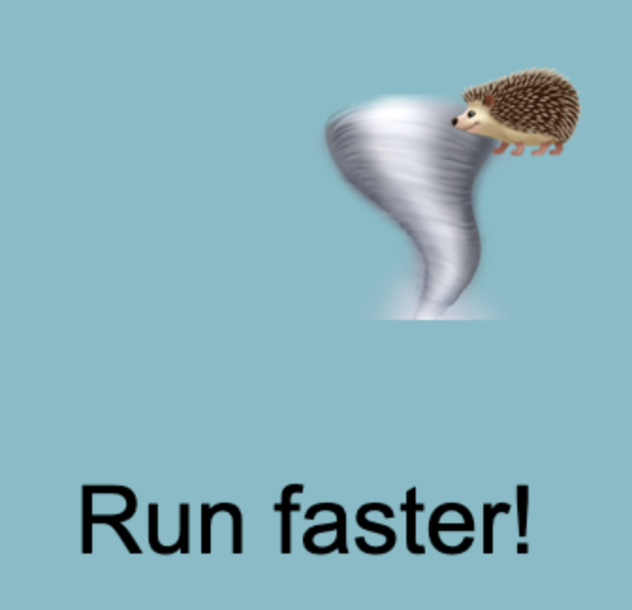
Collision Detection
object1.overlaps(object2)
The code below will tell Subsonic to run faster if the tornado catches him.
tornado = TextSprite("🌪", 100, 100, 100)
hedgehog = TextSprite("🦔", 600, 600, 70)
tornado.draw()
hedgehog.draw()
if tornado.overlaps(hedgehog)
text("Run faster!", 400, 400, 20)

Slide 22
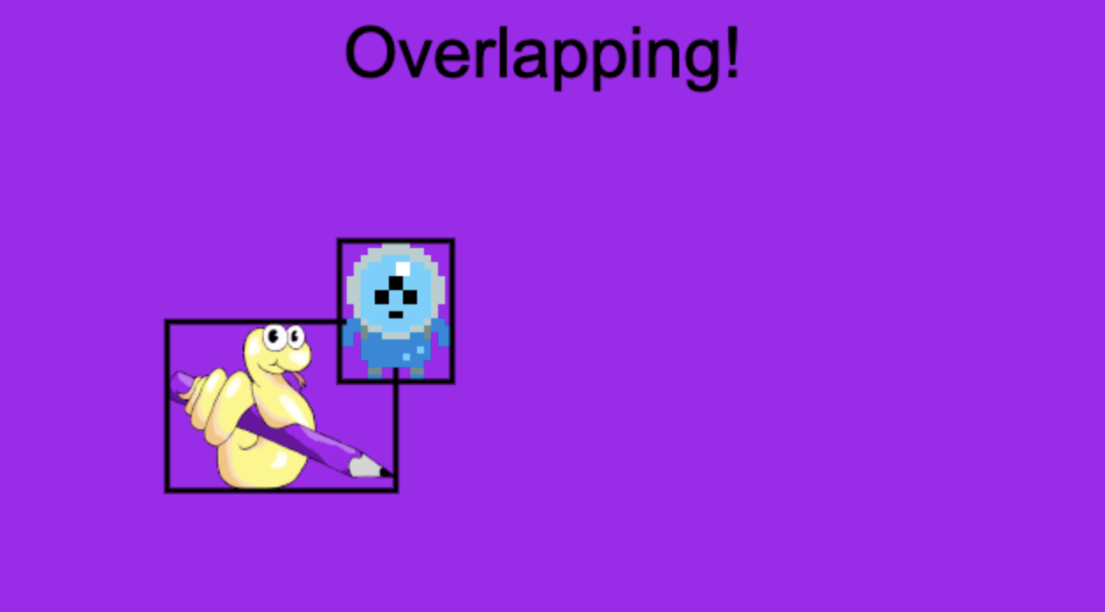
Demo 06.03 - Bounding Boxes
Run this program! Why does it say the objects are overlapping when the alien and the snake are not actually touching?
Bounding Boxes
22

Slide 23
Demo 06.03 - Bounding Boxes
In the demo you just tried:
Why does the text “Overlapping!” appear sometimes even when the images do not seem to be overlapping?
Which of the two images would be better for use in a game and why?
23
Notes:
The images used to make sprites have a perimeter that does not match the image you see exactly. This perimeter, or bounding box, is hidden by PyAngelo, but it forms the rectangle that is used to determine if Sprites are colliding, in the demo we made it so you can see the hidden rectangle
The alien takes up more of the perimeter and so the bounding boxes method would look more realistic with the alien image rather than the image of the PyAngelo snake

Slide 24

Activity 06.03 - Adding Collision Detection
Modify your program to detect when the two text sprites overlap.
06.03 - Adding Collision Detection
24

Slide 25
Extension - Make it a game!
Here are some more features to add to Subsonic the Hedgehog:
If the tornado touches Subsonic, teleport Subsonic to a new location (HINT: use the moveTo(...) method)
Create and display a score variable that increases every time the tornado catches Subsonic
Display a game title as a TextSprite moving across the top of the screen
Add in a third character with its’ own controls
Make sure none of the sprites can leave the screen
25

Slide 26
Summary
The isKeyPressed(...) function detects if a key is currently being pressed
It returns True if the key is pressed otherwise it returns False
Sprites in PyAngelo can detect if they are touching other sprites
This is done with the .overlaps(...) method
This uses the bounding boxes method of collision detection
Bounding boxes can be misleading - especially if the image doesn’t fill a rectangle nicely!
26

Slide 27
License Information
These CS in Schools lessons plans, worksheets, and other materials were created by the CS in Schools Team. They are licensed under a Creative Commons Attribution-ShareAlike 4.0 International License.
27

