Slide 1


Lesson 7
Building Your Game
csinschools.com

Slide 2



Previously, on CS in Schools...
duck = TextSprite("🦆", 50, 75, 100)
What attribute should be printed to show 50 in the console?
duck.x
duck.y
duck.size
duck.location
2
Notes:
Answer: A

Slide 3
Previously, on CS in Schools...
if isKeyPressed(______):
What variable should we use in the if statement to check if the ‘A’ key is pressed?
keyA
KEY_A
A_key
THEBUTTONA
3
Notes:
Answer: B

Slide 4
Previously, on CS in Schools...
if tornado.overlaps(hedgehog):
What does the above line of code check for?
What are some issues with this method?
4
Notes:
Answers:
if the tornado and hedgehog sprites are overlapping
the bounding boxes might not be accurate, meaning the PyAngelo says there is a collision when it doesn’t look like there is

Slide 5
Learning objectives
By the end of this lesson, you should be able to:
begin working on your assignment
understand what you need to do to be successful in this assignment
know where to find the assignment rubric, description and template code
5

Slide 6


Your Assignment
Case Study SuperstarClothing have begun getting very popular, and their servers cannot cope. They have asked teens to develop a game that they can put in their online waiting room to keep customers entertained while they wait to enter the main site.
Description
Rubric

Slide 7
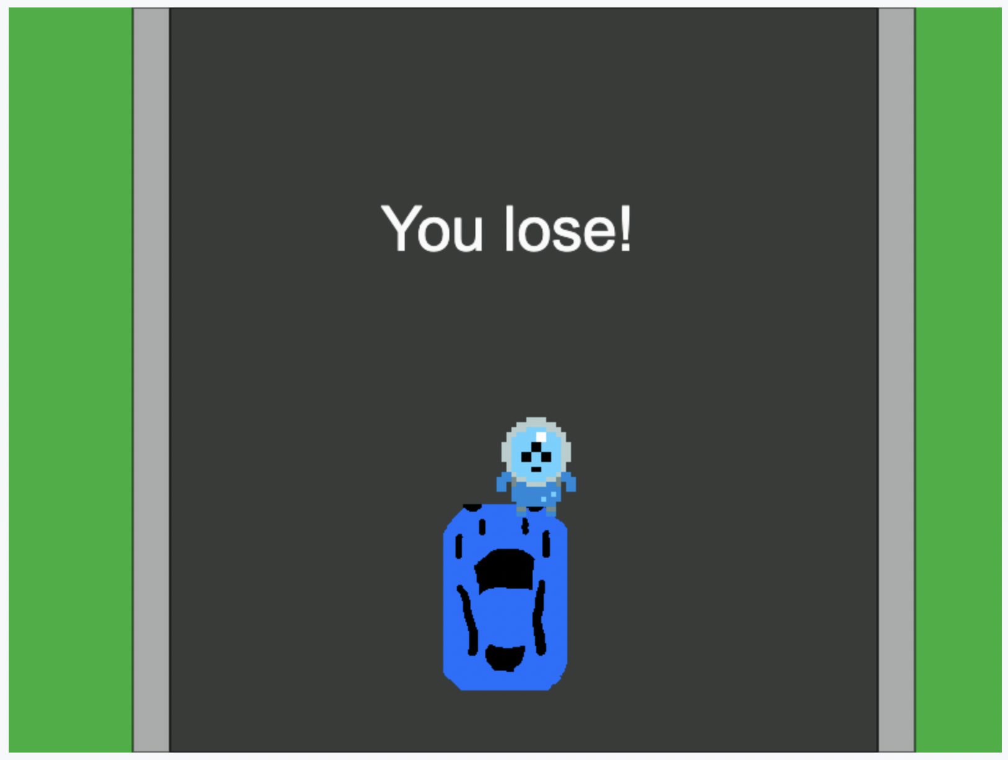
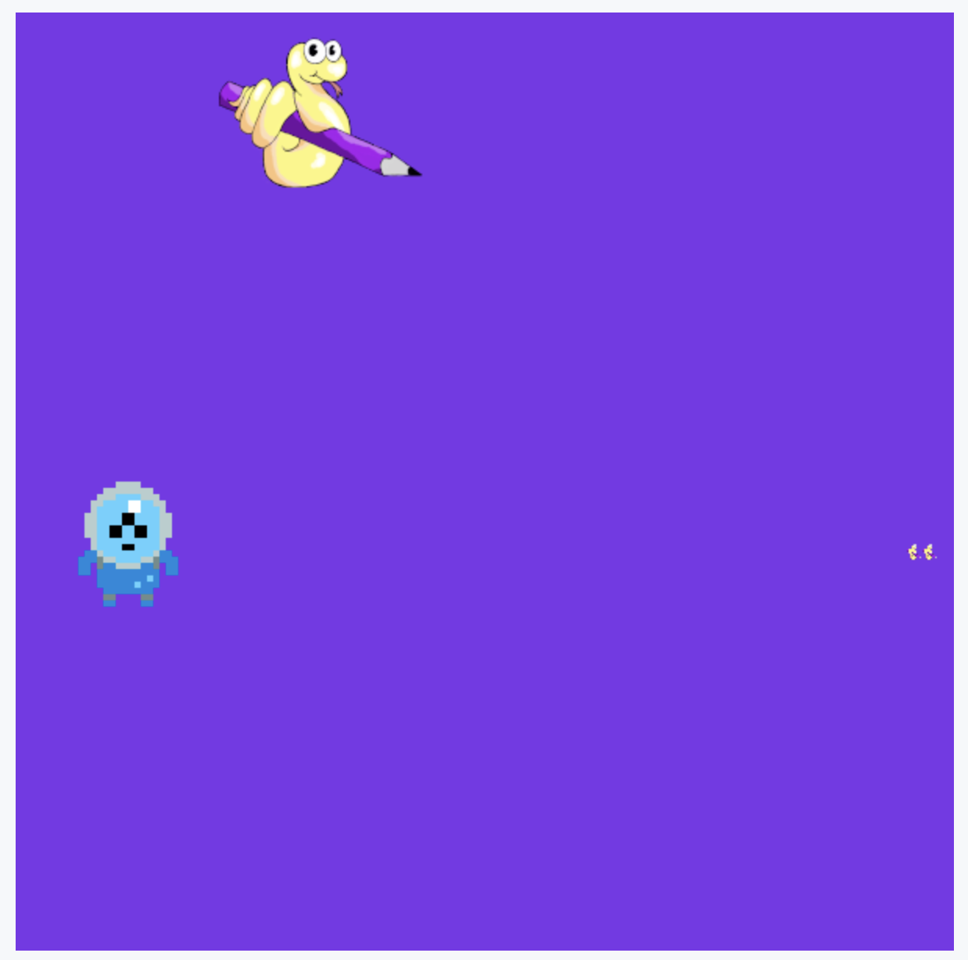
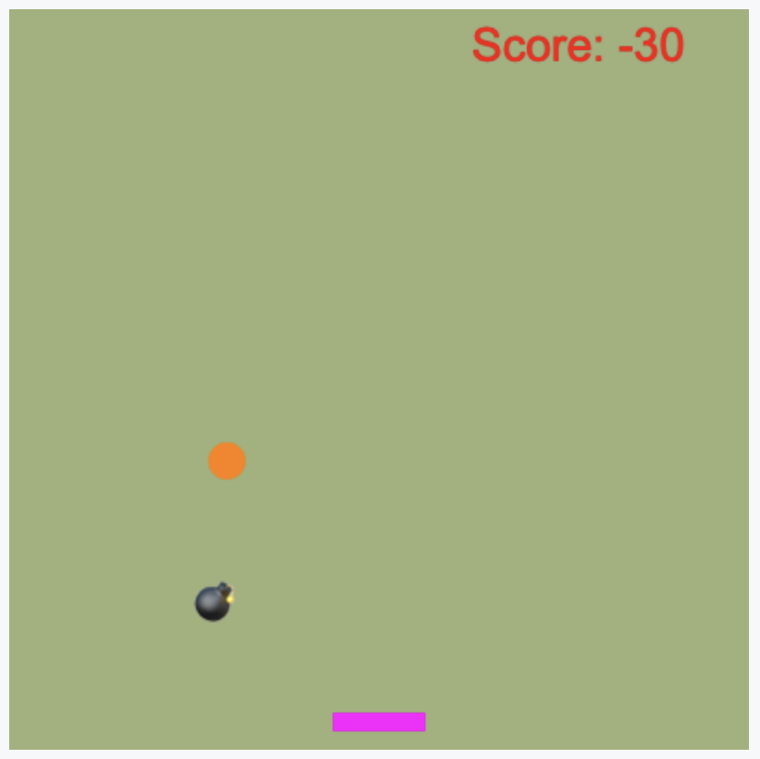
Get some ideas….
Open up these games and have a go at playing them!
Take a look through the code, you don’t need to make any changes
There are comments at the top as suggested improvements, maybe you want to consider these for your own game…
Avoid the Alien
Space Hunter
Catch the Ball

Slide 8


A High Scoring Assignment
Here is an example of an assignment that would score highly. Use this as inspiration.
High Scoring Example
8

Slide 9
Planning
Before any project, it is important to plan!
Use the worksheets in the description to help you plan out your project.
Description

Slide 10

Activity 07.01 - Building Your Game
Here is some template (skeleton) code to help you get started! Follow the instructions in the description to help you out.
07.01 - My Game
10

Slide 11
License Information
These CS in Schools lessons plans, worksheets, and other materials were created by the CS in Schools Team. They are licensed under a Creative Commons Attribution-ShareAlike 4.0 International License.
11

