Slide 1

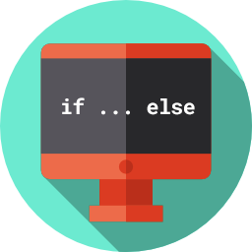
Lesson 3
Decisions, Decisions!
csinschools.com

Slide 2



Previously, on CS in Schools...
The following code produces an error. Can you figure out what's wrong and how to fix it?
your_age = input("Enter your age:")
years_needed = 18 - your_age
Notes:
Answer:
years_needed = 18 - int(your_age)

Slide 3
Previously, on CS in Schools...
Which of the following lines of code correctly increases lives by 10?
a) lives = + 10
b) lives = lives + 10
c) lives + 10
d) increase lives by 10
Notes:
Answer:
(b)

Slide 4
Previously, on CS in Schools...
If the user types in 14 when asked for their age, what will be displayed on the screen after the following code is run:
age = input("Please enter your age:")
if age == "15":
print("We are not twins!")
if age == "14":
print("We could be twins!")
Notes:
Answer:
We could be twins!

Slide 5
Learning objectives
By the end of this lesson, you should be able to:
understand how to use if and elif statements to handle three or more options
understand how to use the else statement to handle all other cases or when input doesn't make sense

Slide 6

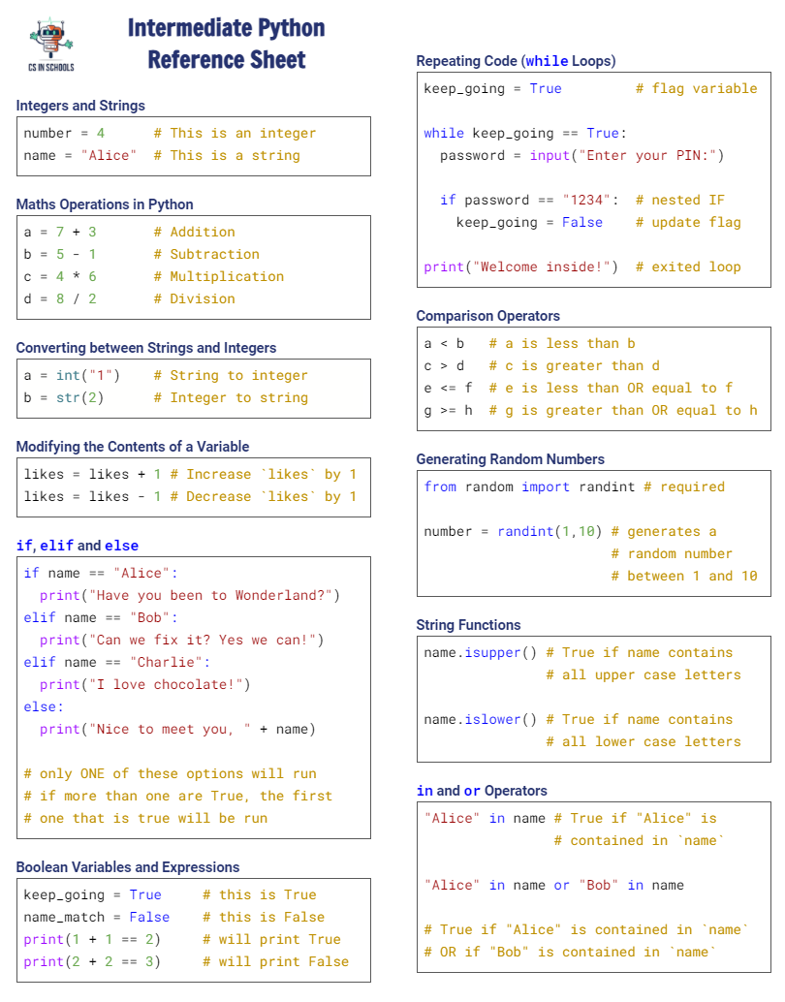

Python Reference Sheet
Python Reference Sheet
Print it out and use it!
Get it online. (Microsoft)
6

Slide 7

Activity: Academy Awards
Click here to answer this Oscars Award trivia!

Slide 8

if statements for multiple options
Click here for more info on if statements
In the previous course, we learned about if statements and how to control what happens when the expression was either True or False
Notice that the Academy Awards quiz can do something more complicated:
Did you notice how it could recognise more than two different types of responses (a, b, c, or d)?
Did you notice that if you type a response that it doesn't understand, it can display an error message? (Try typing e or another answer that isn't a, b, c, or d)
When is it useful to be able to accept more than two responses?
What could you build if you could accept more than two responses?

Slide 9
if statements for multiple options
Click here for more info on if statements
When is it useful to be able to accept more than two responses?
Video games - direction, picking up objects, choosing what to do next
Changing the radio in your car - more than two radio stations!
Choosing a show on Netflix
What could you build if you could accept more than two responses?
Games
Streaming sites
Remote controls
Online stores

Slide 10
Trivia Responses
If the user answered... | The program displays...
a | Correct! It is one of the reasons for the saying 'bigger than Ben-Hur'.
b | The answer is Ben-Hur. La La Land did, however, win 6 Academy Awards in 2016.
c | The answer is Ben-Hur. Titanic did win 11 Academy Awards, but it occurred later, in 1998.
d | The answer is Ben-Hur. Sound of Music won 5 Academy Awards in 1966.
[anything else] | Sorry, that was not an option.

Slide 11
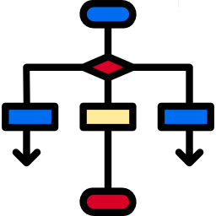
Recap of Flowcharts
A flowchart is a special type of diagram that is used by programmers to help them lay out their step-by-step design for their programs
Flowcharts help us better understand the way computers make "decisions" and how they act differently based on different choices
Flowcharts are written in English, and they often don't use the same keywords as a programming language
Click here for more info on flowcharts
11

Slide 12
Summary of flowchart symbols
Start
Ask user for name
The start and end points of the program.
Wait 5 seconds
The program needs to input information (eg. from the user typing something in) or output something (eg. display text on the screen)
Is the name "John"?
True
Display "Hey! I'm called John, too!"
The program performs an operation or calculation.
False
Display "See ya later!"
The program is making a True/False decision.
End
12

Slide 13
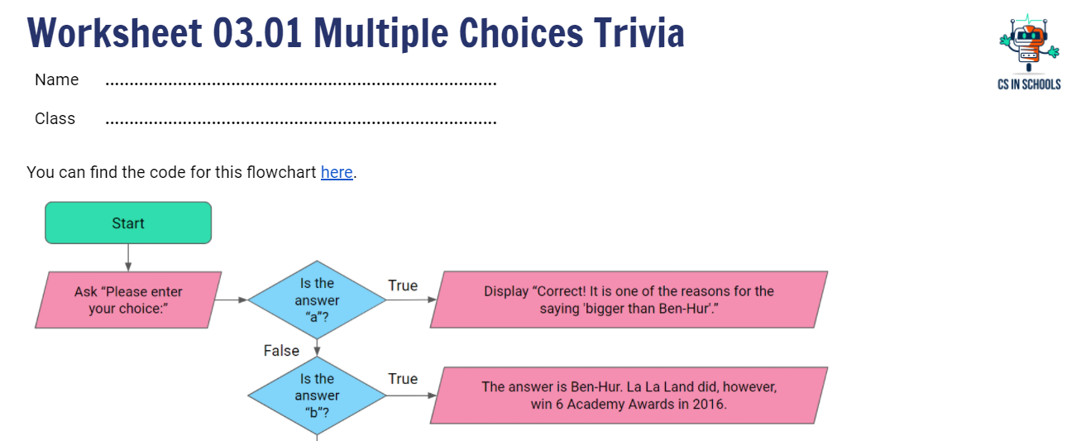
Constructing The Trivia Program's Flowchart
Please follow along with your handout

Slide 14
Trivia Program Flowchart
Start

Slide 15
Trivia Program Flowchart
Start
Ask "Please enter your choice:"

Slide 16
Trivia Program Flowchart
Start
Is the answer "a"?
Ask "Please enter your choice:"

Slide 17
Trivia Program Flowchart
Start
Is the answer "a"?
True
Ask "Please enter your choice:"
Display "Correct! It is one of the reasons for the saying 'bigger than Ben-Hur'."

Slide 18
Trivia Program Flowchart
Start
Is the answer "a"?
True
Ask "Please enter your choice:"
Display "Correct! It is one of the reasons for the saying 'bigger than Ben-Hur'."
False
Is the answer "b"?

Slide 19
Trivia Program Flowchart
Start
Is the answer "a"?
True
Ask "Please enter your choice:"
Display "Correct! It is one of the reasons for the saying 'bigger than Ben-Hur'."
False
Is the answer "b"?
True
The answer is Ben-Hur. La La Land did, however, win 6 Academy Awards in 2016.

Slide 20
Trivia Program Flowchart
Start
Is the answer "a"?
True
Ask "Please enter your choice:"
Display "Correct! It is one of the reasons for the saying 'bigger than Ben-Hur'."
False
Is the answer "b"?
True
The answer is Ben-Hur. La La Land did, however, win 6 Academy Awards in 2016.
False
Is the answer "c"?

Slide 21
Trivia Program Flowchart
Start
Is the answer "a"?
True
Ask "Please enter your choice:"
Display "Correct! It is one of the reasons for the saying 'bigger than Ben-Hur'."
False
Is the answer "b"?
True
The answer is Ben-Hur. La La Land did, however, win 6 Academy Awards in 2016.
False
Is the answer "c"?
True
The answer is Ben-Hur. Titanic did win 11 Academy Awards, but it occurred later, in 1998.

Slide 22
Trivia Program Flowchart
Start
Is the answer "a"?
True
Ask "Please enter your choice:"
Display "Correct! It is one of the reasons for the saying 'bigger than Ben-Hur'."
False
Is the answer "b"?
True
The answer is Ben-Hur. La La Land did, however, win 6 Academy Awards in 2016.
False
Is the answer "c"?
True
The answer is Ben-Hur. Titanic did win 11 Academy Awards, but it occurred later, in 1998.
False
Is the answer "d"?

Slide 23
Trivia Program Flowchart
Start
Is the answer "a"?
True
Ask "Please enter your choice:"
Display "Correct! It is one of the reasons for the saying 'bigger than Ben-Hur'."
False
Is the answer "b"?
True
The answer is Ben-Hur. La La Land did, however, win 6 Academy Awards in 2016.
False
Is the answer "c"?
True
The answer is Ben-Hur. Titanic did win 11 Academy Awards, but it occurred later, in 1998.
False
Is the answer "d"?
True
The answer is Ben-Hur. Sound of Music won 5 Academy Awards in 1966.

Slide 24
Trivia Program Flowchart
Start
Is the answer "a"?
True
Ask "Please enter your choice:"
Display "Correct! It is one of the reasons for the saying 'bigger than Ben-Hur'."
False
Is the answer "b"?
True
The answer is Ben-Hur. La La Land did, however, win 6 Academy Awards in 2016.
False
Is the answer "c"?
True
The answer is Ben-Hur. Titanic did win 11 Academy Awards, but it occurred later, in 1998.
False
Is the answer "d"?
True
Display "Sorry, that was not an option."
The answer is Ben-Hur. Sound of Music won 5 Academy Awards in 1966.
False

Slide 25
Trivia Program Flowchart
Start
Is the answer "a"?
True
Ask "Please enter your choice:"
Display "Correct! It is one of the reasons for the saying 'bigger than Ben-Hur'."
False
Is the answer "b"?
True
The answer is Ben-Hur. La La Land did, however, win 6 Academy Awards in 2016.
False
Is the answer "c"?
True
The answer is Ben-Hur. Titanic did win 11 Academy Awards, but it occurred later, in 1998.
False
Is the answer "d"?
True
Display "Sorry, that was not an option."
The answer is Ben-Hur. Sound of Music won 5 Academy Awards in 1966.
False
End

Slide 26
if, elif, and else

Slide 27
if, elif, and else
Is the answer "a"?
True
Display "Correct! It is one ...
Is the answer "b"?
True
The answer is Ben-Hur. La La Land ...
Is the answer "c"?
True
The answer is Ben-Hur. Titanic ...
Is the answer "d"?
True
The answer is Ben-Hur. Sound of Music ...
False
Display "Sorry, that was not an option."

Slide 28
if, elif, and else
Is the answer "a"?
True
Display "Correct! It is one ...
Is the answer "b"?
True
The answer is Ben-Hur. La La Land ...
Is the answer "c"?
True
The answer is Ben-Hur. Titanic ...
Is the answer "d"?
True
The answer is Ben-Hur. Sound of Music ...
False
Display "Sorry, that was not an option."

Slide 29
if, elif, and else
if answer == "a":
Is the answer "a"?
True
Display "Correct! It is one ...
Is the answer "b"?
True
The answer is Ben-Hur. La La Land ...
Is the answer "c"?
True
The answer is Ben-Hur. Titanic ...
Is the answer "d"?
True
The answer is Ben-Hur. Sound of Music ...
False
Display "Sorry, that was not an option."

Slide 30
if, elif, and else
if answer == "a":
Is the answer "a"?
True
Display "Correct! It is one ...
Is the answer "b"?
True
The answer is Ben-Hur. La La Land ...
Is the answer "c"?
True
The answer is Ben-Hur. Titanic ...
Is the answer "d"?
True
The answer is Ben-Hur. Sound of Music ...
False
Display "Sorry, that was not an option."

Slide 31
if, elif, and else
if answer == "a":
print("Correct! It is one…")
Is the answer "a"?
True
Display "Correct! It is one ...
Is the answer "b"?
True
The answer is Ben-Hur. La La Land ...
Is the answer "c"?
True
The answer is Ben-Hur. Titanic ...
Is the answer "d"?
True
The answer is Ben-Hur. Sound of Music ...
False
Display "Sorry, that was not an option."

Slide 32
if, elif, and else
if answer == "a":
print("Correct! It is one…")
Is the answer "a"?
True
Display "Correct! It is one ...
Is the answer "b"?
True
The answer is Ben-Hur. La La Land ...
Is the answer "c"?
True
The answer is Ben-Hur. Titanic ...
Is the answer "d"?
True
The answer is Ben-Hur. Sound of Music ...
False
Display "Sorry, that was not an option."

Slide 33
if, elif, and else
if answer == "a":
print("Correct! It is one…")
elif answer == "b":
Is the answer "a"?
True
Display "Correct! It is one ...
Is the answer "b"?
True
The answer is Ben-Hur. La La Land ...
Is the answer "c"?
True
The answer is Ben-Hur. Titanic ...
Is the answer "d"?
True
The answer is Ben-Hur. Sound of Music ...
False
Display "Sorry, that was not an option."

Slide 34
if, elif, and else
if answer == "a":
print("Correct! It is one…")
elif answer == "b":
Is the answer "a"?
True
Display "Correct! It is one ...
Is the answer "b"?
True
The answer is Ben-Hur. La La Land ...
Is the answer "c"?
True
The answer is Ben-Hur. Titanic ...
Is the answer "d"?
True
The answer is Ben-Hur. Sound of Music ...
False
Display "Sorry, that was not an option."

Slide 35
if, elif, and else
if answer == "a":
print("Correct! It is one…")
elif answer == "b":
Is the answer "a"?
True
Display "Correct! It is one ...
Is the answer "b"?
elif is an abbreviation for "else if"
True
The answer is Ben-Hur. La La Land ...
Is the answer "c"?
True
The answer is Ben-Hur. Titanic ...
Is the answer "d"?
True
The answer is Ben-Hur. Sound of Music ...
False
Display "Sorry, that was not an option."

Slide 36
if, elif, and else
if answer == "a":
print("Correct! It is one…")
elif answer == "b":
Is the answer "a"?
True
Display "Correct! It is one ...
Is the answer "b"?
It is used when we want to continue with checking for other options when the first option is False.
True
The answer is Ben-Hur. La La Land ...
Is the answer "c"?
True
The answer is Ben-Hur. Titanic ...
Is the answer "d"?
True
The answer is Ben-Hur. Sound of Music ...
False
Display "Sorry, that was not an option."

Slide 37
if, elif, and else
if answer == "a":
print("Correct! It is one…")
elif answer == "b":
Is the answer "a"?
True
Display "Correct! It is one ...
Is the answer "b"?
It is used when we want to continue with checking for other options when the first option is False.
True
The answer is Ben-Hur. La La Land ...
Is the answer "c"?
True
The answer is Ben-Hur. Titanic ...
Is the answer "d"?
True
The answer is Ben-Hur. Sound of Music ...
False
Display "Sorry, that was not an option."

Slide 38
if, elif, and else
False!
if answer == "a":
print("Correct! It is one…")
elif answer == "b":
Is the answer "a"?
True
Display "Correct! It is one ...
Is the answer "b"?
It is used when we want to continue with checking for other options when the first option is False.
True
The answer is Ben-Hur. La La Land ...
Is the answer "c"?
True
The answer is Ben-Hur. Titanic ...
Is the answer "d"?
True
The answer is Ben-Hur. Sound of Music ...
False
Display "Sorry, that was not an option."

Slide 39
if, elif, and else
False!
if answer == "a":
print("Correct! It is one…")
elif answer == "b":
Is the answer "a"?
True
Display "Correct! It is one ...
So, let's check this one...
Is the answer "b"?
It is used when we want to continue with checking for other options when the first option is False.
True
The answer is Ben-Hur. La La Land ...
Is the answer "c"?
True
The answer is Ben-Hur. Titanic ...
Is the answer "d"?
True
The answer is Ben-Hur. Sound of Music ...
False
Display "Sorry, that was not an option."

Slide 40
if, elif, and else
if answer == "a":
print("Correct! It is one…")
elif answer == "b":
Is the answer "a"?
True
Display "Correct! It is one ...
Is the answer "b"?
True
The answer is Ben-Hur. La La Land ...
Is the answer "c"?
True
The answer is Ben-Hur. Titanic ...
Is the answer "d"?
True
The answer is Ben-Hur. Sound of Music ...
False
Display "Sorry, that was not an option."

Slide 41
if, elif, and else
if answer == "a":
print("Correct! It is one…")
elif answer == "b":
Is the answer "a"?
True
Display "Correct! It is one ...
Is the answer "b"?
True
The answer is Ben-Hur. La La Land ...
Is the answer "c"?
True
The answer is Ben-Hur. Titanic ...
Is the answer "d"?
True
The answer is Ben-Hur. Sound of Music ...
False
Display "Sorry, that was not an option."

Slide 42
if, elif, and else
if answer == "a":
print("Correct! It is one…")
elif answer == "b":
print("… La La Land …")
Is the answer "a"?
True
Display "Correct! It is one ...
Is the answer "b"?
True
The answer is Ben-Hur. La La Land ...
Is the answer "c"?
True
The answer is Ben-Hur. Titanic ...
Is the answer "d"?
True
The answer is Ben-Hur. Sound of Music ...
False
Display "Sorry, that was not an option."

Slide 43
if, elif, and else
if answer == "a":
print("Correct! It is one…")
elif answer == "b":
print("… La La Land …")
Is the answer "a"?
True
Display "Correct! It is one ...
Is the answer "b"?
True
The answer is Ben-Hur. La La Land ...
Is the answer "c"?
True
The answer is Ben-Hur. Titanic ...
Is the answer "d"?
True
The answer is Ben-Hur. Sound of Music ...
False
Display "Sorry, that was not an option."

Slide 44
if, elif, and else
if answer == "a":
print("Correct! It is one…")
elif answer == "b":
print("… La La Land …")
elif answer == "c":
Is the answer "a"?
True
Display "Correct! It is one ...
Is the answer "b"?
True
The answer is Ben-Hur. La La Land ...
Is the answer "c"?
True
The answer is Ben-Hur. Titanic ...
Is the answer "d"?
True
The answer is Ben-Hur. Sound of Music ...
False
Display "Sorry, that was not an option."

Slide 45
if, elif, and else
if answer == "a":
print("Correct! It is one…")
elif answer == "b":
print("… La La Land …")
elif answer == "c":
Is the answer "a"?
True
Display "Correct! It is one ...
Is the answer "b"?
True
The answer is Ben-Hur. La La Land ...
Is the answer "c"?
True
The answer is Ben-Hur. Titanic ...
Is the answer "d"?
True
The answer is Ben-Hur. Sound of Music ...
False
Display "Sorry, that was not an option."

Slide 46
if, elif, and else
if answer == "a":
print("Correct! It is one…")
elif answer == "b":
print("… La La Land …")
elif answer == "c":
print("… Titanic did …")
Is the answer "a"?
True
Display "Correct! It is one ...
Is the answer "b"?
True
The answer is Ben-Hur. La La Land ...
Is the answer "c"?
True
The answer is Ben-Hur. Titanic ...
Is the answer "d"?
True
The answer is Ben-Hur. Sound of Music ...
False
Display "Sorry, that was not an option."

Slide 47
if, elif, and else
if answer == "a":
print("Correct! It is one…")
elif answer == "b":
print("… La La Land …")
elif answer == "c":
print("… Titanic did …")
Is the answer "a"?
True
Display "Correct! It is one ...
Is the answer "b"?
True
The answer is Ben-Hur. La La Land ...
Is the answer "c"?
True
The answer is Ben-Hur. Titanic ...
Is the answer "d"?
True
The answer is Ben-Hur. Sound of Music ...
False
Display "Sorry, that was not an option."

Slide 48
if, elif, and else
if answer == "a":
print("Correct! It is one…")
elif answer == "b":
print("… La La Land …")
elif answer == "c":
print("… Titanic did …")
elif answer == "d":
Is the answer "a"?
True
Display "Correct! It is one ...
Is the answer "b"?
True
The answer is Ben-Hur. La La Land ...
Is the answer "c"?
True
The answer is Ben-Hur. Titanic ...
Is the answer "d"?
True
The answer is Ben-Hur. Sound of Music ...
False
Display "Sorry, that was not an option."

Slide 49
if, elif, and else
if answer == "a":
print("Correct! It is one…")
elif answer == "b":
print("… La La Land …")
elif answer == "c":
print("… Titanic did …")
elif answer == "d":
Is the answer "a"?
True
Display "Correct! It is one ...
Is the answer "b"?
True
The answer is Ben-Hur. La La Land ...
Is the answer "c"?
True
The answer is Ben-Hur. Titanic ...
Is the answer "d"?
True
The answer is Ben-Hur. Sound of Music ...
False
Display "Sorry, that was not an option."

Slide 50
if, elif, and else
if answer == "a":
print("Correct! It is one…")
elif answer == "b":
print("… La La Land …")
elif answer == "c":
print("… Titanic did …")
elif answer == "d":
print("… Sound of Music …")
Is the answer "a"?
True
Display "Correct! It is one ...
Is the answer "b"?
True
The answer is Ben-Hur. La La Land ...
Is the answer "c"?
True
The answer is Ben-Hur. Titanic ...
Is the answer "d"?
True
The answer is Ben-Hur. Sound of Music ...
False
Display "Sorry, that was not an option."

Slide 51
if, elif, and else
if answer == "a":
print("Correct! It is one…")
elif answer == "b":
print("… La La Land …")
elif answer == "c":
print("… Titanic did …")
elif answer == "d":
print("… Sound of Music …")
Is the answer "a"?
True
Display "Correct! It is one ...
Is the answer "b"?
True
The answer is Ben-Hur. La La Land ...
Is the answer "c"?
True
The answer is Ben-Hur. Titanic ...
Is the answer "d"?
True
The answer is Ben-Hur. Sound of Music ...
False
Display "Sorry, that was not an option."

Slide 52
if, elif, and else
if answer == "a":
print("Correct! It is one…")
elif answer == "b":
print("… La La Land …")
elif answer == "c":
print("… Titanic did …")
elif answer == "d":
print("… Sound of Music …")
else:
print("Sorry that was…")
Is the answer "a"?
True
Display "Correct! It is one ...
Is the answer "b"?
True
The answer is Ben-Hur. La La Land ...
Is the answer "c"?
True
The answer is Ben-Hur. Titanic ...
Is the answer "d"?
True
The answer is Ben-Hur. Sound of Music ...
False
Display "Sorry, that was not an option."

Slide 53
if, elif, and else
if answer == "a":
print("Correct! It is one…")
elif answer == "b":
print("… La La Land …")
elif answer == "c":
print("… Titanic did …")
elif answer == "d":
print("… Sound of Music …")
else:
print("Sorry that was…")
Is the answer "a"?
True
Display "Correct! It is one ...
Is the answer "b"?
True
The answer is Ben-Hur. La La Land ...
Is the answer "c"?
True
The answer is Ben-Hur. Titanic ...
Is the answer "d"?
True
The answer is Ben-Hur. Sound of Music ...
False
Display "Sorry, that was not an option."

Slide 54
if answer == "a":
print("Correct! It is one…")
elif answer == "b":
print("… La La Land …")
elif answer == "c":
print("… Titanic did …")
elif answer == "d":
print("… Sound of Music …")
else:
print("Sorry that was…")
Is the answer "a"?
True
Display "Correct! It is one ...
Is the answer "b"?
True
The answer is Ben-Hur. La La Land ...
Is the answer "c"?
True
The answer is Ben-Hur. Titanic ...
else always comes last
Is the answer "d"?
True
The answer is Ben-Hur. Sound of Music ...
False
Display "Sorry, that was not an option."

Slide 55
if answer == "a":
print("Correct! It is one…")
elif answer == "b":
print("… La La Land …")
elif answer == "c":
print("… Titanic did …")
elif answer == "d":
print("… Sound of Music …")
else:
print("Sorry that was…")
Is the answer "a"?
True
Display "Correct! It is one ...
Is the answer "b"?
True
The answer is Ben-Hur. La La Land ...
Is the answer "c"?
True
The answer is Ben-Hur. Titanic ...
It means: only if everything else above it is False, then do the statement below.
Is the answer "d"?
True
The answer is Ben-Hur. Sound of Music ...
False
Display "Sorry, that was not an option."

Slide 56
if answer == "a":
print("Correct! It is one…")
elif answer == "b":
print("… La La Land …")
elif answer == "c":
print("… Titanic did …")
elif answer == "d":
print("… Sound of Music …")
else:
print("Sorry that was…")
Is the answer "a"?
True
Display "Correct! It is one ...
Is the answer "b"?
True
The answer is Ben-Hur. La La Land ...
Is the answer "c"?
True
The answer is Ben-Hur. Titanic ...
It means: only if everything else above it is False, then do the statement below.
Is the answer "d"?
True
The answer is Ben-Hur. Sound of Music ...
False
Display "Sorry, that was not an option."

Slide 57
if answer == "a":
print("Correct! It is one…")
elif answer == "b":
print("… La La Land …")
elif answer == "c":
print("… Titanic did …")
elif answer == "d":
print("… Sound of Music …")
else:
print("Sorry that was…")
False!
Is the answer "a"?
True
Display "Correct! It is one ...
False!
False!
Is the answer "b"?
True
The answer is Ben-Hur. La La Land ...
False!
Is the answer "c"?
True
The answer is Ben-Hur. Titanic ...
It means: only if everything else above it is False, then do the statement below.
Is the answer "d"?
True
The answer is Ben-Hur. Sound of Music ...
False
Display "Sorry, that was not an option."

Slide 58
if answer == "a":
print("Correct! It is one…")
elif answer == "b":
print("… La La Land …")
elif answer == "c":
print("… Titanic did …")
elif answer == "d":
print("… Sound of Music …")
else:
print("Sorry that was…")
Is the answer "a"?
True
Display "Correct! It is one ...
Is the answer "b"?
True
The answer is Ben-Hur. La La Land ...
Is the answer "c"?
True
The answer is Ben-Hur. Titanic ...
Is the answer "d"?
True
The answer is Ben-Hur. Sound of Music ...
False
Display "Sorry, that was not an option."

Slide 59
if answer == "a":
print("Correct! It is one…")
elif answer == "b":
print("… La La Land …")
elif answer == "c":
print("… Titanic did …")
elif answer == "d":
print("… Sound of Music …")
else:
print("Sorry that was…")
Is the answer "a"?
True
Display "Correct! It is one ...
Is the answer "b"?
True
The answer is Ben-Hur. La La Land ...
Is the answer "c"?
True
The answer is Ben-Hur. Titanic ...
Remember, else and elif are all optional!
Is the answer "d"?
True
The answer is Ben-Hur. Sound of Music ...
False
Display "Sorry, that was not an option."

Slide 60
if answer == "a":
print("Correct! It is one…")
elif answer == "b":
print("… La La Land …")
elif answer == "c":
print("… Titanic did …")
elif answer == "d":
print("… Sound of Music …")
else:
print("Sorry that was…")
Is the answer "a"?
True
Display "Correct! It is one ...
Is the answer "b"?
True
The answer is Ben-Hur. La La Land ...
Is the answer "c"?
True
The answer is Ben-Hur. Titanic ...
Is the answer "d"?
True
The answer is Ben-Hur. Sound of Music ...
False
Display "Sorry, that was not an option."

Slide 61


Activity: Win a Car!
Helpful hint:
Need some help?
Have a look at slide 58 for a similar program
Activity 03.01 Win a Car
61

Slide 62

Activity: Your solar system!
Helpful hint:
Need some help?
Check out the cheat sheet!
Activity 03.02 Your Solar System
62

Slide 63

Activity: In the Burrows!
Tutorial Video:
Need some help?
Watch the tutorial video.
Activity 03.03 In the Burrows
63

Slide 64
Glossary
else: A statement that means only if everything above is False, do the following
elif: If the statement above is false, check if this is True

Slide 65
Summary
if and elif statements allow us to handle three or more options
The else statement is useful to handle all other cases or when the input() doesn't make sense

Slide 66


Reflection: Exit pass
What is one new thing you learnt today?
Write it on a sticky note and stick it on the board before you leave the classroom
66

Slide 67
License Information
These CS in Schools lessons plans, worksheets, and other materials were created by Toan Huynh and Hugh Williams. They are licensed under a Creative Commons Attribution-ShareAlike 4.0 International License.
Images, in order of appearance:
"Award" by Good Ware on flaticon.com
"Our Solar System Features Eight Planets" from NASA
"Mouse" by freepik on flaticon.com

