Slide 1


Lesson 6
String Functions
csinschools.com

Slide 2
Previously, on CS in Schools...
What should we type in the _____________ (blanks) to generate a random number between 1 and 20?
from random import *
rand_num = _____________
print(rand_num)
Notes:
Answer:
randint(1, 20)

Slide 3
Previously, on CS in Schools...
Will the program display "yes" or "no"?
number = 7
if number >= 7:
print("yes")
else:
print("no")
Notes:
Answer:
yes

Slide 4
Previously, on CS in Schools...
Will the program display "yes" or "no"?
number = 10
if number < 10:
print("yes")
else:
print("no")
Notes:
Answer:
no

Slide 5
Previously, on CS in Schools...
Will the program display "yes" or "no"?
number = 5
if number <= 6:
print("yes")
else:
print("no")
Notes:
Answer:
yes

Slide 6
Learning Objectives
By the end of this lesson, you should be able to:
understand how to use string methods to detect for uppercase and lowercase strings
use the in operator to check whether a shorter string exists inside a longer string
combine if conditions together using the or operator

Slide 7
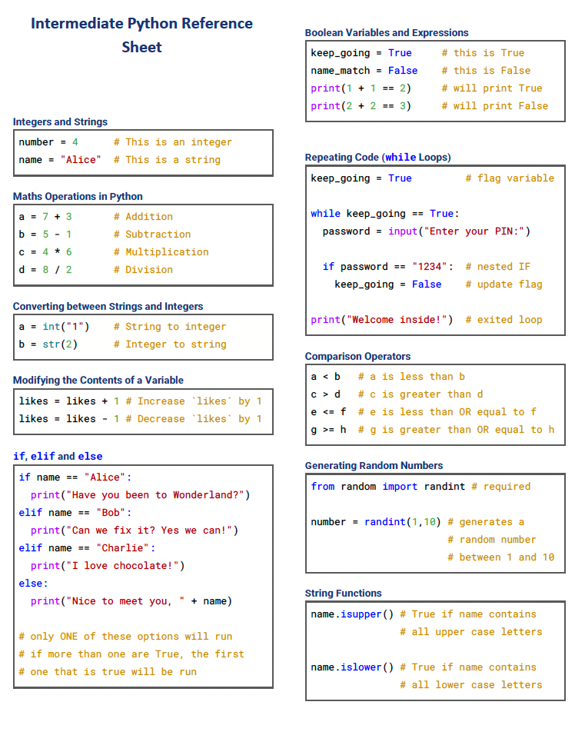
Python Reference Sheet
7

Slide 8

Demo: Speak Louder!
How can you be heard?

Slide 9
keep_talking = True
while keep_talking == True:
speech = input("Say again?")
if speech.isupper() == True:
print("Thanks for SHOUTING!")
keep_talking = False
Let's take a look at a new piece of code that checks if a string is in ALL UPPERCASE

Slide 10
keep_talking = True
while keep_talking == True:
speech = input("Say again?")
if speech.isupper() == True:
print("Thanks for SHOUTING!")
keep_talking = False
.isupper() is a method

Slide 11
keep_talking = True
while keep_talking == True:
speech = input("Say again?")
if speech.isupper() == True:
print("Thanks for SHOUTING!")
keep_talking = False
A method is a piece of code that operates on the object to the left of the . symbol.

Slide 12
keep_talking = True
while keep_talking == True:
speech = input("Say again?")
if speech.isupper() == True:
print("Thanks for SHOUTING!")
keep_talking = False
In this case, speech is a string object and it came from here

Slide 13
keep_talking = True
while keep_talking == True:
speech = input("Say again?")
if speech.isupper() == True:
print("Thanks for SHOUTING!")
keep_talking = False
So the .isupper() method checks if the string to the left of the . is in ALL UPPERCASE.

Slide 14
keep_talking = True
while keep_talking == True:
speech = input("Say again?")
if speech.isupper() == True:
print("Thanks for SHOUTING!")
keep_talking = False
The .isupper() method will only produce 2 results: True or False

Slide 15
keep_talking = True
while keep_talking == True:
speech = input("Say again?")
if speech.isupper() == True:
print("Thanks for SHOUTING!")
keep_talking = False
And we check the result here, in the if statement

Slide 16
keep_talking = True
while keep_talking == True:
speech = input("Say again?")
if speech.isupper() == True:
print("Thanks for SHOUTING!")
keep_talking = False
So this whole line is checking if the speech string is all in UPPERCASE.

Slide 17
keep_talking = True
while keep_talking == True:
speech = input("Say again?")
if speech.isupper() == True:
print("Thanks for SHOUTING!")
keep_talking = False
A review of methods again...
Object.method()

Slide 18
keep_talking = True
while keep_talking == True:
speech = input("Say again?")
if speech.isupper() == True:
print("Thanks for SHOUTING!")
keep_talking = False
This where the name of the method goes.
Object.method()

Slide 19
This is the variable or object that the method acts on.
keep_talking = True
while keep_talking == True:
speech = input("Say again?")
if speech.isupper() == True:
print("Thanks for SHOUTING!")
keep_talking = False
This where the name of the method goes.
Object.method()

Slide 20
This is the variable or object that the method acts on.
keep_talking = True
while keep_talking == True:
speech = input("Say again?")
if speech.isupper() == True:
print("Thanks for SHOUTING!")
keep_talking = False
This where the name of the method goes.
For example…
Object.method()

Slide 21
This is the variable or object that the method acts on.
keep_talking = True
while keep_talking == True:
speech = input("Say again?")
if speech.isupper() == True:
print("Thanks for SHOUTING!")
keep_talking = False
This where the name of the method goes.
For example…
speech.isupper()

Slide 22
keep_talking = True
while keep_talking == True:
speech = input("Say again?")
if speech.isupper() == True:
print("Thanks for SHOUTING!")
keep_talking = False
Can you guess what .islower() does?
speech.islower()

Slide 23
keep_talking = True
while keep_talking == True:
speech = input("Say again?")
if speech.isupper() == True:
print("Thanks for SHOUTING!")
keep_talking = False
It checks to see if all letters are lowercase!
speech.islower()

Slide 24




Activity: Whisper in the Library!
Helpful Hints
You can use .islower(), or you could try .isupper() and !=
Activity 06.01 Whisper in the Library
24

Slide 25

Demo: All About Me!
Can you change the listeners name?

Slide 26
keep_talking = True
print("Say my name to get my attention.")
while keep_talking == True:
speech = input("Say again?")
if "John" in speech:
print("Did you say my name?")
keep_talking = False
Let's take a look at a new piece of code that checks for whether a string contains another shorter string inside it.

Slide 27
keep_talking = True
print("Say my name to get my attention.")
while keep_talking == True:
speech = input("Say again?")
if "John" in speech:
print("Did you say my name?")
keep_talking = False
Let's take a look at a new piece of code that checks for whether a string contains another shorter string inside it.

Slide 28
keep_talking = True
print("Say my name to get my attention.")
while keep_talking == True:
speech = input("Say again?")
if "John" in speech:
print("Did you say my name?")
keep_talking = False
The in operator is the key to performing this check.

Slide 29
keep_talking = True
print("Say my name to get my attention.")
while keep_talking == True:
speech = input("Say again?")
if "John" in speech:
print("Did you say my name?")
keep_talking = False
It checks if the string on the left hand side is contained within the string on the right hand side.

Slide 30
keep_talking = True
print("Say my name to get my attention.")
while keep_talking == True:
speech = input("Say again?")
if "John" in speech:
print("Did you say my name?")
keep_talking = False
It checks if the string on the left hand side is contained within the string on the right hand side.
if "John" in speech:

Slide 31
keep_talking = True
print("Say my name to get my attention.")
while keep_talking == True:
speech = input("Say again?")
if "John" in speech:
print("Did you say my name?")
keep_talking = False
It checks if the string on the left hand side is contained within the string on the right hand side.
if "John" in speech:

Slide 32
keep_talking = True
print("Say my name to get my attention.")
while keep_talking == True:
speech = input("Say again?")
if "John" in speech:
print("Did you say my name?")
keep_talking = False
It checks if the string on the left hand side is contained within the string on the right hand side.
if "John" in speech:

Slide 33
keep_talking = True
print("Say my name to get my attention.")
while keep_talking == True:
speech = input("Say again?")
if "John" in speech:
print("Did you say my name?")
keep_talking = False
It checks if the string on the left hand side is contained within the string on the right hand side.
Am I in here?
if "John" in speech:

Slide 34
keep_talking = True
print("Say my name to get my attention.")
while keep_talking == True:
speech = input("Say again?")
if "John" in speech:
print("Did you say my name?")
keep_talking = False
It checks if the string on the left hand side is contained within the string on the right hand side.
Remember that speech was the variable that contains what the user typed in...
Am I in here?
if "John" in speech:

Slide 35
keep_talking = True
print("Say my name to get my attention.")
while keep_talking == True:
speech = input("Say again?")
if "John" in speech:
print("Did you say my name?")
keep_talking = False
It checks if the string on the left hand side is contained within the string on the right hand side.
If the user had typed in "Hey John, how're you?"
Am I in here?
if "John" in speech:

Slide 36
keep_talking = True
print("Say my name to get my attention.")
while keep_talking == True:
speech = input("Say again?")
if "John" in speech:
print("Did you say my name?")
keep_talking = False
It checks if the string on the left hand side is contained within the string on the right hand side.
If the user had typed in "Hey John, how're you?"
Am I in here?
if "John" in speech:

Slide 37
keep_talking = True
print("Say my name to get my attention.")
while keep_talking == True:
speech = input("Say again?")
if "John" in speech:
print("Did you say my name?")
keep_talking = False
It checks if the string on the left hand side is contained within the string on the right hand side.
If the user had typed in "Hey John, how're you?"
True!
if "John" in speech:

Slide 38
keep_talking = True
print("Say my name to get my attention.")
while keep_talking == True:
speech = input("Say again?")
if "John" in speech:
print("Did you say my name?")
keep_talking = False
It checks if the string on the left hand side is contained within the string on the right hand side.
If the user had typed in "Hi, how're you?"
Am I in here?
if "John" in speech:

Slide 39
keep_talking = True
print("Say my name to get my attention.")
while keep_talking == True:
speech = input("Say again?")
if "John" in speech:
print("Did you say my name?")
keep_talking = False
It checks if the string on the left hand side is contained within the string on the right hand side.
If the user had typed in "Hi, how're you?"
False!
if "John" in speech:

Slide 40
keep_talking = True
print("Say my name to get my attention.")
while keep_talking == True:
speech = input("Say again?")
if "John" in speech:
print("Did you say my name?")
keep_talking = False
All done!

Slide 41

Activity: Secret Code Word!
Helpful Hints
You can use if "string" in variable
Activity 06.02 Secret Code Word
41

Slide 42

Demo: Moods!
Can you add some extra moods?

Slide 43
speech = input("How are you feeling?")
if "good" in speech or "fantastic" in speech or "great" in speech or "amazing" in speech:
print("That's wonderful!")
else:
print("Ok")
print("Let's hang out.")
Let's now see how we can join various conditions together in an if statement so we can do multiple checks at once.

Slide 44
speech = input("How are you feeling?")
if "good" in speech or "fantastic" in speech or "great" in speech or "amazing" in speech:
print("That's wonderful!")
else:
print("Ok")
print("Let's hang out.")
Let's now see how we can join various conditions together in an if statement so we can do multiple checks at once.

Slide 45
speech = input("How are you feeling?")
if "good" in speech or "fantastic" in speech or "great" in speech or "amazing" in speech:
print("That's wonderful!")
else:
print("Ok")
print("Let's hang out.")
We can use the or keyword to join together different conditions so that if ANY of the conditions are True, the whole statement is True.

Slide 46
speech = input("How are you feeling?")
if "good" in speech or "fantastic" in speech or "great" in speech or "amazing" in speech:
print("That's wonderful!")
else:
print("Ok")
print("Let's hang out.")
Notice that the condition is repeated for each or section.

Slide 47
speech = input("How are you feeling?")
if "good" in speech or "fantastic" in speech or "great" in speech or "amazing" in speech:
print("That's wonderful!")
else:
print("Ok")
print("Let's hang out.")
Notice that the condition is repeated for each or section.

Slide 48
speech = input("How are you feeling?")
if "good" in speech or "fantastic" in speech or "great" in speech or "amazing" in speech:
print("That's wonderful!")
else:
print("Ok")
print("Let's hang out.")
Notice that the condition is repeated for each or section.

Slide 49
speech = input("How are you feeling?")
if "good" in speech or "fantastic" in speech or "great" in speech or "amazing" in speech:
print("That's wonderful!")
else:
print("Ok")
print("Let's hang out.")
Notice that the condition is repeated for each or section.

Slide 50
speech = input("How are you feeling?")
if "good" in speech or "fantastic" in speech or "great" in speech or "amazing" in speech:
print("That's wonderful!")
else:
print("Ok")
print("Let's hang out.")
Notice that the condition is repeated for each or section.

Slide 51
speech = input("How are you feeling?")
if "good" in speech or "fantastic" in speech or "great" in speech or "amazing" in speech:
print("That's wonderful!")
else:
print("Ok")
print("Let's hang out.")
Notice that the condition is repeated for each or section.

Slide 52
speech = input("How are you feeling?")
if "good" in speech or "fantastic" in speech or "great" in speech or "amazing" in speech:
print("That's wonderful!")
else:
print("Ok")
print("Let's hang out.")
We can't just do something like this…
if "good" or
"fantastic" or
"great" or
"amazing" in speech:

Slide 53
speech = input("How are you feeling?")
if "good" in speech or "fantastic" in speech or "great" in speech or "amazing" in speech:
print("That's wonderful!")
else:
print("Ok")
print("Let's hang out.")
We can't just do something like this…
if "good" or
"fantastic" or
"great" or
"amazing" in speech:

Slide 54
speech = input("How are you feeling?")
if "good" in speech or "fantastic" in speech or "great" in speech or "amazing" in speech:
print("That's wonderful!")
else:
print("Ok")
print("Let's hang out.")
It needs to be like this.
if "good" in speech or "fantastic" in speech or "great" in speech or "amazing" in speech:

Slide 55
speech = input("How are you feeling?")
if "good" in speech or "fantastic" in speech or "great" in speech or "amazing" in speech:
print("That's wonderful!")
else:
print("Ok")
print("Let's hang out.")
We can use the or keyword to join together different conditions so that if ANY of the conditions are True, the whole statement is True.
String value in the speech variable | Result (True/False)
I'm feeling good
I'm great
I'm amazingly wonderful
I'm fantastically great
I'm terrific
Great
Have a go at filling in the table to the left.

Slide 56
speech = input("How are you feeling?")
if "good" in speech or "fantastic" in speech or "great" in speech or "amazing" in speech:
print("That's wonderful!")
else:
print("Ok")
print("Let's hang out.")
We can use the or keyword to join together different conditions so that if ANY of the conditions are True, the whole statement is True.
String value in the speech variable | Result (True/False)
I'm feeling good | True
I'm great | True
I'm amazingly wonderful | True (why?)
I'm fantastically great | True
I'm terrific | False
Great | False (why?)

Slide 57
speech = input("How are you feeling?")
if "good" in speech or "fantastic" in speech or "great" in speech or "amazing" in speech:
print("That's wonderful!")
else:
print("Ok")
print("Let's hang out.")
We can use the or keyword to join together different conditions so that if ANY of the conditions are True, the whole statement is True.
String value in the speech variable | Result (True/False)
I'm feeling good | True
I'm great | True
I'm amazingly wonderful | True (why?)
I'm fantastically great | True
I'm terrific | False
Great | False (why?)

Slide 58

Activity: Favourite Feed!
Activity 06.03 Favourite Food
58

Slide 59

Summary
String methods can be used to detect uppercase and lowercase strings
The in operator can be used to check whether a shorter string exists inside a longer string
You can combine if conditions together using the or operator
59

Slide 60


Reflection: Exit pass
What is one new thing you learnt today?
Write it on a sticky note and stick it on the board before you leave the classroom
60

Slide 61
License Information
These CS in Schools lessons plans, worksheets, and other materials were created by Toan Huynh and Hugh Williams. They are licensed under a Creative Commons Attribution-ShareAlike 4.0 International License.
Images, in order of appearance:
"Loud" by freepik on flaticon.com
"Talking" by freepik on flaticon.com
"Whisper" by freepik on flaticon.com
"Secret Code" by Eucalyp on flaticon.com
"Food" by wanicon on flaticon.com

