Slide 1


Lesson 2
Integers and Strings
1 2 3
csinschools.com

Slide 2



Previously, on CS in Schools...
What is the final value of x?
x = 2
y = 1
x = 2 * (y + 3)
Notes:
Answer:
8

Slide 3
Previously, on CS in Schools...
What is the final value of x?
x = 2
y = 1
y = x * 3
x = y + 3
Notes:
Answer:
9

Slide 4


Learning objectives
By the end of this lesson, you should be able to:
understand how to convert a text variable to a number variable and why this would be needed
perform maths on numbers that users type in

Slide 5

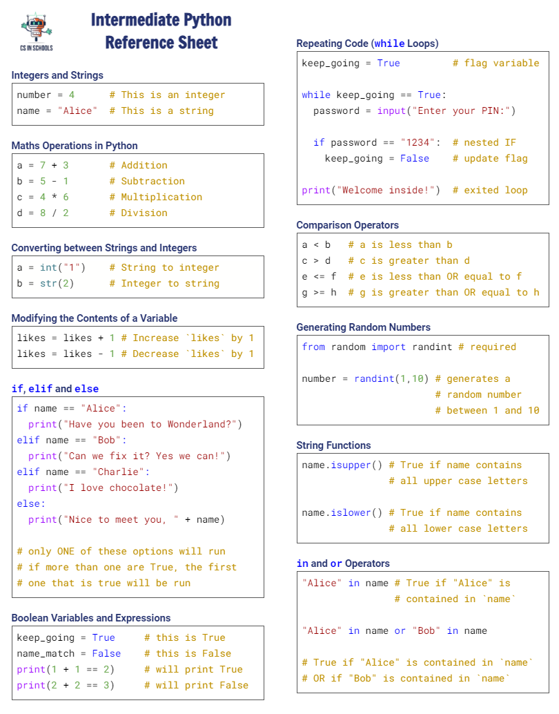

Python Reference Sheet
Python Reference Sheet
Print it out and use it!
Get it online. (Microsoft)
5

Slide 6

How many more years before you can drive?
What is wrong with this program when it runs?

Slide 7
Changing string to int
your_age = input("Enter your age:")
years_needed = 18 - your_age
print("You only need...")
print(years_needed)
print("... more year(s) before you can drive!")

Slide 8
Changing string to int
your_age = input("Enter your age:")
years_needed = 18 - your_age
print("You only need...")
print(years_needed)
print("... more year(s) before you can drive!")

Slide 9
Changing string to int
your_age = input("Enter your age:")
years_needed = 18 - your_age
print("You only need...")
print(years_needed)
print("... more year(s) before you can drive!")
The input() command will always give us back some text

Slide 10
Changing string to int
your_age = input("Enter your age:")
years_needed = 18 - your_age
print("You only need...")
print(years_needed)
print("... more year(s) before you can drive!")
The input() command will always give us back some text

Slide 11
Changing string to int
your_age = input("Enter your age:")
years_needed = 18 - your_age
print("You only need...")
print(years_needed)
print("... more year(s) before you can drive!")
The input() command will always give us back a string

Slide 12

Changing string to int
your_age = input("Enter your age:")
years_needed = 18 - your_age
print("You only need...")
print(years_needed)
print("... more year(s) before you can drive!")
The input() command will always give us back a string
Click here for more info on the input() function and strings.

Slide 13
Changing string to int
your_age = input("Enter your age:")
years_needed = 18 - your_age
print("You only need...")
print(years_needed)
print("... more year(s) before you can drive!")
The input() command will always give us back a string
These are examples of strings:
"John"
"text124"
"13"

Slide 14
Changing string to int
your_age = input("Enter your age:")
years_needed = 18 - your_age
print("You only need...")
print(years_needed)
print("... more year(s) before you can drive!")
The input() command will always give us back a string
These are examples of strings:
"John"
"text124"
"13"

Slide 15
Changing string to int
your_age = input("Enter your age:")
years_needed = 18 - your_age
print("You only need...")
print(years_needed)
print("... more year(s) before you can drive!")
The input() command will always give us back a string
These are examples of strings:
"John"
"text124"
"13" <- Even though this looks a number, it is considered a string

Slide 16
Changing string to int
your_age = input("Enter your age:")
years_needed = 18 - your_age
print("You only need...")
print(years_needed)
print("... more year(s) before you can drive!")
The input() command will always give us back a string
These are examples of strings:
"John"
"text124"
"13" <- Even though this looks a number, it is considered a string
You cannot add, subtract, multiply, divide or do any maths on it

Slide 17
Changing string to int
your_age = input("Enter your age:")
years_needed = 18 - your_age
print("You only need...")
print(years_needed)
print("... more year(s) before you can drive!")
The input() command will always give us back a string

Slide 18
Changing string to int
your_age = input("Enter your age:")
years_needed = 18 - your_age
print("You only need...")
print(years_needed)
print("... more year(s) before you can drive!")
The input() command will always give us back a string
This has to be the case because the user could type anything: numbers or letters or symbols

Slide 19
Changing string to int
your_age = input("Enter your age:")
years_needed = 18 - your_age
print("You only need...")
print(years_needed)
print("... more year(s) before you can drive!")
The input() command will always give us back a string
This has to be the case because the user could type anything: numbers or letters or symbols
So Python puts everything into a string to be safe

Slide 20
Changing string to int
your_age = input("Enter your age:")
years_needed = 18 - your_age
print("You only need...")
print(years_needed)
print("... more year(s) before you can drive!")
The input() command will always give us back a string

Slide 21
Changing string to int
your_age = input("Enter your age:")
years_needed = 18 - your_age
print("You only need...")
print(years_needed)
print("... more year(s) before you can drive!")
The input() command will always give us back a string

Slide 22
Changing string to int
your_age = input("Enter your age:")
years_needed = 18 - your_age
print("You only need...")
print(years_needed)
print("... more year(s) before you can drive!")
The input() command will always give us back a string
We now assign a string to your_age (so inside the your_age variable is a string)

Slide 23
Changing string to int
your_age = input("Enter your age:")
years_needed = 18 - your_age
print("You only need...")
print(years_needed)
print("... more year(s) before you can drive!")
The input() command will always give us back a string
We now assign a string to your_age (so inside the your_age variable is a string)

Slide 24
Changing string to int
your_age = input("Enter your age:")
years_needed = 18 - your_age
print("You only need...")
print(years_needed)
print("... more year(s) before you can drive!")
The input() command will always give us back a string
We now assign a string to your_age (so inside the your_age variable is a string)
Now we are trying to do some maths on the string:
18 - your_age

Slide 25
Changing string to int
your_age = input("Enter your age:")
years_needed = 18 - your_age
print("You only need...")
print(years_needed)
print("... more year(s) before you can drive!")
The input() command will always give us back a string
We now assign a string to your_age (so inside the your_age variable is a string)
Now we are trying to do some maths on the string:
18 - your_age

Slide 26
Changing string to int
your_age = input("Enter your age:")
years_needed = 18 - your_age
print("You only need...")
print(years_needed)
print("... more year(s) before you can drive!")
The input() command will always give us back a string
We now assign a string to your_age (so inside the your_age variable is a string)
Now we are trying to do some maths on the string:
18 - "12"

Slide 27
Changing string to int
your_age = input("Enter your age:")
years_needed = 18 - your_age
print("You only need...")
print(years_needed)
print("... more year(s) before you can drive!")
The input() command will always give us back a string
We now assign a string to your_age (so inside the your_age variable is a string)
Now we are trying to do some maths on the string:
18 - "12"

Slide 28
Changing string to int
your_age = input("Enter your age:")
years_needed = 18 - your_age
print("You only need...")
print(years_needed)
print("... more year(s) before you can drive!")
The input() command will always give us back a string
We now assign a string to your_age (so inside the your_age variable is a string)
Now we are trying to do some maths on the string:
18 - "12"
Python does not know how to do this!

Slide 29
Changing string to int
your_age = input("Enter your age:")
years_needed = 18 - your_age
print("You only need...")
print(years_needed)
print("... more year(s) before you can drive!")
The input() command will always give us back a string
We now assign a string to your_age (so inside the your_age variable is a string)
So we must convert your_age to a number

Slide 30
Changing string to int
your_age = input("Enter your age:")
years_needed = 18 - your_age
print("You only need...")
print(years_needed)
print("... more year(s) before you can drive!")
The input() command will always give us back a string
We now assign a string to your_age (so inside the your_age variable is a string)
So we must convert your_age to a number
This is how we do it...

Slide 31
Changing string to int
your_age = input("Enter your age:")
years_needed = 18 - int(your_age)
print("You only need...")
print(years_needed)
print("... more year(s) before you can drive!")
The input() command will always give us back a string
We now assign a string to your_age (so inside the your_age variable is a string)
So we must convert your_age to a number
This is how we do it...

Slide 32
Changing string to int
your_age = input("Enter your age:")
years_needed = 18 - int(your_age)
print("You only need...")
print(years_needed)
print("... more year(s) before you can drive!")
int() stands for integer

Slide 33
Changing string to int
your_age = input("Enter your age:")
years_needed = 18 - int(your_age)
print("You only need...")
print(years_needed)
print("... more year(s) before you can drive!")
int() stands for integer
An integer is a whole number, like 3 or 12

Slide 34
Changing string to int
your_age = input("Enter your age:")
years_needed = 18 - int(your_age)
print("You only need...")
print(years_needed)
print("... more year(s) before you can drive!")
int() stands for integer
An integer is a whole number, like 3 or 12
This operation is called casting
It converts data from one type to another - in this case, using int() converts the string into an integer
int("12") → 12

Slide 35
Changing string to int
your_age = input("Enter your age:")
years_needed = 18 - int(your_age)
print("You only need...")
print(years_needed)
print("... more year(s) before you can drive!")
Now this line is okay!

Slide 36
Changing string to int
your_age = input("Enter your age:")
years_needed = 18 - int(your_age)
print("You only need...")
print(years_needed)
print("... more year(s) before you can drive!")

Slide 37
Changing string to int
your_age = input("Enter your age:")
years_needed = 18 - int(your_age)
print("You only need...")
print(years_needed)
print("... more year(s) before you can drive!")
Displays "You only need..."

Slide 38
Changing string to int
your_age = input("Enter your age:")
years_needed = 18 - int(your_age)
print("You only need...")
print(years_needed)
print("... more year(s) before you can drive!")

Slide 39
Changing string to int
your_age = input("Enter your age:")
years_needed = 18 - int(your_age)
print("You only need...")
print(years_needed)
print("... more year(s) before you can drive!")
Notice how years_needed is not inside quotation marks?

Slide 40
Changing string to int
your_age = input("Enter your age:")
years_needed = 18 - int(your_age)
print("You only need...")
print(years_needed)
print("... more year(s) before you can drive!")
This means Python will look for a variable called 'years_needed'

Slide 41

Changing string to int
your_age = input("Enter your age:")
years_needed = 18 - int(your_age)
print("You only need...")
print(years_needed)
print("... more year(s) before you can drive!")
This means Python will look for a variable called 'years_needed'
years_needed

Slide 42
Changing string to int
your_age = input("Enter your age:")
years_needed = 18 - int(your_age)
print("You only need...")
print(years_needed)
print("... more year(s) before you can drive!")
This means Python will look for a variable called 'years_needed'
years_needed

Slide 43
Changing string to int
your_age = input("Enter your age:")
years_needed = 18 - int(your_age)
print("You only need...")
print(years_needed)
print("... more year(s) before you can drive!")
This means Python will look for a variable called 'years_needed'
years_needed
6

Slide 44
Changing string to int
your_age = input("Enter your age:")
years_needed = 18 - int(your_age)
print("You only need...")
print(years_needed)
print("... more year(s) before you can drive!")
This means Python will look for a variable called 'years_needed'
6
years_needed
6

Slide 45
Changing string to int
your_age = input("Enter your age:")
years_needed = 18 - int(your_age)
print("You only need...")
print(years_needed)
print("... more year(s) before you can drive!")
Makes a copy of the value...
6
years_needed
6

Slide 46
Changing string to int
your_age = input("Enter your age:")
years_needed = 18 - int(your_age)
print("You only need...")
print(years_needed)
print("... more year(s) before you can drive!")
Makes a copy of the value...
6
The value is still inside the variable…
because a copy is made
years_needed
6

Slide 47
Changing string to int
your_age = input("Enter your age:")
years_needed = 18 - int(your_age)
print("You only need...")
print(years_needed)
print("... more year(s) before you can drive!")
Then substitutes it back into the print() statement
6
years_needed
6

Slide 48
Changing string to int
your_age = input("Enter your age:")
years_needed = 18 - int(your_age)
print("You only need...")
print(6)
print("... more year(s) before you can drive!")
Then substitutes it back into the print() statement
6
years_needed
6

Slide 49
Changing string to int
your_age = input("Enter your age:")
years_needed = 18 - int(your_age)
print("You only need...")
print(years_needed)
print("... more year(s) before you can drive!")
So Python displays the value of 'years_needed' on the screen
years_needed
6

Slide 50
Changing string to int
your_age = input("Enter your age:")
years_needed = 18 - int(your_age)
print("You only need...")
print(years_needed)
print("... more year(s) before you can drive!")
Displays "... more year(s) before you can drive!"

Slide 51
Changing string to int
your_age = input("Enter your age:")
years_needed = 18 - int(your_age)
print("You only need...")
print(years_needed)
print("... more year(s) before you can drive!")
And the whole program now works!
All done!

Slide 52


Activity: I Vote to Vote!
Tutorial Video
Need some help?
Have a look at the code on slide 51 for a similar program!
Activity 02.01 I Vote to Vote
52

Slide 53

Activity: Cat's Years!
Tutorial Video
In human years, a cat is 7 times its cat years
A cat that is 3 years old is 21 years old in human years!
Activity 02.02 Cat's Years
53

Slide 54

Chocolates game
There are 12 chocolates
Players take turns taking 1, 2 or 3 chocolates each
The player who takes the last chocolate in their turn wins, and takes them all!
Can you try to beat the computer?
Click here to play!

Slide 55
Chocolates game
Did you figure out the computer's "trick"?

Slide 56
Chocolates game
Did you figure out the computer's "trick"?
if num_chocs <= 0:
print("You win!")
break
computer_takes = 4 - player_takes
print("I'll take" + computer_takes + "chocolate(s).")
num_chocs = num_chocs - computer_takes

Slide 57
Chocolates game
Did you figure out the computer's "trick"?
if num_chocs <= 0:
print("You win!")
break
computer_takes = 4 - player_takes
print("I'll take" + computer_takes + "chocolate(s).")
num_chocs = num_chocs - computer_takes
In this lesson, we'll take a look at this statement.

Slide 58
Chocolates game
Did you figure out the computer's "trick"?
if num_chocs <= 0:
print("You win!")
break
computer_takes = 4 - player_takes
print("I'll take" + computer_takes + "chocolate(s).")
num_chocs = num_chocs - computer_takes
Click here for more info on if statements

Slide 59
Chocolates game
Did you figure out the computer's "trick"?
if num_chocs <= 0:
print("You win!")
break
computer_takes = 4 - player_takes
print("I'll take" + computer_takes + "chocolate(s).")
num_chocs = num_chocs - computer_takes
Click here for more info on the goto command

Slide 60

Modifying variables
In our chocolate game, we are always decreasing the number of chocolates after every turn
There will be occasions when you will need to change the value of a variable from its original value

Slide 61
Modifying variables
In our chocolate game, we are always decreasing the number of chocolates after every turn
There will be occasions when you will need to change the value of a variable from its original value
For example:
Decrease chocolates by 3
Increase score by 10
Decrease health by 5
Increase money by $100
Increase number of "likes" by 1

Slide 62
Modifying variables
In our chocolate game, we are always decreasing the number of chocolates after every turn
There will be occasions when you will need to change the value of a variable from its original value
For example:
Decrease chocolates by 3
Increase score by 10
Decrease health by 5
Increase money by $100
Increase number of "likes" by 1

Slide 63
Modifying variables
In our chocolate game, we are always decreasing the number of chocolates after every turn
There will be occasions when you will need to change the value of a variable from its original value
For example:
Decrease chocolates by 3
Increase score by 10
Decrease health by 5
Increase money by $100
Increase number of "likes" by 1
We will be writing this a bit later together. But first, we need to learn a little more about modifying integer variables

Slide 64
Changing the value of the same variable
x = 46
x + 10

Slide 65
Changing the value of the same variable
x = 46
x + 10

Slide 66
Changing the value of the same variable
x = 46
x + 10
When a variable is by itself (with no "=" sign), we look "inside" the bucket and make a copy of the value we find inside

Slide 67
Examples of variables
x = 46
x + 10

Slide 68
Examples of variables
x = 46
x + 10
x

Slide 69
Examples of variables
x = 46
x + 10
x

Slide 70
Examples of variables
46
x = 46
x + 10
x
46

Slide 71
Examples of variables
46
x = 46
x + 10
x
46

Slide 72
Examples of variables
46
x = 46
x + 10
x
46

Slide 73
Examples of variables
46
+ 10
x = 46
x + 10
x
46

Slide 74
Examples of variables
56
x = 46
x + 10
x
46

Slide 75
Examples of variables
56
x = 46
x + 10
x
46

Slide 76
Examples of variables
56
x = 46
x + 10
x
Is there anything left to do?
46

Slide 77
Examples of variables
56
x = 46
x + 10
x
Is there anything left to do?
We're done!
46

Slide 78
Examples of variables
56
x = 46
x + 10
x
46

Slide 79

Examples of variables
56
x = 46
x + 10
x
46

Slide 80
Examples of variables
x = 46
x + 10
x = 46
x + 10
x
46

Slide 81
Examples of variables
x = 46
x + 10
x
Has the original value of x changed?
46

Slide 82
Examples of variables
x = 46
x + 10
x
Has the original value of x changed?
46
No, there was no assignment back into x

Slide 83
Examples of variables
x = 46
x + 10
x
Has the original value of x changed?
46
No, there was no assignment back into x

Slide 84
Changing the value of the same variable
x = 46
x + 10
x = 46
x + 10
Let's try a different approach!

Slide 85
Changing the value of the same variable
x = 46
x = x + 10
Let's try a different approach!

Slide 86
Changing the value of the same variable
x = 46
x = x + 10

Slide 87
Changing the value of the same variable
x = 46
x = x + 10
x

Slide 88
Changing the value of the same variable
x = 46
x = x + 10
x

Slide 89
Changing the value of the same variable
x = 46
x = x + 10
46
x

Slide 90
Changing the value of the same variable
x = 46
x = x + 10
46
x
46

Slide 91
Changing the value of the same variable
x = 46
x = x + 10
46
x
46

Slide 92
Changing the value of the same variable
x = 46
x = x + 10
46
+ 10
x
46

Slide 93
Changing the value of the same variable
x = 46
x = x + 10
56
x
46

Slide 94
Changing the value of the same variable
x = 46
x = x + 10
56
x
46

Slide 95
Changing the value of the same variable
x = 46
x = x + 10
56
x
46

Slide 96
Changing the value of the same variable
x = 46
x = x + 10
56
x
46

Slide 97
Changing the value of the same variable
x = 46
x = x + 10
56
x
46

Slide 98
Changing the value of the same variable
x = 46
x = x + 10
x
56

Slide 99
Changing the value of the same variable
x = 46
x = x + 10
We have successfully increased the value of x by 10!
x
56

Slide 100
Changing the value of the same variable
x = 46
x = x + 10
This line of code will work, no matter what the original value of x was
x
56

Slide 101
Changing the value of the same variable
x = 46
x = x + 10
It will always increase x by 10
x
56

Slide 102
Changing the value of the same variable
x = 46
x = x + 10
What will happen if we try to run this line of code again?
x
56

Slide 103
Changing the value of the same variable
x = 46
x = x + 10
x = x + 10
What will happen if we try to run this line of code again?
x
56

Slide 104
Changing the value of the same variable
x = 46
x = x + 10
x = x + 10
What will happen if we try to run this line of code again?
x
66

Slide 105
Examples of variables
x = int(input("Enter a number:"))
x = x + 10

Slide 106
Examples of variables
x = int(input("Enter a number:"))
x = x + 10
In fact… we can ask the user to type in a number

Slide 107
Examples of variables
x = int(input("Enter a number:"))
x = x + 10
In fact… we can ask the user to type in a number

Slide 108
Examples of variables
x = int(input("Enter a number:"))
x = x + 10
We don't know what this will be in advance

Slide 109
Examples of variables
x = int(input("Enter a number:"))
x = x + 10
x
We don't know what this will be in advance
??

Slide 110
Examples of variables
x = int(input("Enter a number:"))
x = x + 10
x
We don't know what this will be in advance
??

Slide 111
Examples of variables
x = int(input("Enter a number:"))
x = x + 10
x
But, we can still increase the value by 10 – no matter what it was!
??

Slide 112
Variables
x = x + 1
This is a perfectly valid expression in programming
It makes no sense in mathematics!
However, expressions like this are used often in programming

Slide 113

Check your understanding
How would you write code to do the following?
Increase x by 2
Decrease x by 10
Double x
Halve x
Increase x by y

Slide 114
Check your understanding
How would you write code to do the following?
Increase x by 2 # x = x + 2
Decrease x by 10 # x = x - 10
Double x # x = x * 2
Halve x # x = x / 2
Increase x by y # x = x + y

Slide 115
Check your understanding
How would you write code to do the following?
Increase x by 2 # x = x + 2
Decrease x by 10 # x = x - 10
Double x # x = x * 2
Halve x # x = x / 2
Increase x by y # x = x + y
These are comments, click here for more info!

Slide 116

Now, you have a try!

Slide 117
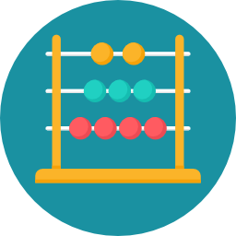
Have a try
How would you write code to do the following?
Increase x by 5
Decrease x by 2
Triple x
Divide x by 4
Multiply y by x

Slide 118
Have a try
How would you write code to do the following?
Increase x by 5 # x = x + 5
Decrease x by 2 # x = x - 2
Triple x # x = x * 3
Divide x by 4 # x = x / 4
Multiply y by x # x = y * x

Slide 119
What we've learnt about variables
Variables are used to store changing information in a program
They are like buckets with a name that store things
Initialising variables:
x = 10
Variables on the RHS of the = doesn't change the variable:
y = x + 2 # x doesn't change!
How to change the value of the same variable:
x = x + 12

Slide 120
Modifying variables
There will be occasions when you will need to change the value of a variable from its original value
For example:
Decrease chocolates by 3
Increase score by 10
Decrease health by 5
Increase money by $100
Increase number of "likes" by 1
Let's apply what we've learnt to write this little program...

Slide 121
Increase number of "likes" by 1
num_likes = num_likes + 1

Slide 122
Increase number of "likes" by 1
num_likes = num_likes + 1
This line of code will work no matter what the original value of num_likes was
e.g. Whether the original number of likes were: 0, 10, 13, 67 or -200, this line of code will always increase it by 1
For those examples, the new values will be 1, 11, 14, 68, -199
Note: this line of code does not make sense as a mathematical statement!

Slide 123

Activity: Thumbs Up and Down!
Helpful hint:
Need some help?
Have a look at slide 124
Activity 02.03 Thumbs Up and Down
123

Slide 124


Activity: Cafe Simulator!
Activity 02.04 Cafe Simulator
124

Slide 125
Glossary
Integer: A numeric data type representing whole numbers
Casting: Changing one data type to another

Slide 126

Summary
To do maths on text variables (string), we must convert them to a number variable
The int() command is used to convert a variable to an integer
Once we've converted a string to an integer, we can use it in maths

Slide 127


Reflection: Exit pass
What is one new thing you learnt today?
Write it on a sticky note and stick it on the board before you leave the classroom
127

Slide 128
License Information
These CS in Schools lessons plans, worksheets, and other materials were created by Toan Huynh and Hugh Williams. They are licensed under a Creative Commons Attribution-ShareAlike 4.0 International License.
Images, in order of appearance:
"Car" by Vectors Market on flaticon.com
"Vote" by Freepik on flaticon.com
"Cat" by Freepik on flaticon.com
"Chocolate" by photo3idea_studio on flaticon.com

