Slide 1

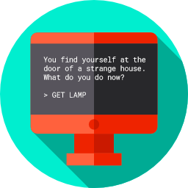
Lesson 7
A Simple Chatbot or Combat Simulator
csinschools.com

Slide 2

Learning objectives
By the end of this lesson, you should be able to:
understand the assignment and how you will be marked
understand how this assignment allows you to demonstrate all you have learned about Python coding so far
start working on your assignment!

Slide 3

Assignment rubric
This is your chance to code up a chat bot or combat simulation using all the skills and knowledge that you've developed in the course so far!
Check out the marking rubric here

Slide 4
Sample Code to get you started
Sample chatbot code | Sample combat simulator code

Slide 5
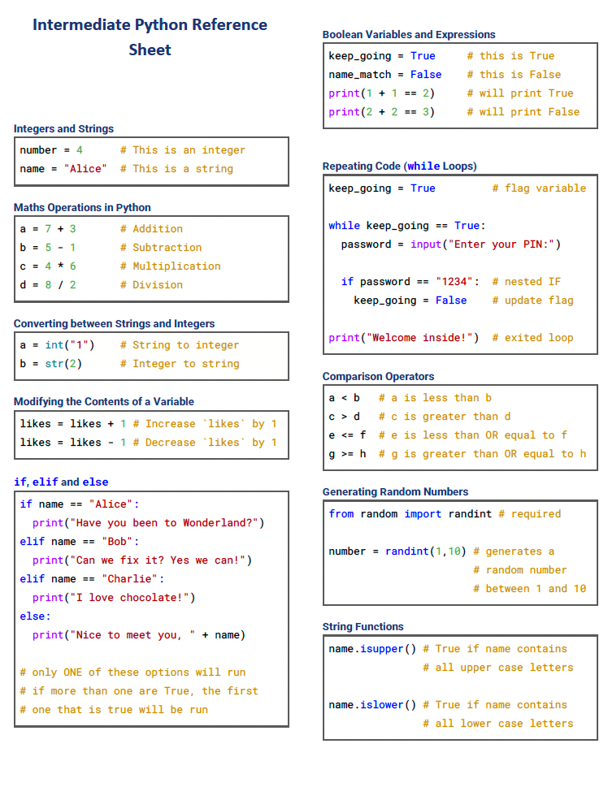
Python Reference Sheet
5

Slide 6
License Information
These CS in Schools lessons plans, worksheets, and other materials were created by Toan Huynh and Hugh Williams. They are licensed under a Creative Commons Attribution-ShareAlike 4.0 International License.
Images, in order of appearance:
"Knight" by Eucalyp on flaticon.com
"Chatbot" by Flat Icons on flaticon.com

