Slide 1

Lesson 2
Our First Web Page
HTML Basics

Slide 2



Previously, on CS in Schools...
True or False: the Internet is a network of computers that are connected together.
True or False: A URL (Uniform Resource Locator) specifies where a resource such as a web page can be found on the Internet.
2
Notes:
Answers:
Both are true

Slide 3
Learning objectives
By the end of the lesson you will be able to:
sign up and into replit.com
build your first web page
understand and use the basic HTML tags
3

Slide 4

Join Replit at https://replit.com/
4

Slide 5
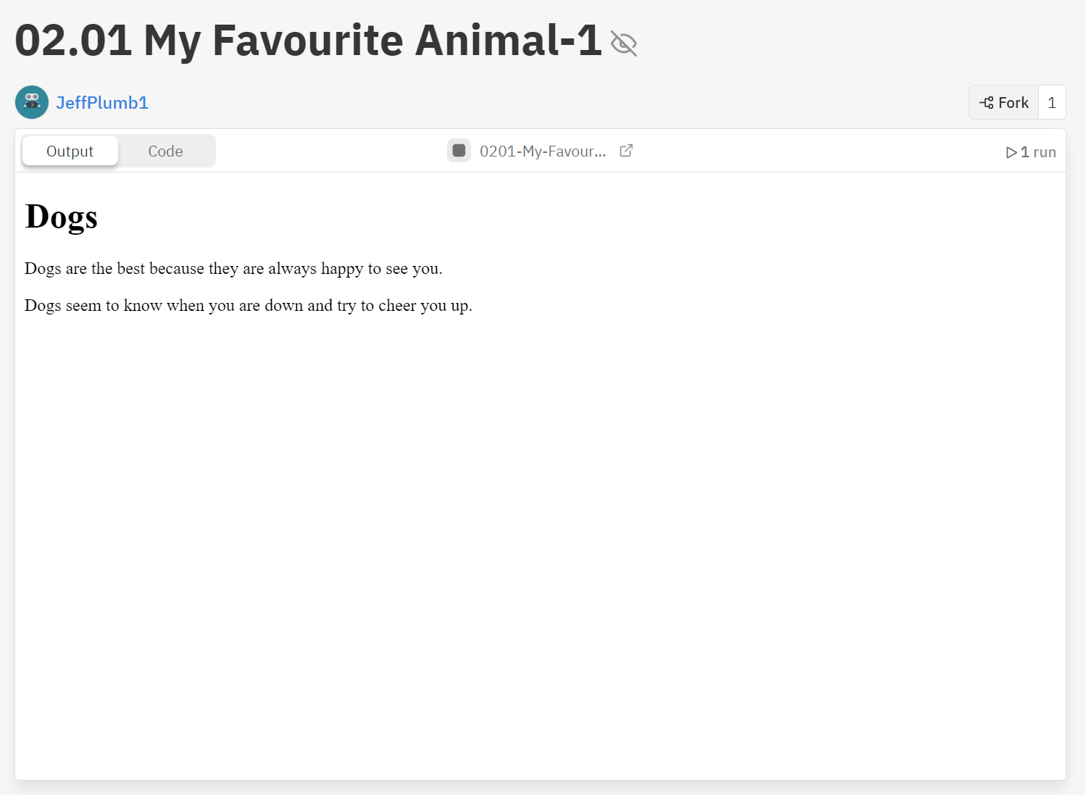



Activity 02.01 - My Favourite Animal
Your first task is to update the following web page to highlight your favourite animal.
Activity hint!
Need some help?
See the next slide.
Complete Repl.it Activity: 02.01 - My Favourite Animal
5

Slide 6
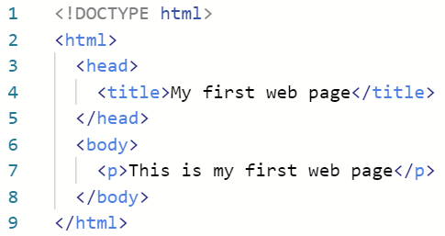

Basic HTML Structure
Unlike Python, HTML code is not affected by indentations. However, indentation is useful for readability for the user!
6

Slide 7
Basic HTML Structure - Specifying a Version of HTML
This tag lets your browser know that this document is using the latest version of HTML which is called HTML5.
Did you know: The World Wide Web Consortium develop the standards for the web (https://www.w3.org/)
7

Slide 8
Basic HTML Structure - HTML Tag
The <html> tag is used to indicate the start of the page content. This is called an opening tag.
The </html> tag indicates the end of the HTML code. This is called a closing tag. Notice the "/"?
8

Slide 9
Basic HTML Structure - HTML Tag
Together, <html> and </html> contain all other tags in our document.
9

Slide 10
Basic HTML Structure - Head tag
Similarly, the <head> element is a container for metadata.
Here we use it to set the title of the webpage, which gets displayed in the tab of your browser.
Metadata is data about other data. For example, if we call a song our data, the metadata would be the author and song title.
10

Slide 11
Basic HTML Structure - Title Tag
By using the <title> element, we can specify the text we want to appear as the title for our webpage.
Because it is inside the <head> element, it will be displayed in the tab of our browser.
11

Slide 12
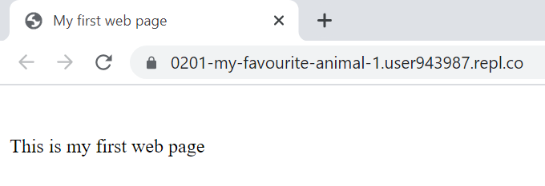
Basic HTML Structure - Title Tag
Here we can see that the tab of our browser has been modified by the <title> element inside the <head> element. Now it says "My first web page".
12

Slide 13
Basic HTML Structure - Body Tag
The <body> element should contain all the content of the website - this includes images, tables, text, buttons, links and more.
13

Slide 14
Basic HTML Structure - The Content
Here we have what will be displayed on our web page. In this case it is a paragraph of text.
Paragraphs are indicated by <p> and </p>. The text in between these opening and closing tags will be displayed on the web page.
14

Slide 15
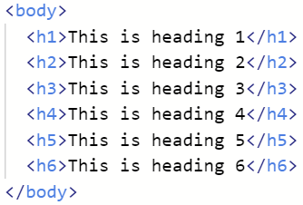
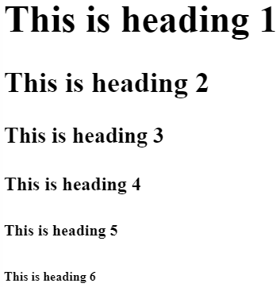
HTML Tags - Headings
Headings are specified in a tag with a h followed by a number from 1 to 6. 1 is the largest heading, and 6 is the smallest.
These tags belong inside the body element.
The text inside the start tag and close tag is displayed.
15

Slide 16
HTML Tags - Images
To insert an image in HTML we use the img tag.
Notice how the tag is only 3 letters and not the full word "image".
16

Slide 17
HTML Tags - Images
The image tag contains two attributes called src and alt.
17

Slide 18
HTML Tags - Images
The src attribute specifies where the actual image is located. In this case it is looking for a file called charlie.jpg.
The alt attribute provides a text description of the image and can be used by search engines. If for some reason the image cannot be displayed, this text will be shown.
18

Slide 19

HTML Tags - Straight Lines
The <hr /> tag displays a big straight line across the page, called a "horizontal rule", like you can see below.
19

Slide 20
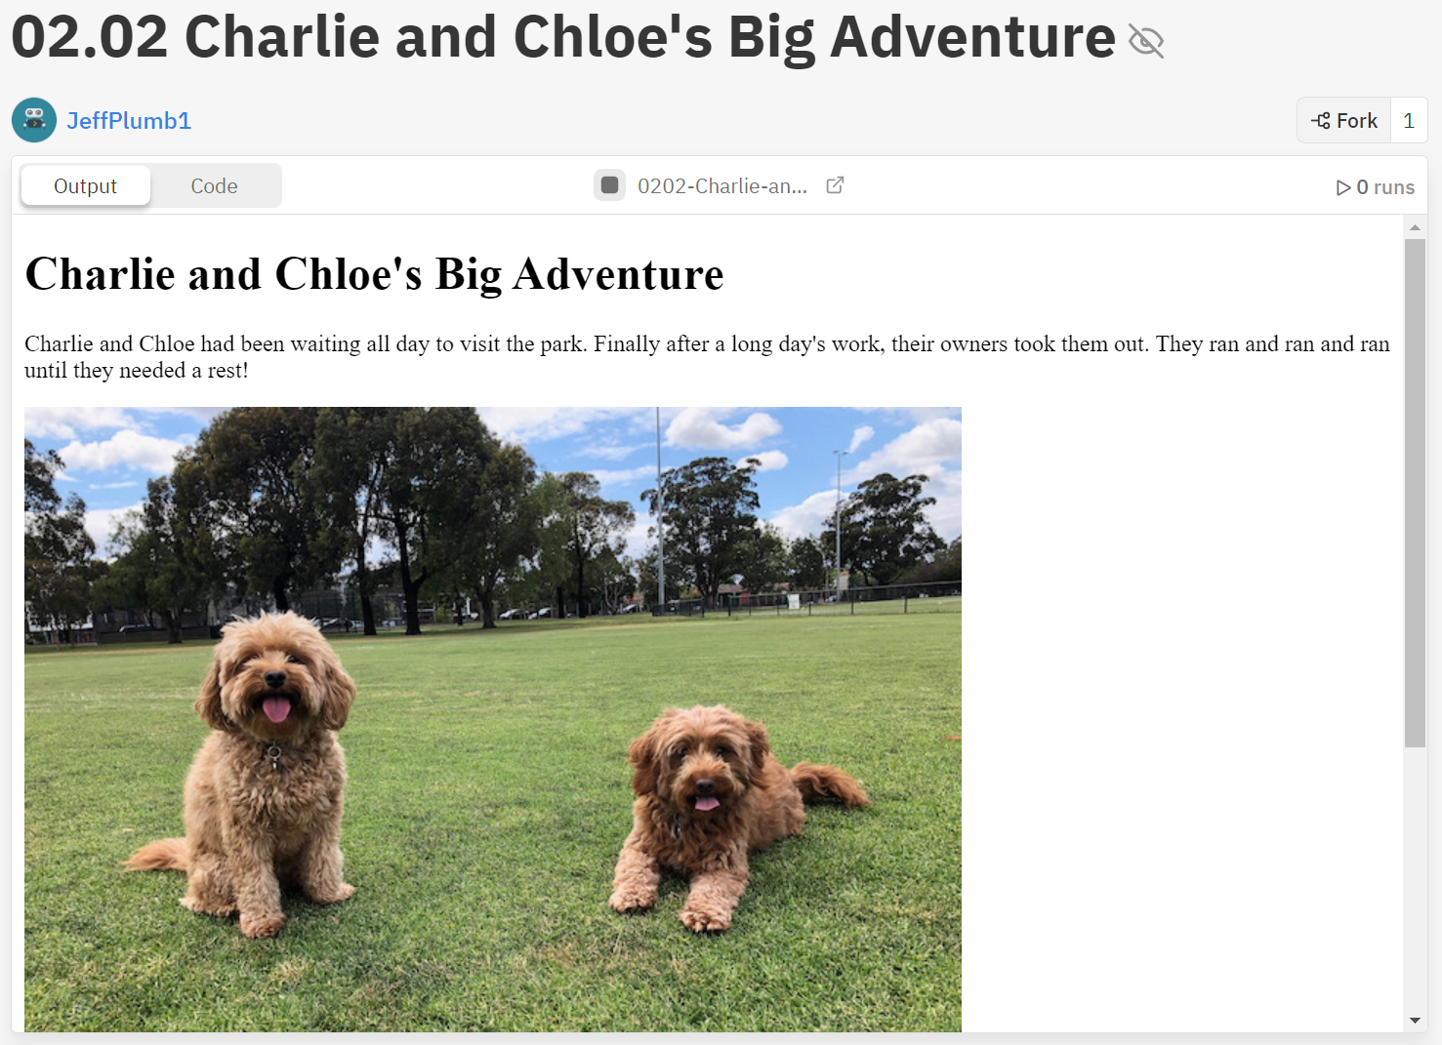
Activity 02.02 - Charlie and Chloe's Big Adventure
Your task is to complete the web page about two dogs called Charlie and Chloe who embark upon a big adventure.
Complete Repl.it Activity: 02.02 - Charlie and Chloe's Big Adventure
20
Notes:
https://replit.com/@ricproenca/WD0202-Charlie-and-Chloes-Big-Adventure

Slide 21
Privacy
Ensure anything you publish on the internet passes the Grandma test
Don't publish any material you would not be proud to show your Grandmother!
Make sure to never post anything that identifies you personally
Home address
Full name
Gamertag
Phone number
Always make sure to get permission from anyone before posting their image online
21
Notes:
Anyone with the URL

Slide 22
Summary
HTML uses a series of tags to determine what is displayed
The <h1> to <h6> tags are used for headings, with <h1> being the largest
<p> tags are used to display paragraphs
<img> tags are used to display images
<hr /> tags display a horizontal rule
22

Slide 23



Extension Activity: My Favourite Thing!
Worksheet
Create a webpage based on something that you really love!
Open a copy of the
Extension Activity and have a go at making your own webpage
23

Slide 24
License Information
These CS in Schools lessons plans, worksheets, and other materials were created by Jeff Plumb and have been modified by the team at CS in Schools. They are licensed under a Creative Commons Attribution-ShareAlike 4.0 International License.
24

