Slide 1


Lesson 7
Assignment
csinschools.com

Slide 2

Learning objectives
By the end of this lesson, you should be able to:
describe the assignment and how you will be marked
understand how this assignment allows you to demonstrate skills you have learnt about the fundamentals of the web
start working on your assignment!
2

Slide 3
Assignment: Your Epic
There is a school just down the road from yours that has noticed the students at their school are coming unprepared and late to class.
After a staff meeting, the school decided to launch Operation STACOT (Students To Attend Class On Time). This operation involved students creating their own apps and tools to help them get to class on time.
Operation STACOT was such a success that your principal has decided to launch the operation as well. So, your epic is:
The principal of your school wants to see all students attend class on time and prepared.
3

Slide 4
Assignment: Your User Story
One user story that was generated from your principal’s epic is:
As a principal I want my students to be able to view their classes on a selected day on their phones so that they can attend class on time and prepared, with the correct books.
4

Slide 5
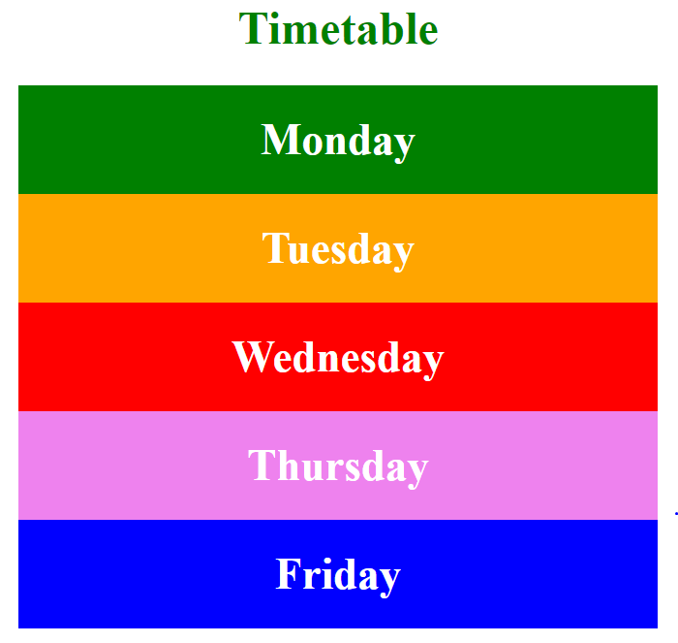
Assignment: Skills
Your website will allow you to demonstrate:
Your knowledge of HTML
Your knowledge of CSS
Your knowledge of colours
Your knowledge of mobile first development
Your creativity in designing a user interface
Your ability to evaluate a website against a user story
5

Slide 6

Assignment: Design
Use your worksheets from last time to help guide your design
Incorporate the feedback you have gathered in lesson 6 (where necessary)
We are using the agile methodology, so there is always time for adjustments!
The next few slides will show you how to ‘open’ a mobile phone in google chrome

Slide 7
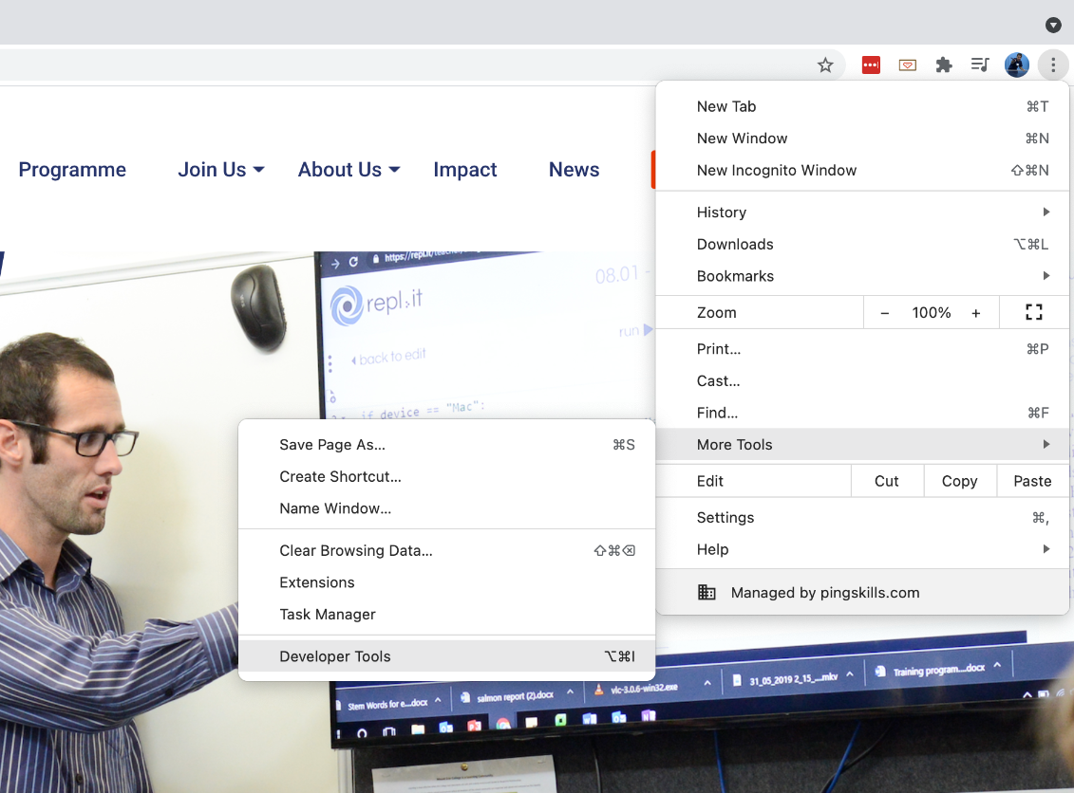
Mobile Emulator in Google Chrome
You can emulate how your website would look on a mobile in Google Chrome by using the developer tools.
Select “More Tools -> Developer Tools” or;
Use the keyboard shortcut CTRL-SHIFT-I on Windows or;
CMD-OPTION-I on a Mac
7
Notes:
\

Slide 8
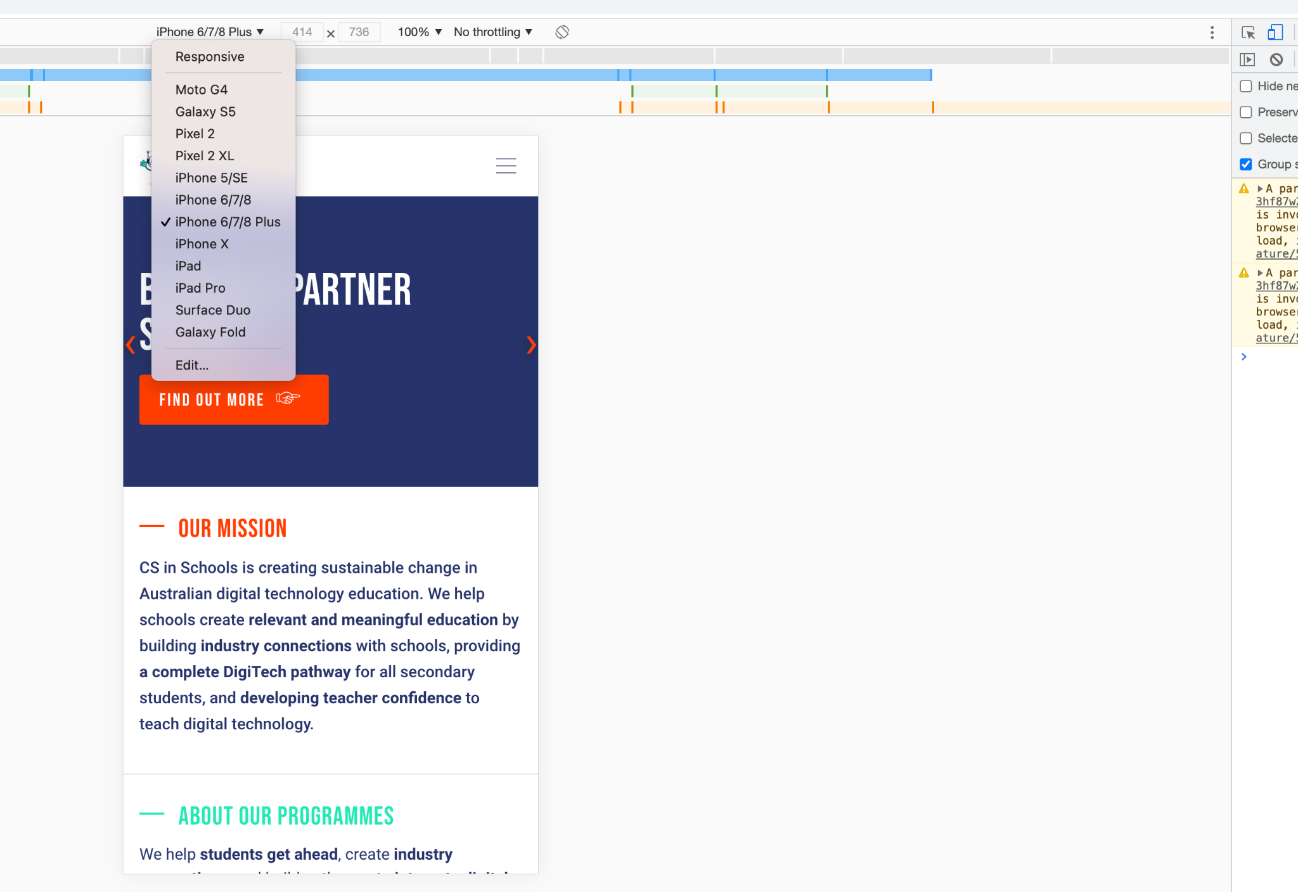
Mobile Emulator in Google Chrome
In developer tools, you can “toggle device toolbar” by clicking the phone icon or using the shortcut CTRL-SHIFT-M on Windows and CMD-SHIFT-M on a Mac.
Then you can use the drop down list to choose a device and you web page will be displayed as it would appear on that device.
8
Notes:
Simple layout, only one column, ensure buttons are large enough to be easily pressed. Important information at the top

Slide 9
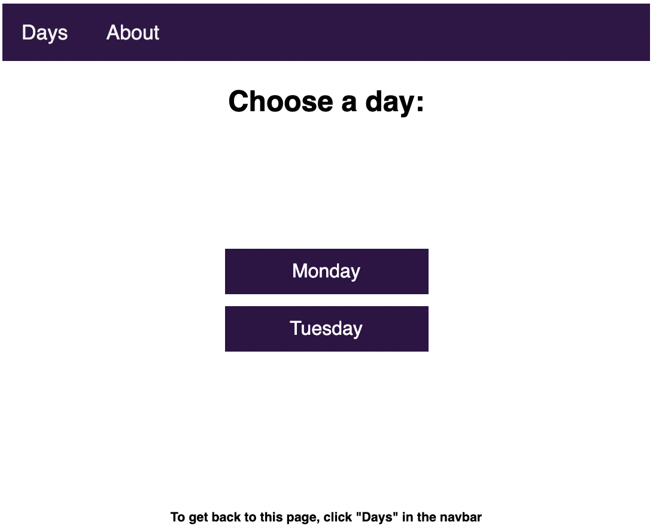
Assignment: Detailed Instructions & Links
Assignment Specification
Describes what you need to do
Design Template Documents
For brainstorming your design
Startup / Template Code on Replit
Code to help you get started
Getting Started Guide (step-by-step)
If you need help getting started
Assignment Marking Rubric
How you will be marked
9

Slide 10

Assignment: Let’s Get Started!
10

