Slide 1

Lesson 5
Hyperlinks

Slide 2



Previously, on CS in Schools...
What colour is the triplet rgb(255, 0, 0)?
What colour is the triplet rgb(210, 210, 210)?
2
Notes:
Answer:
(255, 0, 0) = red
(220, 220, 220) = a light shade of grey

Slide 3
Previously, on CS in Schools...
What colour is the hex triplet #00FF00?
What colour is the hex triplet #FFFFFF?
3
Notes:
Answers:
#00FF00 = green
#FFFFFF = white

Slide 4
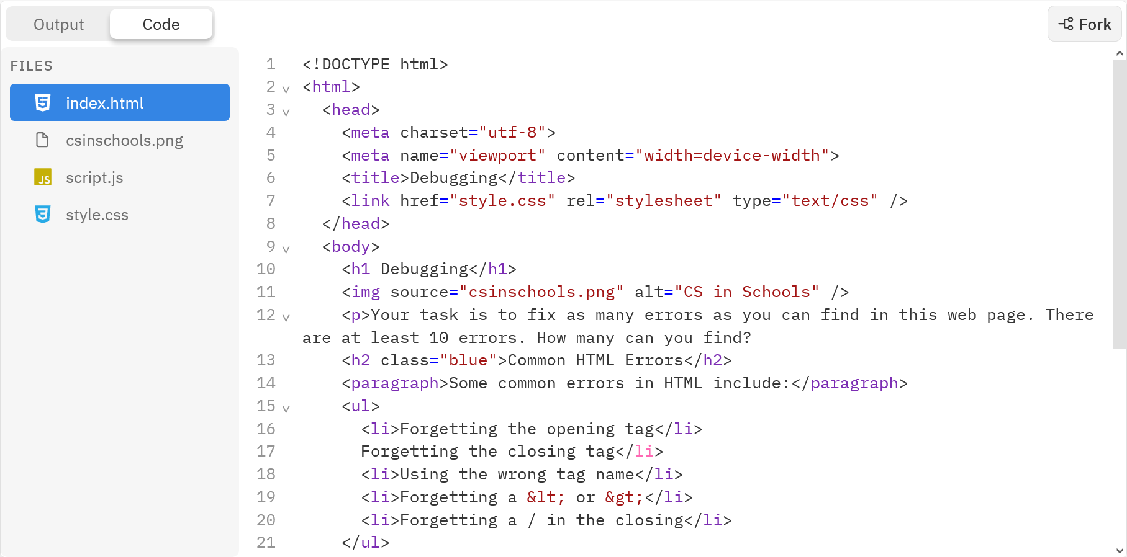
Worksheet - Debugging
We have created a web page with at least 10 errors! Your task is to try and find as many as you can and fix them. Good luck!
Try this worksheet first, or if you’re feeling confident, jump straight into the code!
4

Slide 5
Learning objectives
By the end of this lesson, you should be able to:
Analyse the use of links in popular web pages
Understand and use the two types of hyperlinks (external and internal)
Create hyperlinks in a HTML document
Style hyperlinks using CSS
Implement a navbar using HTML code
5

Slide 6
HTML - HyperText Markup Language
Hypertext Markup Language
Hypertext is a phrase invented in the 1960's to mean text that is connected to other text that the reader can immediately jump to.
In Hypertext Markup Language we use a hyperlink (now usually called a link) to connect web pages.
6

Slide 7
HTML - HyperText Markup Language
Hypertext Markup Language
A markup Language is a way of using tags to markup content
7

Slide 8
Hyperlinks
To create a link using HTML, we use the opening anchor tag <a> and closing tag </a>
8

Slide 9
Hyperlinks
The href attribute contains the URL of the page to visit when the hypertext is clicked.
9

Slide 10

Hyperlinks
The text in between the opening <a> tag and closing </a> tag, is the hypertext.
When this text is clicked the browser will take you to the web page identified in the href attribute. By default this text is underlined.
The hyperlink defined above will appear on our webpage like this:
10

Slide 11
Absolute vs Relative URLs
When specifying the URL you can use an absolute URL or a relative URL.
An absolute URL includes the full URL, including the "https://":
A relative URL includes a path from the current file:
11

Slide 12



Using Relative URLs
Relative URLs are most commonly used within a website. For example, if you have a 'home', 'about' and 'contact' page, our URLs could be as follows:
Page | Absolute | Relative
Home | href="https://example.com/home.html" | href="home.html"
About | href="https://example.com/about.html" | href="about.html"
Contact | href="https://example.com/contact.html" | href="contact.html"
12

Slide 13
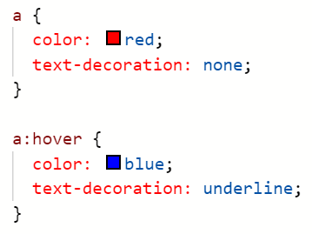


Styling Hyperlinks with CSS
To style all links we will use a basic selector, as you can see on the left
Selectors
We could use an ID selector to style one hyperlink, or a class selector to style a group of them
See Lesson 3 if you'd like to do this!
13

Slide 14


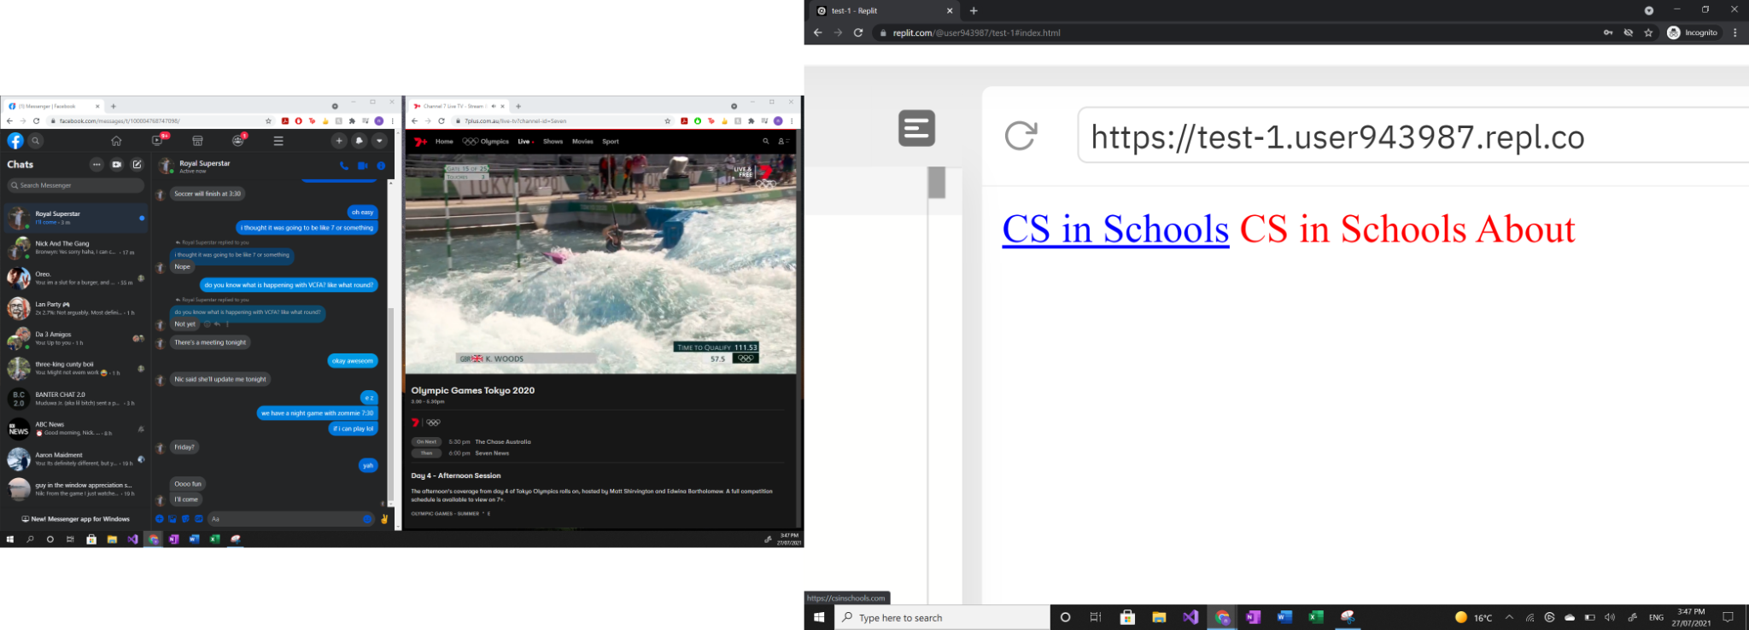

Styling Hyperlinks with CSS
a: This will change the hyperlink to red
a:hover: This will change the hyperlink to blue, and underline it, when we hover over it with our mouse
You can add ":hover" to any element in CSS.
14

Slide 15
Styling Hyperlinks with CSS
color: This will change the colour of the specified element.
text-decoration: This adds special effects to the specified element. Values include:
underline
overline
line-through
none
15

Slide 16
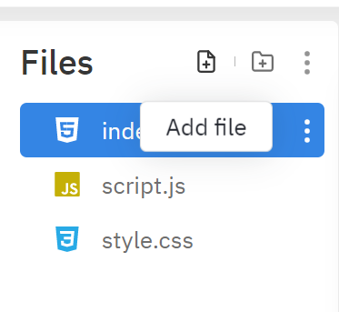
Creating New Pages in Repl
To create a new page in repl:
Click on the "Add file" icon
Name the file and give it an extension of ".html" (eg. "about.html")
To hyperlink using relative URL:
For the exercise on the next page, you will call this page "about.html", and use the line of code above.
16

Slide 17
Internal Links
<a href="#help">Jump to help section</a>
<h1 id="contacts">How to cook curry:</h1>
<p>Lots of information</p>
<p>Lots of information</p>
<p>Lots of information</p>
<p>Lots of information</p>
<p>Lots of information</p>
...
<h1 id="help">Need help?</h1>
<p>Phone us anytime</p>
You don't have to link to another webpage, you can use links within web pages
This can be done by changing the href attribute of the <a> tag
17

Slide 18
Internal Links
<a href="#help">Jump to help section</a>
<h1 id="contacts">How to cook curry:</h1>
<p>Lots of information</p>
<p>Lots of information</p>
<p>Lots of information</p>
<p>Lots of information</p>
<p>Lots of information</p>
...
<h1 id="help">Need help?</h1>
<p>Phone us anytime</p>
If the href attribute begins with a #, it represents an id within the page
This type of link is also called anchor text (a kind of hypertext)
Clicking the text of this hyperlink will make the web page jump to the element with that id
18

Slide 19
Internal Links
<a href="#help">Jump to help section</a>
<h1 id="contacts">How to cook curry:</h1>
<p>Lots of information</p>
<p>Lots of information</p>
<p>Lots of information</p>
<p>Lots of information</p>
<p>Lots of information</p>
...
<h1 id="help">Need help?</h1>
<p>Phone us anytime</p>
This code creates a web page where clicking "Jump to help section" would scroll the page down to the heading "Need help?"
19

Slide 20
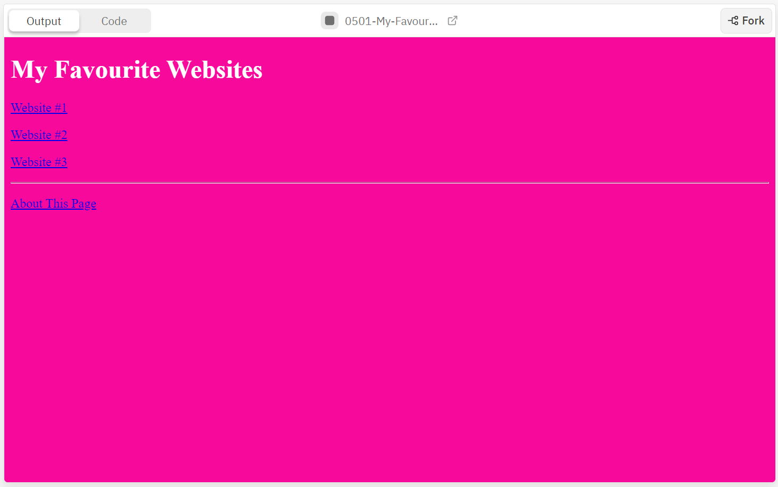
Activity 05.01 - My Favourite Websites
Your task is to create a website with links to 3 of your favourite websites. You should also create an "about this page" web page as part of your website. Then, add some CSS code to style the web page.
Complete Repl.it Activity: 05.01 - My Favourite Websites
20

Slide 21
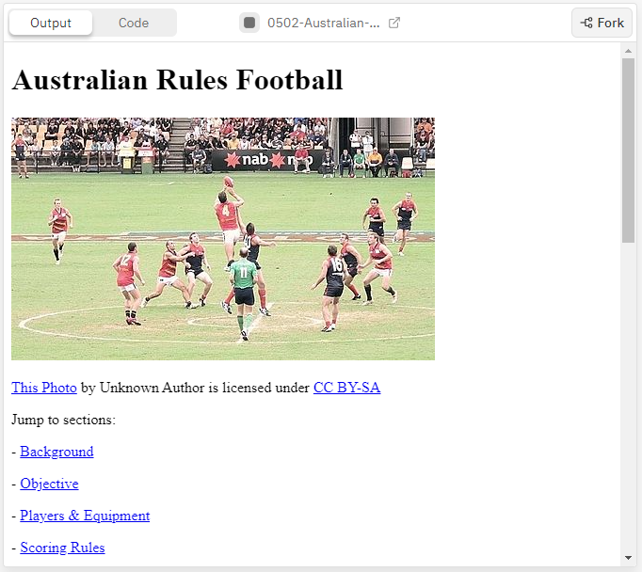
Activity 05.02 - Australian Rules Football
Give this activity a go, let's make it easier to navigate the page:
Complete Repl.it Activity: 05.02 - Australian Rules Football
21

Slide 22
Navbars
Navbars, short for navigation bars, are important for every website
They allow the user to quickly navigate a website, which typically contains lots of information
We are going to learn how to create our own!
22

Slide 23
Navbars
The company logo is usually a hyperlink to the home page
23

Slide 24
Navbars
The remaining options could link to whatever you like!
These typically refer to other pages on the same website.
24

Slide 25
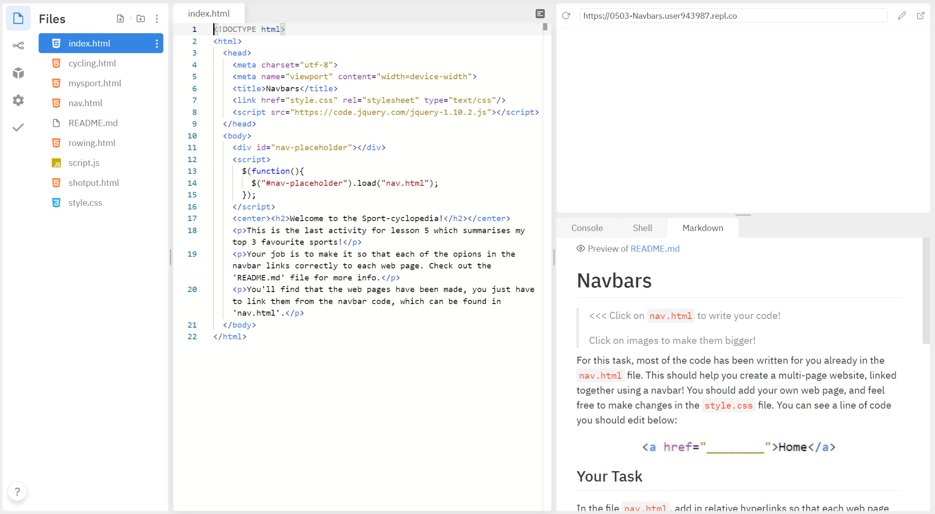
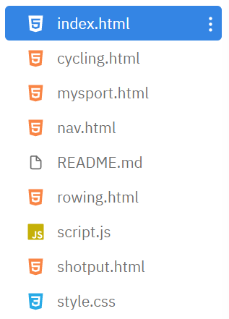
Navbars - your final activity, let's make our own!
Look at all these files!
25

Slide 26
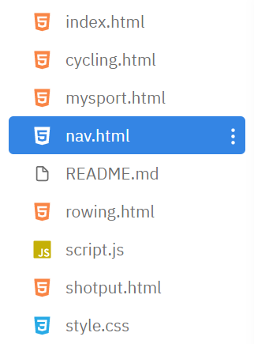
Navbars - your final activity, let's make our own!
nav.html contains all the code we need to edit to make our navbar work
26

Slide 27
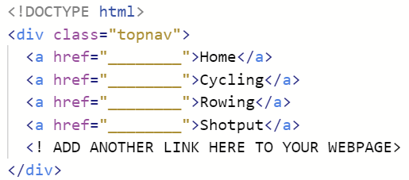
Navbars - your final activity, let's make our own!
By replacing the "______" with a relative link, we can hyperlink all our web pages together.
Make sure that the link you put in is exactly the same as the file name you wish to load! (e.g. cycling.html)
27

Slide 28
Remember - Creating New Pages in Repl
To create a new page in repl:
Click on the "Add file" icon
Name the file and give it an extension of ".html" (eg. "about.html")
To hyperlink using relative URL:
28

Slide 29
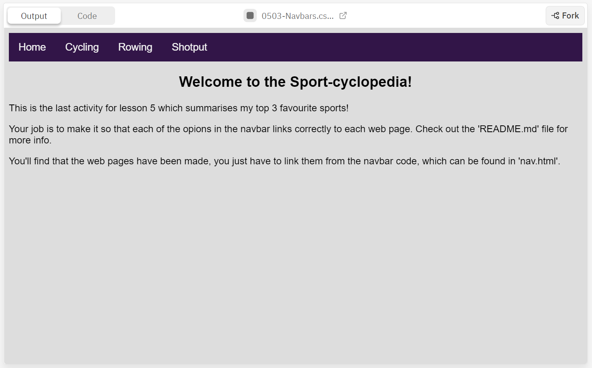
Activity 05.03 - Navigation Bars
This last activity will help you get used to making and using navbars.
Complete Repl.it Activity: 05.03 - Navbars
29

Slide 30
Summary
Links can be external or internal
The href attribute specifies a URL for external links
The href attribute specified an id (with a # in front) for internal links
Navbars are useful for easy navigation through a website
30

Slide 31
License Information
These CS in Schools lessons plans, worksheets, and other materials were created by Jeff Plumb and have been modified by the team at CS in Schools. They are licensed under a Creative Commons Attribution-ShareAlike 4.0 International License.
31

