Slide 1


Lesson 6 part 1
Software Engineering
csinschools.com

Slide 2



Previously, on CS in Schools...
What are two types of hyperlinks we discussed last lesson?
What is the difference?
2
Notes:
Answers:
Absolute and relative
Internal and external

Slide 3
Previously, on CS in Schools...
Why is it important to have a navbar on a website?
3
Notes:
Answer:
Makes it easier for user to navigate webpage
more...

Slide 4
Learning objectives
By the end of this lesson, you should be able to:
describe software engineering
describe the purpose of a methodology
create a user story for a product
sketch a user interface
4

Slide 5

What is a website you wish existed?
A website where you can rent shoes to try on before purchasing
Purchase a food online and it 3D prints it for me
An online calendar that tells you when you need to leave to get to your next appointment
5

Slide 6
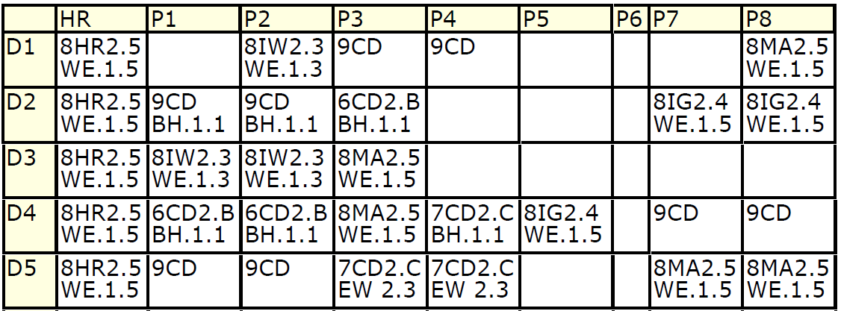
Online Timetables, for Students and Teachers
Do you have an online timetable for your classes at school?
Do you use it?
6

Slide 7
Think, Pair, Share.
How can we improve this timetable?
E.g. colours, are the headings clear, who is the audience?
7
Notes:
Colours for each type of lesson, links to directions to classroom, more information about each class, have the current day highlighted, have the current class highlighted based on the time of day.

Slide 8

Software Engineering
When developing software, teams use a process called software engineering
Software engineering is the process of developing software
It involves gathering user requirements, then, designing, building, and testing the solution
There are some methodologies that software engineers use to improve their work efficiency
8

Slide 9
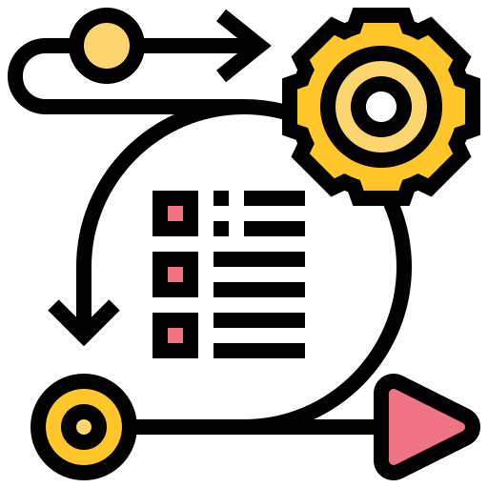
Software Methodologies
A methodology is a set of rules or procedures
Software development methodologies are designed to guide a team on how to best divide up work so that it can be completed efficiently and successfully
Most modern methodologies are based upon the agile principles which were formed by a group of seventeen people in 2001. You can read about the agile manifesto here.
9

Slide 10
Agile Manifesto
Individuals and interactions over processes and tools
Working software over comprehensive documentation
Customer collaboration over contract negotiation
Responding to change over following a plan
That is, while there is value in the items on
the right, we value the items on the left more.
10

Slide 11

Agile vs Waterfall
Agile | Waterfall
Flexible to customer requests | Not flexible to customer requests
Released in stages | Project completion prior to full release
Quick and cost effective | Typically slower and more expensive
Iterative process | “One way” process - like a waterfall
11

Slide 12

Sprints
To improve things, the agile approach uses ‘sprints’
A sprint is a short period of time (often two weeks) in which a set piece of work will be delivered to the customer
By regularly receiving working software, the customer is happier and their feedback is easier to manage
12

Slide 13
Epics and User Stories
One approach to gathering user requirements is to divide your tasks into epics and user stories
An epic is a big task that your team wishes to achieve
An epic is broken down into user stories
User stories are smaller tasks, and completion of them all will mean the epic has also been completed
13

Slide 14
Examples - Epic
Create an online timetable for students and teachers that allows them to view, create, edit, and delete timetables.
Create an online application that allows users to share pictures or videos, along with text descriptions.
Create an online application that allows users to control a virtual character that can mine for resources and build a variety of structures.
14

Slide 15
Breaking Down an Epic into User Stories
User stories are a way of breaking down an epic into smaller tasks that a software engineer can implement
User stories should be written using the following template:
As a <type of user> I want <some goal> so that <some reason>
For example:
As a teacher I want to be able to view my homeroom students’ timetables so that I can write the classes they will have for the day on the whiteboard.
As a science teacher I want to be able to delete student timetables so that at the end of every term I can redo my timetable.
15

Slide 16
Lesson 6 part 2
Assignment Introduction
csinschools.com

Slide 17
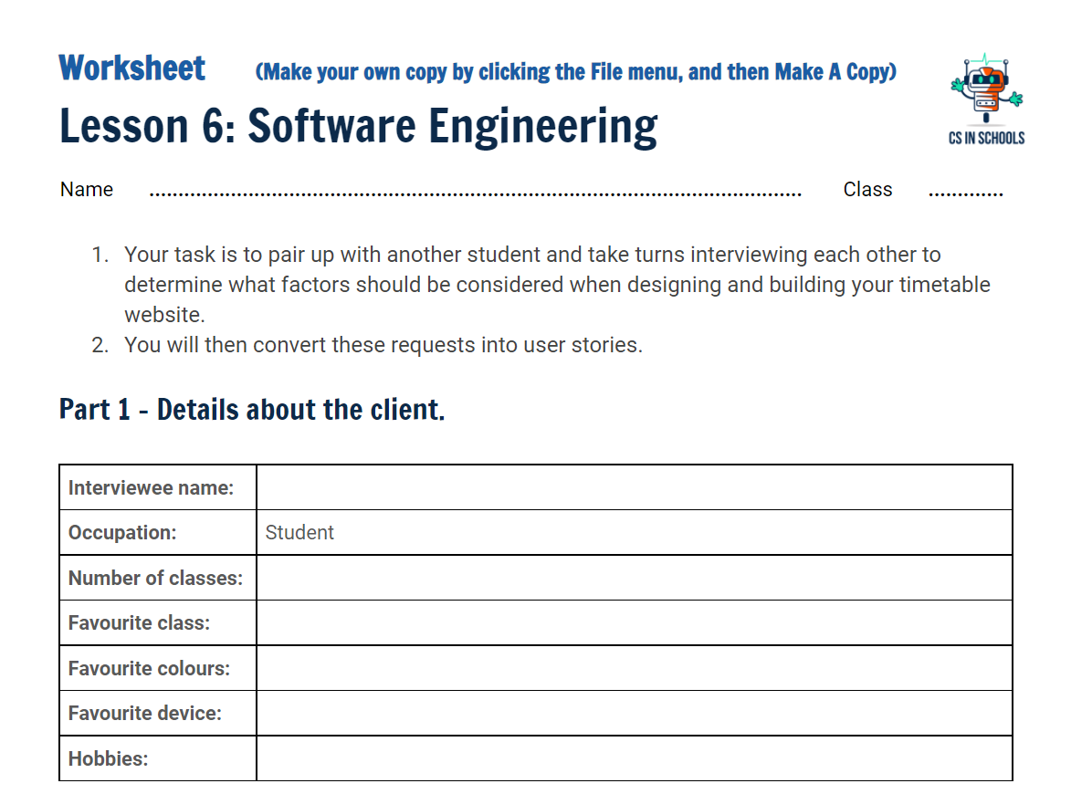
Activity 06.01 - User Stories
Users are central to creating epics and user stories. Since you are all students, you are perfectly placed to write user stories about an online timetable application. Interview your classmates to determine what should be included in such a website.
Complete Repl.it Activity: 06.01 - User Stories
17

Slide 18
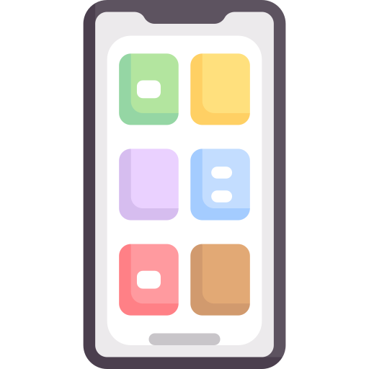
Your First Sprint
Your task for today will be to complete a sprint from the epic we have been discussing this lesson. You are assigned the following user story:
As a student I want to be able to view the classes I have on a selected day on my phone so that I can pack my bags with the required books and textbooks before I travel to school.
18

Slide 19
Your First Sprint
To complete the sprint you will need to:
Interview client who needs the timetable website
Create a paper prototype of your website
Gather feedback from your classmates on your prototype
Modify your prototype as necessary
19

Slide 20
Mobile First Development
As more and more users are accessing the internet on their phone, it is important to ensure that websites are functional and user friendly when viewed on a phone
The term mobile first design refers to creating a website specifically for a phone before considering how it should look and function on a desktop
Why do you think mobile first design is becoming more popular?
Our user story refers specifically to viewing the timetable on a phone, therefore, we will be designing our prototype to fit on a phone
20

Slide 21
What should we keep in mind when building a phone app?
21
Notes:
Simple layout, only one column, ensure buttons are large enough to be easily pressed. Important information at the top

Slide 22
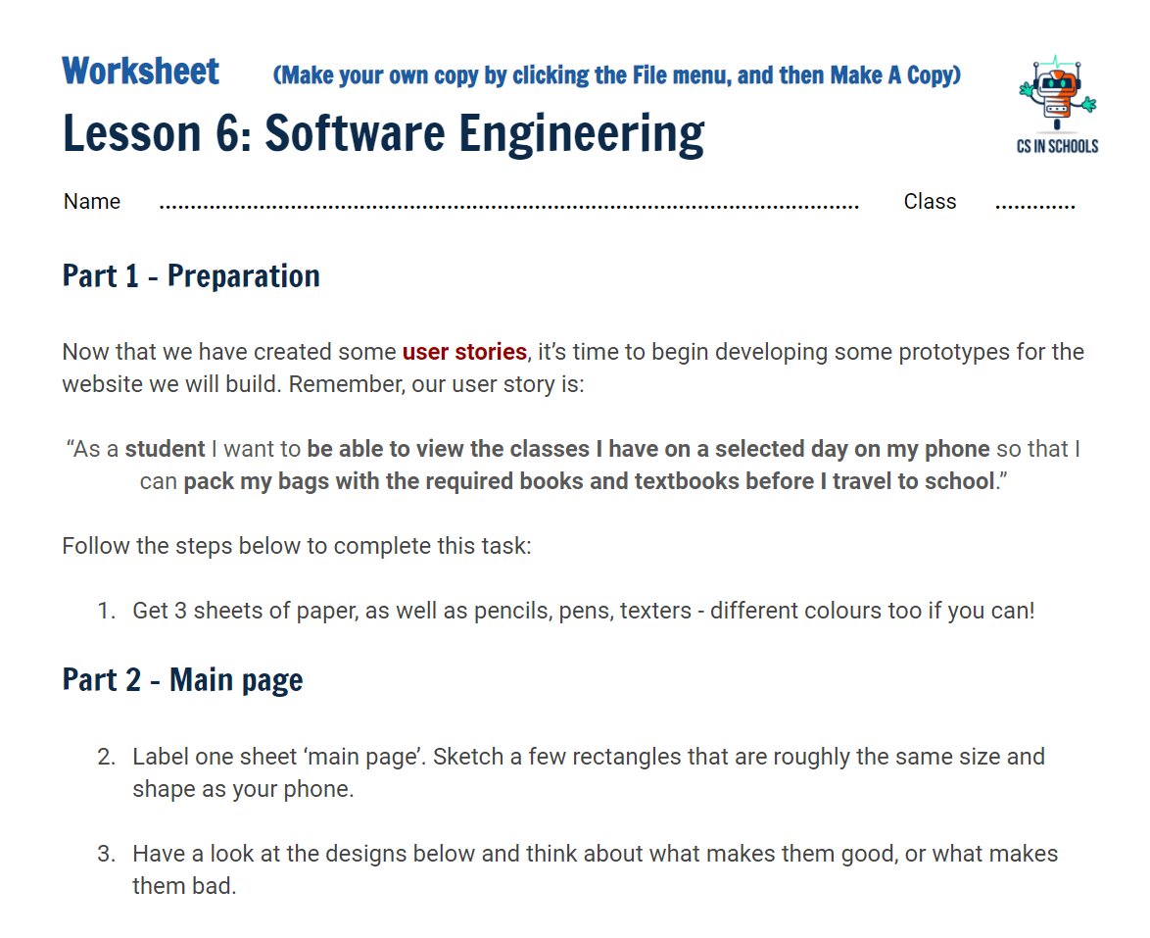
Activity 06.02 - Create a Paper Prototype
As a student I want to be able to view the classes I have on a selected day on my phone so that I can pack my bags with the required books and textbooks before I travel to school.
Complete Repl.it Activity: 06.02 - Paper Prototypes
22

Slide 23
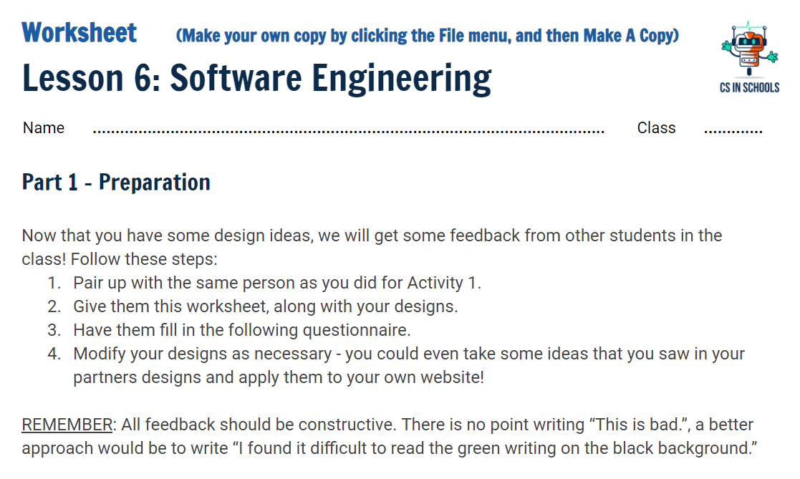
Activity 06.03 - Review Prototype
An important aspect of the software engineering process is to critically evaluate alternative designs. Your task is to provide feedback to your classmates on their prototypes.
Complete Repl.it Activity: 06.03 - Review Prototype
23

Slide 24
User Stories - How well did you do?
Now that you have had a chance to gather feedback on your design, did you:
Meet your clients requirements?
Pay attention to your clients favourite colour?
Incorporate your clients ratings of ‘most important’ and ‘least important’?
Agile methodology is useful because it allows for the client to make suggestions at each stage of the design
So now you could revise your design to make sure you incorporate your clients feedback!
You don’t have to include everything, but make sure you can justify why you didn’t
24

Slide 25
Summary
Software engineering is the process of developing software
A methodology is a set of rules or procedures
Most modern methodologies are based on the “agile” principles
An Epic is a large piece of work
User stories are used to break an epic into smaller tasks with a user focus
Prototypes are a useful tool to help design a web site and seek feedback
25

Slide 26
License Information
These CS in Schools lessons plans, worksheets, and other materials were created by Jeff Plumb and have been modified by the team at CS in Schools. They are licensed under a Creative Commons Attribution-ShareAlike 4.0 International License.
Images, in order of appearance:
"Software Engineer" by itim2101 on Flaticon
"Method" by eucalyp on Flaticon
"Waterfall" by Freepik on Flaticon
"Sprint" by Flat icons on Flaticon
"Phone" by Freepik on Flaticon
26

