Slide 1

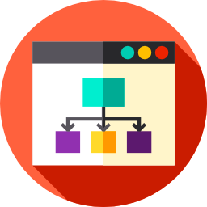
Lesson 5
Programs That Make Decisions
csinschools.com

Slide 2

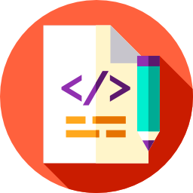
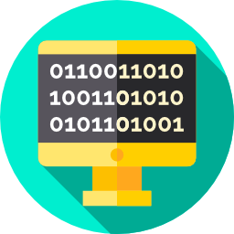
Previously, on CS in Schools...
Will the following code run?
name = input("Enter your first name:")
2
Notes:
Answer:
Yes

Slide 3
Previously, on CS in Schools...
If the user types in John when asked for their name, what will be displayed on the screen after the following code is run:
name = input("Enter your first name:")
print("Hello, " + name)
3
Notes:
Answer:
Hello, John

Slide 4
Previously, on CS in Schools...
If the user types in Jane when asked for their name, and 21 when asked for their age, what will be displayed on the screen after the following code is run:
name = input("Enter your first name:")
age = input("Enter your age:")
print("Hello, " + name + ", " + age)
4
Notes:
Answer:
Hello, Jane, 21

Slide 5
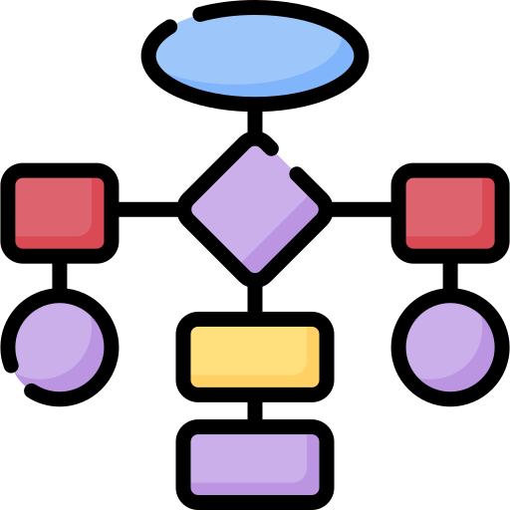
Learning objectives
By the end of this lesson, you should be able to:
understand control flow and how we can use it in our programs to make decisions
use a flowchart to represent program flow
understand boolean expressions and how they are either True or False
use if statements to make choices in a program so that it can behave differently depending on what a user types
5

Slide 6
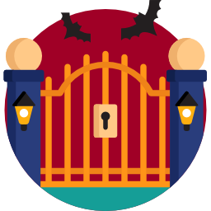
Can you pass through the Gates of Doom?
Click here and see if you can "guess" the password
Hint: Look through the code and see if you can figure out what’s going on
6

Slide 7
How did you go?
print("Who dares approach the gates of doom! ")
password = input("Speak the password:")
if password == "0p3nSe5@m3":
print("You are correct!")
print("You may enter, friend.")
if password != "0p3nSe5@m3":
print(" ****** ")
print(" * ** ")
7

Slide 8
How did you go?
print("Who dares approach the gates of doom! ")
password = input("Speak the password:")
if password == "0p3nSe5@m3":
print("You are correct!")
print("You may enter, friend.")
if password != "0p3nSe5@m3":
print(" ****** ")
print(" * ** ")
8

Slide 9
How did you go?
print("Who dares approach the gates of doom! ")
password = input("Speak the password:")
if password == "0p3nSe5@m3":
print("You are correct!")
print("You may enter, friend.")
if password != "0p3nSe5@m3":
print(" ****** ")
print(" * ** ")
Here are the key lines.
We’ll learn more about what this means in this lesson.
9

Slide 10

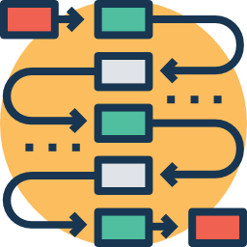
Control flow
Play Video
4:57 min
Slide 11 - 53
Up until now, our programs never had to make a choice about anything
Sometimes, we might want to display something different when the user enters a certain word or string of characters
When and why would doing this be useful?
10

Slide 11
Control flow
Here are some examples of when changing the flow might be useful:
Being able to recognise a user (for example, so we can show them the purchases they’ve made online)
Recall and continue past interactions (for example, to continue a game at Level 5)
Bring up customised displays and preferences (for example, show you a link to submit an assignment in your school management system)
Apply specific rules and permissions (for example, only let teachers mark assignments)
There are many different examples and situations where control flow is important
11

Slide 12
Flowcharts
A flowchart is a special type of diagram that is used by programmers to help them lay out their step-by-step design for their programs
Flowcharts help us better understand the way computers make "decisions" and how they act differently based on different choices
Flowcharts are written in English, and they often don’t use the same keywords as a programming language
12

Slide 13
Program example
from time import sleep
name = input("Please enter your name:")
sleep(5)
print("See ya later" + name)
Suppose we have this program...
13

Slide 14
Program example
Start
from time import sleep
name = input("Please enter your name:")
sleep(5)
print("See ya later" + name)
14

Slide 15
Program example
Start
from time import sleep
name = input("Please enter your name:")
sleep(5)
print("See ya later" + name)
15

Slide 16
Program example
Start
from time import sleep
name = input("Please enter your name:")
sleep(5)
print("See ya later" + name)
Ask user for name
16

Slide 17
Program example
Start
from time import sleep
name = input("Please enter your name:")
sleep(5)
print("See ya later" + name)
Ask user for name
17

Slide 18
Program example
Start
from time import sleep
name = input("Please enter your name:")
sleep(5)
print("See ya later" + name)
Ask user for name
Wait 5 seconds
18

Slide 19
Program example
Start
from time import sleep
name = input("Please enter your name:")
sleep(5)
print("See ya later" + name)
Ask user for name
Wait 5 seconds
19

Slide 20
Program example
Start
from time import sleep
name = input("Please enter your name:")
sleep(5)
print("See ya later" + name)
Ask user for name
Wait 5 seconds
Display "See ya later ", name
20

Slide 21
Program example
Start
from time import sleep
name = input("Please enter your name:")
sleep(5)
print("See ya later" + name)
Ask user for name
Wait 5 seconds
Display "See ya later ", name
End
21

Slide 22
Program example
Start
Ask user for name
This symbol represents the start and end points of the program.
Wait 5 seconds
Display "See ya later ", name
End
22

Slide 23
Program example
Start
Ask user for name
This symbol represents getting input or producing output
Examples include: • the user typing something in • retrieving data from the internet • displaying text on the screen
Wait 5 seconds
Display "See ya later ", name
End
23

Slide 24
Program example
Start
Ask user for name
This symbol represents steps where the program actually needs to do something with the information.
You can see that it’s normal in flowcharts to use English words like "Wait" rather than Python code words like sleep()
Wait 5 seconds
Display "See ya later ", name
End
24

Slide 25
Look at this flowchart
Start
Ask user for name
Let’s take a look at what this flowchart describes.
Wait 5 seconds
Is the name "John"?
True
Display "Hey! I’m called John, too!"
False
Display "See ya later!"
End
25

Slide 26
Look at this flowchart
Start
Ask user for name
Wait 5 seconds
Is the name "John"?
True
Display "Hey! I’m called John, too!"
False
Display "See ya later!"
End
26

Slide 27
Look at this flowchart
Start
Ask user for name
Wait 5 seconds
Is the name "John"?
True
Display "Hey! I’m called John, too!"
False
Display "See ya later!"
End
27

Slide 28
Look at this flowchart
Start
Ask user for name
Please enter your name:
Wait 5 seconds
Is the name "John"?
True
Display "Hey! I’m called John, too!"
False
Display "See ya later!"
End
28

Slide 29
Look at this flowchart
Start
Ask user for name
Please enter your name: Carla
Wait 5 seconds
Is the name "John"?
True
Display "Hey! I’m called John, too!"
False
Display "See ya later!"
End
29

Slide 30
Look at this flowchart
Start
Ask user for name
Please enter your name: Carla
Wait 5 seconds
Is the name "John"?
True
Display "Hey! I’m called John, too!"
False
Display "See ya later!"
End
30

Slide 31
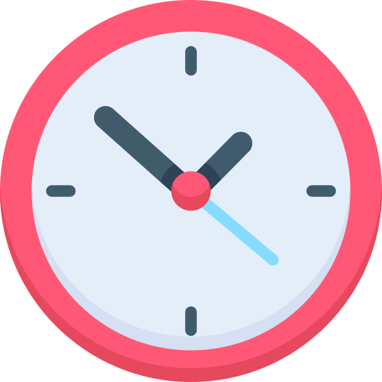
Look at this flowchart
Start
Ask user for name
Please enter your name: Carla
Wait 5 seconds
Is the name "John"?
True
Display "Hey! I’m called John, too!"
False
Wait 5 seconds...
Display "See ya later!"
End
31

Slide 32
Look at this flowchart
Start
Ask user for name
Please enter your name: Carla
Wait 5 seconds
Is the name "John"?
True
Display "Hey! I’m called John, too!"
False
Display "See ya later!"
End
32

Slide 33
Look at this flowchart
Start
Ask user for name
Please enter your name: Carla
Wait 5 seconds
Is the name "John"?
True
Display "Hey! I’m called John, too!"
False
Display "See ya later!"
End
33

Slide 34
Look at this flowchart
Start
Ask user for name
Please enter your name: Carla
Wait 5 seconds
Is the name "John"?
True
Display "Hey! I’m called John, too!"
False
Display "See ya later!"
End
34

Slide 35
Look at this flowchart
Start
Ask user for name
Please enter your name: Carla
See ya later!
Wait 5 seconds
Is the name "John"?
True
Display "Hey! I’m called John, too!"
False
Display "See ya later!"
End
35

Slide 36
Look at this flowchart
Start
Ask user for name
Please enter your name: Carla
See ya later!
Wait 5 seconds
Is the name "John"?
True
Display "Hey! I’m called John, too!"
False
Display "See ya later!"
End
36

Slide 37
Look at this flowchart
Start
Ask user for name
Now, let’s try again with a different response.
Wait 5 seconds
Is the name "John"?
True
Display "Hey! I’m called John, too!"
False
Display "See ya later!"
End
37

Slide 38
Look at this flowchart
Start
Ask user for name
Wait 5 seconds
Is the name "John"?
True
Display "Hey! I’m called John, too!"
False
Display "See ya later!"
End
38

Slide 39
Look at this flowchart
Start
Ask user for name
Wait 5 seconds
Is the name "John"?
True
Display "Hey! I’m called John, too!"
False
Display "See ya later!"
End
39

Slide 40
Look at this flowchart
Start
Ask user for name
Please enter your name:
Wait 5 seconds
Is the name "John"?
True
Display "Hey! I’m called John, too!"
False
Display "See ya later!"
End
40

Slide 41
Look at this flowchart
Start
Ask user for name
Please enter your name: John
Wait 5 seconds
Is the name "John"?
True
Display "Hey! I’m called John, too!"
False
Display "See ya later!"
End
41

Slide 42
Look at this flowchart
Start
Ask user for name
Please enter your name: John
Wait 5 seconds
Is the name "John"?
True
Display "Hey! I’m called John, too!"
False
Display "See ya later!"
End
42

Slide 43
Look at this flowchart
Start
Ask user for name
Please enter your name: John
Wait 5 seconds
Is the name "John"?
True
Display "Hey! I’m called John, too!"
False
Wait 5 seconds...
Display "See ya later!"
End
43

Slide 44
Look at this flowchart
Start
Ask user for name
Please enter your name: John
Wait 5 seconds
Is the name "John"?
True
Display "Hey! I’m called John, too!"
False
Display "See ya later!"
End
44

Slide 45
Look at this flowchart
Start
Ask user for name
Please enter your name: John
Wait 5 seconds
Is the name "John"?
True
Display "Hey! I’m called John, too!"
False
Display "See ya later!"
End
45

Slide 46
Look at this flowchart
Start
Ask user for name
Please enter your name: John
Wait 5 seconds
Is the name "John"?
True
Display "Hey! I’m called John, too!"
False
Display "See ya later!"
End
46

Slide 47
Look at this flowchart
Start
Ask user for name
Please enter your name: John
Hey! I’m called John, too!
Wait 5 seconds
Is the name "John"?
True
Display "Hey! I’m called John, too!"
False
Display "See ya later!"
End
47

Slide 48
Look at this flowchart
Start
Ask user for name
Please enter your name: John
Hey! I’m called John, too!
See ya later!
Wait 5 seconds
Is the name "John"?
True
Display "Hey! I’m called John, too!"
False
Display "See ya later!"
End
48

Slide 49
Look at this flowchart
Start
Ask user for name
Please enter your name: John
Hey! I’m called John, too!
See ya later!
Wait 5 seconds
Is the name "John"?
True
Display "Hey! I’m called John, too!"
False
Display "See ya later!"
End
49

Slide 50
Look at this flowchart
Start
Ask user for name
This is the part in the program where a choice needs to be made. In programming, this comes in the form of a question that is asked
Wait 5 seconds
Is the name "John"?
True
Display "Hey! I’m called John, too!"
False
Display "See ya later!"
End
50

Slide 51
Look at this flowchart
Start
Ask user for name
Notice that the question can only have two answers: True or False (yes or no)
Wait 5 seconds
Is the name "John"?
True
Display "Hey! I’m called John, too!"
False
Display "See ya later!"
End
51

Slide 52
Summary of flowchart symbols
Start
Ask user for name
The start and end points of the program.
Wait 5 seconds
The program needs to input information (eg. from the user typing something in) or output something (eg. display text on the screen)
Is the name "John"?
True
Display "Hey! I’m called John, too!"
The program performs an operation or calculation.
False
Display "See ya later!"
The program is making a True/False decision.
End
52

Slide 53
Activity: Flowcharts!
Draw a flowchart for this program.
User types: green
User types: red
53

Slide 54
Activity: Flowcharts!
Draw a flowchart for this program.
Hi there!
Hi there!
User types: green
User types: red
54

Slide 55
Activity: Flowcharts!
Draw a flowchart for this program.
Hi there!
Enter a colour:
Hi there!
Enter a colour:
User types: green
User types: red
55

Slide 56
Activity: Flowcharts!
Draw a flowchart for this program.
Hi there!
Enter a colour: green
Hi there!
Enter a colour: red
User types: green
User types: red
56

Slide 57
Activity: Flowcharts!
Draw a flowchart for this program.
Hi there!
Enter a colour: green
That’s my favourite colour!
Hi there!
Enter a colour: red
User types: green
User types: red
57

Slide 58
Activity: Flowcharts!
Draw a flowchart for this program.
Hi there!
Enter a colour: green
That’s my favourite colour!
See ya later!
Hi there!
Enter a colour: red
See ya later!
User types: green
User types: red
58

Slide 59
Activity: Flowcharts!
Draw a flowchart for this program.
Draw a flowchart for this program.
Make a copy of the worksheet and draw the flowchart
59

Slide 60
Look at this flowchart
Start
Ask user for name
Wait 5 seconds
In Python, this choice is represented by an if statement
Is the name "John"?
True
Display "Hey! I’m called John, too!"
False
Display "See ya later!"
End
60

Slide 61
Look at this flowchart
Start
Ask user for name
In Python, this choice is represented by an if statement
In this case:
if name == "John":
Wait 5 seconds
Is the name "John"?
True
Display "Hey! I’m called John, too!"
False
Display "See ya later!"
End
61

Slide 62
Look at this flowchart
Start
Ask user for name
In Python, this choice is represented by an if statement
In this case:
if name == "John":
Wait 5 seconds
Is the name "John"?
True
Display "Hey! I’m called John, too!"
False
Display "See ya later!"
The if keyword. Notice that it is all lowercase.
End
62

Slide 63
Look at this flowchart
Start
Ask user for name
In Python, this choice is represented by an if statement
In this case:
if name == "John":
Wait 5 seconds
Is the name "John"?
True
Display "Hey! I’m called John, too!"
False
Display "See ya later!"
This is the question that we are asking.
End
63

Slide 64
Look at this flowchart
Start
Ask user for name
In Python, this choice is represented by an if statement
In this case:
if name == "John":
Wait 5 seconds
Is the name "John"?
True
Display "Hey! I’m called John, too!"
False
Display "See ya later!"
In this case, it is asking whether name is the same as "John".
End
64

Slide 65
Look at this flowchart
Start
Ask user for name
In Python, this choice is represented by an if statement
In this case:
if name == "John":
Wait 5 seconds
Is the name "John"?
True
Display "Hey! I’m called John, too!"
False
Display "See ya later!"
In this case, it is asking whether name is the same as "John".
End
65

Slide 66
Look at this flowchart
Start
Ask user for name
In Python, this choice is represented by an if statement
In this case:
if name == "John":
Wait 5 seconds
Is the name "John"?
True
Display "Hey! I’m called John, too!"
False
Display "See ya later!"
In this case, it is asking whether name is the same as "John".
End
66

Slide 67
Look at this flowchart
Start
Ask user for name
In Python, this choice is represented by an if statement
In this case:
if name == "John":
Wait 5 seconds
Is the name "John"?
True
Display "Hey! I’m called John, too!"
False
Display "See ya later!"
In this case, it is asking whether name is the same as "John".
End
67

Slide 68
Look at this flowchart
Start
Ask user for name
In Python, this choice is represented by an if statement
In this case:
if name == "John":
Wait 5 seconds
Is the name "John"?
True
Display "Hey! I’m called John, too!"
False
Display "See ya later!"
In this case, it is asking whether name is the same as "John".
End
68

Slide 69
Look at this flowchart
Start
Ask user for name
In Python, this choice is represented by an if statement
In this case:
if name == "John":
Wait 5 seconds
Is the name "John"?
True
Display "Hey! I’m called John, too!"
False
Display "See ya later!"
Notice the double == If we just use a single = sign, it won’t work. Instead, == is used to compare if one thing is equal to another.
End
69

Slide 70
Look at this flowchart
Start
Ask user for name
In Python, this choice is represented by an if statement
In this case:
if name == "John":
Wait 5 seconds
Is the name "John"?
True
Display "Hey! I’m called John, too!"
False
Display "See ya later!"
We always end the if statement with a colon character :
End
70

Slide 71
Look at this flowchart
Start
Ask user for name
In Python, this choice is represented by an if statement
In this case:
if name == "John":
print("Hey! I’m called John, too!")
Wait 5 seconds
Is the name "John"?
True
Display "Hey! I’m called John, too!"
False
Display "See ya later!"
Now, if the answer to the question is True, Python will run any code that is underneath and indented below the if statement.
End
71

Slide 72
Look at this flowchart
Start
Ask user for name
In Python, this choice is represented by an if statement
In this case:
if name == "John":
print("Hey! I’m called John, too!")
Wait 5 seconds
Is the name "John"?
True
Display "Hey! I’m called John, too!"
False
Display "See ya later!"
Now, if the answer to the question is True, Python will run any code that is underneath and indented below the if statement.
End
72

Slide 73
Look at this flowchart
Start
Ask user for name
In Python, this choice is represented by an if statement
In this case:
if name == "John":
print("Hey! I’m called John, too!")
Wait 5 seconds
Is the name "John"?
True
Display "Hey! I’m called John, too!"
False
Display "See ya later!"
Now, if the answer to the question is True, Python will run any code that is underneath and indented below the if statement.
End
73

Slide 74
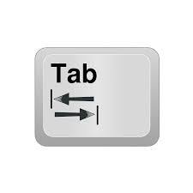
Look at this flowchart
Start
Ask user for name
In Python, this choice is represented by an if statement
In this case:
if name == "John":
print("Hey! I’m called John, too!")
Wait 5 seconds
Is the name "John"?
True
Display "Hey! I’m called John, too!"
False
Display "See ya later!"
To indent, press the [TAB] key ( ).
End
74

Slide 75
Look at this flowchart
Start
Ask user for name
In Python, this choice is represented by an if statement
In this case:
if name == "John":
print("Hey! I’m called John, too!") print("Let’s be twins!")
Wait 5 seconds
Is the name "John"?
True
Display "Hey! I’m called John, too!"
False
Display "See ya later!"
Now, if the answer to the question is True, Python will run any code that is underneath and indented below the if statement.
End
75

Slide 76
Look at this flowchart
Start
Ask user for name
In Python, this choice is represented by an if statement
In this case:
if name == "John":
print("Hey! I’m called John, too!") print("See ya later!")
Wait 5 seconds
Is the name "John"?
True
Display "Hey! I’m called John, too!"
False
Display "See ya later!"
But if the answer was False, Python will skip all the code that was indented, and run the next line of code that was not indented.
End
76

Slide 77
Look at this flowchart
Start
Ask user for name
In Python, this choice is represented by an if statement
In this case:
if name == "John":
print("Hey! I’m called John, too!") print("See ya later!")
Wait 5 seconds
Is the name "John"?
True
Display "Hey! I’m called John, too!"
False
Display "See ya later!"
But if the answer was False, Python will skip all the code that was indented, and run the next line of code that was not indented.
End
77

Slide 78
Look at this flowchart
Start
Ask user for name
In Python, this choice is represented by an if statement
In this case:
if name == "John":
print("Hey! I’m called John, too!") print("See ya later!")
Wait 5 seconds
Is the name "John"?
True
Display "Hey! I’m called John, too!"
False
Display "See ya later!"
This line of code also gets run when Python finishes running all the code above that was for the True answer.
End
78

Slide 79
Look at this flowchart
Start
Ask user for name
In Python, this choice is represented by an if statement
In this case:
if name == "John":
print("Hey! I’m called John, too!") print("See ya later!")
Wait 5 seconds
Is the name "John"?
True
Display "Hey! I’m called John, too!"
False
Display "See ya later!"
This line of code also gets run when Python finishes running all the code above that was for the True answer.
End
79

Slide 80
Let’s go through the code
Start
Ask user for name
from time import sleep
Wait 5 seconds
Is the name "John"?
True
Display "Hey! I’m called John, too!"
False
Display "See ya later!"
End
80

Slide 81
Let’s go through the code
Start
Ask user for name
from time import sleep
Importing the sleep() command from the time module.
Wait 5 seconds
Is the name "John"?
True
Display "Hey! I’m called John, too!"
False
Display "See ya later!"
End
81

Slide 82
Let’s go through the code
Start
Ask user for name
from time import sleep
This line has to go at the top, or we won’t be able to use sleep() later on
Wait 5 seconds
Is the name "John"?
True
Display "Hey! I’m called John, too!"
False
Display "See ya later!"
End
82

Slide 83
Let’s go through the code
Start
Ask user for name
from time import sleep
Wait 5 seconds
Is the name "John"?
True
Display "Hey! I’m called John, too!"
False
Display "See ya later!"
End
83

Slide 84
Let’s go through the code
Start
Ask user for name
from time import sleep
Wait 5 seconds
Is the name "John"?
True
Display "Hey! I’m called John, too!"
False
Display "See ya later!"
End
84

Slide 85
Let’s go through the code
Start
Ask user for name
from time import sleep
name=input("Enter your name:")
Wait 5 seconds
Is the name "John"?
True
Display "Hey! I’m called John, too!"
False
Display "See ya later!"
End
85

Slide 86
Let’s go through the code
Start
Ask user for name
from time import sleep
name=input("Enter your name:")
Wait 5 seconds
Is the name "John"?
True
Display "Hey! I’m called John, too!"
False
Display "See ya later!"
End
86

Slide 87
Let’s go through the code
Start
Ask user for name
from time import sleep
name=input("Enter your name:")
sleep(5)
Wait 5 seconds
Is the name "John"?
True
Display "Hey! I’m called John, too!"
False
Display "See ya later!"
End
87

Slide 88
Let’s go through the code
Start
Ask user for name
from time import sleep
name=input("Enter your name:")
sleep(5)
Wait 5 seconds
Is the name "John"?
True
Display "Hey! I’m called John, too!"
False
Display "See ya later!"
End
88

Slide 89
Let’s go through the code
Start
Ask user for name
from time import sleep
name=input("Enter your name:")
sleep(5)
if name == "John":
Wait 5 seconds
Is the name "John"?
True
Display "Hey! I’m called John, too!"
False
Display "See ya later!"
End
89

Slide 90
Let’s go through the code
Start
Ask user for name
from time import sleep
name=input("Enter your name:")
sleep(5)
if name == "John":
Wait 5 seconds
Is the name "John"?
True
Display "Hey! I’m called John, too!"
False
Display "See ya later!"
End
90

Slide 91
Let’s go through the code
Start
Ask user for name
from time import sleep
name=input("Enter your name:")
sleep(5)
if name == "John":
Wait 5 seconds
Is the name "John"?
True
Display "Hey! I’m called John, too!"
False
Display "See ya later!"
End
91

Slide 92
Let’s go through the code
Start
Ask user for name
from time import sleep
name=input("Enter your name:")
sleep(5)
if name == "John":
print("Hey! I’m called John, too!")
Wait 5 seconds
Is the name "John"?
True
Display "Hey! I’m called John, too!"
False
Display "See ya later!"
End
92

Slide 93
Let’s go through the code
Start
Ask user for name
from time import sleep
name=input("Enter your name:")
sleep(5)
if name == "John":
print("Hey! I’m called John, too!")
Wait 5 seconds
Is the name "John"?
True
Display "Hey! I’m called John, too!"
False
Display "See ya later!"
End
93

Slide 94
Let’s go through the code
Start
Ask user for name
from time import sleep
name=input("Enter your name:")
sleep(5)
if name == "John":
print("Hey! I’m called John, too!")
Wait 5 seconds
Is the name "John"?
True
Display "Hey! I’m called John, too!"
False
Display "See ya later!"
End
94

Slide 95
Let’s go through the code
Start
Ask user for name
from time import sleep
name=input("Enter your name:")
sleep(5)
if name == "John":
print("Hey! I’m called John, too!")
print("See ya later!")
Wait 5 seconds
Is the name "John"?
True
Display "Hey! I’m called John, too!"
False
Display "See ya later!"
End
95

Slide 96
Let’s go through the code
Start
Ask user for name
from time import sleep
name=input("Enter your name:")
sleep(5)
if name == "John":
print("Hey! I’m called John, too!")
print("See ya later!")
Wait 5 seconds
Is the name "John"?
True
Display "Hey! I’m called John, too!"
False
Display "See ya later!"
End
96

Slide 97
Let’s go through the code
Start
Ask user for name
from time import sleep
name=input("Enter your name:")
sleep(5)
if name == "John":
print("Hey! I’m called John, too!")
print("See ya later!")
Wait 5 seconds
Is the name "John"?
True
Display "Hey! I’m called John, too!"
False
Display "See ya later!"
End
97

Slide 98

Activity: Favourite Subject!
Start
Ask user for favourite school subject
Is the subject "coding"?
True
Display "Hey, fellow programmer!!"
False
Display "Art is my favourite subject!"
Activity 05.01 Favourite Subject!
End
98

Slide 99
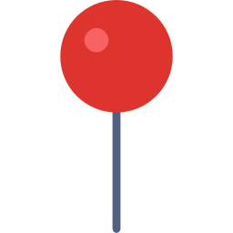


Activity: Are we Twins?
Helpful Hints
You might need to draw a flowchart to help you with the flow!
Activity 05.02 Are We Twins
99

Slide 100

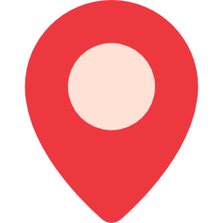
Activity: A Quiz!
Activity 05.03 A Quiz
100

Slide 101
Summary
Flowcharts can be used to represent how a program flows
if statements are used to make choices in a program so that it can behave differently based on what the user entered
101

Slide 102


Reflection: Exit pass
What is one new thing you learnt today?
Write it on a sticky note and stick it on the board before you leave the classroom
102

Slide 103
License Information
These CS in Schools lessons plans, worksheets, and other materials were created by Toan Huynh and Hugh Williams. They are licensed under a Creative Commons Attribution-ShareAlike 4.0 International License.
"Clock" by Freepik on flaticon.com
103

