Slide 1

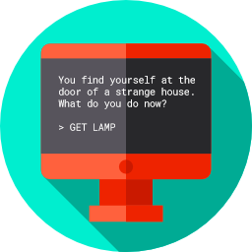
Alternative Assignment
A Simple Text Animation
csinschools.com

Slide 2
Learning objectives
By then end of this lesson, you should be able to:
understand the assignment and how you will be marked
understand how this assignment allows you to demonstrate all you have learned about Python coding so far
start working on your assignment!
2

Slide 3
Simple Text Animation
You assignment is to design and code up a simple text-based animation!
Assignment Details and Marking Rubric here
It’ll be your chance to demonstrate the Python skills you’ve learned so far, including:
Printing text and symbols
Colour
ASCII art! (see below links for some handy ASCII art resources, feel free to look for more!)
ASCII Art Archive
Text to ASCII
3

Slide 4
Simple Text Animation
Below is a sample animation done in the style of a movie trailer!
You can check out the code for it here!
4

Slide 5
Sample Animation - (From past student work!)
Here is another example of a more storyline driven animation. It was based on a previous student’s assignment!
You can check out the code for it here!
5

Slide 6

Sample Code to get you started
Sample Code to help you start
6

Slide 7
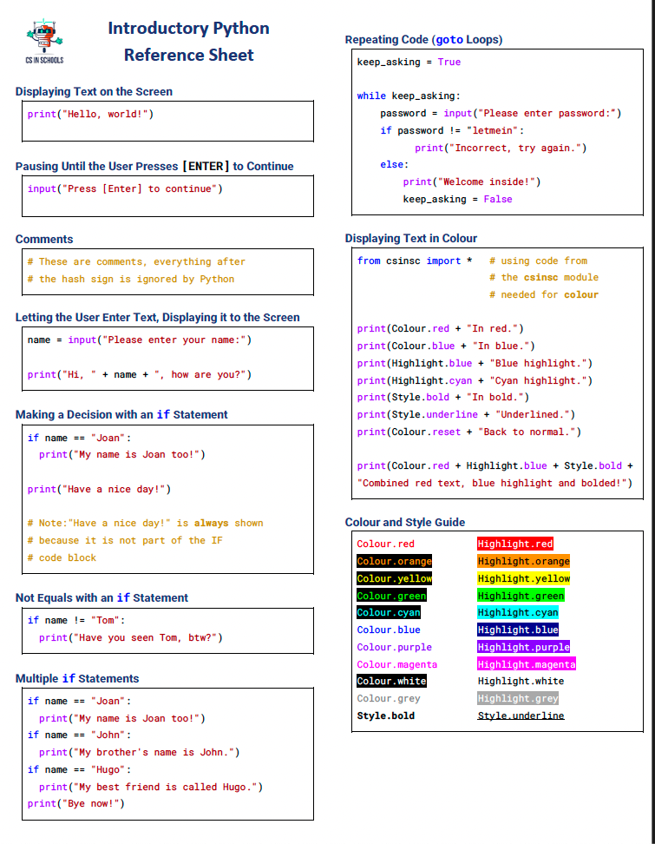
Python Reference Sheet
7

Slide 8
License Information
These CS in Schools lessons plans, worksheets, and other materials were created by Toan Huynh and Hugh Williams. They are licensed under a Creative Commons Attribution-ShareAlike 4.0 International License.
8

