Slide 1

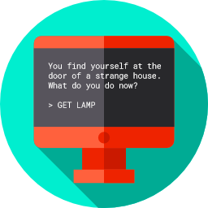
Lesson 7
A Simple Text Adventure Game
csinschools.com

Slide 2

Learning objectives
By then end of this lesson, you should be able to:
understand the assignment and how you will be marked
understand how this assignment allows you to demonstrate all you have learned about Python coding so far
start working on your assignment!
2

Slide 3
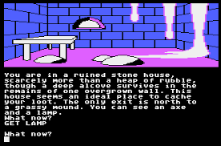
Assignment rubric
Text adventure games were popular in the 1980s and were sometimes referred to as “interactive novels”. Some of them also featured graphics to enhance the playing experience!
Check out the marking rubric here
3

Slide 4
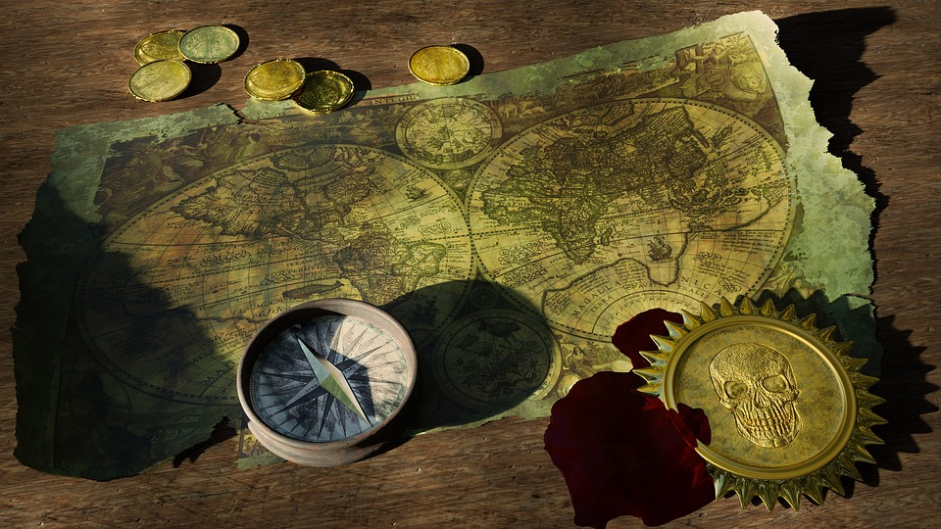
Some examples to get you thinking...
City of Gold Example Your Spirit Animal Example
4

Slide 5

Sample Code to get you started
Sample Code to help you start You can delete the code from the editor if you don’t need it!
5

Slide 6
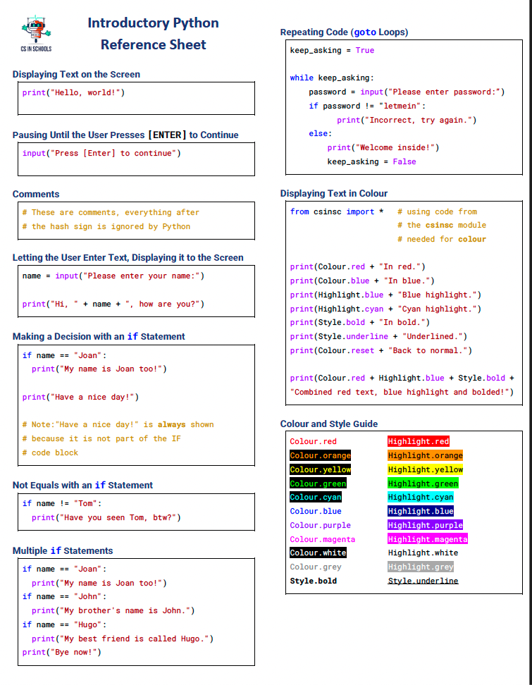
Python Reference Sheet
6

Slide 7
License Information
These CS in Schools lessons plans, worksheets, and other materials were created by Toan Huynh and Hugh Williams. They are licensed under a Creative Commons Attribution-ShareAlike 4.0 International License.
7

