Slide 1


Lesson 8
The Finale!
csinschools.com

Slide 2



Learning objectives
By the end of this lesson, you should be able to:
finish off your final assessment
wonder, where to from here?
2

Slide 3
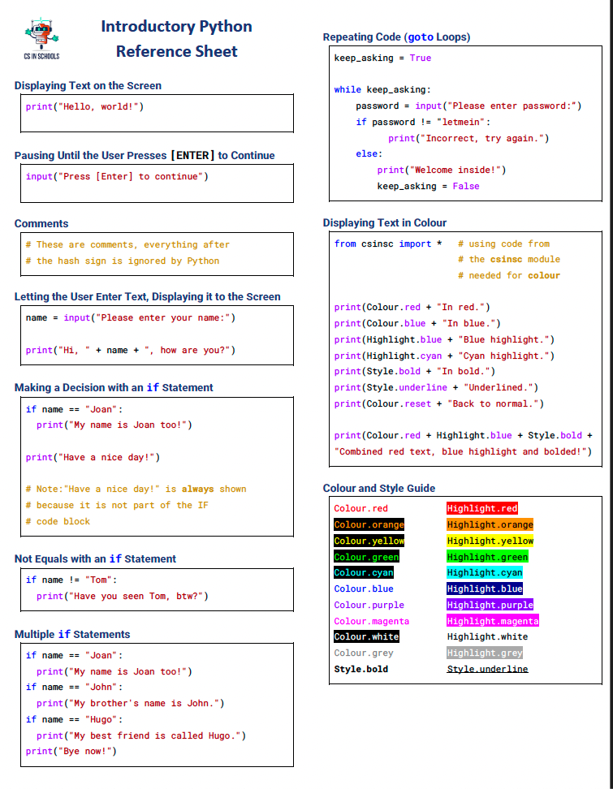
Python Reference Sheet
3

Slide 4

Some examples to get you thinking...
City of Gold Example Your Spirit Animal Example
4

Slide 5
Where to from here?
This is only the very beginning of your programming and Python journey.
We really hope you have enjoyed it!
There are many, many resources online for your to continue learning about programming and Python. Feel free to check some of the following out:
Code Academy courses
Treehouse Python courses
Coursera Python courses
Grok Learning courses
5

Slide 6
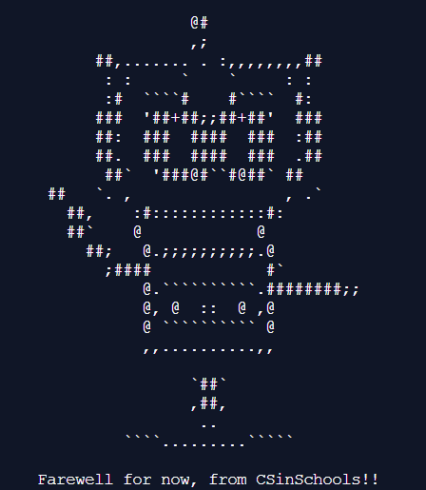
6

Slide 7
License Information
These CS in Schools lessons plans, worksheets, and other materials were created by Toan Huynh and Hugh Williams. They are licensed under a Creative Commons Attribution-ShareAlike 4.0 International License.
7

