Slide 1
Automatic Detection of Semantic Conflicts in Merge Commits via LLMs
Duarte Sardão – up201905497

Slide 2
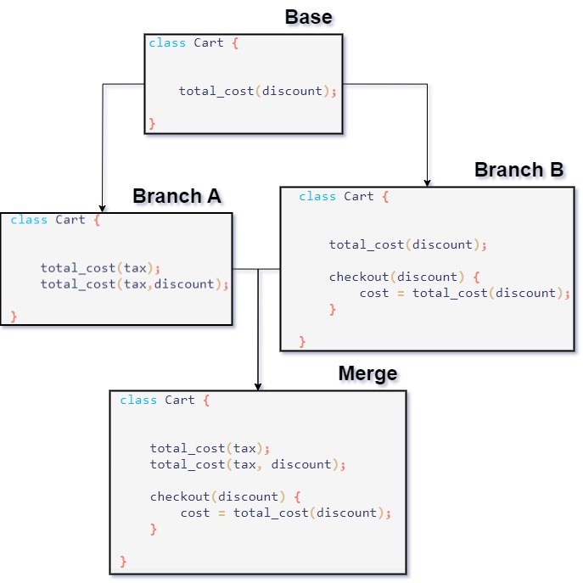
Semantic Conflicts – Context and Motivation
In software merging, we find 3 types of conflicts:
Textual, where different changes are made in the same lines of code. These are easily detected by version control systems, who block the merge until it is resolved.
Syntactic, where different changes make the code syntatically incorrect. These are aren’t detected by most version control systems, but easily detected by humans, as the code will then fail to compiled.
Semantic conflicts remains the most complex, where paralell changes resulted in unexpected emergent, altered or lost behaviour. An example of this is where a method is simultaneously altered in one branch and called upon in another.
Due to the difficulty of detection, semantic conflicts can often be missed for extended periods of time, thus the development of solutions for their easier detection is imperative.
Fabricated conflict: Branch B calls function total_cost, expecting calculation with a discount. Due to changes in A however, the calculation is done with tax: the value will thus be different (higher) than expected.

Slide 3
Goals
The goal of current work is to develop a tool that can identify semantic conflicts in merge scenarios and generate tests to make them evident.
The novel approach of this project, compared to previous work with regard to semantic conflict detection, is to make use of Large Language Models (LLMs) for test generation.

Slide 4
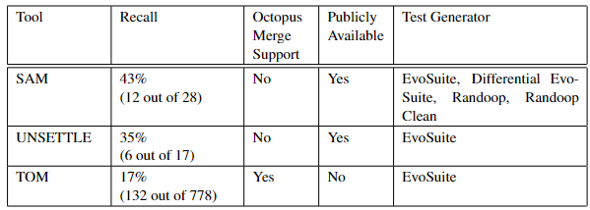
Related Work – Semantic Conflict Detection
In previous work exploring the ability to highlight semantic conflicts by generating unit tests, we found 3 mains tools previously developed:
SAM (SemAntic Merge) – SAM could detect nearly half of the tested conflicts and can generate tests with myriad of generators, although the authors highligh Evosuite and Differential Evosuite suffice for most cases.
UNSETTLE (aUtomatic uNit teSt gEneraTion for semanTic confLict dEtection) – Composed of two modules: a pattern matcher (Changes Matcher) and a test generator, using Evosuite.
TOM (Testing On Merges) – Despite lower recall, supports octopus merges.

Slide 5
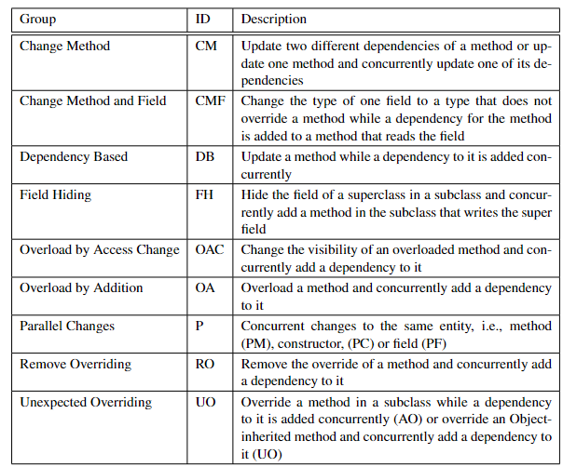
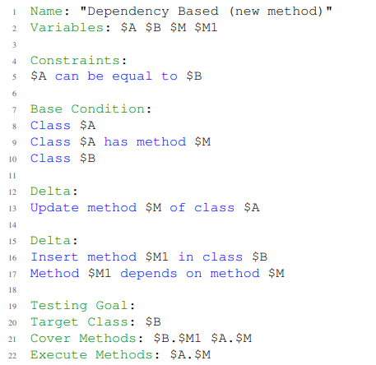
Related Work – Changes Matcher
A component of the UNSETTLE tool, Changes Matcher is of particular interest: with a library of common causes for semantic conflicts, Changes Matcher computes the changes between the base, branches and merge commits. If the changes correspond to one of these patterns, output in Domain Specific Language is generated, then used to guide test generation.

Slide 6
Related Work – Test Generation with LLMs
The recent explosive rise in the usage and capabalities of LLMs also brought forward an explosive rise in interest in their ability to evaluate code and generate unit tests.
While LLMs lag behind traditional automated code generation solutions (such as Evosuite), they present some key benefits:
Generated tests are much more human readable and explained, making them often preferred by developers
Existing testing suites can be offered as input, allowing generated tests to emulate the style and conventions established.
While LLMs present several drawbacks (often generating non-compillable code, hallucinating, several improvements can be made:
K-Shot Learning (giving example inputs and outputs before the actual prompt)
Intention Prompting (making use of LLMs strengths by first asking them to identify the purpose of the software, in natural language, before asking for development of the test for it)
Test Correction (feeding error outputs, for example from failed compilations back into the LLM and prompting for correction)

Slide 7
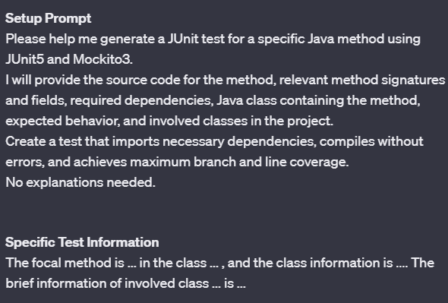
Related Work – Test Generation with LLMs Example Prompt

Slide 8
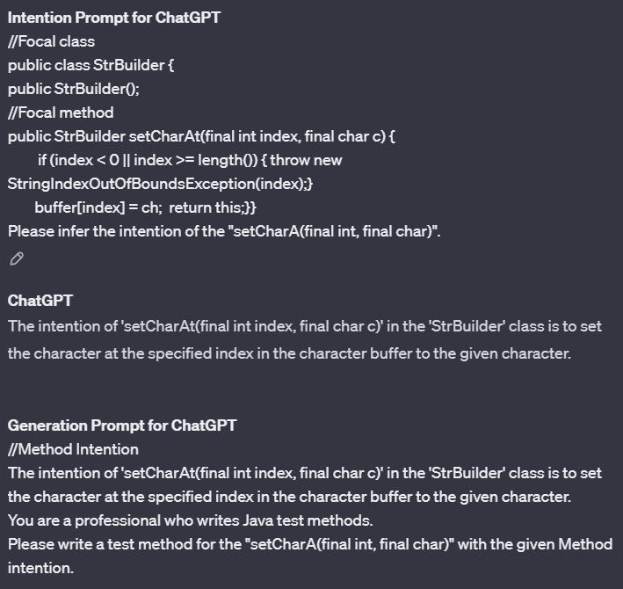
Related Work – Test Generation with LLMs Intention Prompting

Slide 9
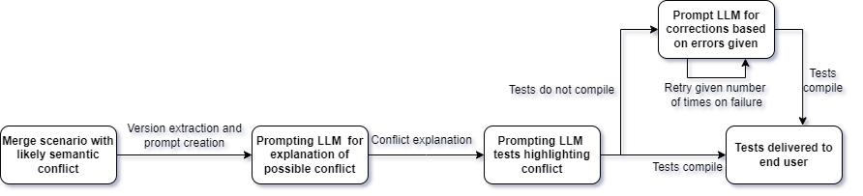
Future Work – Proposed Solution
Based on the previous work, we designed the solution to:
Detect the conflict in a merge scenario, by applying, for example, Changes-Matchet
Prompt the LLM to explain the conflict
Prompt the LLM to generate a test to highlight the explained conflict
Prompt the LLM for correction of generated tests, if they fail to compile for some reason, for a limited number of times.
The developed tool should then generate tests for problematic merge scenarios, hopefully achieving higher recall than previous solutions.

Slide 10
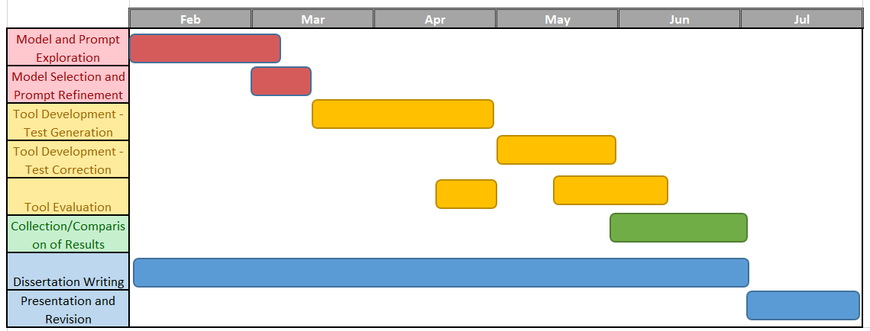
Future Work - Gantt

Slide 11
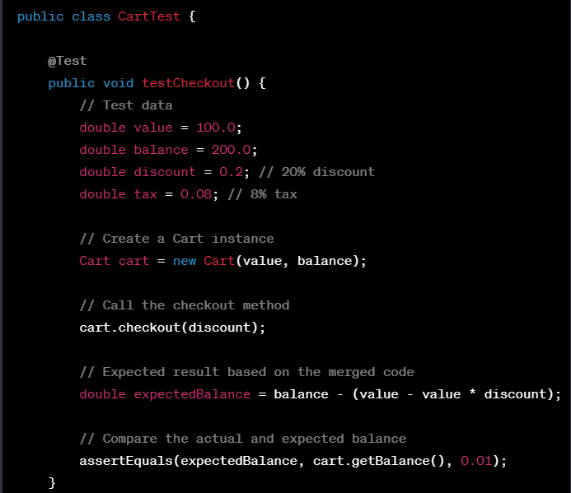
Preliminary Work
Preliminary work has focused on the ability of ChatGPT to identify and generate tests for semantic conflicts.
While in small, fabricated examples, with specific prompting it shows ability to generate appropriate tests, in real world merge scenarions it struggles with hallucinations, confusion at the high volume of data, inability to answer the question and generation of nonsensical tests.
Further work needs to be done to see how prompts can be further improved and whether other models show better results.
Generated test for Cart example.

