Slide 1
Projeto aed
Grupo 65
Duarte Gonçalves – up202108772
Gonçalo Miranda – up202108773
Jorge Restivo – up202108886

Slide 2
Classes Used (1/2)
Airline Class
private:
string code;
string name;
string callsign;
string country;
public:
Airline(string code, string name, string callsign, string country);
string getCode() const;
string getName() const;
string getCallsign() const;
string getCountry() const;
---------------------------------------------------
Files:
Airline.h
Airline.cpp
Airport Class
private:
string code;
string name;
string city;
string country;
double latitude;
double longitude;
public:
Airport(string code, string name, string city, string country, double latitude, double longitude);
string getCode() const;
string getName() const;
string getCity() const;
string getCountry() const;
double getLatitude() const;
double getLongitude() const;
double distance(double lat, double lon) const;
---------------------------------------------------
Files:
Airport.h
Airport.cpp
Flight Class
private:
string source;
string target;
string airline;
public:
Flight(string source, string target, string airline);
string getSource() const;
string getTarget() const;
string getAirline() const;
---------------------------------------------------
Files:
Flight.h
Flight.cpp
MenuHandler Class
private:
string source;
string target;
string airline;
public:
Flight(string source, string target, string airline);
string getSource() const;
string getTarget() const;
string getAirline() const;
---------------------------------------------------
Files:
MenuHandler.h
MenuHandler.cpp

Slide 3
Classes Used (2/2)
Graph Class
private:
struct Edge {
int dest;
set<string> airlines;
};
struct Node {
list<Edge> edges;
int dist = -1;
bool visited = false;
vector<int> previous;
};
int n;
vector<Node> nodes;
public:
explicit Graph(int n);
void addEdge(int src, int dest, const string &airline);
void bfs(int src);
void bfs(set<int> src);
vector<list<int>> shortestPaths(int src, int dest);
vector<list<int>> shortestPaths(int src, int dest, const set<string> &airlines);
vector<list<int>> shortestPaths(set<int> src, set<int> dest);
vector<list<int>> shortestPaths(set<int> src, set<int> dest, const set<string> &airlines);
int getNumOutgoing(int src) const;
int getNumAirlines(int src) const;
set<int> getDestinations(int src) const;
set<int> reachable(int src, int hops);
Files Used:
Graph.h
Graph.cpp

Slide 4
Reading Dataset
  ifstream function to get files;
  getline(file, line);
  One time to skip first line, then do a while loop to get each line;
  getline(iss,attribute, ‘,’);
  Separate each line into each attribute;
  .insert function to add each attribute to its correspondent vector;
  graph.addEdge to add each flight possible (edge) to correspondent codes (nodes);

Slide 5
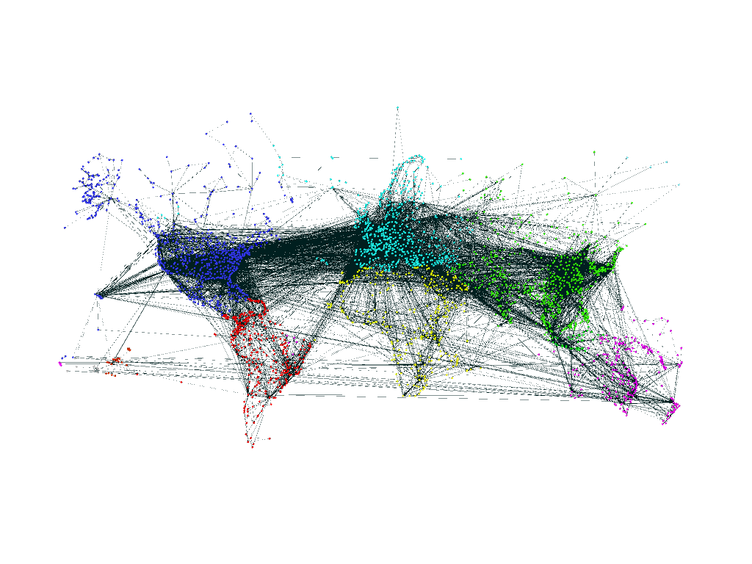
Graph Used
The graph used in this project represents the airports as nodes (every continent has color-coded nodes) and their respective flights are represented as edges.

Slide 6
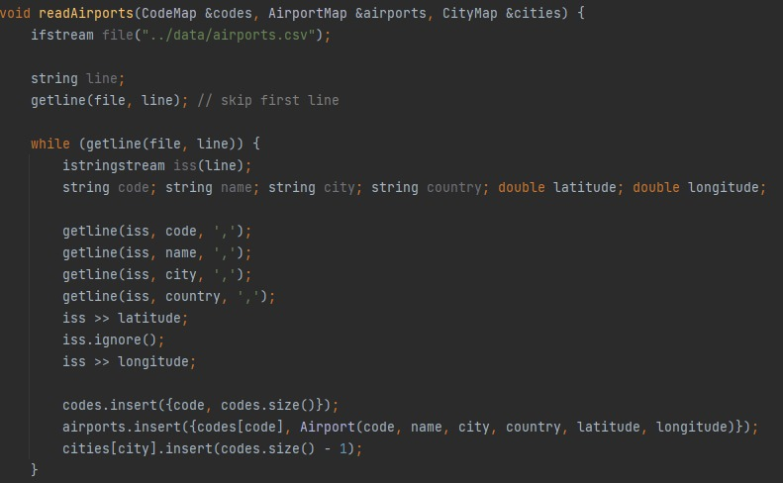
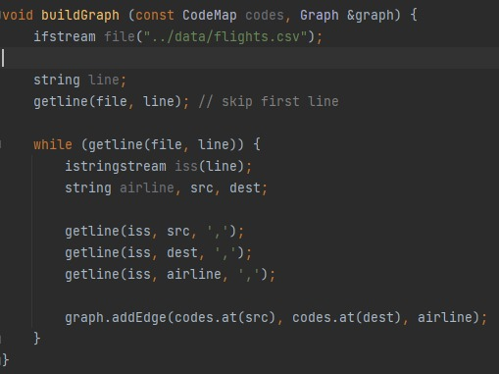
Reading Dataset

Slide 7
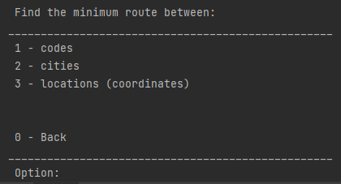

Implemented Features – Finding Minimum Route:
Main Feature
This feature allows the user to find the minimum route between two different airport codes, two different cities or between two different locations (using their coordinates).
The user also has the option to select either one or more prefered airlines to search for.
The options using cities and location have a complexity of O(V(V+E)), while the codes one has a complexity of O(V+E).

Slide 8
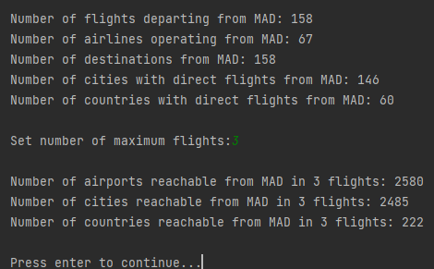
Implemented Features – Airport Statistics
This feature allows the user to find the minimum route between two different airport codes, two different cities or between two different locations (using their coordinates).
The user also has the option to select either one or more prefered airlines to search for.
This feature has a complexity of O(V+E).
Example using Madrid’s Airport

Slide 9
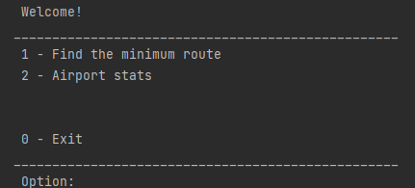
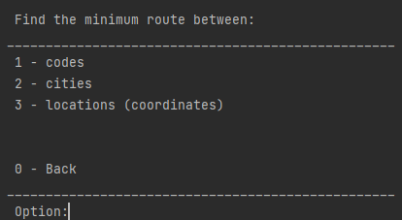
User Interface:
Here are the various menus that compose the user interface.

Slide 10
Biggest Difficulties and Work Distribution
Our biggest difficulty resided in properly listing all the shortest paths, since it required some engineous
The work was evenly distributed along all group members.

