Slide 1

MICROECONOMICS
by Robert S. Pindyck Daniel Rubinfeld
Ninth Edition
Copyright © 2016, 2012, 2009 Pearson Education, Inc. All Rights Reserved

Slide 2
Chapter 18
Externalities and Public Goods (1 of 2)
CHAPTER OUTLINE
18.1 Externalities
18.2 Ways of Correcting Market Failure
18.2 Stock Externalities
18.2 Externalities and Property Rights
18.2 Common Property Resources
18.2 Public Goods
LIST OF EXAMPLES
18.1 The Costs and Benefits of Sulfur Dioxide Emissions
18.1 Emissions Trading and Clean Air
18.1 Regulating Municipal Solid Wastes
18.1 Global Warming
18.1 The Coase Theorem at Work
18.1 Crawfish Fishing in Louisiana
18.1 The Demand for Clean Air

Slide 3
Externalities and Public Goods (2 of 2)
In this chapter we study externalities—the effects of production and consumption activities not directly reflected in the market—and public goods—goods that benefit all consumers but that the market either undersupplies or does not supply at all.
When externalities are present, the price of a good need not reflect its social value. As a result, firms may produce too much or too little, so that the market outcome is inefficient.
The marginal cost of providing a public good to an additional consumer is zero, and people cannot be prevented from consuming it. We distinguish between those goods that are difficult to provide privately and those that could have been provided by the market.

Slide 4
18.1 Externalities (1 of 4)
externality Action by either a producer or a consumer which affects other producers or consumers, but is not accounted for in the market price.
Externalities can be negative—when the action of one party imposes costs on another party—or positive—when the action of one party benefits another party.
Negative Externalities and Inefficiency
marginal external cost Increase in cost imposed externally as one or more firms increase output by one unit.
marginal social cost Sum of the marginal cost of production and the marginal external cost.
Notes:
In §6.3, we explain that with a fixed-proportions production function, it is impossible to substitute among inputs because each level of output requires a specific combination of labor and capital.

Slide 5
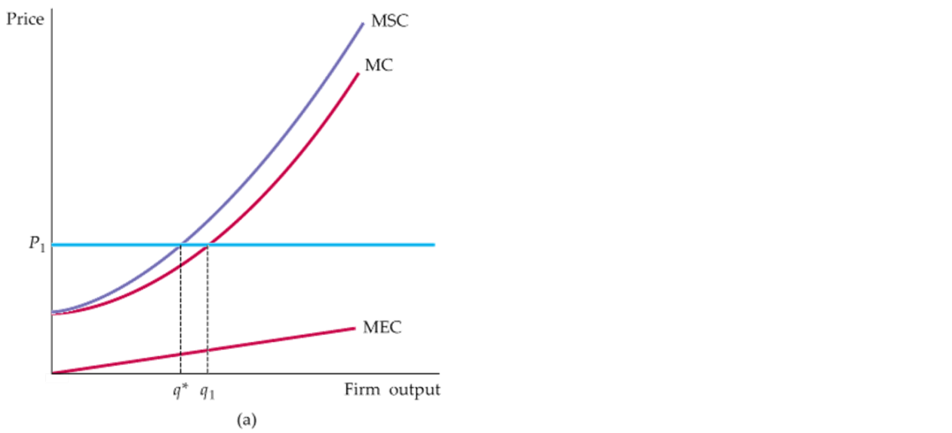
18.1 Externalities (2 of 4)
FIGURE 18.1 (1 of 2)
EXTERNAL COST
When there are negative externalities, the marginal social cost MSC is higher than the marginal cost MC.
The difference is the marginal external cost MEC.
In (a), a profit-maximizing firm produces at q₁, where price is equal to MC.
The efficient output is q*, at which price equals MSC.

Slide 6
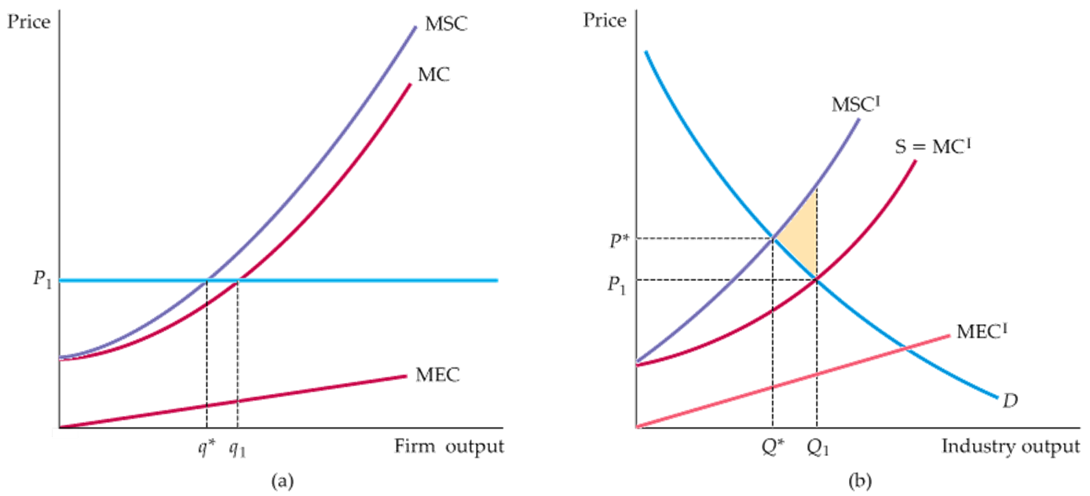
18.1 Externalities (3 of 4)
FIGURE 18.1 (2 of 2)
EXTERNAL COST
In (b), the industry’s competitive output is Q₁, at the intersection of industry supply MC and demand D.
However, the efficient output Q* is lower, at the intersection of demand and marginal social cost MSC.
The aggregate social cost is as the shaded triangle between MSC^{I}, D, and output Q₁.
Notes:
In §8.3, we explain that because a competitive firm faces a horizontal demand curve, choosing its output so that marginal cost is equal to price is profit-maximizing.

Slide 7
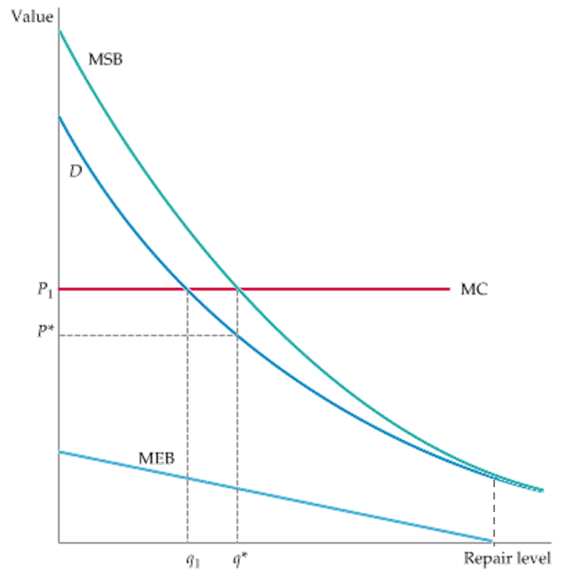
18.1 Externalities (4 of 4)
Positive Externalities and Inefficiency
marginal external benefit Increased benefit that accrues to other parties as a firm increases output by one unit.
marginal social benefit Sum of the marginal private benefit plus the marginal external benefit.
FIGURE 18.2
EXTERNAL BENEFITS
When there are positive externalities, marginal social benefits MSB are higher than marginal benefits D.
The difference is the marginal external benefit MEB.
A self-interested homeowner invests q₁ in repairs, determined by the intersection of the marginal benefit curve D and the marginal cost curve MC.
The efficient level of repair q* is higher and is given by the intersection of the marginal social benefit and marginal cost curves.
Notes:
In §9.2, we explain that, absent market failure, a competitive market leads to the economically efficient output level.
In §4.5, we explain that when there is a network externality, each individual’s demand depends on the purchases of other individuals.

Slide 8
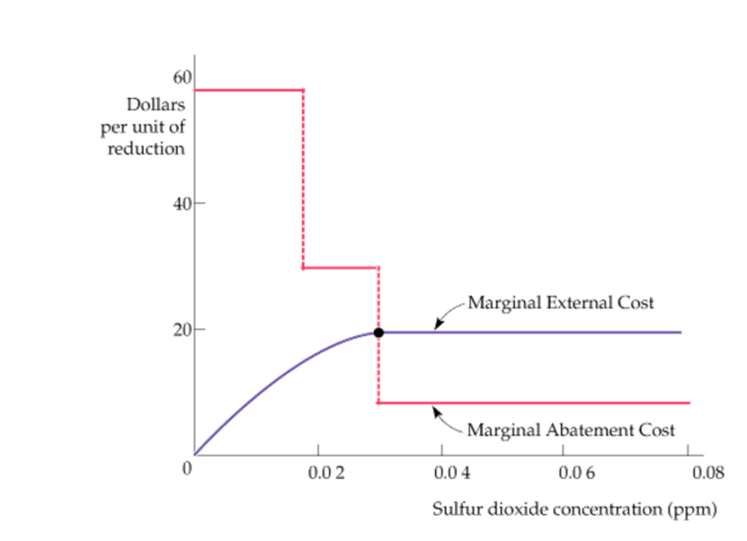
EXAMPLE 18.1 THE COSTS AND BENEFITS OF SULFUR DIOXIDE EMISSIONS
Although sulfur dioxide gas can be produced naturally by volcanoes, almost two-thirds of all sulfur dioxide emissions in the United States come from electric power generation that depends on burning fossil fuels such as coal and petroleum. In addition to human health, acid rain causes damage to water and forests as well as to man-made structures.
FIGURE 18.3
SULFUR DIOXIDE EMISSIONS REDUCTIONS
The efficient sulfur dioxide concentration equates the marginal abatement cost to the marginal external cost.
Here the marginal abatement cost curve is a series of steps, each representing the use
of a different abatement technology.

Slide 9
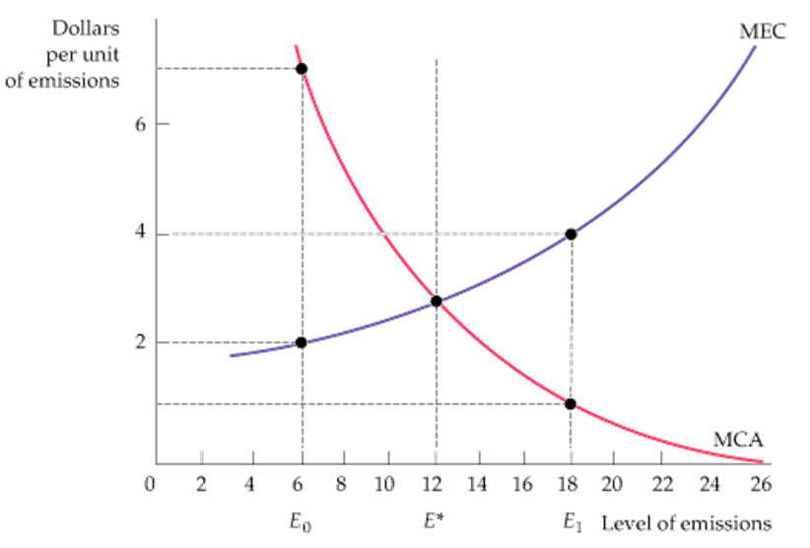
18.2 Ways of Correcting Market Failure
(1 of 6)
FIGURE 18.4
THE EFFICIENT LEVEL OF EMISSIONS
The efficient level of factory emissions is the level that equates the marginal external cost of emissions MEC to the benefit associated with lower abatement costs MCA. The efficient level of 12 units is E*.
Here the marginal abatement cost curve is a series of steps, each representing the use of a different abatement technology.
With no effort at abatement, the firm’s profit-maximizing level of emissions is 26, the level at which the marginal cost of abatement is zero.
We can encourage the firm to reduce emissions to E* in three ways: (1) emissions standards; (2) emissions fees; and (3) transferable emissions permits.
Notes:
Recall from §7.3 that a firm can substitute among inputs by changing technologies in response to an effluent fee.

Slide 10
18.2 Ways of Correcting Market Failure (2 of 6)
An Emissions Standard
emissions standard Legal limit on the amount of pollutants that a firm can emit.
The standard ensures that the firm produces efficiently. The firm meets the standard by installing pollution-abatement equipment. Firms will find it profitable to enter the industry only if the price of the product is greater than the average cost of production plus abatement—the efficient condition for the industry.
An Emissions Fee
emissions fee Charge levied on each unit of a firm’s emissions.

Slide 11
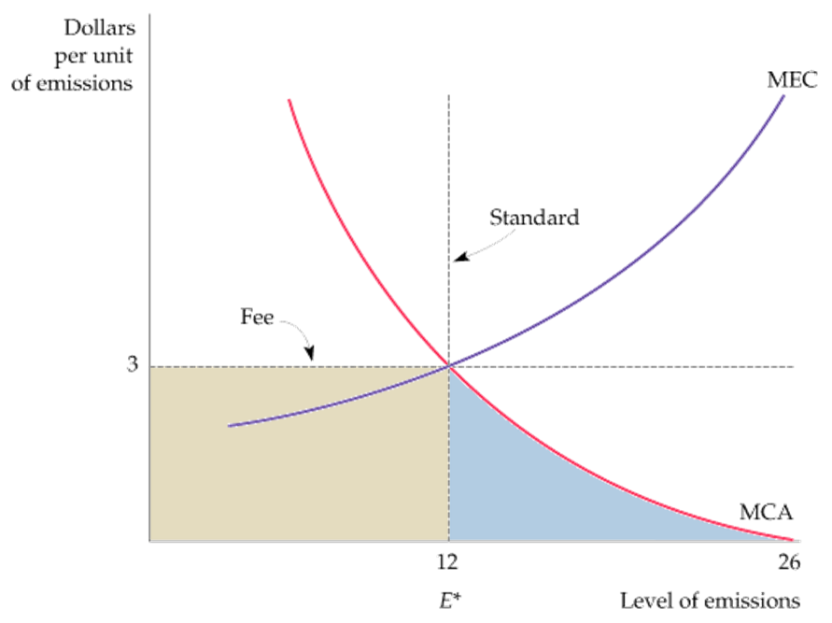
18.2 Ways of Correcting Market Failure (3 of 6)
FIGURE 18.5
STANDARDS AND FEES
The efficient level of emissions at E* can be achieved through either an emissions fee or an emissions standard.
Facing a fee of $3 per unit of emissions, a firm reduces emissions to the point at which the fee is equal to the marginal cost of abatement.
The same level of emissions reduction can be achieved with a standard that limits emissions to 12 units.

Slide 12
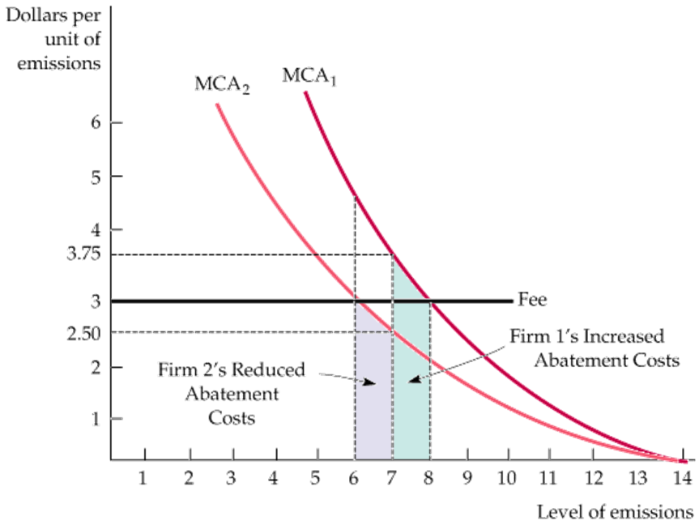
18.2 Ways of Correcting Market Failure (4 of 6)
THE CASE FOR FEES
FIGURE 18.6
THE CASE FOR FEES
With limited information, a policymaker may be faced with the choice of either a single emissions fee or a single emissions standard for all firms.
The fee of $3 achieves a total emissions level of 14 units more cheaply than a 7-unit-per-firm emissions standard.
With the fee, the firm with a lower abatement cost curve (Firm 2) reduces emissions more than the firm with a higher cost curve (Firm 1).

Slide 13
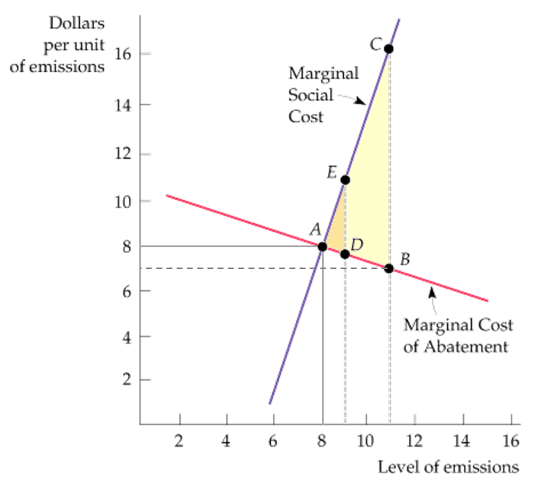
18.2 Ways of Correcting Market Failure (5 of 6)
THE CASE FOR STANDARDS
FIGURE 18.7
THE CASE FOR STANDARDS
When the government has limited information about the costs and benefits of pollution abatement, either a standard or a fee may be preferable. The standard is preferable when the marginal external cost curve is steep and the marginal abatement cost curve is relatively flat.
Here a 12.5 percent error in setting the standard leads to extra social costs of triangle ADE.
The same percentage error in setting a fee would result in excess costs of ABC.

Slide 14
18.2 Ways of Correcting Market Failure (6 of 6)
Tradable Emissions Permits
tradable emissions permits System of marketable permits, allocated among firms, specifying the maximum level of emissions that can be generated.
Each permit specifies the number of units of emissions that the firm is allowed to put out. Excess emissions are subject to substantial monetary sanctions. The total number of permits is chosen to achieve the desired maximum level of emissions. Permits are marketable: They can be bought and sold.
If there are enough firms and permits, a competitive market will develop. In equilibrium,
the price of a permit equals the marginal cost of abatement for all firms; otherwise, a firm will find it advantageous to buy more permits. The level of emissions chosen by the government will be achieved at minimum cost. Those firms with relatively low marginal cost of abatement curves will be reducing emissions the most, and those with relatively high marginal cost of abatement will be buying more permits and reducing emissions the least.

Slide 15
EXAMPLE 18.2 EMISSIONS TRADING AND CLEAN AIR
In the 1980s and 1990s, the Environmental Protection Agency’s “bubble” and “offset” programs were modest attempts to use a trading system to lower the cleanup costs of emissions. Abatement cost savings associated with the EPA’s program of 42 bubbles have been approximately $300 million per year since 1979.
Under the offset program, new sources of emissions may be found, but only if they offset their new emissions by reducing emissions from existing sources by at least as much. A total of more than 2000 offset transactions have occurred since 1976.
Bubble and offset programs substantially understate the potential gain from a broad-based emissions trading program. The 1990 Clean Air Act focused on transferable permits as a way of dealing with “acid rain.” In 2005 the program was modified through the Clean Air Interstate Rule to put a “cap” on emissions in 25 states while continuing to allow emissions “trades”—hence the term “cap and trade” program.
In the early 1990s, economists expected these permits to trade for around $300, but reducing sulfur dioxide emissions was less costly than anticipated. From 2005 to 2006, the price of permits rose sharply, hitting a high of nearly $1600 in December 2005, but starting in 2007, the market price of emission permits began to decline, in part because the EPA lost a lawsuit brought by a group of utilities.

Slide 16
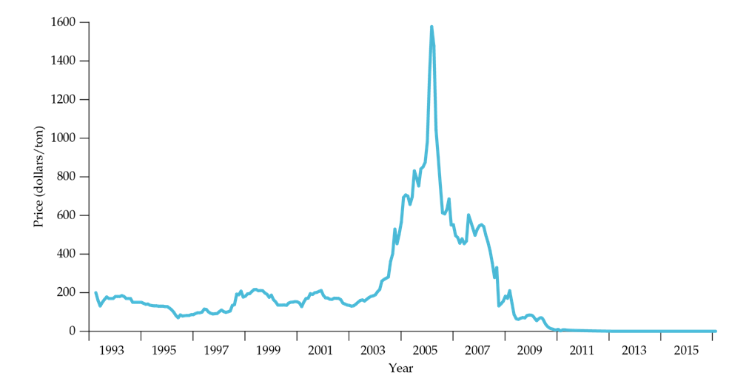
EXAMPLE 18.3 EMISSIONS TRADING AND CLEAN AIR (1 of 2)
THE CASE FOR STANDARDS
FIGURE 18.8
PRICE OF TRADEABLE EMISSIONS PERMITS
The price of tradeable permits for sulfur dioxide emissions fluctuated between $100 and $200 from 1993 to 2003, but then increased sharply in 2005 and 2006 in response to an increased demand for permits. The price fluctuated between $400 and $500 per ton for the next few years, before the stock market crashed in 2008. By 2012, the price of permits was close to zero, and the permit market had effectively collapsed.

Slide 17
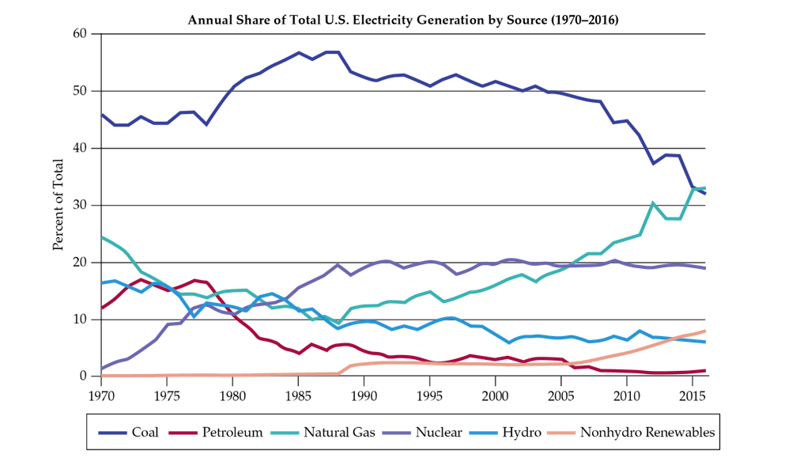
EXAMPLE 18.3 EMISSIONS TRADING AND CLEAN AIR (2 of 2)
FIGURE 18.9
FUEL MIX FOR U.S. ELECTRICITY GENERATION
Until recently, coal had been the primary fuel for generating electricity, accounting for over 50% of electricity generation during the 1980s and 1990s. But starting around 2000, coal has been increasingly displaced by natural gas.

Slide 18
18.2 Ways of Correcting Market Failure
(1 of 3)
Recycling
The disposal of waste products involves little or no private cost. This means that society
will dispose of too much waste material.
The overutilization of virgin materials and the underutilization of recycled materials will result in a market failure.
In many communities, households are charged a fixed annual fee for trash disposal,
which allows households to dispose of glass and other garbage at very low cost.
The low cost of disposal creates a divergence between the private and social cost. The marginal private cost, which is the cost to the household of throwing out the glass, is likely to be constant (independent of the amount of disposal) for low to moderate levels of disposal. It will then increase for large disposal levels involving additional shipping and dump charges. In contrast, the social cost of disposal includes the harm to the environment from littering, and injuries. Marginal social cost is likely to increase, in part because the marginal private cost is increasing and in part because the environmental and aesthetic costs of littering are likely to increase sharply as the level of disposal increases.

Slide 19
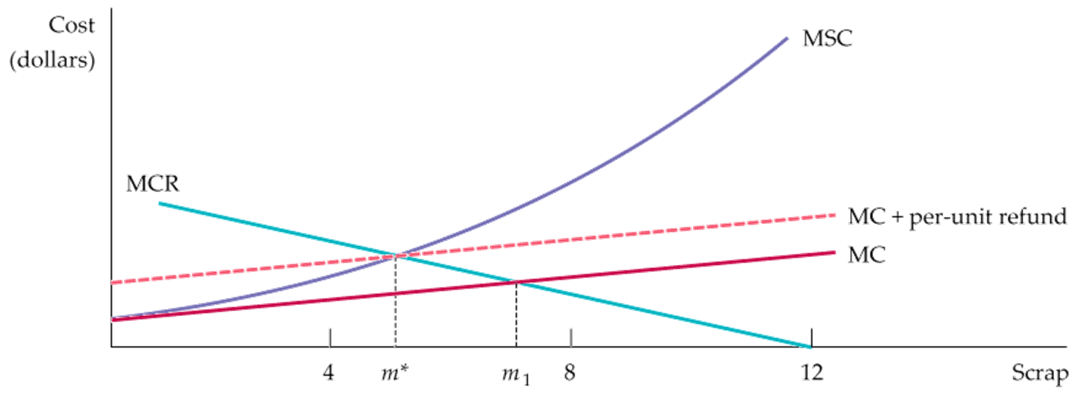
18.2 Ways of Correcting Market Failure (2 of 3)
FIGURE 18.10
THE EFFICIENT AMOUNT OF RECYCLING
The efficient amount of recycling of scrap material is the amount that equates the marginal social cost of scrap disposal, MSC, to the marginal cost of recycling, MCR.
The efficient amount of scrap for disposal m* is less than the amount that will arise in a private market, m₁.

Slide 20
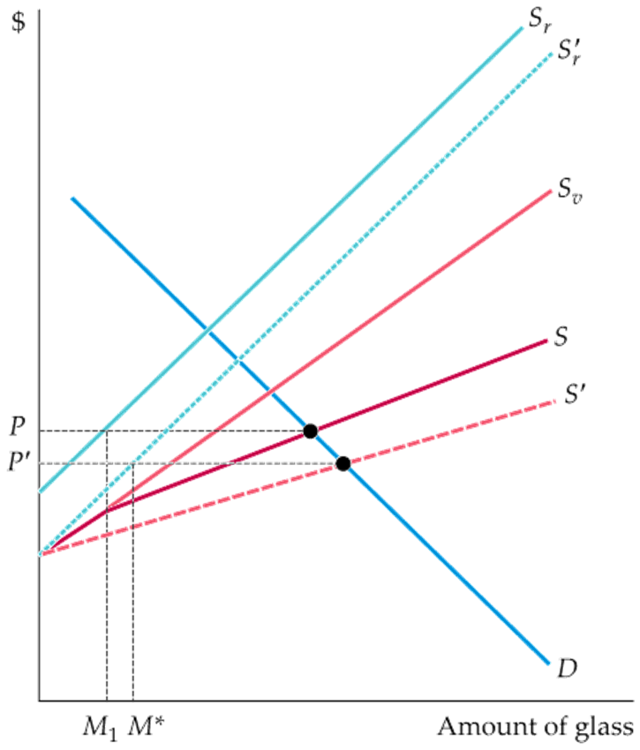
18.2 Ways of Correcting Market Failure (3 of 3)
REFUNDABLE DEPOSITS
FIGURE 18.11
REFUNDABLE DEPOSITS
The supply of virgin glass containers is given by S_{v} and the supply of recycled glass by S_{r}.
The market supply S is the horizontal sum of these two curves.
Initially, equilibrium in the market for glass containers involves a price P and a supply of recycled glass M₁.
By raising the relative cost of disposal and encouraging recycling, the refundable deposit increases the supply of recycled glass from S_{r} to S’_{r} and the aggregate supply of glass from S to S’.
The price of glass then falls to P’, the quantity of recycled glass increases to M*, and the amount of disposed glass decreases.
Notes:
The refundable deposit creates an additional private cost of disposal: the opportunity cost of failing to obtain a refund. With the higher cost of disposal, the individual will reduce disposal and increase recycling to the optimal social level m*.

Slide 21
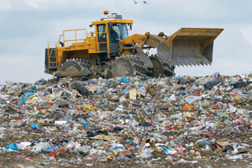
EXAMPLE 18.4 REGULATING MUNICIPAL SOLID WASTES (1 of 2)
In 2009, the average resident of the United States generated 4.34 pounds of solid waste per day,
substantially higher than residents of Tokyo, Paris, Hong Kong, and Rome.
Some of these differences are due to variations in consumption levels, but most are due to the efforts that many other countries have made to encourage recycling.
A number of policy proposals have been introduced to encourage recycling in the United States. Refundable deposits, curbside charges and mandatory separation of recyclable materials such as glass are policies with varying degrees of effectiveness based on consumer preferences. A refundable deposit system does best, with 78.9 percent of consumers purchasing recyclable glass containers.
Recycling efforts have expanded in the past decade. By 2009, 50.7 percent of aluminum, 74.2 percent of office paper, and 31.1 percent of glass containers were recycled. In 2013, Americans created 4.40 pounds of solid waste per person per day. 1.51 pounds of that total was either recycled or composted.

Slide 22
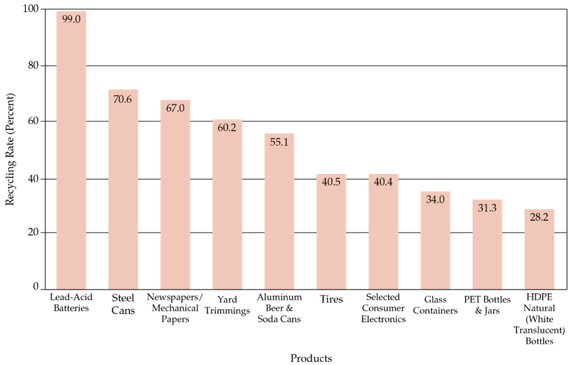
EXAMPLE 18.4 REGULATING MUNICIPAL SOLID WASTES (2 of 2)
FIGURE 18.12
RECYCLING RATES OF SELECTED PRODUCTS FOR U.S., 2013
In 2013, Americans generated about 254 million tons of trash and recycled and composted about 87 million tons of this material, equivalent to a 34.3 percent average recycling rate. This represents 1.51 pounds of the 4.40 pounds of waste generated per person per day.

Slide 23
18.2 Ways of Correcting Market Failure
(1 of 2)
Sometimes, the damage to society comes not directly from the emissions flow, but rather from the accumulated stock of a pollutant.
A good example is global warming. It is the stock of accumulated greenhouse gases (GHGs) in the atmosphere that ultimately causes harm. Furthermore, the dissipation rate for accumulated GHGs is very low.
stock externality Accumulated result of action by a producer or consumer which, though not accounted for in the market price, affects other producers or consumers.
Stock externalities (like flow externalities) can also be positive. An example is the stock of “knowledge” that accumulates as a result of investments in R&D.
By calculating the investment’s net present value (NPV), the firm can decide whether or not the investment is economically justified. The same net present value concept applies when we want to analyze how the government should respond to a stock externality.
Notes:
Recall from §15.1 that a firm’s capital is measured as a stock, while the investment that creates the capital is a flow. The firm’s output is also measured as a flow.
Also, recall from §15.2 that the present discounted value (PDV) of a series of expected future cash flows is the sum of those cash flows discounted by the appropriate interest rate. Moreover, we observe in §15.4 that, according to the net present value (NPV) rule, a firm should invest if the PDV of the expected future cash flow from an investment is greater than the cost.

Slide 24
18.2 Ways of Correcting Market Failure (2 of 2)
Stock Buildup and Its Impact
With ongoing emissions, the stock will accumulate, but some fraction of the stock, δ, will dissipate each year. In the first year, the stock of pollutant (S) will be just the amount of that year’s emissions (E):
In the second year, the stock of pollutant will equal the emissions that year plus the nondissipated stock from the first year—
—and so on. In general, the stock in any year t is given by the emissions generated that year plus the nondissipated stock from the previous year:
If emissions are at a constant annual rate E, then after N years, the stock of pollutant will be:
As N becomes infinitely large, the stock will approach the long-run equilibrium level E/δ.

Slide 25
18.3 Stock Externalities (1 of 3)
NUMERICAL EXAMPLE
TABLE 18.1: BUILDUP IN THE STOCK POLLUTANT
YEAR | E | S_{t} | DAMAGE ($ BILLION) | Cost of E = 0 ($ BILLION) | NET BENEFIT ($ BILLION)
2010 | 100 | 100 | 0.100 | 1.5 | – 1.400
2011 | 100 | 198 | 0.198 | — | –1 .302
2012 | 100 | 296 | 0.296 | 50 | –1 .204
2110 | 100 | 4.337 | 4.337 | 20 | 2.837
Blank Cell | 100 | 5,000 | 5.000 | 1.5 | 3.500
To determine whether a policy of zero emissions makes sense, we must calculate the NPV, or the present discounted value of the annual net benefits. Denoting the discount rate by R, the NPV is:
Notes:
Recall from §15.1 that the NPV of an investment declines as the discount rate becomes larger. Figure 15.3 shows the NPV for an electric motor factory; note the similarity to our environmental policy problem.

Slide 26
18.3 Stock Externalities (2 of 3)
NUMERICAL EXAMPLE
TABLE 18.2 NPV OF “ZERO EMISSIONS” POLICY
Blank Cell | Blank Cell | Discount Rate, R | Discount Rate, R | Discount Rate, R | Discount Rate, R | Discount Rate, R
Blank Cell | Blank Cell | .01 | .02 | .04 | .06 | .08
Dissipation Rate, δ | .01 | 108.81 | 54.07 | 12.20 | –0.03 | –4.08
Dissipation Rate, δ | .02 | 65.93 | 31.20 | 4.49 | –3.25 | –5.69
Dissipation Rate, δ | .04 | 15.48 | 3.26 | –5.70 | –7.82 | –8.81
Note: Entries in table are NPVs in $billions. Entries for δ = .02 correspond to net benefit numbers in Table 18.1.
Table 18.2 shows the NPV as a function of the discount rate.
Table 18.2 also shows how the NPV of a “zero emissions” policy depends on the dissipation rate, δ. If δ is lower, the accumulated stock of pollutant will reach higher levels and cause more economic damage, so the future benefits of reducing emissions will be greater.

Slide 27
18.3 Stock Externalities (3 of 3)
What discount rate should be used?
social rate of discount Opportunity cost to society as a whole of receiving an economic benefit in the future rather than the present.
In principle, the social rate of discount depends on three factors: (1) the expected rate of real economic growth; (2) the extent of risk aversion for society as a whole; and (3) the “rate of pure time preference” for society as a whole.
With rapid economic growth, future generations will have higher incomes than current generations, and if their marginal utility of income is decreasing (i.e., they are risk-averse), their utility from an extra dollar of income will be lower than the utility to someone living today; that’s why future benefits provide less utility and should thus be discounted.
Without economic growth, people may simply prefer to receive a benefit today than in the future (the rate of pure time preference). For problems involving long time horizons, the policy debate often boils down to a debate over the correct discount rate.

Slide 28

EXAMPLE 18.4 GLOBAL WARMING
(1 of 2)
Emissions of carbon dioxide and other greenhouse gases have increased dramatically over the past century as economic growth has been accompanied by the greater use of fossil fuels, which has in turnled to an increase in atmospheric concentrations of GHGs.
GHG emissions could be reduced from their current levels—governments, for example, could impose stiff taxes on the use of gasoline and other fossil fuels—but this solution would be costly. The problem is that the costs occur today, but the benefits would be realized only in some 50 or more years.
Is the present discounted value of the likely benefits of such policies simply too small? Although there is considerable uncertainty over the economic impact of higher temperatures, the consensus view is that the impact could be significant, so that there would be a future benefit from reducing emissions today. The cost of reducing emissions (or preventing them from growing above current levels) can be assessed as well, although here too there is uncertainty over the numbers.
Whether a policy to restrict GHG emissions makes economic sense clearly depends on the rate used to discount future costs and benefits.

Slide 29
EXAMPLE 18.4 GLOBAL WARMING (2 of 2)
TABLE 18.3 REDUCING GHG EMISSIONS
Blank Cell | “BUSINESS AS USUAL” | “BUSINESS AS USUAL” | “BUSINESS AS USUAL” | “BUSINESS AS USUAL” | EMISSIONS REDUCED BY 1% PER YEAR | EMISSIONS REDUCED BY 1% PER YEAR | EMISSIONS REDUCED BY 1% PER YEAR | EMISSIONS REDUCED BY 1% PER YEAR | EMISSIONS REDUCED BY 1% PER YEAR | EMISSIONS REDUCED BY 1% PER YEAR
YEAR | E_{t} | S_{t} | ∆T_{t} | DAMAGE | E_{t} | S_{t} | ∆T_{t} | DAMAGE | COST | NET BENEFIT
2010 | 55 | 460 | 0° | 0 | 45 | 460 | 0° | 0 | 0.82 | – 0.82
2020 | 62 | 490 | 0.4° | 0. 63 | 41 | 485 | 0.5° | 0.63 | 1.05 | – 1.05
2030 | 73 | 520 | 0.8° | 1.61 | 37 | 510 | 1° | 1.61 | 1.34 | – 1.34
2040 | 85 | 550 | 1.2° | 3.08 | 33 | 530 | 1.4° | 3.08 | 1.71 | – 1.71
2050 | 90 | 580 | 1.6° | 5.26 | 30 | 550 | 2° | 5.26 | 2.19 | – 2.19
2060 | 95 | 610 | 2° | 8.42 | 27 | 550 | 2° | 8.42 | 2.81 | – 2.81
2070 | 100 | 640 | 2.4° | 12.94 | 25 | 550 | 2° | 10.78 | 3.59 | – 1.44
2080 | 105 | 670 | 2.8° | 19.32 | 22 | 550 | 2° | 13.80 | 4.60 | 0.92
2090 | 110 | 700 | 3.2° | 28.27 | 20 | 550 | 2° | 17.67 | 5.89 | 4.71
2100 | 115 | 730 | 3.6° | 40.71 | 18 | 550 | 2° | 22.61 | 7.54 | 10.55
2110 | 120 | 760 | 4° | 57.90 | 16 | 550 | 2° | 28.95 | 9.65 | 19.30
Notes: E_{t} is measured in gigatonnes (billions of metric tons) of CO₂ equivalent (CO₂e), S_{t} is measured in parts per million (ppm) of atmospheric CO2e, the change in temperature Tt is measured in degrees Celsius, and costs, damages, and net benefits are measured in trillions of 2007 dollars. Cost of reducing
Emissions is estimated to be 1% of GDP each year. World GDP is projected to grow at 2.5% in real terms from a level of $65 trillion in 2016. Damage from warming is estimated to be 1.5% of GDP per year for every 1°C of temperature increase. Under BAU, temperature is predicted to rise by 0.04° per year.

Slide 30
18.4 Externalities and Property Rights
(1 of 7)
Property Rights
property rights Legal rules stating what people or firms may do with their property.
To see why property rights are important, let’s return to our example of the firm that dumps effluent into the river. We assumed both that it had a property right to use the river to dispose of its waste and that the fishermen did not have a property right to “effluent-free” water. As a result, the firm had no incentive to include the cost of effluent in its production calculations. In other words, the firm externalized the costs generated by the effluent.
But suppose that the fishermen had a property right to clean water. In that case, they could demand that the firm pay them for the right to dump effluent. The firm would either cease production or pay the costs associated with the effluent. These costs would be internalized and an efficient allocation of resources achieved.

Slide 31
18.4 Externalities and Property Rights (2 of 7)
Bargaining and Economic Efficiency
Economic efficiency can be achieved without government intervention when the externality affects relatively few parties and when property rights are well specified.
TABLE 18.4: PROFITS UNDER ALTERNATIVE EMISSIONS CHOICES (DAILY)
Blank Cell | FACTORY’S PROFIT ($) | FISHERMEN’S PROFIT ($) | TOTAL PROFIT ($)
No filter, no treatment plant | 500 | 100 | 600
Filter, no treatment plant | 300 | 500 | 800
No filter, treatment plant | 500 | 200 | 700
Filter, treatment plant | 300 | 300 | 600
As Table 18.4 shows, the factory can install a filter system to reduce its effluent, or the fishermen can pay for the installation of a water treatment plant. The efficient solution maximizes the joint profit of the factory and the fishermen.
Maximization occurs when the factory installs a filter and the fishermen do not build a treatment plant.

Slide 32
18.4 Externalities and Property Rights (3 of 7)
TABLE 18.5: BARGAINING WITH ALTERNATIVE PROPERTY RIGHTS
NO COOPERATION | RIGHT TO DUMP ($) | RIGHT TO CLEAN WATER ($)
Profit of factory | 500 | 300
Profit of fishermen | 200 | 500
COOPERATION | RIGHT TO DUMP ($) | RIGHT TO CLEAN WATER ($)
Profit of factory | Blank Cell | Blank Cell
Profit of fishermen | 250 | 500
Without cooperation, the fishermen earn a profit of $200 and the factory $500. With cooperation, the profit of both increases by $50.
If the fishermen are given the property right to clean water, which requires the factory to install the filter. The factory earns a profit of $300 and the fishermen $500. Because neither party can be made better
off by bargaining, having the factory install the filter is efficient. This analysis applies to all situations in which property rights are well specified.
Coase theorem Principle that when parties can bargain without cost and to their mutual advantage, the resulting outcome will be efficient regardless of how property rights are specified.

Slide 33
18.4 Externalities and Property Rights (4 of 7)
Costly Bargaining—The Role of Strategic Behavior
Bargaining can be time-consuming and costly, especially when property rights are not clearly specified. In that case, neither party is sure how hard to bargain before the other party will agree to a settlement. In our example, both parties knew that the bargaining process had to settle on a payment between $200 and $300. If the parties are unsure of the property rights, however, the fishermen might be willing to pay only $100, and the bargaining process would break down.
Bargaining can break down even when communication and monitoring are costless if both parties believe they can obtain larger gains. For example, one party might demand a large share and refuse to bargain, assuming incorrectly that the other party will eventually concede.
Another problem arises when many parties are involved. Suppose, for example, that the emissions from a factory are adversely affecting hundreds or thousands of households who live downstream. In that case, the costs of bargaining will make it very difficult for the parties to reach a settlement.

Slide 34
18.4 Externalities and Property Rights (5 of 7)
A Legal Solution—Suing for Damages
To see how the potential for a lawsuit can lead to an efficient outcome, let’s reexamine
our fishermen–factory example. Suppose first that the fishermen are given the right to
clean water. The factory, in other words, is responsible for harm to the fishermen if it does not install a filter. The harm to the fishermen in this case is $400: the difference between the profit that the fishermen make when there is no effluent ($500) and their profit when there is effluent ($100).
The factory has the following options:
  Do not install filter, pay damages: Profit = $100 ($500 - $400)
  Install filter, avoid damages: Profit = $300 ($500 - $200)
The factory will find it advantageous to install a filter, which is substantially cheaper than paying damages, and the efficient outcome will be achieved.

Slide 35
18.4 Externalities and Property Rights (6 of 7)
An efficient outcome (with a different division of profits) will also be achieved if the factory is given the property right to emit effluent. Under the law, the fishermen would have the legal right to require the factory to install the filter, but they would have to pay the factory for its $200 lost profit (not for the cost of the filter).
This leaves the fishermen with three options:
  Put in a treatment plant: Profit = $200
  Have factory put in a filter
  but pay damages: Profit = $300 ($500 - $200)
  Do not put in treatment
  plant or require a filter: Profit = $100

Slide 36
18.4 Externalities and Property Rights (7 of 7)
The fishermen earn the highest profit if they take the second option. Just as in the situation in which the fishermen had the right to clean water, this outcome is efficient because the filter has been installed.
Note, however, that the $300 profit is substantially less than the $500 profit that the fishermen get when they have a right to clean water. This example shows that a suit for damages eliminates the need for bargaining because it specifies the consequences of
the parties’ choices. (When information is imperfect, however, suing for damages may
lead to inefficient outcomes.)
This example shows that a suit for damages eliminates the need for bargaining because
it specifies the consequences of the parties’ choices.

Slide 37
EXAMPLE 18.5 THE COASE THEOREM AT WORK
As a September 1987 cooperative agreement between New York City and New Jersey illustrates, the Coase theorem applies to governments as well as to people and organizations. For many years, garbage spilling from waterfront trash facilities along New York harbor had adversely affected the quality of water along the New Jersey shore and occasionally littered the beaches.
One of the worst instances occurred in August 1987, when more than 200 tons of garbage formed a 50-milelong slick off the New Jersey shore. New Jersey had the right to clean beaches and could have asked the court to grant an injunction requiring New York City to stop using its trash facilities.
But there was room for mutually beneficial exchange. After two weeks of negotiations, New York and New Jersey reached a settlement. New Jersey would not sue and New York City would use devices to contain spills, monitor trash facilities and shut down those failing to comply.

Slide 38
18.5 Common Property Resources (1 of 2)
common property resource Resource to which anyone has free access.
Occasionally externalities arise when resources can be used without payment. As a result, they are likely to be overutilized.
A lake is a common property resource, and no fisherman has the incentive to take into account how his fishing affects the opportunities of others. As a result, the fisherman’s private cost understates the true cost to society because more fishing reduces the stock of fish, making less available for others. This leads to an inefficiency—too many fish are caught.
In many fishing areas in the United States, the government determines the annual total allowable catch and then allocates that catch to fishermen through individual fishing quotas determined through an auction or other allocative process.

Slide 39
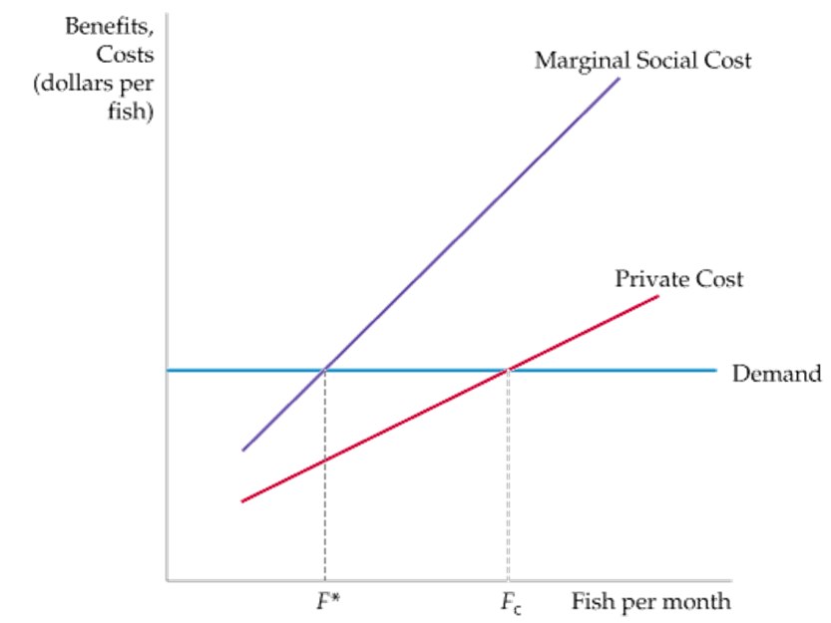
18.5 Common Property Resources (2 of 2)
FIGURE 18.13
COMMON PROPERTY RESOURCES
When a common property resource, such as a fishery, is accessible to all, the resource is used up to the point F_{c} at which the private cost is equal to the additional revenue generated.
This usage exceeds the efficient level F* at which the marginal social cost of using the resource is equal to the marginal benefit (as given by the demand curve).

Slide 40

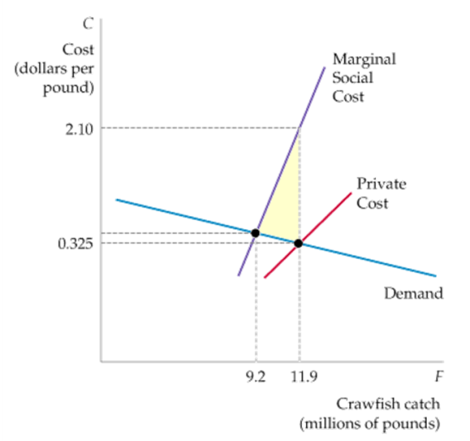
EXAMPLE 18.7 CRAWFISH FISHING IN LOUISIANA
Because most crawfish grow in ponds to which fishermen have unlimited access, a common property resource problem has arisen: Too many crawfish have been trapped, causing the crawfish population to fall far below the efficient level.
FIGURE 18.14
CRAWFISH AS A COMMON PROPERTY RESOURCE
Because crawfish are bred in ponds to which fishermen have unlimited access, they are a common property resource.
The efficient level of fishing occurs when the marginal benefit is equal to the marginal social cost.
However, the actual level of fishing occurs at the point at which the price for crawfish is equal to the private cost of fishing.
The shaded area represents the social cost of the common property resource.
Demand C = 0.401 – 0.0064F
Marginal social cost C = –5.645 + 0.6509F
Private cost: C = –0.357 + 0.0573F
The efficient crawfish catch is 9.2 million pounds. The actual catch is 11.9 million pounds

Slide 41
18.6 Public Goods (1 of 3)
public good Nonexclusive and nonrival good: The marginal cost of provision to an additional consumer is zero and people cannot be excluded from consuming it.
NONRIVAL GOODS
nonrival good Good for which the marginal cost of its provision to an additional consumer is zero.
NONEXCLUSIVE GOODS
nonexclusive good Good that people cannot be excluded from consuming, so that it is difficult or impossible to charge for its use.
Some goods are exclusive but nonrival. Others are nonexclusive but rival. Many publicly provided goods are either rival in consumption, exclusive, or both. High school education and national parks are examples of these types of goods.

Slide 42
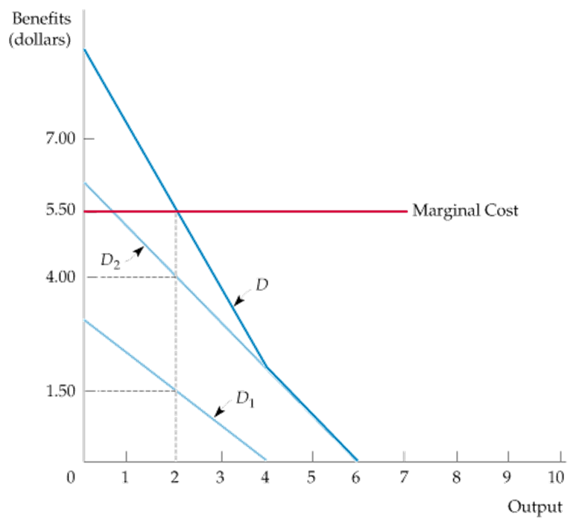
18.6 Public Goods (2 of 3)
Efficiency and Public Goods
FIGURE 18.15
EFFICIENT PUBLIC GOOD PROVISION
When a good is nonrival, the social marginal benefit of consumption, given by the demand curve D, is determined by vertically summing the individual demand curves for the good, D₁ and D₂.
At the efficient level of output, the demand and the marginal cost curves intersect.
Notes:
In §4.3, we show that a market demand curve can be obtained by summing individual demand curves horizontally.

Slide 43
18.6 Public Goods (3 of 3)
Public Goods and Market Failure
Suppose you want to offer a mosquito abatement program for your community. The program is worth more to the community than the $50,000 it will cost. Can you make a profit by providing the program privately? You would break even if you assessed a $5.00 fee to each of the 10,000 households in your community. But you cannot force them to pay the fee, let alone devise a system in which those households that value mosquito abatement most highly pay the highest fees.
Unfortunately, mosquito abatement is nonexclusive. As a result, households have no incentive to pay what the program really is worth to them.
free rider Consumer or producer who does not pay for a nonexclusive good in the expectation that others will.
With public goods, the presence of free riders makes it difficult or impossible for markets to provide goods efficiently. The public good must therefore be subsidized or provided by governments if it is to be produced efficiently.

Slide 44

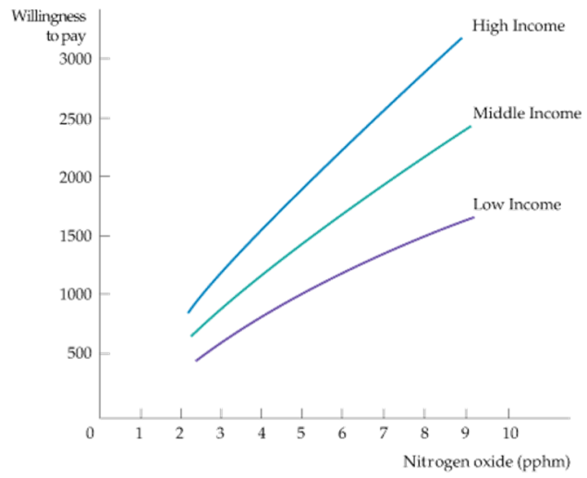
EXAMPLE 18.7 THE DEMAND FOR CLEAN AIR
Clean air is nonexclusive: It is difficult to stop any one person from enjoying it. Clean air is also nonrival: My enjoyment does not inhibit yours. We can infer people’s willingness to pay for clean air from the housing market—households will pay more for a home located in an area with good air quality than for an otherwise identical home in an area with poor air quality.
FIGURE 18.16
THE DEMAND FOR CLEAN AIR
The three curves describe the willingness to pay for clean air (a reduction in the level of nitrogen oxides) for each of three different households (low income, middle income, and high income).
In general, higher-income households have greater demands for clean air than lower-income households. Moreover, each household is less willing to pay for clean air as the level of air quality increases.

Slide 45

Copyright

