Slide 1


@404
- DEMO -

Slide 2
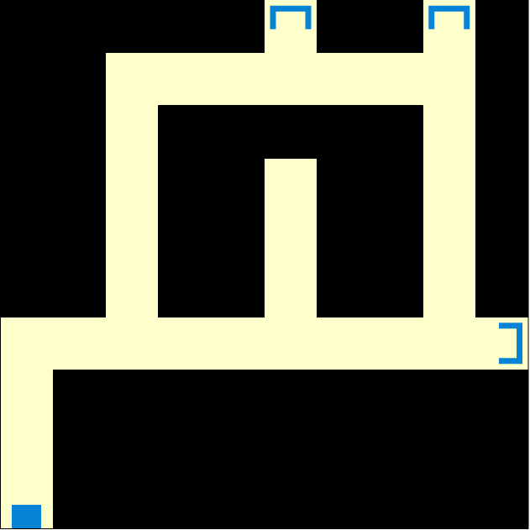
Design
Single player
Dark room
Limited light
Find way out
- thumbnail -

Slide 3
What We Have Done?
Basic UI ✔
Resources design ✔
Camera and Movement ✔
The effect of items ✔

Slide 4
This Is How We Do
Hero.js
PlayGame.js
Item.js

Slide 5

What’s Next?
Paper Work Of Story
Maps Design
Physics In Game
The effect of items

Slide 6
Thank
You
Again.

