Slide 1


@404
- Beta Test -

Slide 2
What We Have Added?
BGM & Sound trigger
·Ascended Vibrations - ¿Téo？
·Ø - the tumbled sea
·Born a Stranger - Kan R. Gao
·Rue des Trois Frères - Fabrizio Paterlini
·Never found - Soundcritters
·： ( - SLIGHT
·Anomaly - Lights & Motion
·Endless Path - 조한빛
·Sky - The Rasmus
trigger
http://www.aigei.com/sound/

Slide 3
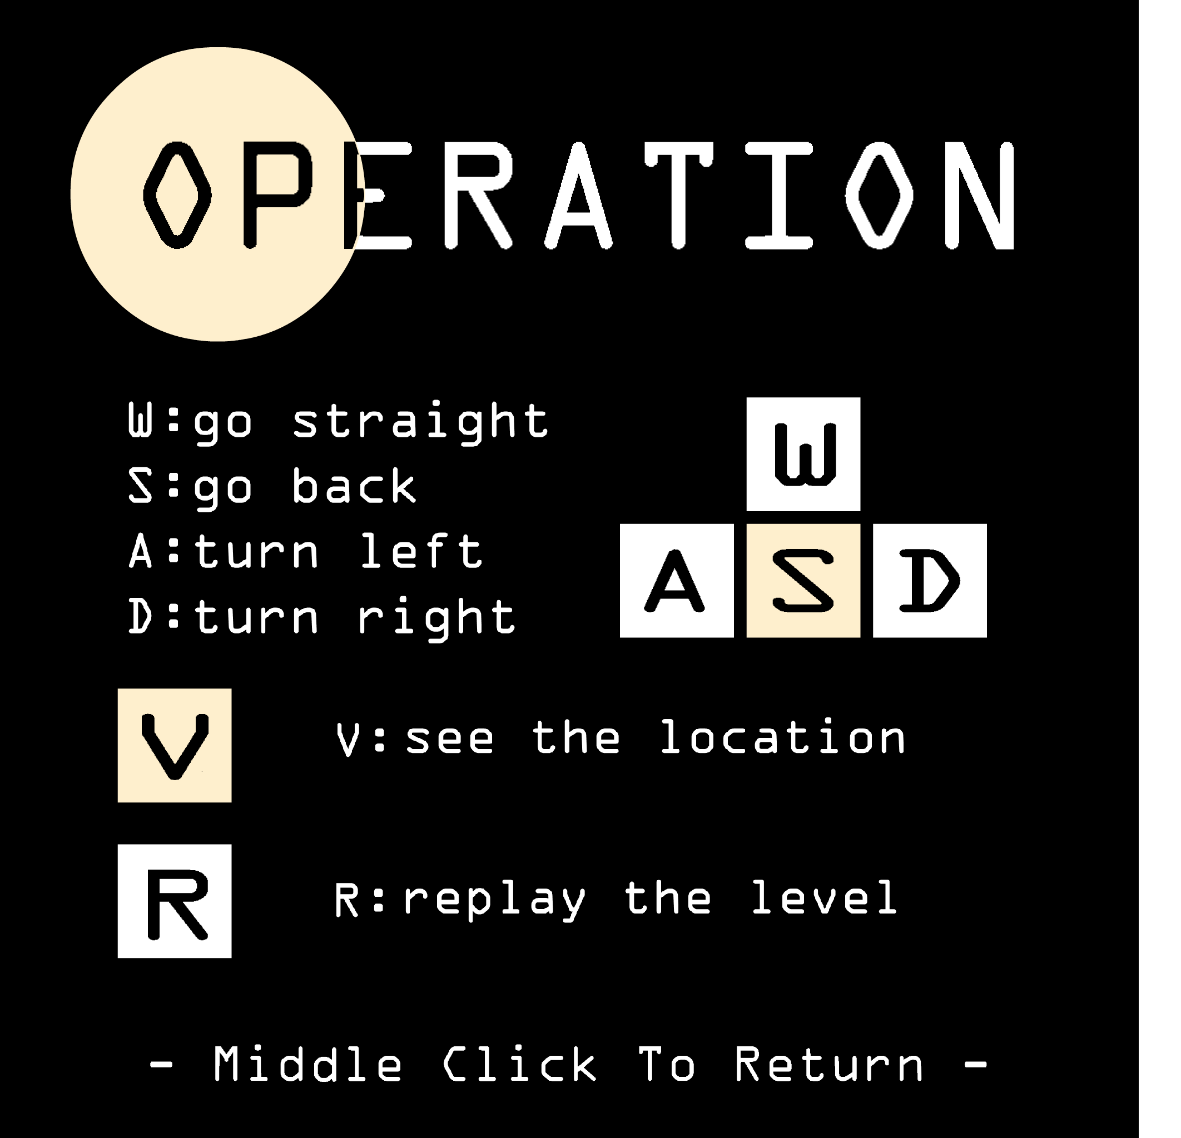
What We Have Added?
BGM & Sound trigger
More Operations
V:click to see your location
R:click to replay the level

Slide 4
What We Have Added?
BGM & Sound trigger
More Operations
Optimize the interface
More of The Story
Try it!

Slide 5
Thank
You
Again.

