Slide 1


Group IV
@404
Name | School
Wang Xingwen | UESTC
Wang Kai | SUStech
Guo Mengwei | SUStech

Slide 2




DESIGN
REQUIREMENT
CONTENTS
CHALLEANGE

Slide 3
DESIGN . Background
- You wake up unconsciously -
- in a dark place -
- with a candle. -
- Try to find what’s happening -
- and who you are. -

Slide 4

DESIGN . Basic rules
Single player
Dark room
Limited light
Find way out

Slide 5
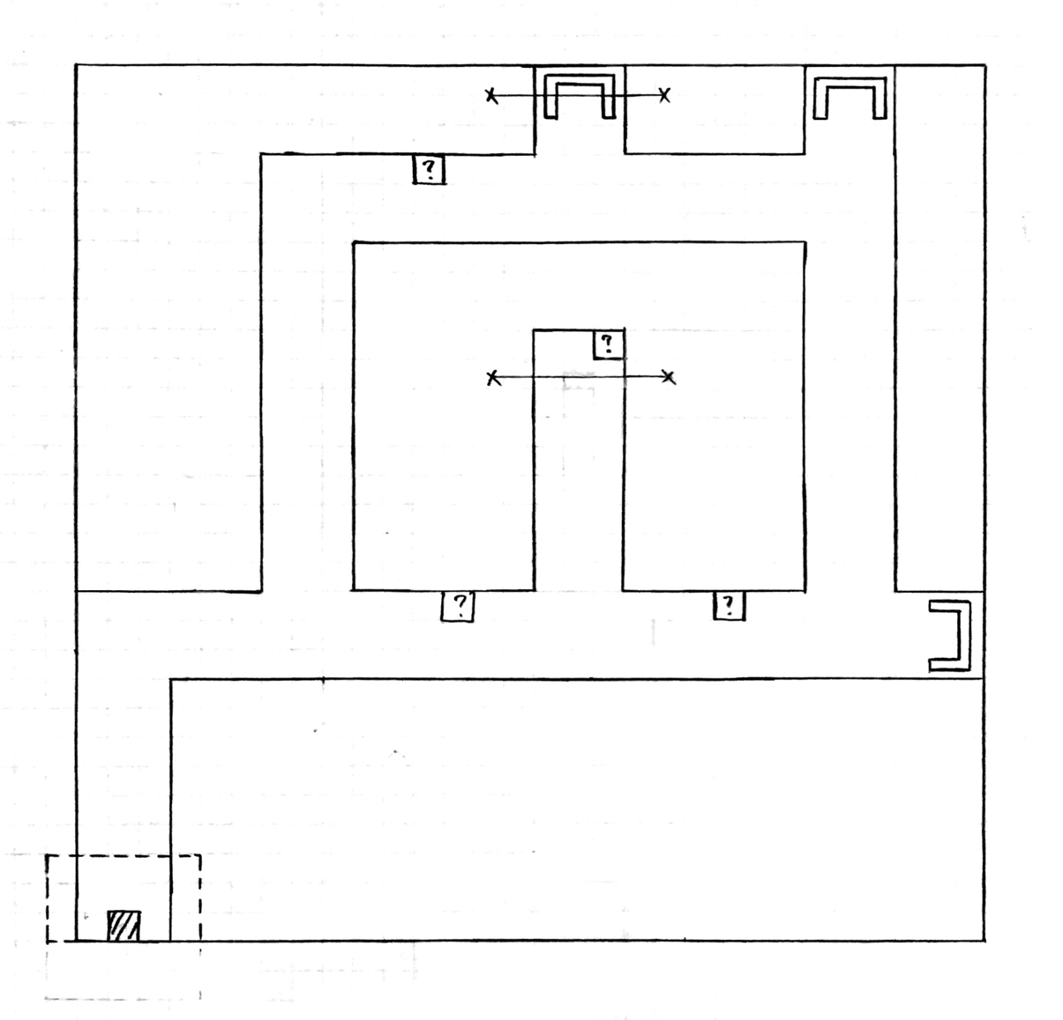
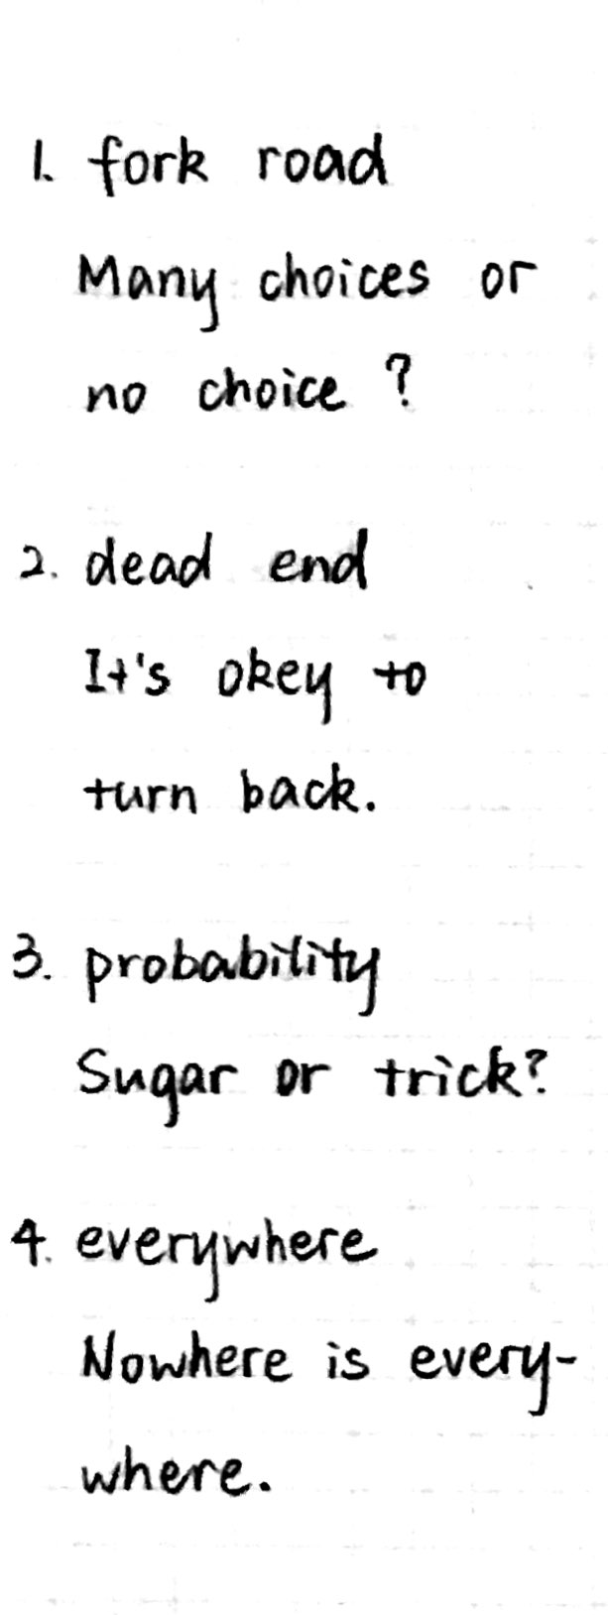

Slide 6

DESIGN . How to play
Move: W.A.S.D
Back: B
Menu: M
Verify: Enter

Slide 7

REQUIREMENT
Camera Manipulation
4 scenes switch
State recording
Physical effects

Slide 8
CHALLENGE & SOLUTION
How to record the state of maps ?
→ Use global variable
2.How to design a good map ?
→ Good ideas & feedback
3.How to make realistic ?
→ Dig the functions of engine

Slide 9
Thank
you.

