Slide 1


Group IV
@404
Name | School
Wang Xingwen | UESTC
Wang Kai | SUStech
Guo Mengwei | SUStech

Slide 2




DESIGN
REQUIREMENT
CONTENTS
CHALLEANGE

Slide 3
DESIGN

Slide 4
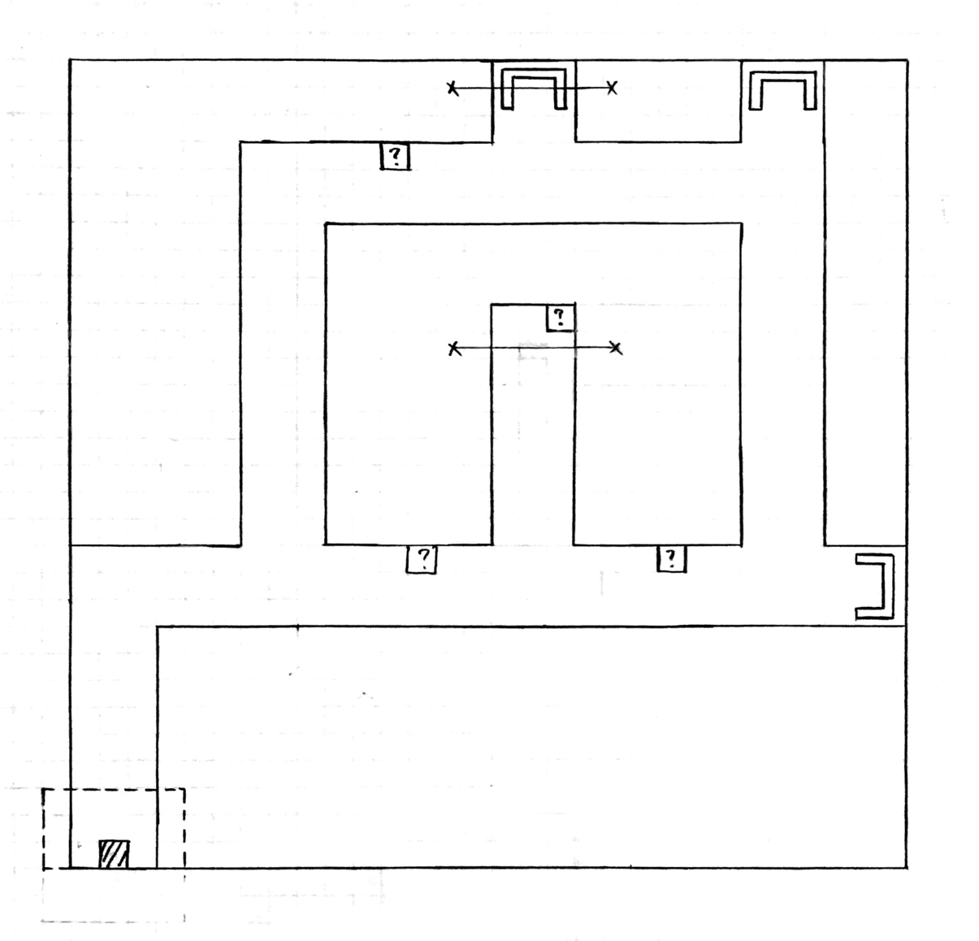
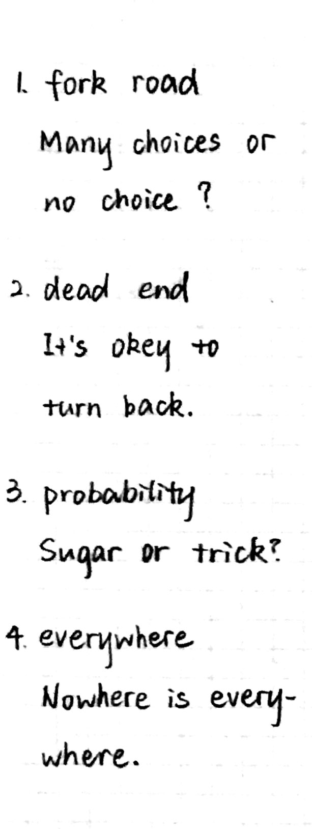

Slide 5
REQUIREMENT

Slide 6
CHANLLENGE

Slide 7
SOLUTION

Slide 8
Thank
you.

