Slide 1
Optimization and application of monkey test
11610615 Guo Mengwei 11612715 Wang Zelin 11610211 Hu Sizhe

Slide 2
C O N T E N T
Background
Approach
Q-learning
Future Work

Slide 3
BACKGROUND

Slide 4
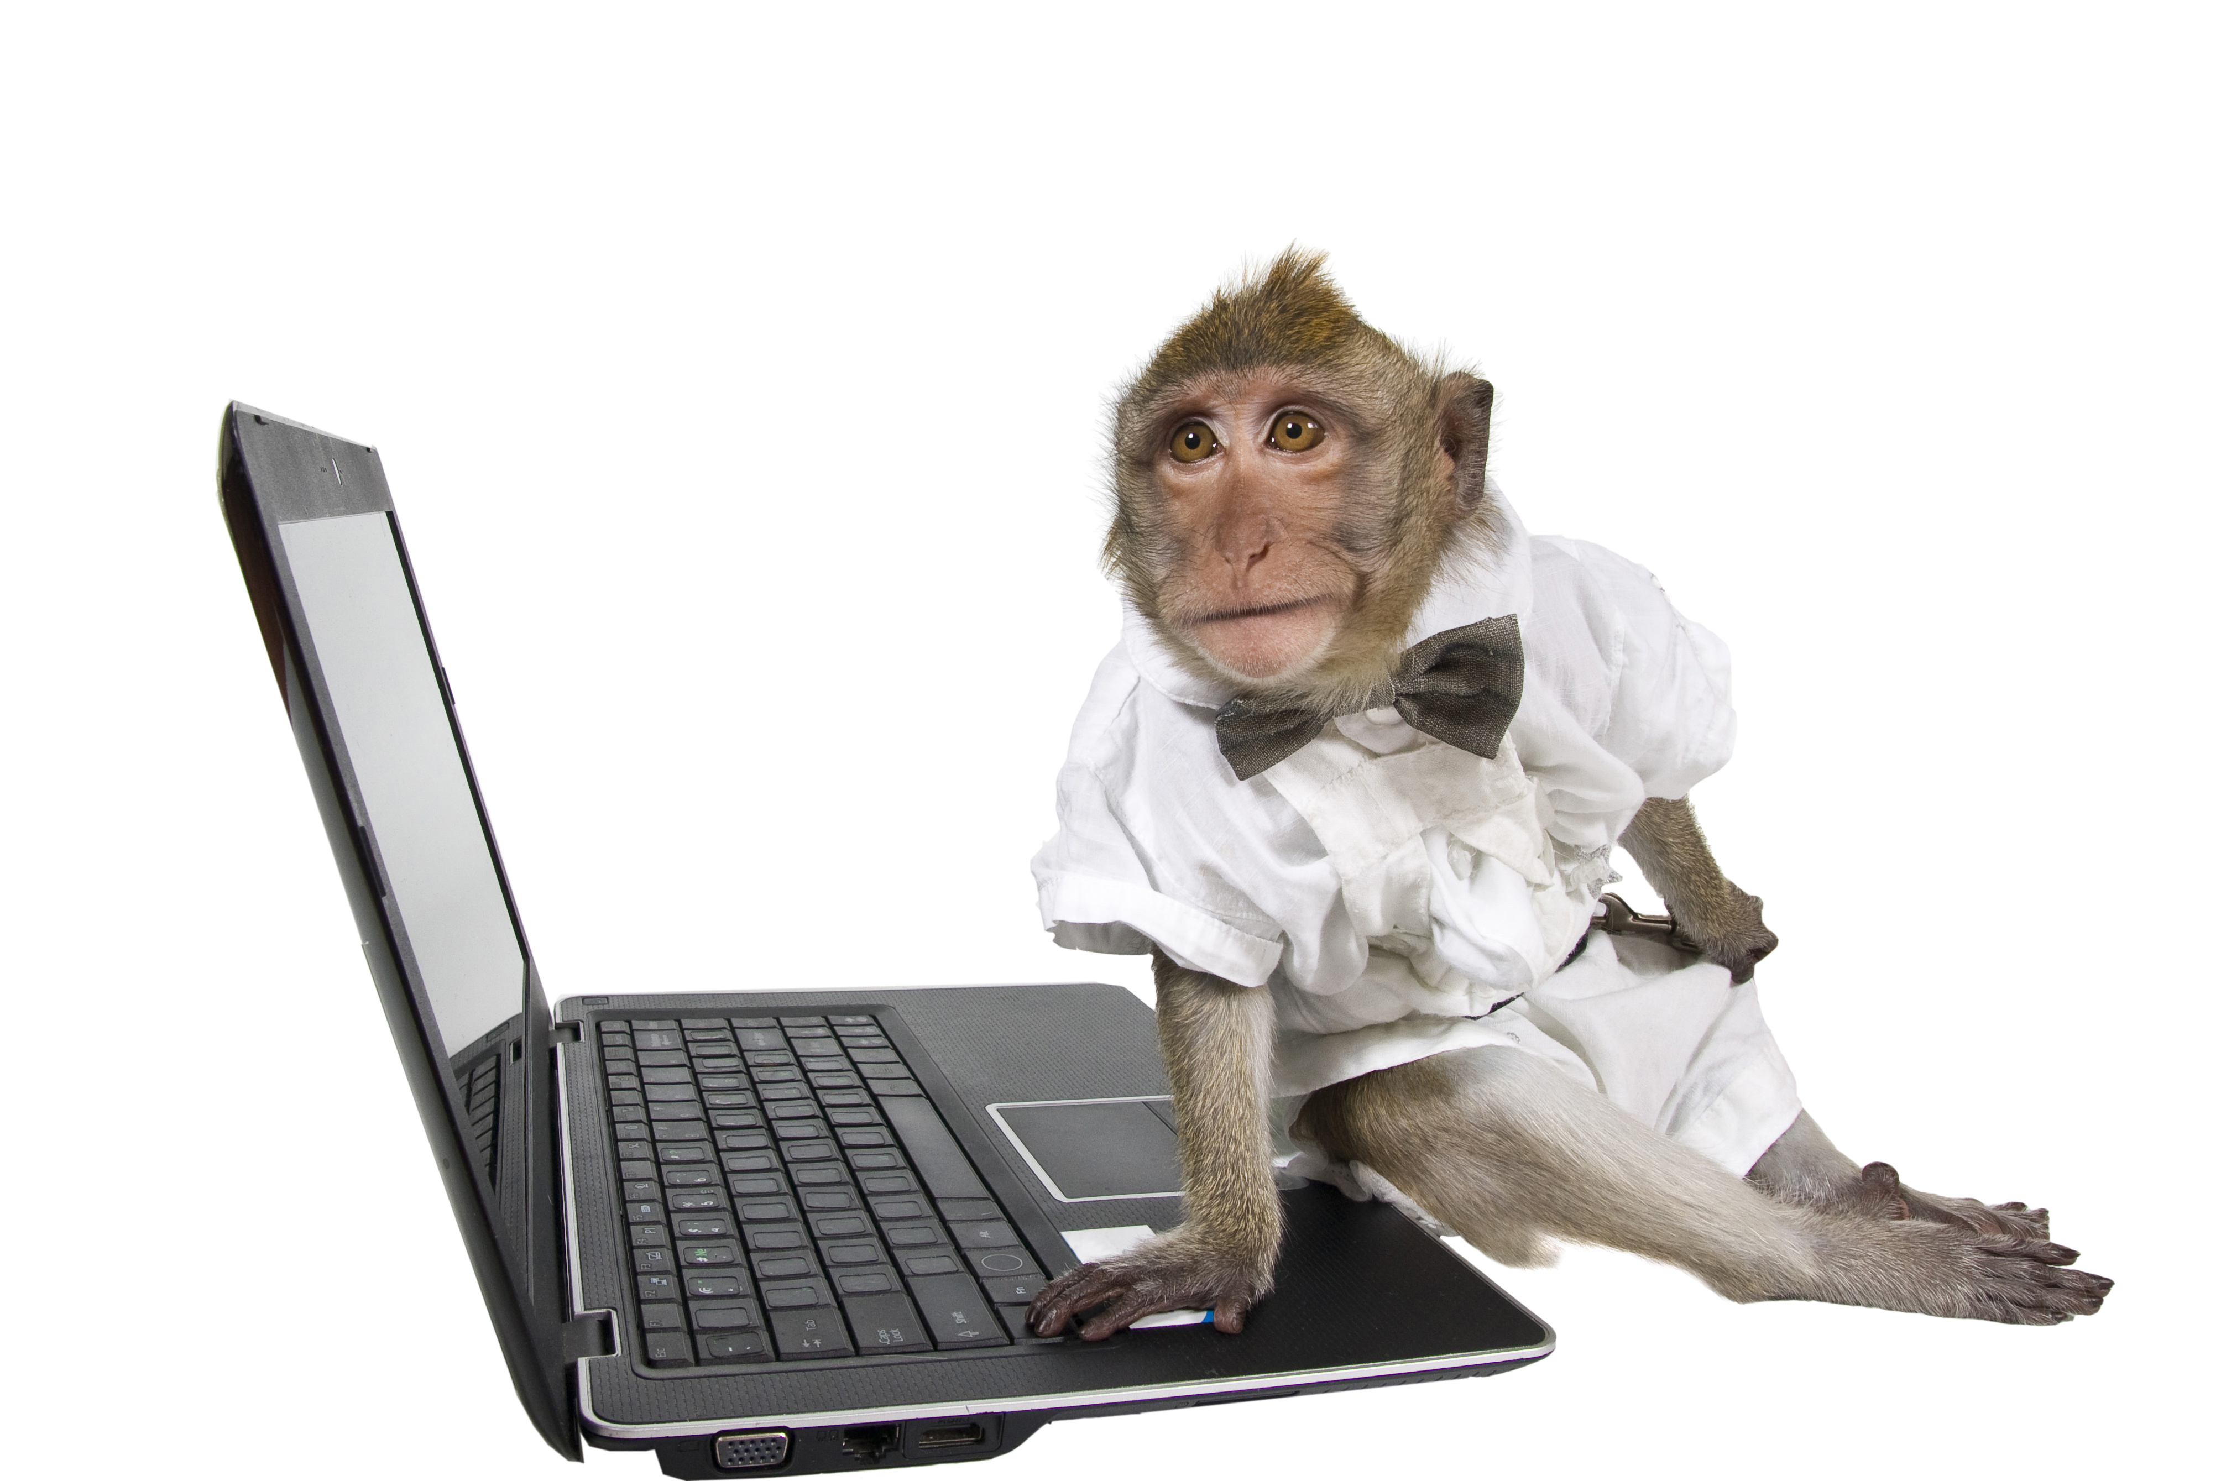
What is monkey testing?
Software testing tools
Mainly based on Android apps
Random UI inputs

Slide 5
The limits of monkey
Widget obliviousness
State obliviousness
Useless exploration

Slide 6
APPROACH

Slide 7
How to optimize monkey?
Get the current widgets’ information
Recognize the difference of state
Choose the next action rationally
Combined with Q-learning

Slide 8
Design flow
💻
📱
Read current state
Read current widgets
Android
Device
PC
4. Operate the event
3. Generate the next event
🤖
Agent

Slide 9
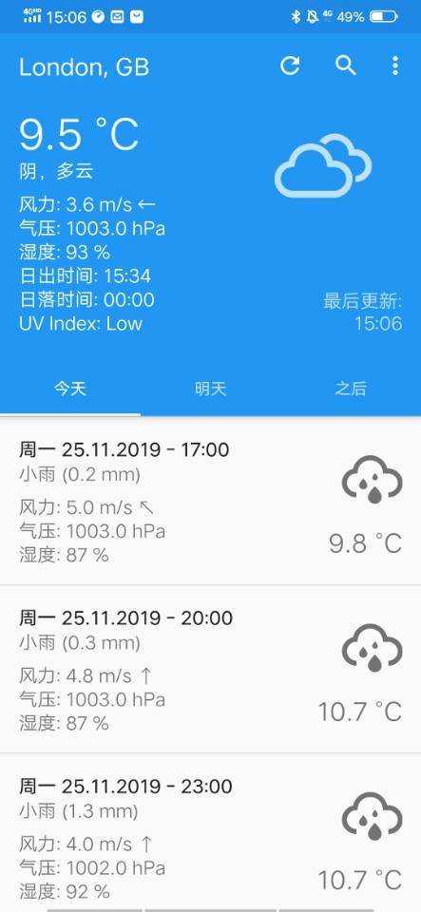
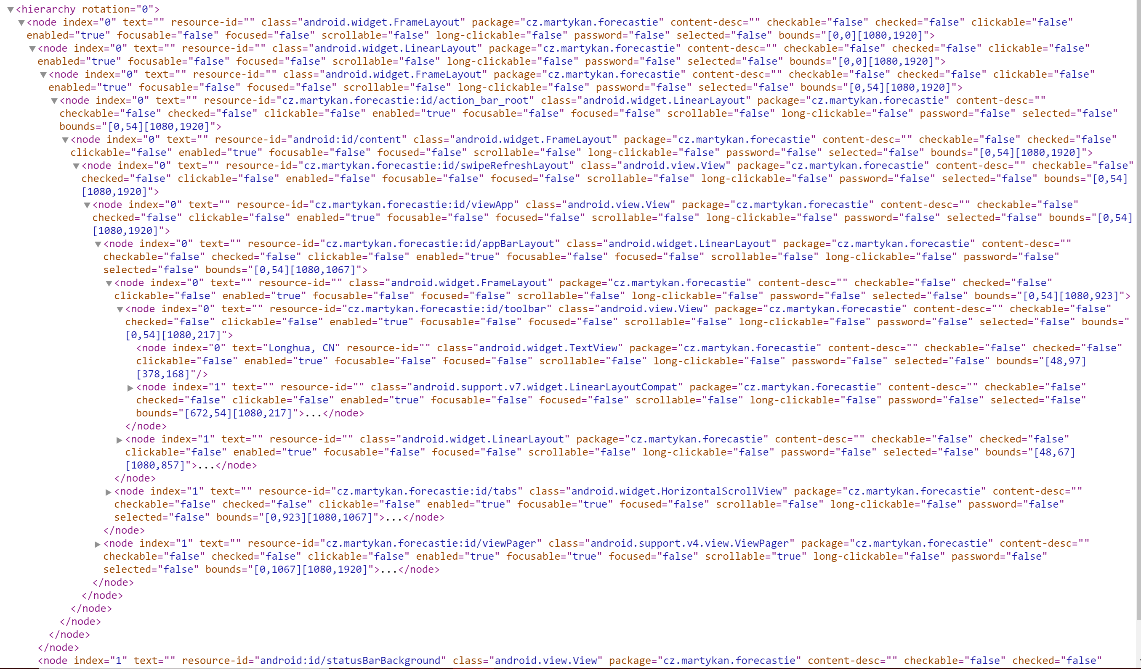
1. Read current state
📜xx.xml
ADB
+ UIAutomator

Slide 10
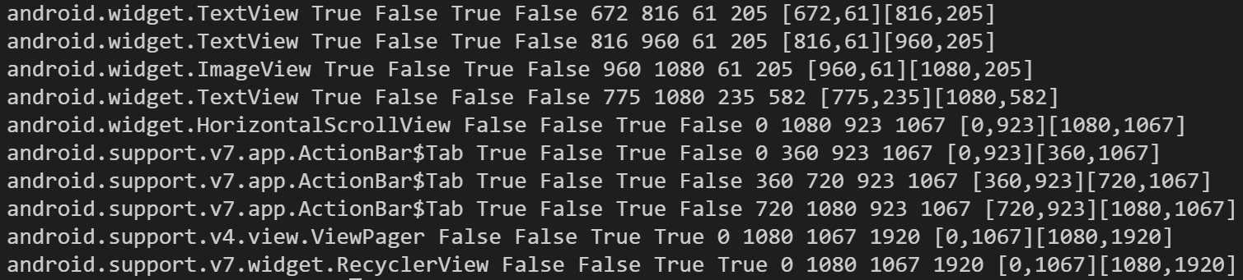
2. Read current widgets
Python script
📜xx.xml
(String clip)

Slide 11
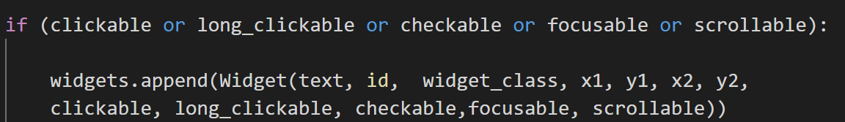
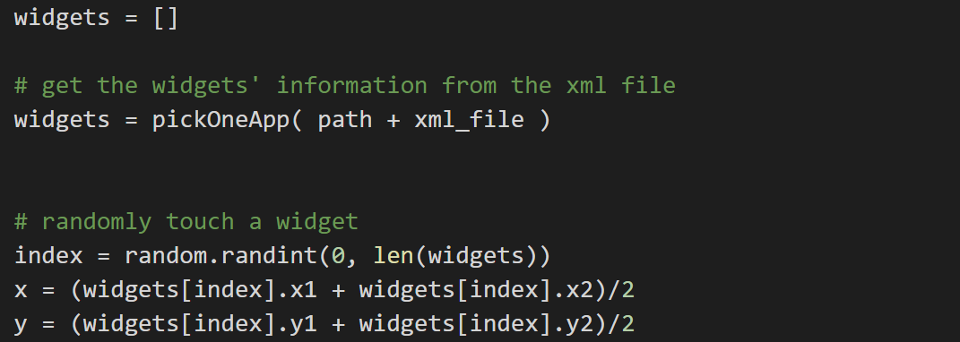
3. Generate the next event ( random )
1.Store specific widgets
Clickable = true
Long-clickable = true
Scrollable = true
Focusable = true
Checkable = true
2.Randomly pick one from array

Slide 12
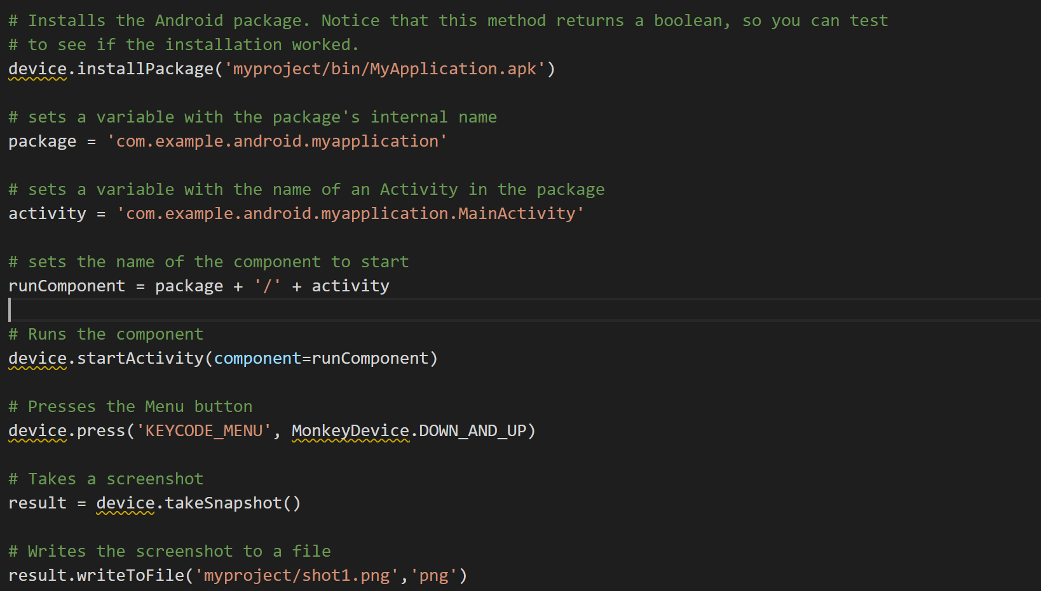
4. Operate the event
Tool: Monkey Runner

Slide 13
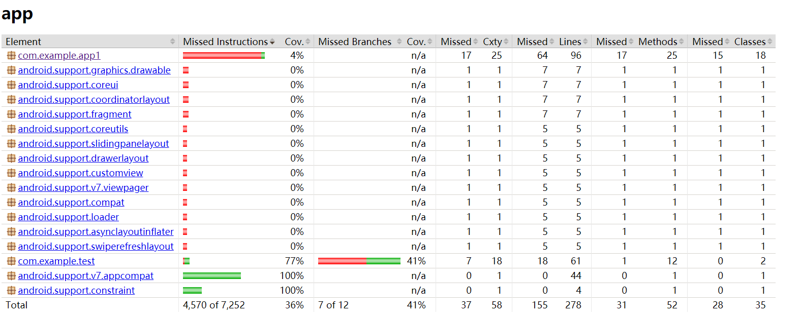
Code Coverage (Jacoco)

Slide 14
Q-Learning in Test Generation

Slide 15
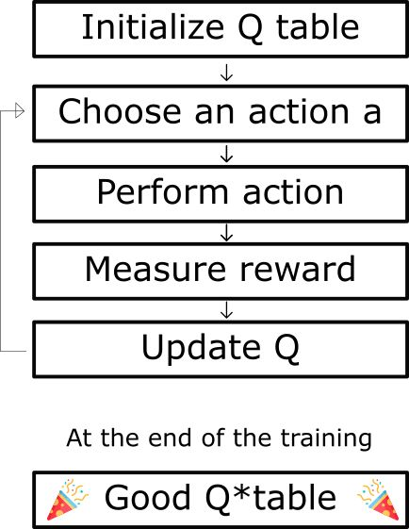
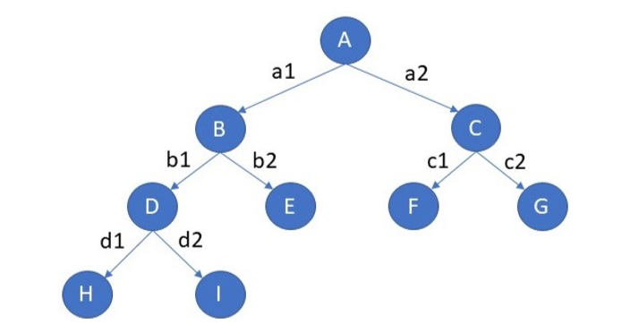
Q-Learning in Test Generation

Slide 16
Future Work

Slide 17
Future Work
Q-learning implementation
Search new tool
Refactoring code
Evaluate the code coverage

Slide 18
REFERENCE
[1]. David Adamo, Md Khorrom Khan, Sreedevi Koppula, and Renée Bryce. 2018. Reinforcement learning for Android GUI testing. In Proceedings of the 9th ACM SIGSOFT International Workshop on Automating TEST Case Design, Selection, and Evaluation (A-TEST 2018). ACM, New York, NY, USA, 2-8. DOI:https://doi.org/10.1145/3278186.3278187
[2] Aravind Machiry, Rohan Tahiliani, and Mayur Naik. 2013. Dynodroid: an input generation system for Android apps. In Proceedings of the 2013 9th Joint Meeting on Foundations of Software Engineering (ESEC/FSE 2013). ACM, New York, NY, USA, 224-234. DOI: https://doi.org/10.1145/2491411.2491450
[3] Domenico Amalfitano, Anna Rita Fasolino, Porfirio Tramontana, Salvatore De Carmine, and Atif M. Memon. 2012. Using GUI ripping for automated testing of Android applications. In Proceedings of the 27th IEEE/ACM International Conference on Automated Software Engineering (ASE 2012). ACM, New York, NY, USA, 258-261. DOI=http://dx.doi.org/10.1145/2351676.2351717
[4] Ke Mao, Mark Harman, and Yue Jia. 2016. Sapienz: multi-objective automated testing for Android applications. In Proceedings of the 25th International Symposium on Software Testing and Analysis (ISSTA 2016). ACM, New York, NY, USA, 94-105. DOI: https://doi.org/10.1145/2931037.2931054
[5] Wenyu Wang, Dengfeng Li, Wei Yang, Yurui Cao, Zhenwen Zhang, Yuetang Deng, and Tao Xie. 2018. An empirical study of Android test generation tools in industrial cases. In Proceedings of the 33rd ACM/IEEE International Conference on Automated Software Engineering (ASE 2018). ACM, New York, NY, USA, 738-748.

Slide 19
Thanks!

