Slide 1
App Deployment on
Kubernetes cluster

Slide 2

scenario
§ Multi-Tier Web Application Stacks
§ Containerized
§ Tested it
§ Want to host for Production
Notes:
1)Revenues: 149Cr-EDS/77Cr-ITS for FY-201617
2)Head Count: 900-EDS/1650-ITS for FY-201617
3 ) Excellence Centers - JD , Cat , Seco , Thysenkrupp , Bentley , Magna , Parkson , ThermoFisher , Emerson , GE , whirlpool , Saint Gobain , Tata Motors , Mathworks

Slide 3
Requirement
High Availability
Fault Tolerance
Easily Scalable
Platform Independent
Portable & Flexible
Notes:
1)Revenues: 149Cr-EDS/77Cr-ITS for FY-201617
2)Head Count: 900-EDS/1650-ITS for FY-201617
3 ) Excellence Centers - JD , Cat , Seco , Thysenkrupp , Bentley , Magna , Parkson , ThermoFisher , Emerson , GE , whirlpool , Saint Gobain , Tata Motors , Mathworks

Slide 4
Advantages
Flexible Access – Employees can work from anywhere with internet access.
§ Client Secure Login – Impress clients with a modern web portal and improve
customer service with automated processes.
§ Easy Setup – It takes a couple of minutes to setup a new user; provide a URL,
username and password and they’re away.
Always Up To Date – As everyone is accessing the same version of the web app via a
URL, they will always be accessing the most up-to-date version of the software.
§ Storage Increase – With the availability of the cloud, storage space is virtually infinite.

Slide 5
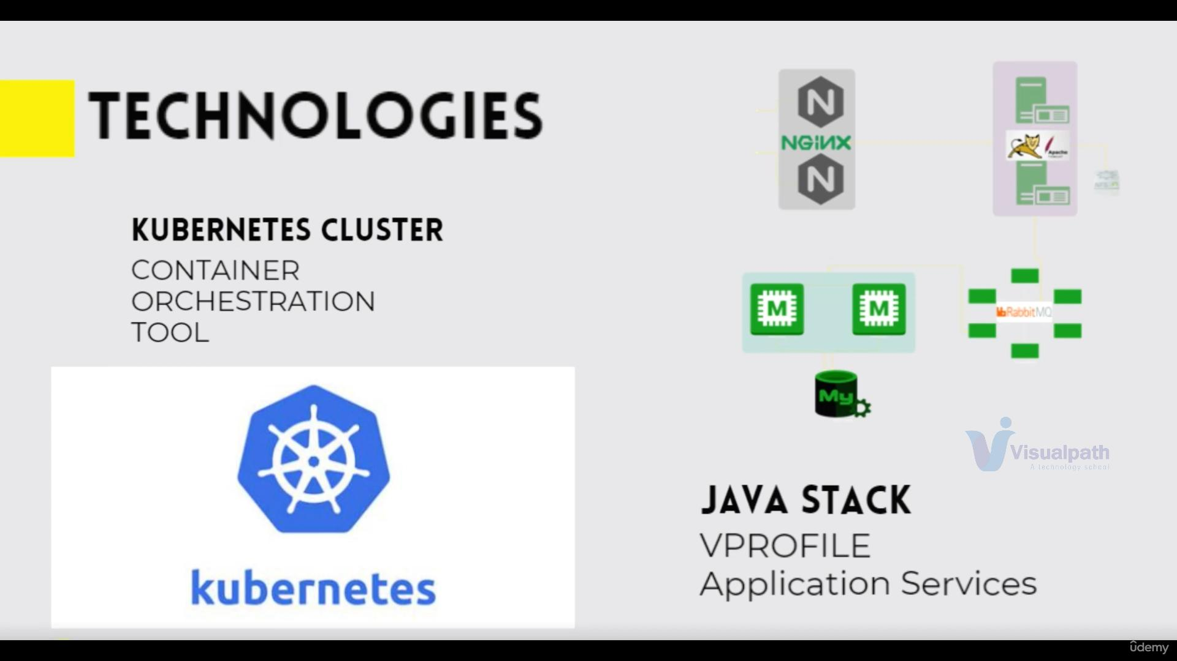

Slide 6
Thank you.

