Slide 1


Top 5 Content Categories by Engagement

Slide 2


Today's agenda
Project recap
Problem
The Analytics team
Process
Insights
Summary

Slide 3

Social Buzz is a fast-growing technology unicorn that needs to adapt quickly to its global scale. Accenture has begun a 3-month POC focusing on these tasks:
An audit of Social Buzz's big data practice
Recommendations for a successful IPO
Analysis to find Social Buzz’s top 5 most popular categories of content
Project Recap

Slide 4

Problem
Over 100,000 posts per day 36,500,000 pieces of content per year! But how to capitalize on it when there is so much?
Analysis to find Social Buzz's top 5 most popular categories of content

Slide 5



Andrew Fleming
Chief Technical Architect
The Analytics Team
Marcus Rompton
Senior Principle
Sakshi Dubey
Data Analyst

Slide 6

🔄Process
1
Data Understanding
2
Data Cleaning
Data Modelling
3
Data Analysis
4
5
Uncover Insights

Slide 7

Insights
16
Unique Categories
1897
Reactions to Animals Post
January
Month with Most Posts

Slide 8
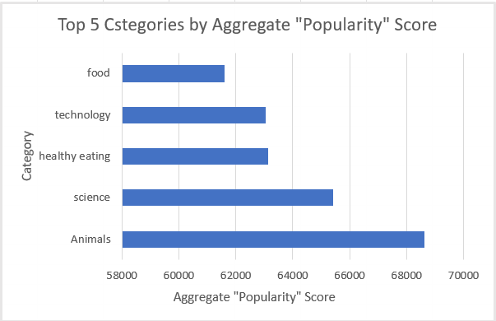

Slide 9
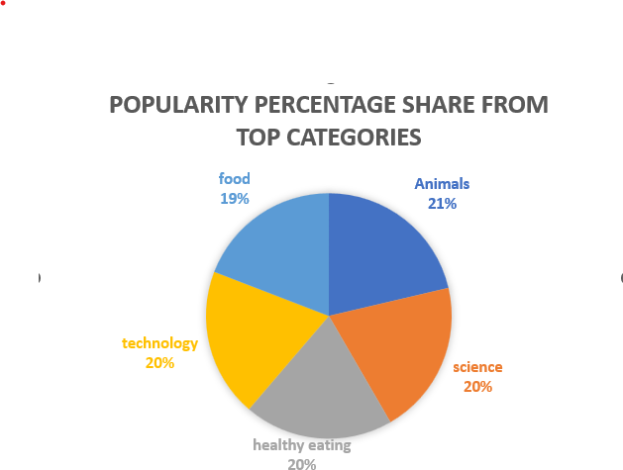

Slide 10

ANALYSIS Technology and travel are among the top-performing content categories, indicating that users are highly engaged with innovative and exploratory themes. This shows a clear preference for content that is both inspiring and forward-looking.
INSIGHT Adventure and gadgets consistently appear in the top categories, with "Tech Reviews" drawing the most attention. This suggests your audience is curious, tech-savvy, and eager to stay updated. You could leverage this insight to collaborate with tech brands and travel influencers to increase content relevance and reach.
NEXT STEPS This initial analysis reveals strong user trends, but scaling it into a continuous monitoring system will provide deeper, ongoing insights. We can help build a dashboard or automation pipeline to track these patterns in real-time and refine your content strategy accordingly.
Summary

Slide 11
Thank you!
ANY QUESTIONS?

