Slide 1
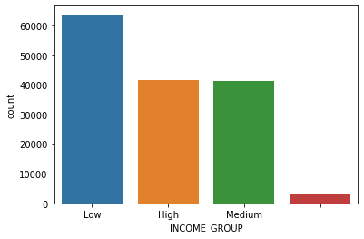
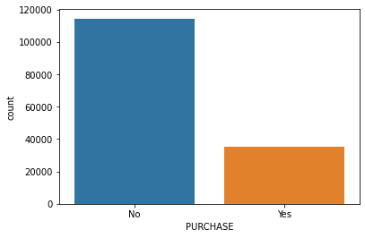
Some insights of given data
LOYALTY_PROGRAM column have 17824 null values
OCCUPATION column have black (“ ”) spaces which make I new category called as Other in that column.
year column values 2008, 2009,2010 …. 2018 I encoded that as 1,2,3,4….13
Can see that data is slightly imbalance might be we have to use class sampling techniques to balance data
Low Income people having max purchase and also past purchase .

Slide 2
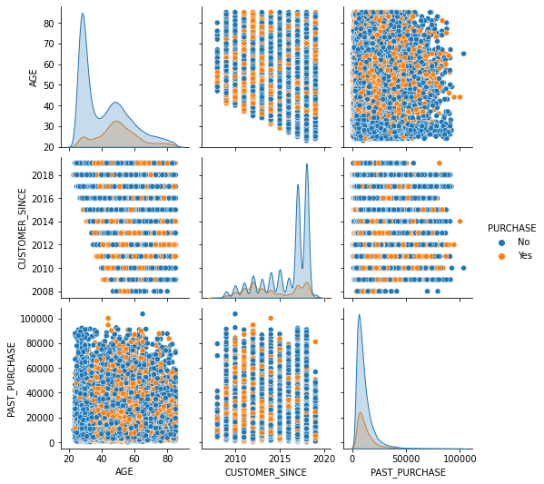
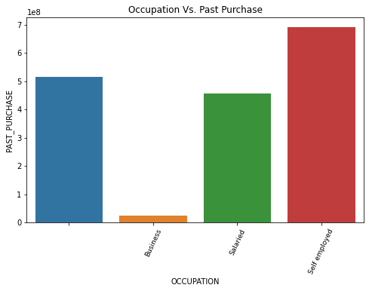
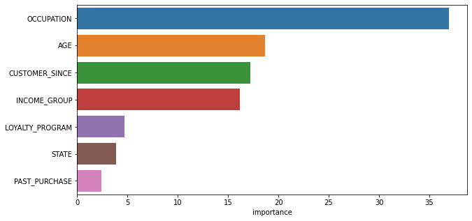
Self Employed people having past max purchase
20-30 years people purchase mostly.
Very small amount of people purchasing
the same item again
Occupation is most important feature

