Slide 1
Embedded Communication
Moving digital data between devices using electrical signals
All data ultimately represented as 1s and 0s
Protocols define how bits are organized and transmitted
Ensures reliable transfer between embedded systems
Common in microcontrollers, sensors, and peripherals

Slide 2
Serial vs Parallel Communication
Two fundamental methods of digital data transfer
Parallel: multiple wires transfer multiple bits simultaneously
Serial: single line sends bits sequentially
Trade‑off between speed and hardware complexity
Most modern embedded systems favor serial communication

Slide 3
Parallel Communication
Multiple data lines transmit bits at the same time
Higher raw throughput compared to serial
Requires more pins, wiring, and hardware
Common in memory buses and older printer interfaces
Limited scalability due to signal timing issues

Slide 4
Serial Communication
Transfers data one bit at a time
Requires fewer wires and simpler hardware
Typically uses TX, RX, and GND lines
More practical for complex embedded systems
Modern serial protocols achieve very high speeds

Slide 5
Basic Communication Concept
Two lines allow bidirectional communication
TX line sends data from one device
RX line receives data from the other device
Devices connect TX ↔ RX crosswise
Shift registers convert parallel data into serial bits

Slide 6
UART Overview
UART = Universal Asynchronous Receiver Transmitter
Operates without a shared clock line
Devices agree on a predefined baud rate
Widely used for debugging and device communication
Requires TX, RX, and common ground

Slide 7
UART Frame Structure
Start bit indicates beginning of transmission
Data bits typically represent one byte
Optional parity bit for error detection
Stop bit marks end of frame
Line stays HIGH when idle

Slide 8
USART Overview
USART = Universal Synchronous Asynchronous Receiver Transmitter
Supports both synchronous and asynchronous modes
Synchronous mode adds a shared clock signal
Improves reliability and timing accuracy
Used in higher‑speed communication systems

Slide 9
UART Data Transmission
CPU writes data into the UART data register
Hardware moves data to a shift register
Bits are transmitted sequentially on the TX line
Timing controlled by the configured baud rate
Transmission complete flag is raised afterwards

Slide 10
UART Data Reception
RX line continuously monitored by UART hardware
Start bit detection triggers reception process
Incoming bits sampled and shifted into register
Completed byte copied into receive data register
CPU reads the byte when RX flag is set

Slide 11
Baud Rate
Baud rate represents symbols transmitted per second
In UART, one symbol usually equals one bit
Examples include 9600 and 115200 bps
Generated using a clock divider inside the UART
Oversampling improves reception accuracy

Slide 12
UART Registers
Control registers configure UART operation
Baud rate register determines communication speed
Data register used for sending and receiving bytes
Status register indicates peripheral state
Flags include TXE, RXNE, TC, and error indicators

Slide 13
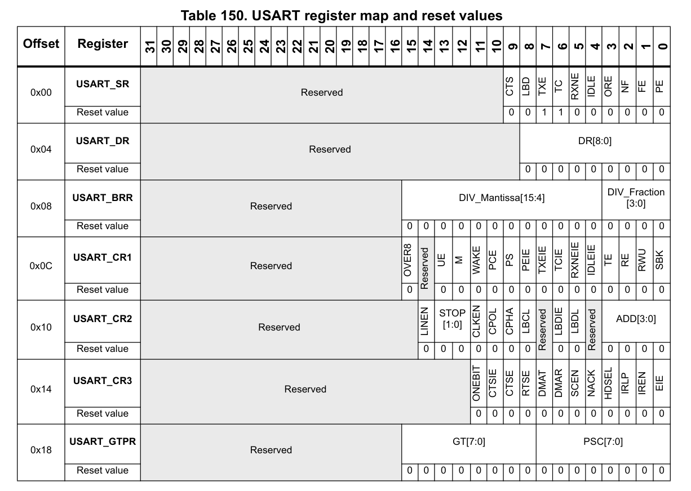

Slide 14
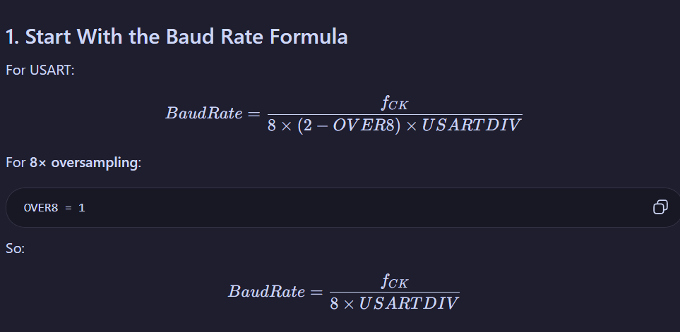

Slide 15
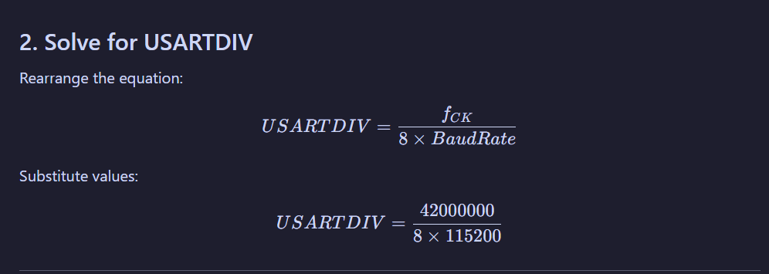

Slide 16
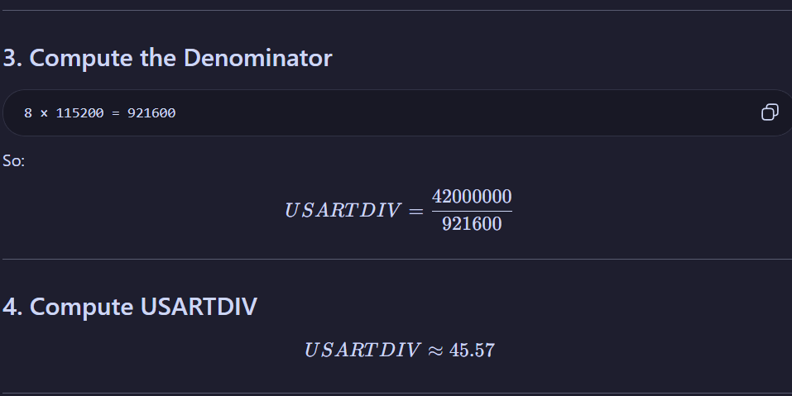

Slide 17
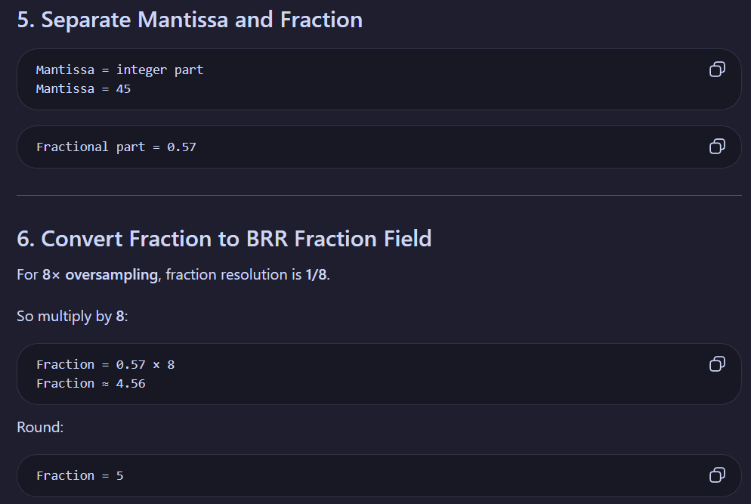

Slide 18
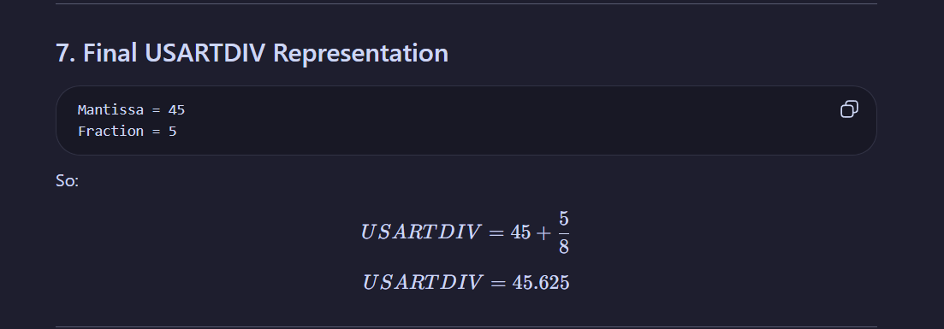
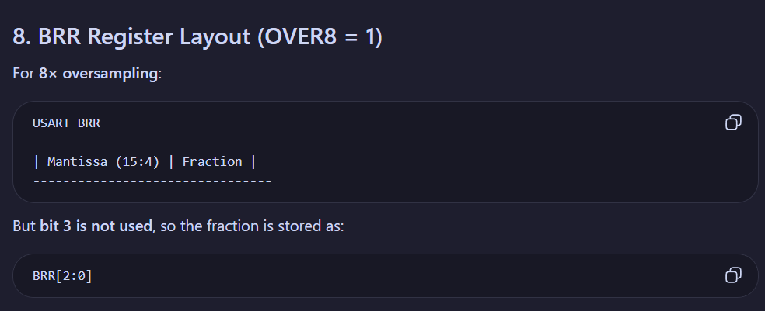

Slide 19
