Slide 1
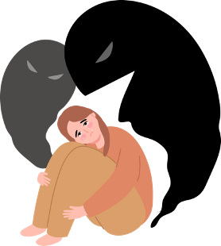
How does the suicide rate change with the wealth of country?
Group B | Data Science Programmierpraktikum

Slide 2
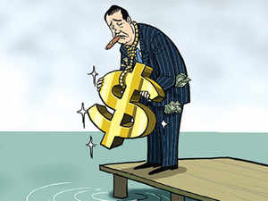
Hypothesis
Suicide is a leading cause of death worldwide
Risk Factors Identification
Mental Health Awareness
Impact on Society
Source: Economic Times, "In China, wealth does not mean happiness as suicides and unnatural deaths among the rich are on the rise"

Slide 3

Hypothesis
higher GDP
higher suicide rate
Source: Economic Times, "In China, wealth does not mean happiness as suicides and unnatural deaths among the rich are on the rise"

Slide 4



Suicide Rates Overview 1985 to 2016
From: United Nations Development Program (UNDP), the World Bank, and the World Health Organization (WHO)
Removed entries with less than 20 years represented in the data

Slide 5

Human Development World Index
This Dataset is created from Human Development Report
The dataset includes global, regional, and country-level data on key dimensions of human development, along with various composite indices such as HDI, MPI, IHDI, GII, GDI, PHDI, and GSNI.
Our analysis will specifically focus on the Human Development Index (HDI).

Slide 6
Variables
These variables provide a broad perspective on the relationship between economic wealth and suicide rates by considering various aspects of a country's social and economic conditions.
Gross Domestic Product (GDP)
Gini Coefficient
Human Development Index (HDI)

Slide 7
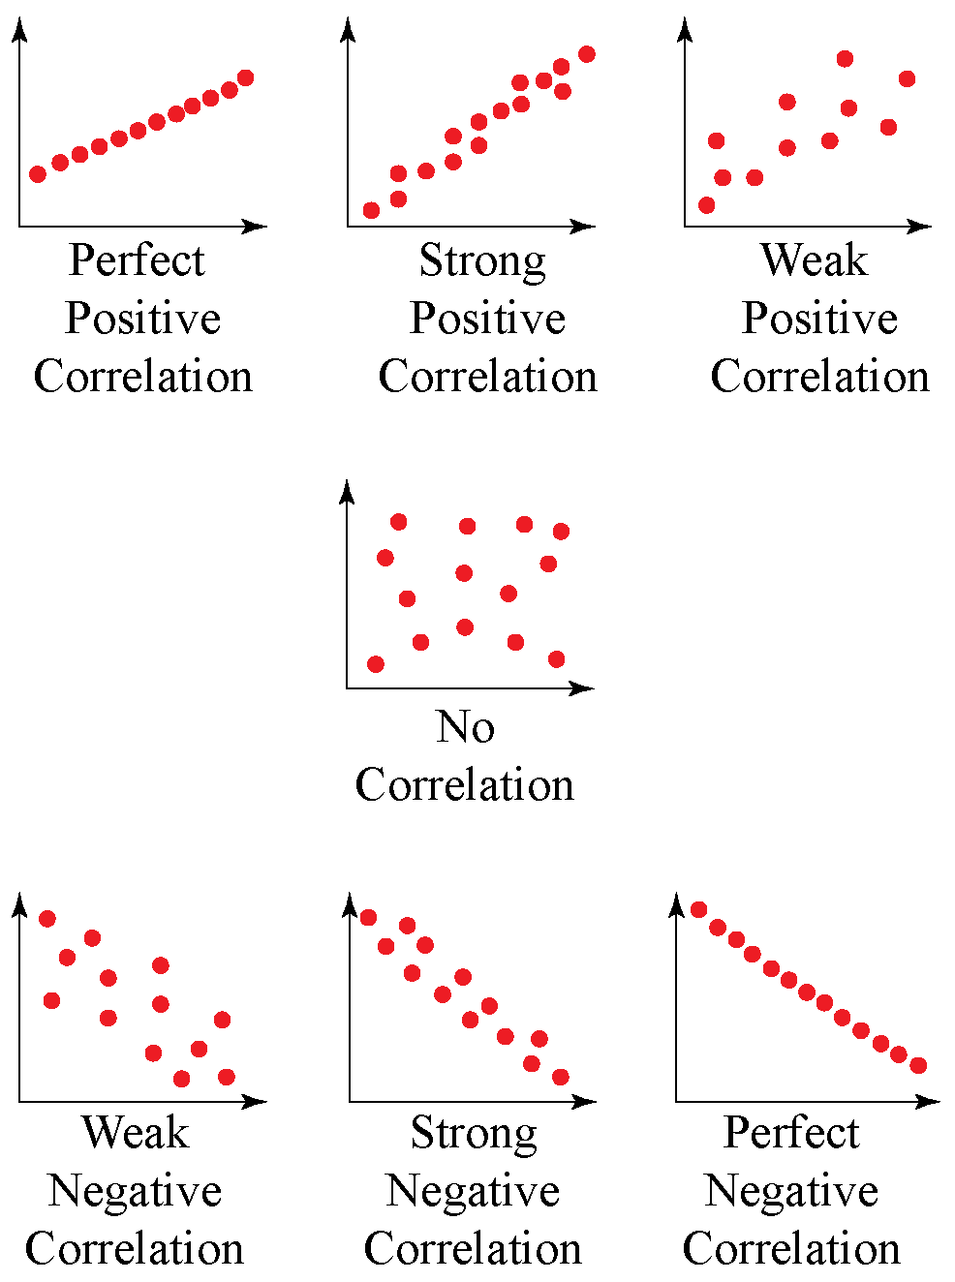
What is Correlation?
Correlation measures the strength and direction of a relationship between two variables.
Positive correlation: both variables increase together
Negative correlation: one variable increases while the other decreases.

Slide 8
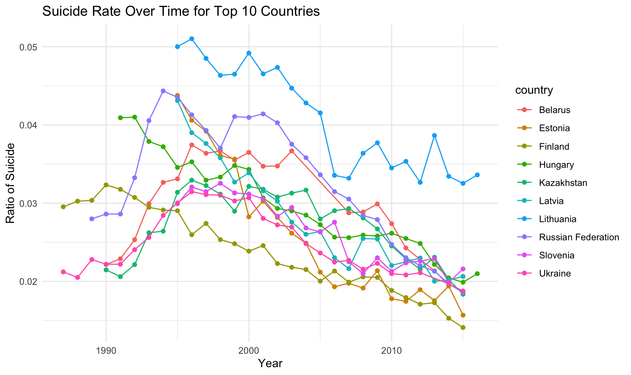
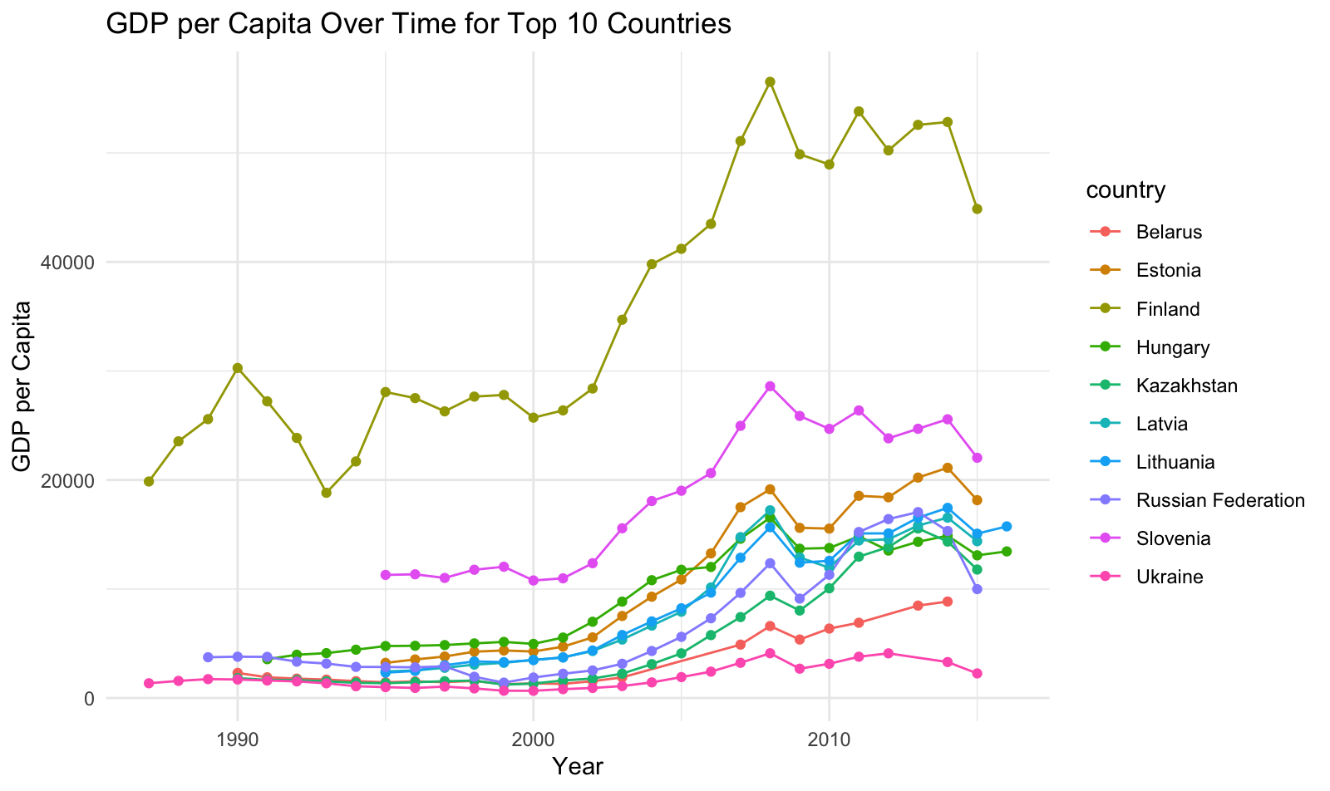
Change over the years
The suicide rate in the ten countries with the highest suicide numbers decreases as their GDP increases.

Slide 9
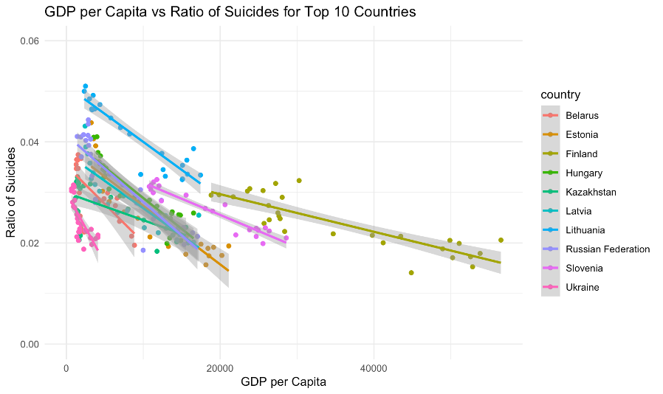
Correlation coefficient
Most trend lines show a downward slope, indicating that as GDP increases, the suicide rate tends to decrease

Slide 10
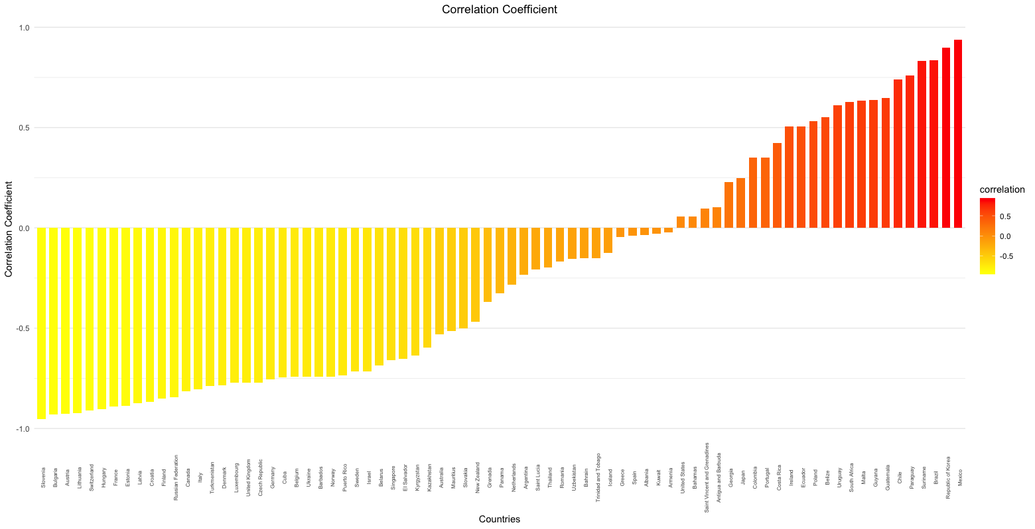
Correlation coefficient
On the left side, the countries have negative correlation coefficients
On the right side, the countries have positive correlation coefficients
Important note:
Correlation does not imply causation
Other factors may influence the relationship

Slide 11
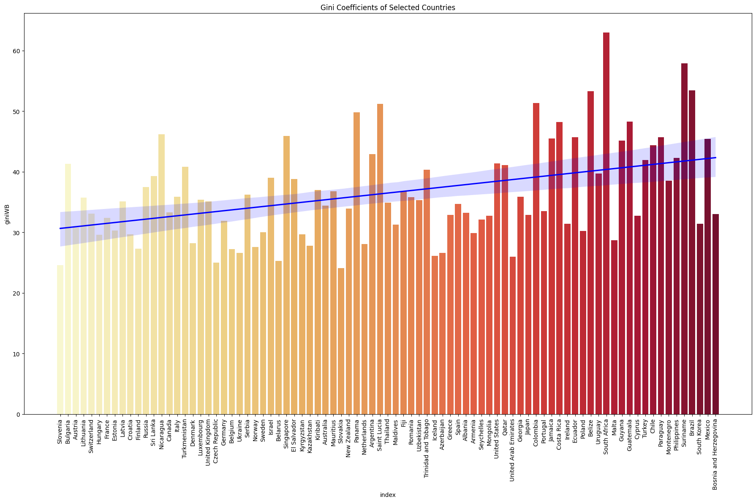
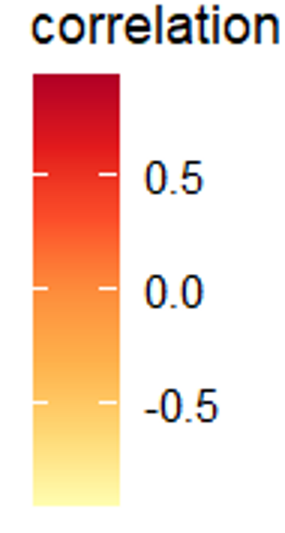
Gini Coefficient
No correlation found between Gini coefficient and suicide rates.
Other factors may influence national suicide rates more.

Slide 12
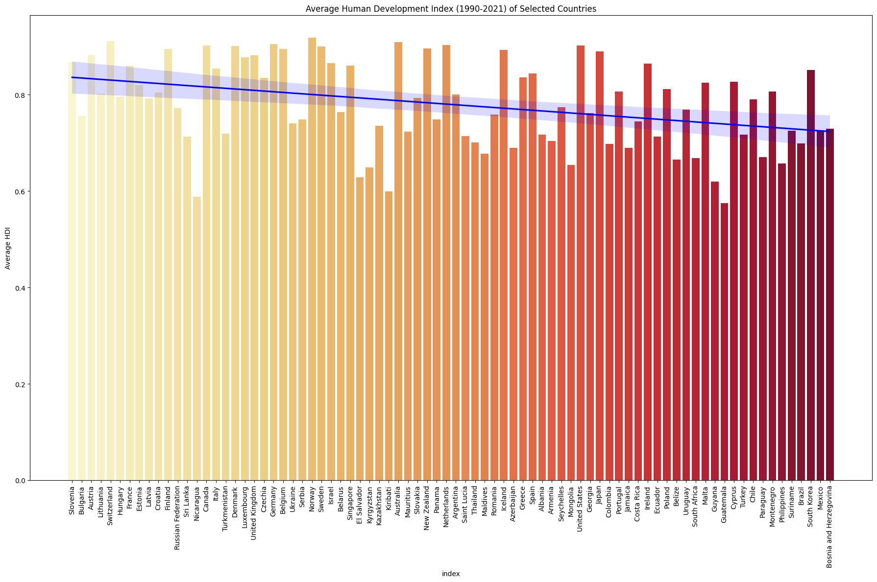
Human Development Index
No trend found between Human Development Index and suicide rates.
Other factors may influence national suicide rates more.

Slide 13
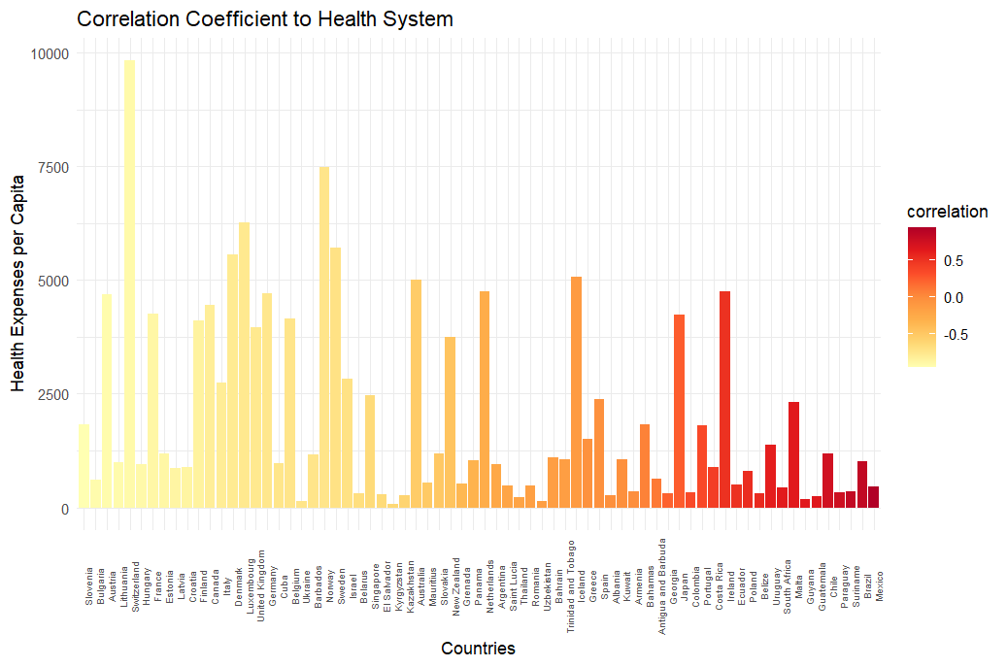
Health System
There is no clear visible trend between Suicide Rate and expenses for the Health System

Slide 14
Variables we've also looked at
Sunshine Index
Education
Latitude

Slide 15
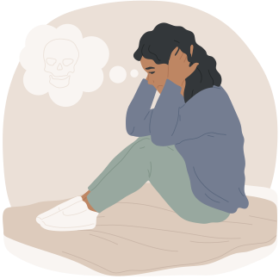
Conclusion
The correlation between GDP per capita and suicide rates varies significantly across countries, highlighting the complex and multifactorial nature of suicide.

Slide 16



Telefon Seelsorge
0800 111 0 111
www.telefonseelsorge.de
International Help Berlin
030-44 01 06 07

