Slide 1

Laboratory of Advanced Programming
Hackathon exam - 11 March 2026
HackSauce:
Francesco Giuseppe Gallo
Angelo Garcia

Slide 2
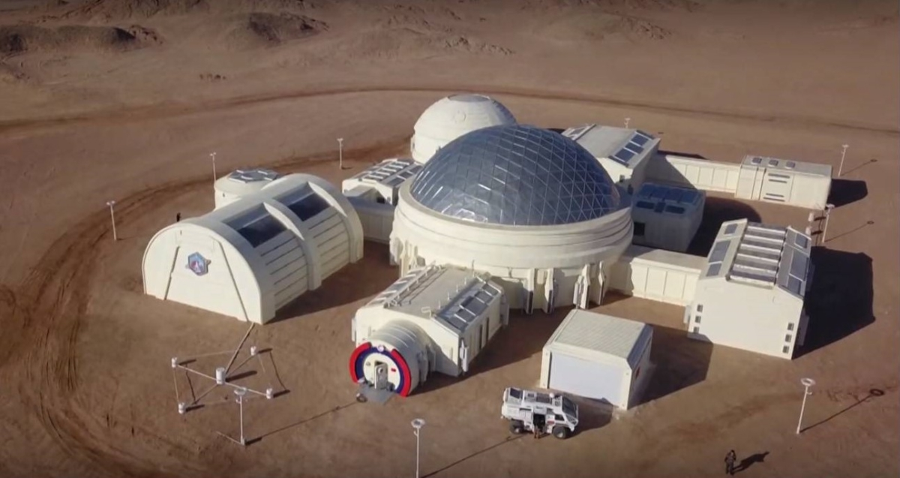
SYSTEM DESCRIPTION:
HackSauce is a distributed automation platform capable of automatically gathering information about your Mars habitat conditions and changing the state of actuators in order to avoid system failures and severe thermodynamic consequences.
The system ingests sensor data in real time, applies automation rules, and allows the habitat operator to monitor live sensor readings, track actuator states, and manage automation rules from a single dashboard.

Slide 3
USER STORIES:
1) As the habitat operator, I want to see the latest value of each sensor in real time so I can monitor habitat conditions.
2) As the habitat operator, I want to see the current state of all actuators so I know what is active.
3) As the habitat operator, I want the system to modify the state of actuators if the state conditions go out of normal ranges.
4) As the habitat operator, I want to see when an actuator was last updated so I know whether the state is recent.
5) As the habitat operator, I want to toggle and untoggle actuators so that i can regulate habitat conditions also manually.
6) As the habitat operator, I want to create automation rules so that the system can react automatically to sensor changes.
7) As the habitat operator, I want to update rules in real time so that i can regulate the habit conditions to my liking.
8) As the habitat operator, I want to toggle and untoggle rules in real time so that i can regulate the habitat conditions to my liking.
9) As the habitat operator, I want the rules to be persistent so that they can survive system failures and restarts.
10) As the habitat operator, I want to receive visual alerts when sensor values exceed critical thresholds so that I can react quickly.

Slide 4
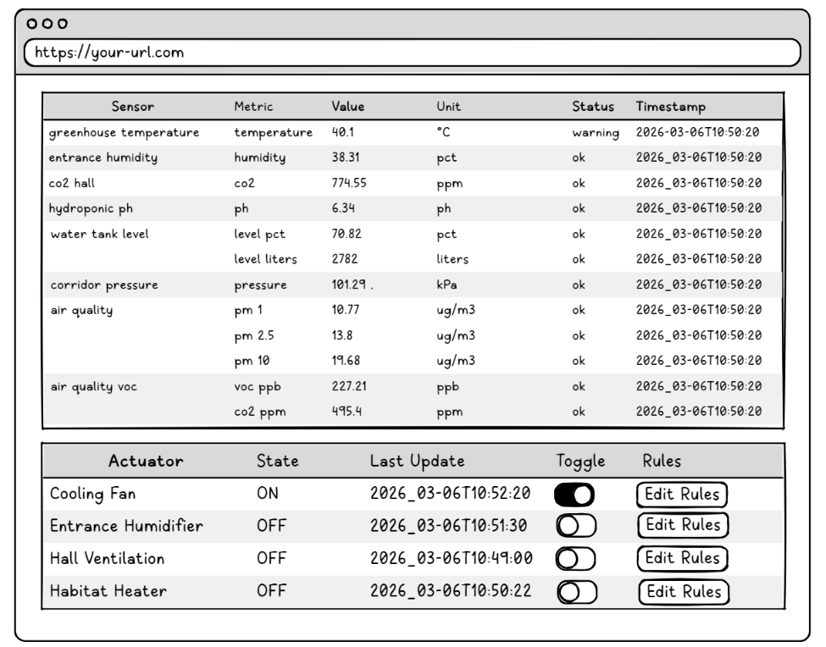
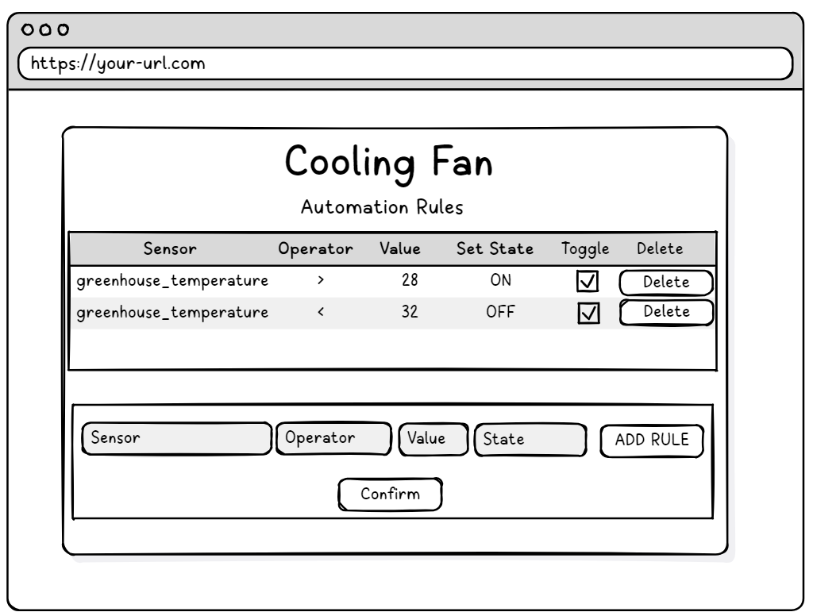
LO-FI MOCKUP (1):
User stories covered: 1, 2, 3, 4, 5, 6, 10

Slide 5
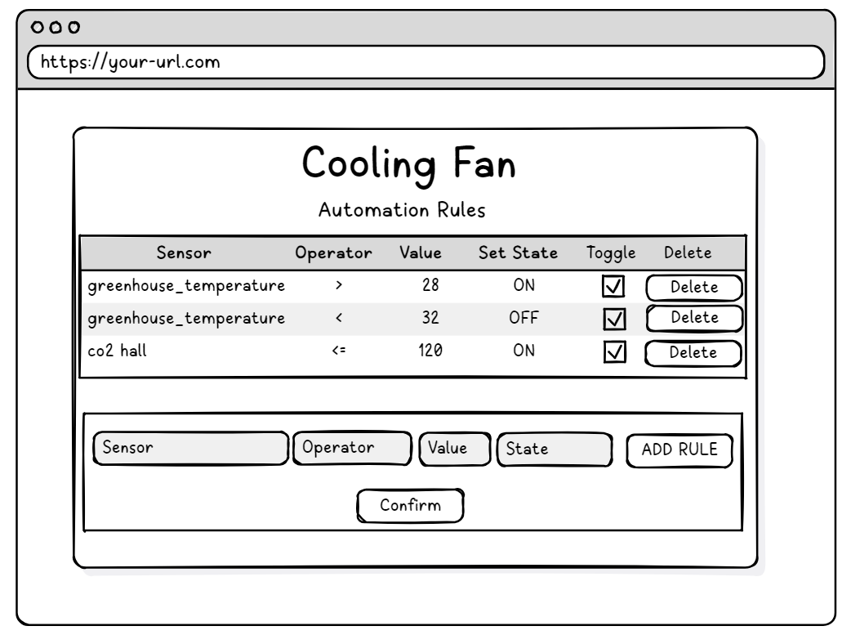
LO-FI MOCKUP (2):
User stories covered: 6, 7

Slide 6
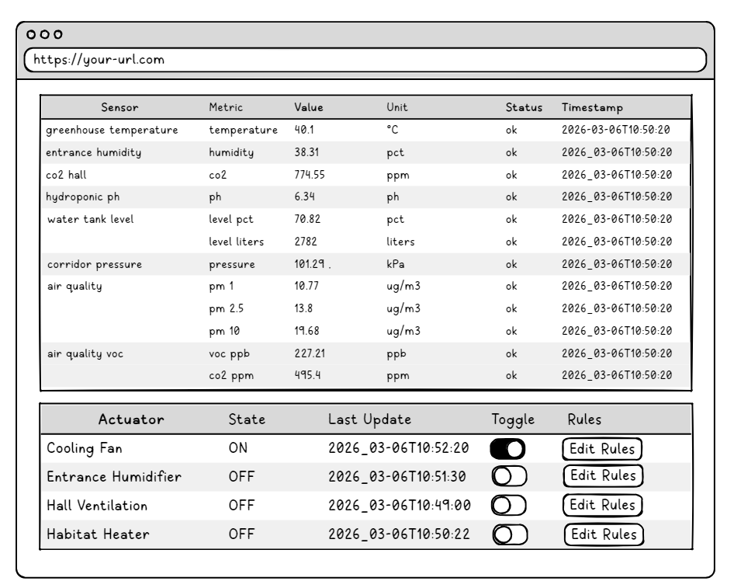
LO-FI MOCKUP (3):
User stories covered: 8, 9

Slide 7
SYSTEM ARCHITECTURE:
Simulator
Ingestion Service
ActiveMQ
Processing Service
FrontEnd
-Sensors
-Actuators
-Rest Client
-Normalization
-Producer
-Queue
-Caching
-Automation Rules
-Rest API
-Sensors
-Actuators
PostgreSQL
– Automation Rules

Slide 8
NORMALIZED MESSAGE FORMAT:
"type": "object",
"required": ["sensor_id", "captured_at", "measurements", "status"],
"properties": {
"sensor_id": { "type": "string" },
"captured_at": { "type": "string", "format": "date-time" },
"measurements": {
"type": "array",
"items": {
"type": "object",
"required": ["metric", "value", "unit"],
"properties": {
"metric": { "type": "string" },
"value": { "type": "number" },
"unit": { "type": "string" }
}
}
},
"status": { "type": "string", "enum": ["ok", "warning"] }
}

Slide 9
INGESTION SERVICE (SENSOR READING):
Simulator
ActiveMQ
Normalized messages
Sensors
Ingestion Service (sensor reading)
- Sensors
- Actuators
- Queue
Message converter
Communication interface with ActiveMQ (Stomp.py)
Producer main

Slide 10
PROCESSING SERVICE:
Simulator
Change Actuators’state
-Sensors
-Actuators
ActiveMQ
Sensors’ State in Standard Event Schema
Jms Consumer
Actuator Client
PostgreSQL
- Message Queue
-@JmsListener
-Deserialization
-Caching
Sensor Cache
-Evaluation
-Automation
-Actuators’control
Automation Rules
-Automation rules table
-Persistence
Api Controller
CRUD operations
Sensor Cache
-HTTP Endpoints
-SSE Stream
Frontend
-User Interface
-Rules’ management
-Actuators Toggle
Rest API

Slide 11
FRONTEND:
Api Controller
- HTTP Endpoints
- SSE Stream
CRUD operations
Frontend
JavaScript
HTML
Rest API
Page logic and dynamic interactions
Page structure
CSS
-“fetch” function to access the controller endpoints
- “EventSource” object to access the events
Page styling and colors

Slide 12
DOCKER-COMPOSE:
DOCKER COMPOSE
Reading Service
ActiveMQ
Processing Service
PostgreSQL
FrontEnd
Container
Container
Container
Container
Container

Slide 13
CONCLUSIONS:
Limitations and Possible Improvements:
No rule conflict resolution, improve by conflict detection and priority system
Sensor history not persisted, improve by sensor history storage and charts
Project Takeaways:
A good design phase, so stating clearly and agreeing before coding on user stories, interfaces and event schema is fundamental to make integration effortless
An event-driven architecture enforcing the previous takeaway allows fast and parallel development of multiple distributed services, and freedom of choice on the technologies used.

