Slide 1
GreenBag: Energy-efficient Bandwidth Aggregation for Real-time Streaming in Heterogeneous Mobile Wireless Networks
Student: Bui, Hoang Duc
Advisor: Professor Shin, Insik

Slide 2
Motivation
Mobile multimedia streaming is very popular today
Real-time multimedia streaming traffic will take up to 66% of global mobile data traffic by 2017, up from 51% in 2012 [Cisco Systems Forecast]
High quality video streaming needs high bandwidth
Streaming ultra-HD 4K videos requires around 19Mbps bandwidth [Youtube]
High definition cameras on modern smartphones are capable of recording 1080p full-HD videos at 17-24Mbps bit rates

Slide 3
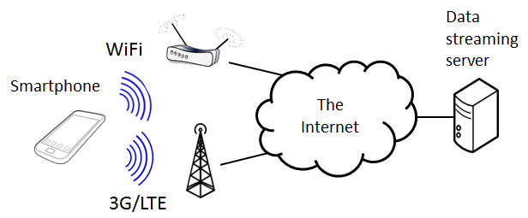
Bandwidth aggregation on mobile devices - Opportunity
Increasing usable bandwidth by bandwidth aggregation: create one logical link via two physical links
Common mobile phones are equipped with at least two network interfaces, 3G/LTE and WiFi
LTE provides high bandwidth comparable to WiFi
Notes:
Fortunately

Slide 4
Bandwidth aggregation
Bandwidth aggregation needs to divide the file downloading into the two different interfaces
Divide the file into small segments and assign each segment to one of the links for downloading

Slide 5
Bandwidth aggregation
Bandwidth aggregation needs to divide the file downloading into the two different interfaces
Divide the file into small segments and assign each segment to one of the links for downloading
File

Slide 6
Bandwidth aggregation
Bandwidth aggregation needs to divide the file downloading into the two different interfaces
Divide the file into small segments and assign each segment to one of the links for downloading
File

Slide 7
Bandwidth aggregation
Bandwidth aggregation needs to divide the file downloading into the two different interfaces
Divide the file into small segments and assign each segment to one of the links for downloading
File
LTE
WiFi
WiFi
LTE
LTE
WiFi
LTE
WiFi
WiFi
WiFi

Slide 8
Bandwidth aggregation
Bandwidth aggregation needs to divide the file downloading into the two different interfaces
Divide the file into small segments and assign each segment to one of the links for downloading
Two basic problems must be solved
Segment size decision
Segment channel assignment
File
LTE
WiFi
WiFi
LTE
LTE
WiFi
LTE
WiFi
WiFi
WiFi

Slide 9
Bandwidth aggregation
Bandwidth aggregation needs to divide the file downloading into the two different interfaces
Divide the file into small segments and assign each segment to one of the links for downloading
Two basic problems must be solved
Segment size decision
Segment channel assignment
Important issue: out-of-order delivery
We cannot use out-of-order segments for playing back which requires in-order data
Out-of-order segment
File
LTE
WiFi
WiFi
LTE
LTE
WiFi
LTE
WiFi
WiFi
WiFi
Downloaded portion
Downloading in progress

Slide 10
Bandwidth aggregation on mobile devices – Requirements
Strict energy saving requirement
Mobile devices are powered by batteries
The use of multiple network interfaces can introduce a significant energy usage
LTE and WiFi have different power management
Ease of deployment
A widely applicable technique should require no change to the Internet infrastructure
Notes:
However

Slide 11
Goal
Address the two basic problems in order to support the QoS requirements of real-time video streaming in the most energy-efficient way
Segment size decision
Segment channel assignment
In this thesis, we consider only on-demand video streaming in which the video file size is known
LTE
WiFi
WiFi
LTE
LTE
WiFi
LTE
WiFi
WiFi
WiFi

Slide 12
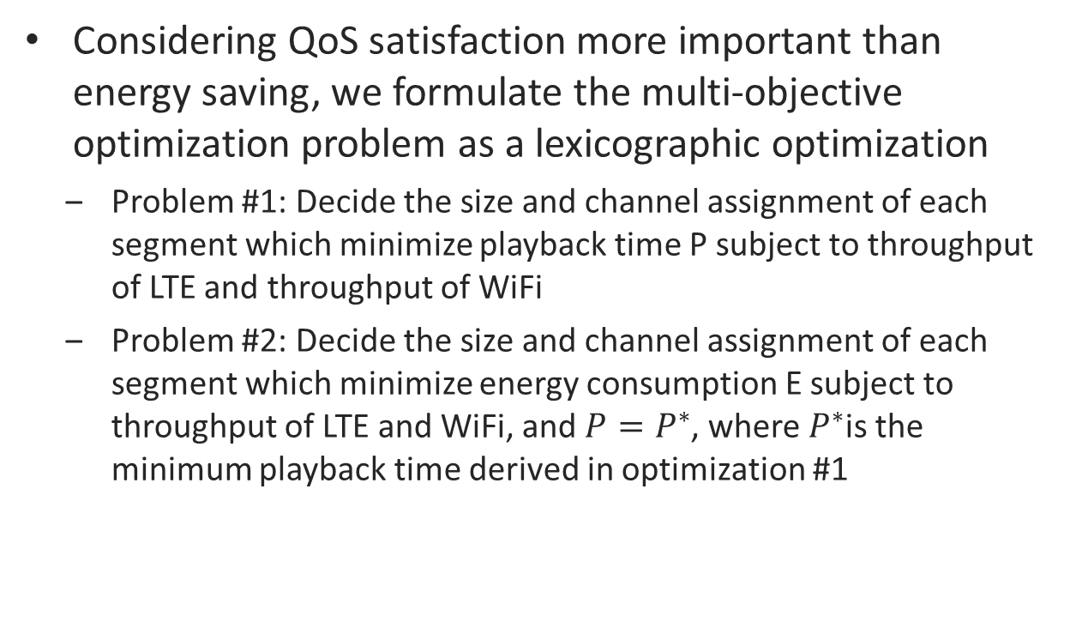
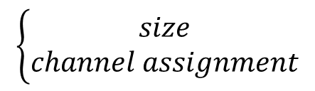
Problem Formulation
Considering QoS satisfaction more important than energy saving, we formulate the multi-objective optimization problem as a lexicographic optimization
Problem #1: Decide the size and channel assignment of each segment which minimize playback time P subject to throughput of LTE and throughput of WiFi
Problem #2: Decide the size and channel assignment of each segment which minimize energy consumption E subject to throughput of LTE and WiFi, and $P=P^{∗}$, where $P^{∗}$is the minimum playback time derived in optimization #1
$$0$$ | $$1$$ |  | $$i$$ |  |  |  | $$N−1$$
$$\left\{\begin{aligned}size \\ channel assignment\end{aligned}\right.$$

Slide 13
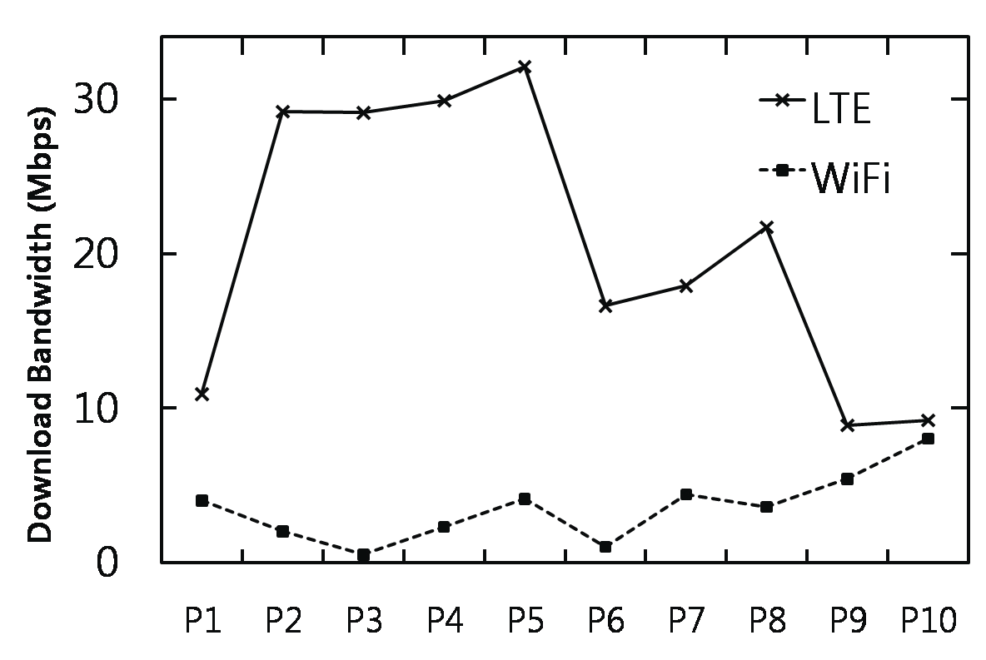
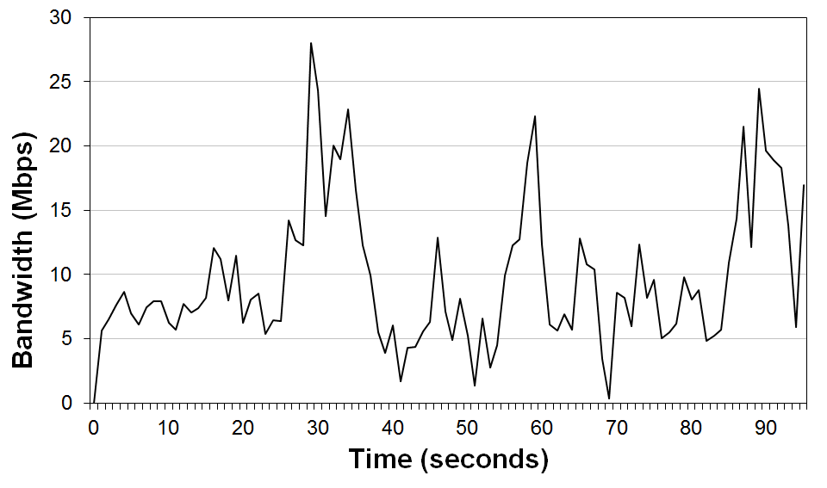
Bandwidth aggregation on mobile devices – Challenges
Link heterogeneity
Out-of-order packet delivery
Bandwidth fluctuation
Accurate prediction of network condition is not possible
Places
Bandwidth heterogeneity in different places
LTE bandwidth fluctuation
Notes:
However

Slide 14
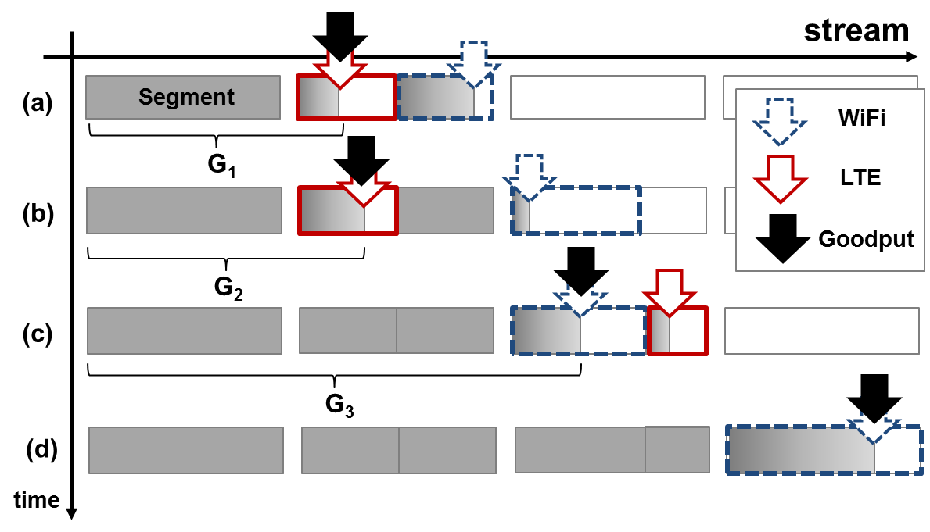




Approach: Multi-link Data Streaming Scheme
Divide a file into segments, then divide each segment further into two subsegments, and assign each subsegment into one of the two interfaces for downloading
$$t_{1}$$
$$t_{2}$$
In-order Data
$$t_{3}$$
$$t_{4}$$
Notes:
Use LTE and WiFi in a smart way so that we achieve the minimum video interruption time at the minimum energy consumption

Slide 15
GreenBag architecture
GreenBag is a middleware which provides energy-efficient multi-link data streaming services
GreenBag’s role is as a proxy between video player and server
GreenBag
Video Player
HTTP
Engine
Download Engine
LTE
Server
Buffer
WiFi
Download Planner

Slide 16
GreenBag architecture
GreenBag is a middleware which provides energy-efficient multi-link data streaming services
GreenBag’s role is as a proxy between video player and server
GreenBag
Video Player
HTTP
Engine
Download Engine
LTE
Server
Buffer
WiFi
Download Planner
Segment Manager
Medium Load Balancer
Recovery Decision Maker
Energy-aware
Link Mode Chooser
Energy Model
Goodput Predictor
Video Player State Monitor

Slide 17
Components of Download Planner (1/5)
Segment Manager
Determine the next segment size when a segment completes
It uses a fixed segment size in typical cases
Overhead of requesting a segment is small because of the use of HTTP pipelining
Download Planner
Segment Manager
Medium Load Balancer
Recovery Decision Maker
Energy-aware
Link Mode Chooser
Energy Model
Goodput Predictor
Video Player State Monitor
Notes:
Given a link $a$ is finishing while the other link $b$ is still downloading its subsegment, the subsegment sizes are computed as
$$\left\{\begin{aligned}Z_{a}=\frac{G_{a}}{G_{a}+G_{b}}∙\left(Z+Z_{u}\right) \\ Z_{b}=Z+Z_{u}−Z_{a}\end{aligned}\right.$$
$Z_{a}$ ($Z_{b}$) and $G_{a}$ ($G_{b}$) are the subsegment size and goodput link $a$ ($b$) in the next segment of size $Z$, respectively
$Z_{u}$is the size of unfinished portions of both links, mainly of link $b$

Slide 18
Components of Download Planner (2/5)
Medium Load Balancer
Determine the subsegment sizes and links’ assignment in the next segment
Basing on unfinished portion size, next segment size, and estimation of current goodput
Reduce out-of-order delivery
Both interfaces would finish at the same time
The faster link would download the earlier subsegment
Require good estimation of current goodput
Download Planner
Segment Manager
Medium Load Balancer
Recovery Decision Maker
Energy-aware
Link Mode Chooser
Energy Model
Goodput Predictor
Video Player State Monitor
Notes:
Given a link $a$ is finishing while the other link $b$ is still downloading its subsegment, the subsegment sizes are computed as
$$\left\{\begin{aligned}Z_{a}=\frac{G_{a}}{G_{a}+G_{b}}∙\left(Z+Z_{u}\right) \\ Z_{b}=Z+Z_{u}−Z_{a}\end{aligned}\right.$$
$Z_{a}$ ($Z_{b}$) and $G_{a}$ ($G_{b}$) are the subsegment size and goodput link $a$ ($b$) in the next segment of size $Z$, respectively
$Z_{u}$is the size of unfinished portions of both links, mainly of link $b$
The size of a subsegment assigned to link $a$ is proportional to the link’s goodput $G_{a}$, and the sum $(Z_{u}+Z)$ of the unfinished portion of both link $Z_{u}$ and next segment size $Z$

Slide 19
Components of Download Planner (3/5)
Recovery Decision Maker
Handle the case when goodput estimation is wrong
Replan the downloading again
When GreenBag made poor decisions on load balancing due to fast fluctuation of network bandwidth, such as a drop of WiFi bandwidth
Download Planner
Segment Manager
Medium Load Balancer
Recovery Decision Maker
Energy-aware
Link Mode Chooser
Energy Model
Goodput Predictor
Video Player State Monitor
Notes:
Recover only when bottleneck subsegment is significantly lagging in the way that there is a high chance to miss a QoS deadline and cause a video playback interruption
Avoid both QoS violation and overhead of recovery
$w_{r}∙T_{P}\left(t\right)≤T_{R}\left(t\right)$ where
$T_{P}\left(t\right)$ is the time available for continuing playing back without interruption
$T_{R}\left(t\right)$ is the time required to finish the bottleneck subsegment
$w_{r}$ is a weighted value
Condition for recovery is when there is insufficient time available for continue playing back without interruption

Slide 20
Components of Download Planner (4/5)
Energy-aware Link-mode Chooser
Download Planner
Segment Manager
Medium Load Balancer
Recovery Decision Maker
Energy-aware
Link Mode Chooser
Energy Model
Goodput Predictor
Video Player State Monitor
Notes:
LTE will demote to IDLE state after if is idle in more than $T_{tail}$

Slide 21
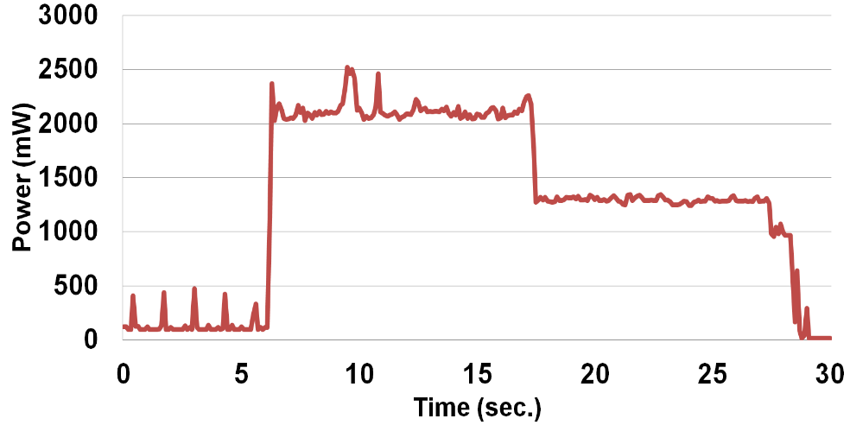


LTE power management
LTE power management has 3 states: ACTIVE, TAIL, and IDLE
LTE interface in TAIL state has high power consumption, about half of the power in ACTIVE state
The TAIL state timeout $T_{tail}$ is long (11.2 seconds)
Suggests to keep LTE idle long enough until LTE interface demotes to IDLE state which consumes almost no energy
ACTIVE
ACTIVE
any data
traffic
no data
traffic
TAIL
any data
traffic
IDLE
$$T_{tail}$$
IDLE
TAIL
TAIL state timeout expires
(a) LTE power states
(b) LTE power trace

Slide 22

Components of Download Planner (4/5)
Energy-aware Link-mode Chooser
Save energy by keeping LTE idle in long period (longer than $T_{tail}$)
Avoid irregular data transfer over LTE which prevents LTE to enter IDLE state
Choose the link mode that consumes the least energy to download the remaining portion of the file without incurring any playback interruption
Three link modes: Dual-link, LTE-only, and WiFi-only
Download Planner
Segment Manager
Medium Load Balancer
Recovery Decision Maker
Energy-aware
Link Mode Chooser
Energy Model
Goodput Predictor
Video Player State Monitor
Notes:
LTE will demote to IDLE state after if is idle in more than $T_{tail}$

Slide 23
Components of Download Planner (5/5)
Goodput Predictor
Predict goodput of each link in the remaining portion of the file using an exponential weighted moving average (EWMA) predictor
Video Player State Monitor
Monitor the video player’s current state and position
Download Planner
Segment Manager
Medium Load Balancer
Recovery Decision Maker
Energy-aware
Link Mode Chooser
Energy Model
Goodput Predictor
Video Player State Monitor

Slide 24
Download Planner - Decision Making
Typically, GreenBag makes the following decisions to download further when a link is going to finish its subsegment
Decide to recover or not, if not
Decide the next segment size
Choose the most energy-efficient link mode
Decide the subsegment sizes of the two links in the next segment
Download Planner
Segment Manager
Medium Load Balancer
Recovery Decision Maker
Energy-aware
Link Mode Chooser
Energy Model
Goodput Predictor
Video Player State Monitor

Slide 25
Evaluation
Evaluation in real-world networks
Evaluation in emulated environment

Slide 26
Evaluation in real-world networks Experiment Setup (1/2)
Compare 4 configurations (GB-E, GB-P, LTE-only, and WiFi-only) in 3 scenarios (Stationary #1, Stationary #2, and Mobile) in terms of 2 performance metrics
Two performance metrics
Playback time
Energy consumption
Four configurations
GB-E: GreenBag-Energy mode, supports QoS while saving energy
GB-P: GreenBag-Performance mode, maximizes throughput without saving energy
LTE-only (WiFi-only): video streaming using only LTE (WiFi)
Notes:
Because of randomness of real-world environments, we did experiments 3 times for each pair of (configuration, scenario) and then derived average values

Slide 27
Evaluation in real-world networks Experiment Setup (2/2)
Compare the 4 configurations (GB-E, GB-P, LTE-only, and WiFi-only) in 3 scenarios (Stationary #1, Stationary #2, and Mobile)
Three scenarios
Stationary #1: Bandwidth of LTE is always greater than of WiFi
Stationary #2: Bandwidth of LTE is always smaller than of WiFi
Mobile: WiFi bandwidth fluctuates fast and has a drop due to user mobility
 | Stationary #1 | Stationary #2 | Mobile
Average LTE bandwidth (Mbps) | 5.14 | 4.12 | 4.73
Average WiFi bandwidth (Mbps) | 3.85 | 5.00 | 4.94
Total average bandwidth (Mbps) | 8.99 | 9.12 | 9.67
Experimented video has 6.1Mbps average bit rate, and is 117 seconds long
Notes:
Because of randomness of real-world environments, we did experiments 3 times for each pair of (configuration, scenario) and then derived average values

Slide 28
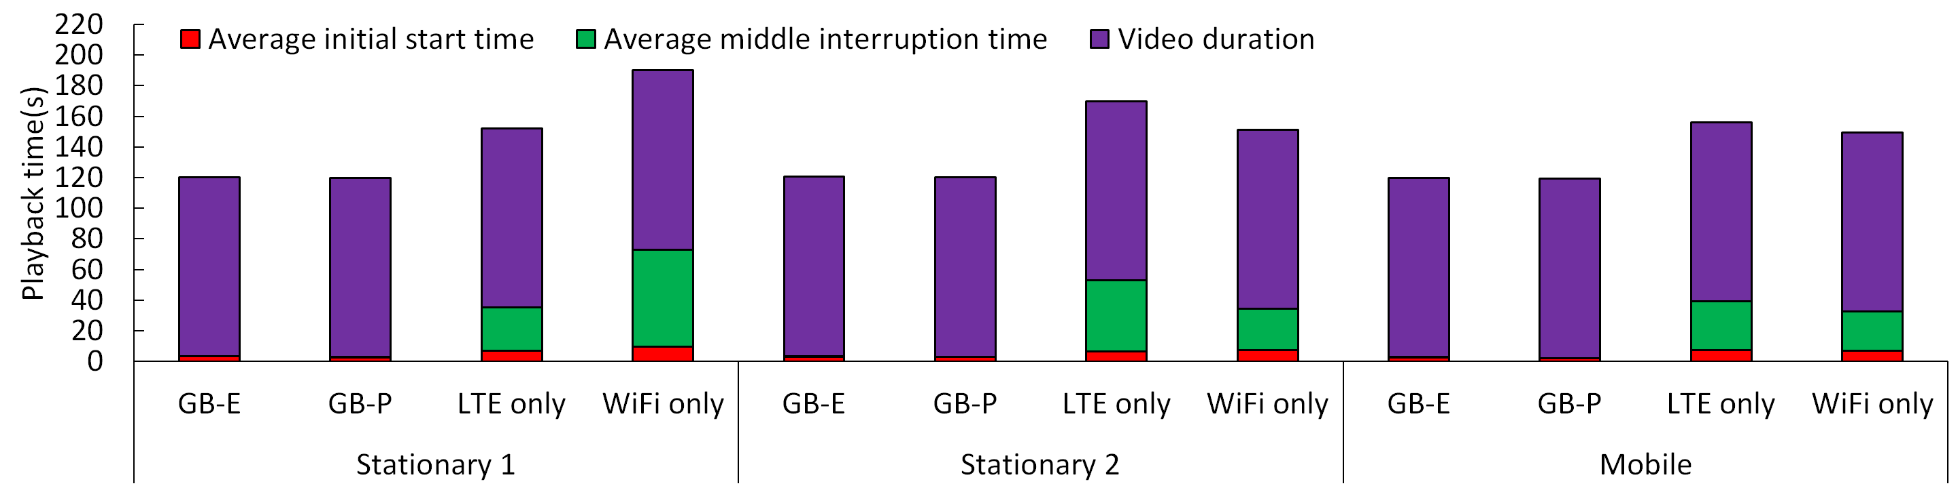
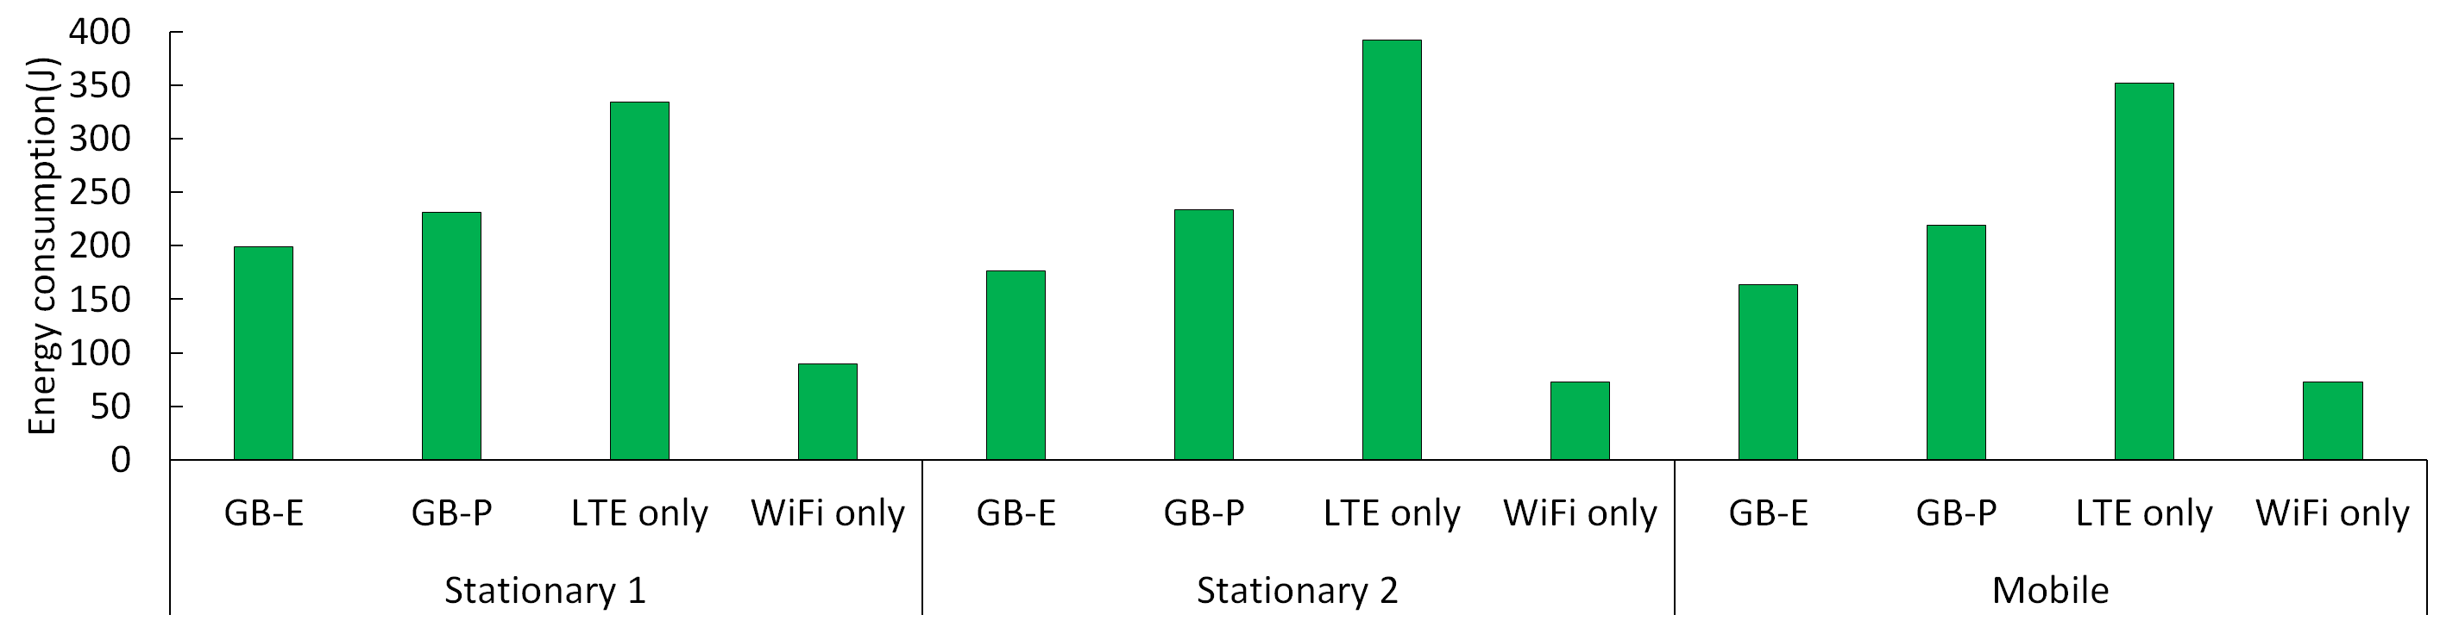
Performance of GreenBag in real-world experiments
GreenBag minimizes video interruption time
GB-E not only minimizes video interruption time but also consumes 14-25% less energy than GB-P

Slide 29
Demonstration Playback time minimization
PlayTime.mp4
Please visit the following website for the video file http://cps.kaist.ac.kr/greenbag/

Slide 30
Demonstration Energy Saving
EnergyConsumption.mp4
Please visit the following website for the video file http://cps.kaist.ac.kr/greenbag/
Notes:
External power monitor tool

Slide 31
Evaluation in Emulated environment
Experiment setup
Emulated network
A client, a server, and an intermediate node equipped with network emulator tools
Emulated player
Implementation of the video player model
Evaluate four aspects of GreenBag
Segment size overhead
Effectiveness of adaptive load balancing
Effectiveness of recovery mechanism
Effectiveness of energy-aware link mode switching

Slide 32
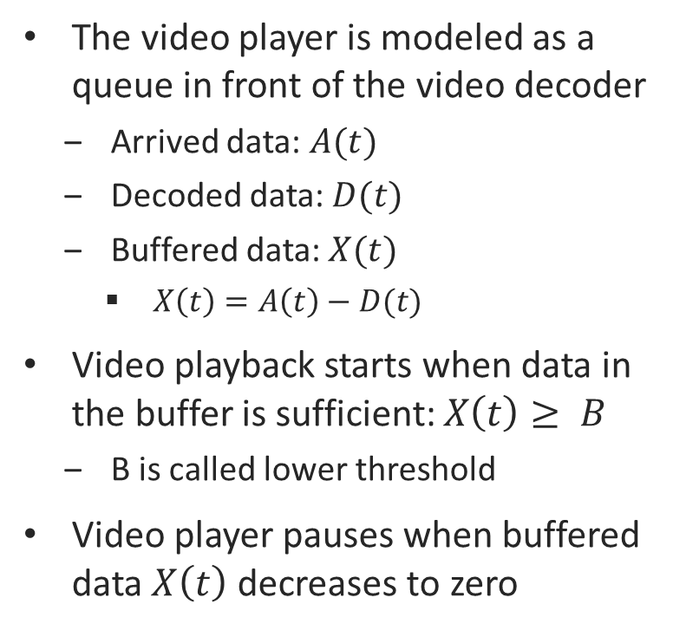
Video Player Model
The video player is modeled as a queue in front of the video decoder
Arrived data: $A(t)$
Decoded data: $D(t)$
Buffered data: $X(t)$
$X\left(t\right)=A\left(t\right)−D(t)$
Video playback starts when data in the buffer is sufficient: $X\left(t\right)≥ B$
B is called lower threshold
Video player pauses when buffered data $X\left(t\right)$ decreases to zero
Data Source
A(t)
Video Buffer
D(t)
Video
Decoder
X(t)
B
Data size
L
k-th
bit
B
X(t)
A(t)
B
Time
D(t)
t₀
t₁
t₂
t₃
t₄

Slide 33
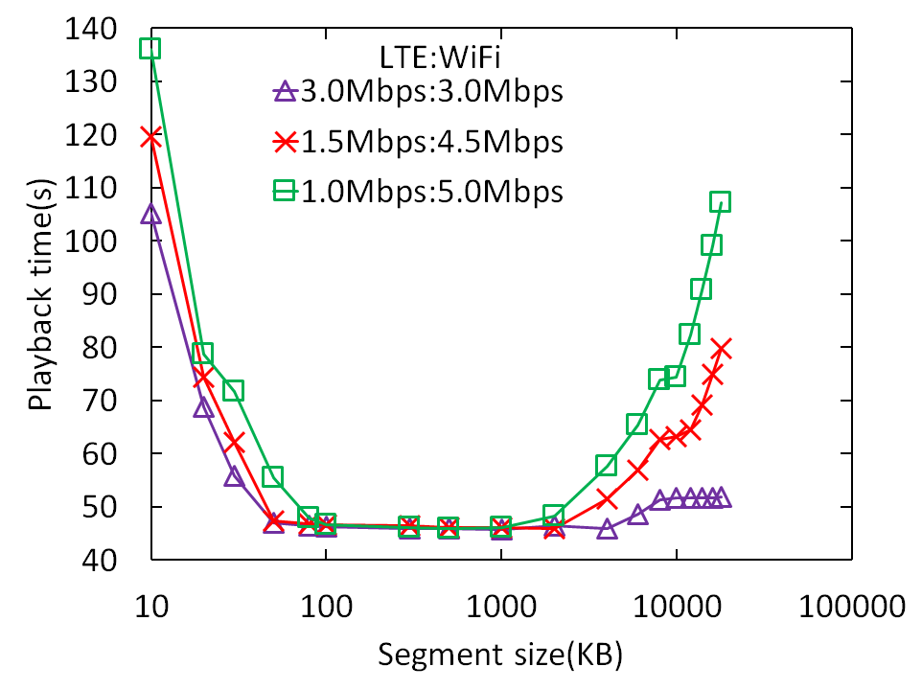
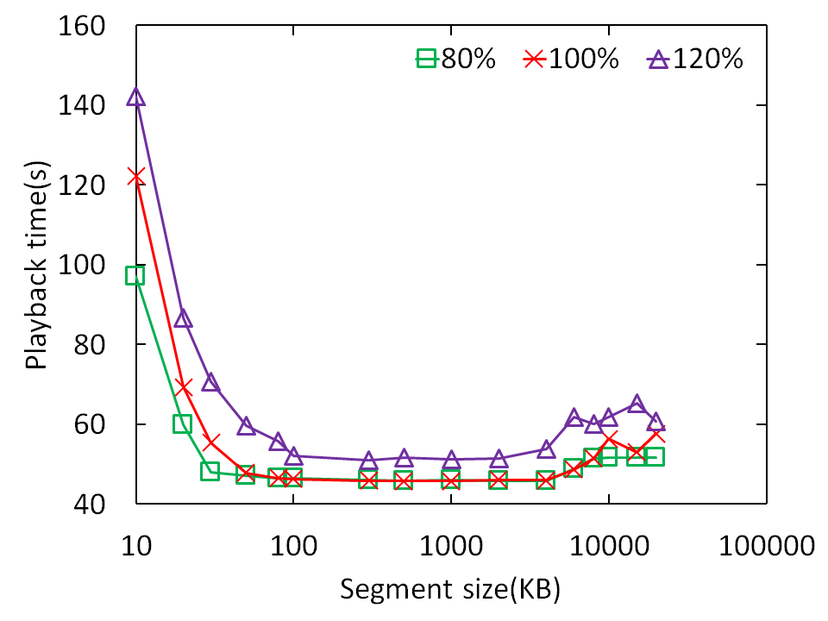

Segment size overhead
Optimal segment sizes are independent of bandwidth heterogeneity and video bit rates
Small segment size imposes more overhead in requesting every new segment
Large segment size increases out-of-order data delivery
$$\frac{VideoBitRate}{TotalBandwidth}$$
(a) Overhead in different link heterogeneity
(b) Overhead in different video bit rates

Slide 34
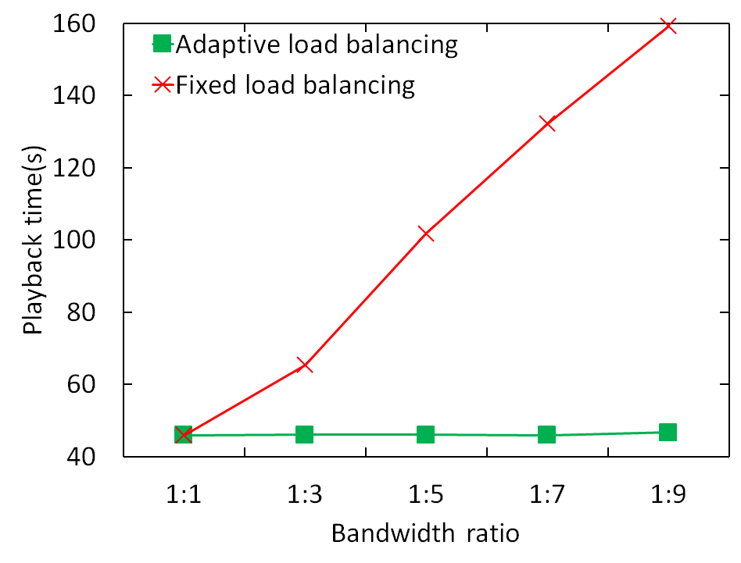
Effectiveness of adaptive load balancing
Bandwidth heterogeneity has little effect on the performance of the adaptive load balancing scheme, while affecting the fixed load balancing (1:1) significantly

Slide 35
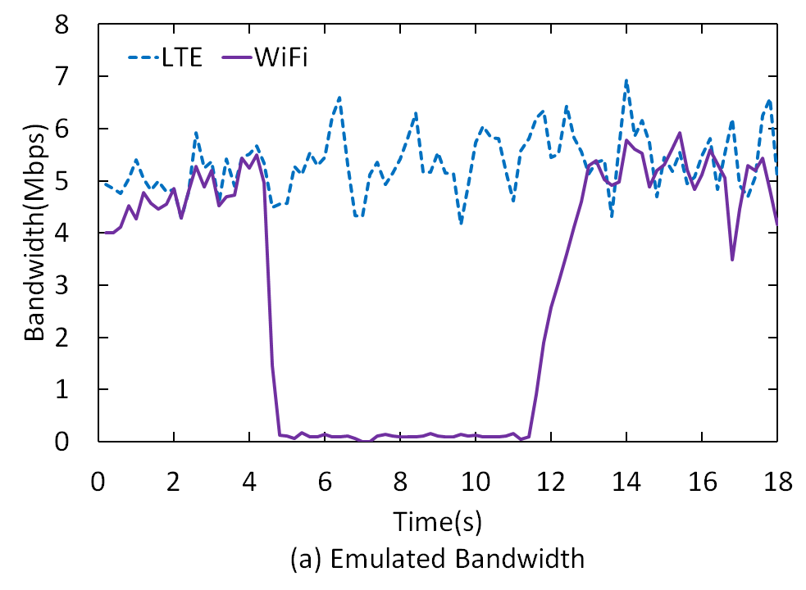
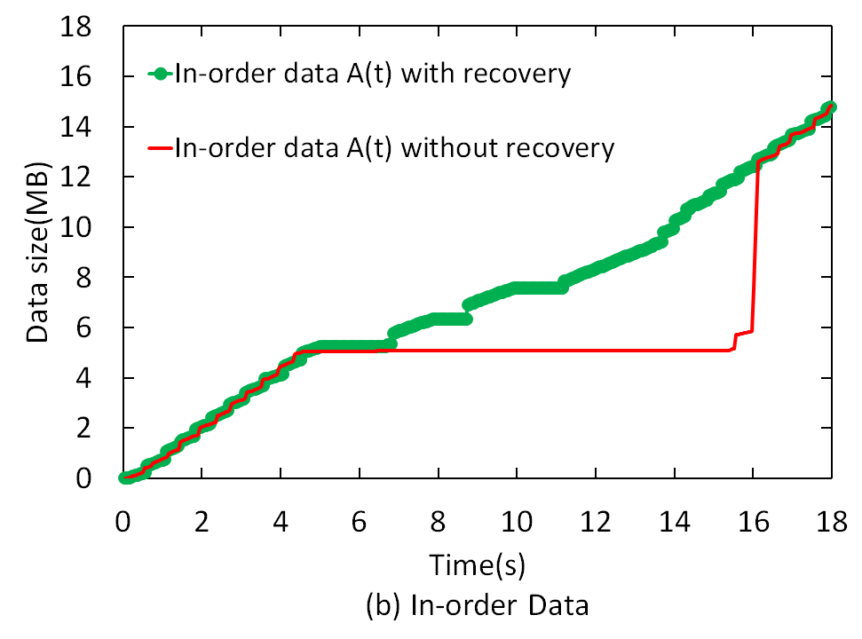
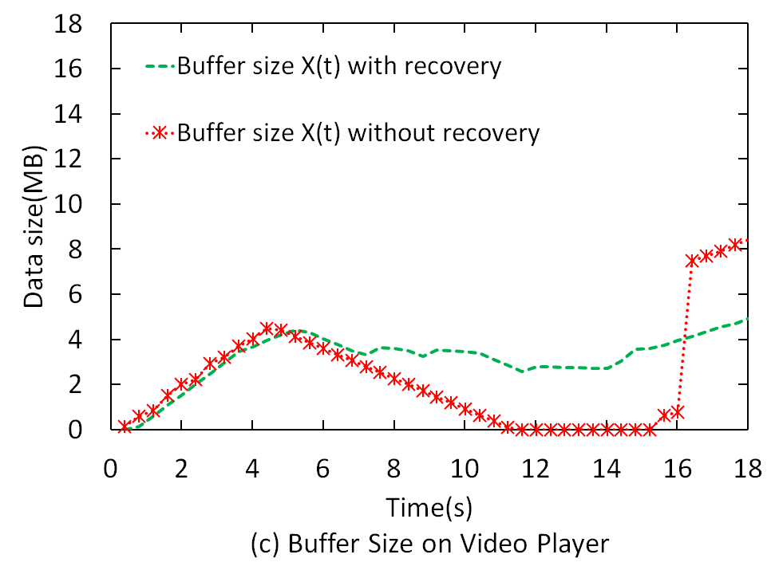
Effectiveness of recovery mechanism (1/2)
Recovery mechanism avoids the long out-of-order data caused by bandwidth drops
E.g. WiFi bandwidth can drop when the smartphone moves out of WiFi coverage

Slide 36
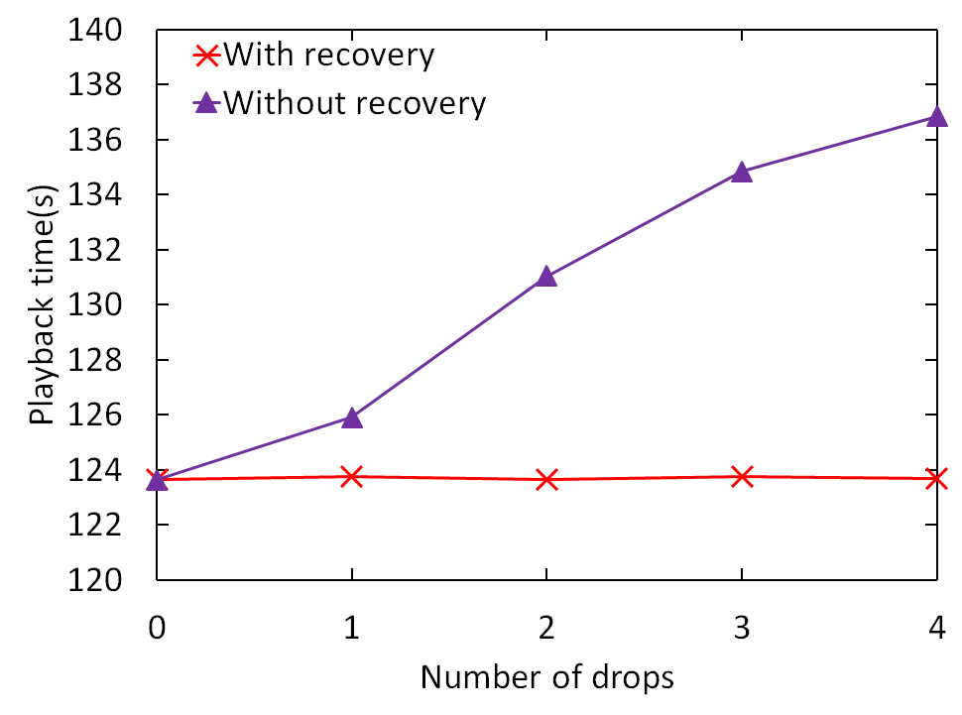
Effectiveness of recovery mechanism (2/2)
Recovery mechanism keeps playback time minimum even in the presence of multiple of bandwidth drops

Slide 37
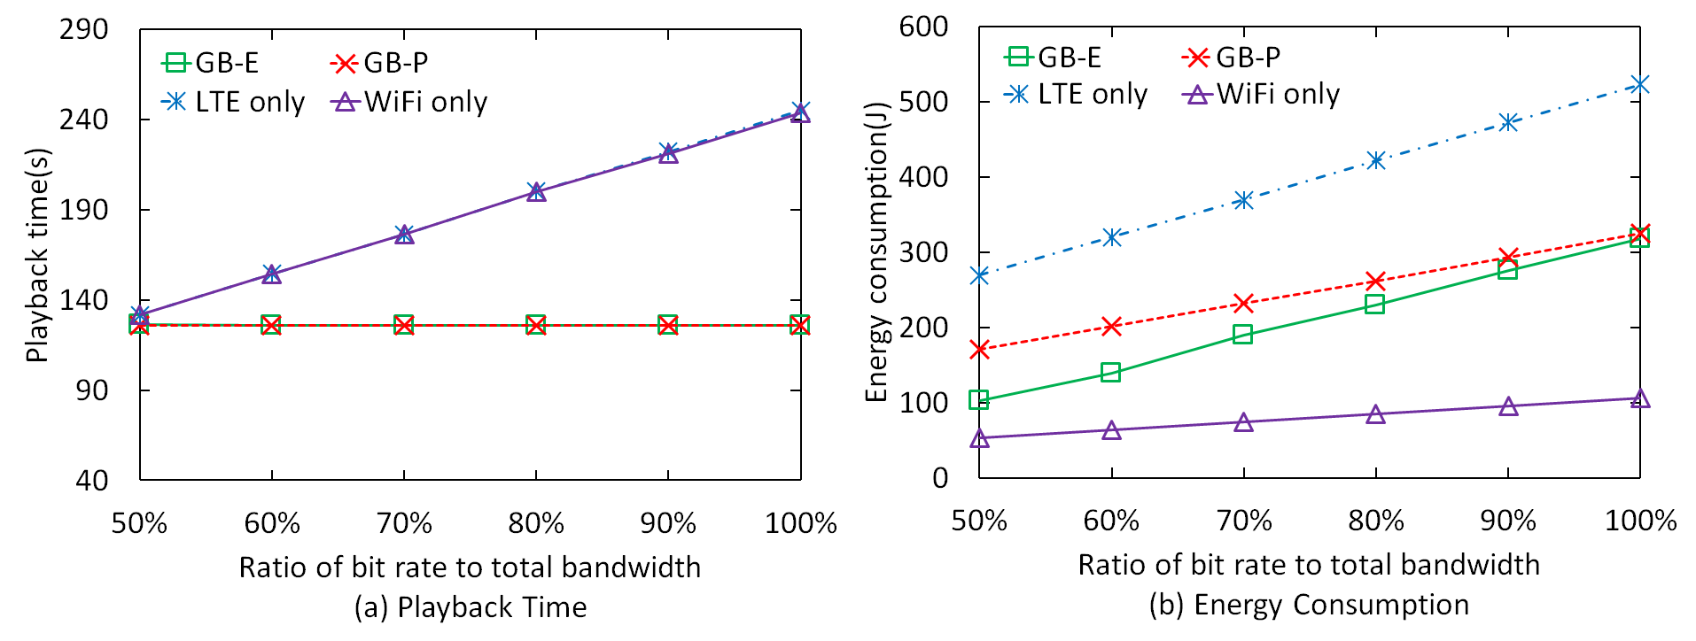

Effectiveness of energy-aware link-mode switching
GB-E provides the same playback time with GB-P, while saving 2%-40% of energy consumption of GB-P
$$\frac{VideoBitRate}{TotalBandwidth}$$

Slide 38
Conclusion
The thesis has the following contributions
Formulate bandwidth aggregation for real-time video streaming as a lexicographic optimization
Design a multi-link data streaming middleware to support real-time delivery in the most energy-efficient way
Implement a prototype of GreenBag on Android-based mobile devices equipped with LTE and WiFi interfaces
To the best of our knowledge, this is one of the first LTE-enabled prototypes which demonstrates the effectiveness of bandwidth aggregation for energy-efficient real-time delivery on mobile phones
Notes:
+ experiment + writing

Slide 39
Acknowledgement
I would like to express my special thanks and appreciation to Kilho Lee, Sangeun Oh (Cyber-Physical Systems Lab), Doctor Hyojeong Shin (Mobile SW Platform Center), Doctor Honguk Woo, and Doctor Daehyun Ban (Samsung Electronics) for their great support and collaboration in the research

Slide 40
Thank you
Questions and Answers

Slide 41
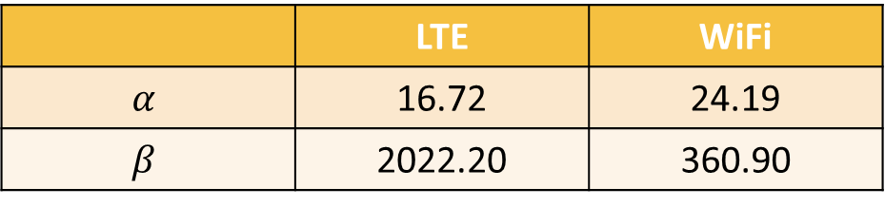
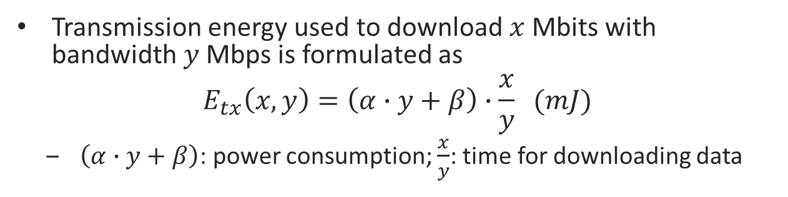
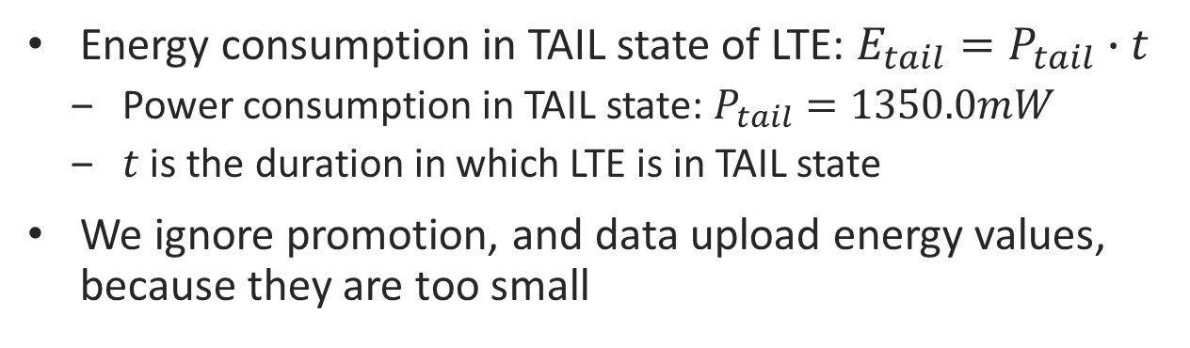
Appendix Energy Models of LTE and WiFi
Transmission energy used to download $x$ Mbits with bandwidth $y$ Mbps is formulated as
$$E_{tx}\left(x,y\right)=\left(α∙y+β\right)∙\frac{x}{y} (mJ)$$
$\left(α∙y+β\right)$: power consumption; $\frac{x}{y}$: time for downloading data
 | LTE | WiFi
$$α$$ | 16.72 | 24.19
$$β$$ | 2022.20 | 360.90
Energy consumption in TAIL state of LTE: $E_{tail}=P_{tail}∙t$
Power consumption in TAIL state: $P_{tail}=1350.0mW$
$t$ is the duration in which LTE is in TAIL state
We ignore promotion, and data upload energy values, because they are too small

