Slide 1
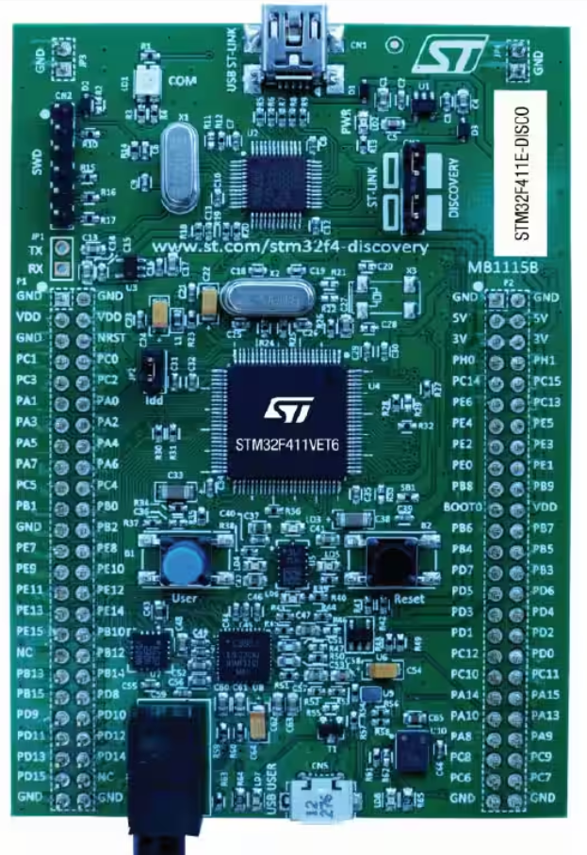
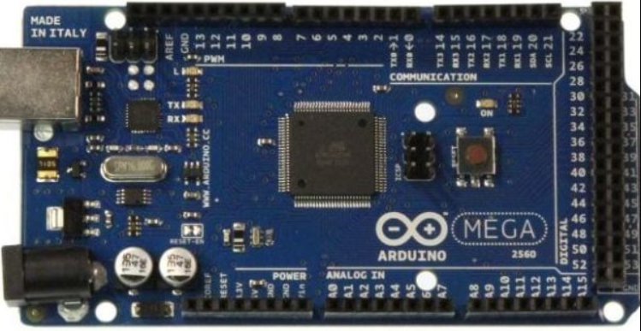
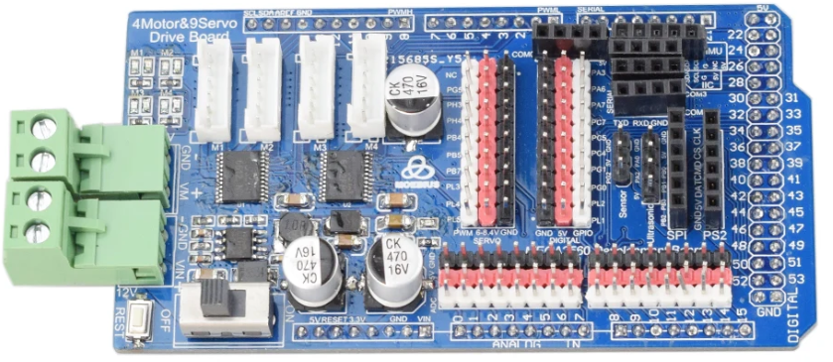

Slide 2
PWM[1] - 12
Encb[2] – PA1
Encb[4] - A1
PWM[2] - 8
PWM[3] – PA2
18, 19, 3, 2
PWM[3] - 9
PWM[4] – PA3
PWM[1] – PE6
PE9, PA1, PA6, PB6
PWM[4] - 5
Enca[2] – PA5
Enca[3] - 3
Encb[3] – PA7
PWM[2] – PB8
In1[4] - A4
In2[4] - A5
Enca[4] - 2
Enca[3] – PA6
18, 19, 3, 2
UART - TX - 14
Enca[1] – PE9
Enca[4] – PB6
Encb[4] – PB7
UART - RX - 15
Encb[1] – PE11
PE9, PB6, PA5, PA6
Enca[1] - 18
Enca[2] - 19
IMU - SDA - 20
IMU - SCL - 21
Encb[3] - 49
In1[3] - 43
In2[3] - 42
Encb[2] - 38
In1[2] - 37
In2[2] - 36
In1[1] - 34
In2[1] - 35
Encb[1] - 31

Slide 3
1 2 3 4 5 6 7 8 9 10 11 12
1 2 3 4 5 6 7 8 9 10 11 12
UART - TX
UART - RX
IMU - SCL
IMU - SDA

Slide 4
1 2 3 4 5 6 7 8 9 10 11 12
1 2 3 4 5 6 7 8 9 10 11 12
UART - TX
UART - RX
IMU - SCL
IMU - SDA

Slide 5
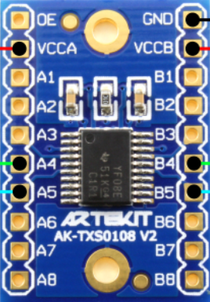
1 2 3 4 5 6 7 8 9 10 11 12
1 2 3 4 5 6 7 8 9 10 11 12
UART - TX
UART - RX
IMU - SCL
IMU - SDA

Slide 6
1 2 3 4 5 6 7 8 9 10 11 12
Conflict pin
Encoder M4 nhiễu
Khi M3 quay theo chiều âm, M3 và M4 nhiễu nhau
Chiều dương ko lỗi
Action: Check 2 chân encoder
Encoder M3
Encoder M4
PWM M4
PWM M3
Encoder M3
Encoder M4
1 2 3 4 5 6 7 8 9 10 11 12
UART - TX
UART - RX
IMU - SCL
IMU - SDA

