Slide 1
Lecture 5: Language Models and Recurrent Neural Network
Presenter: Chu Đình Đức

Slide 2
Lecture Plan
Language Models
Recurrent Neural Networks (RNN)

Slide 3
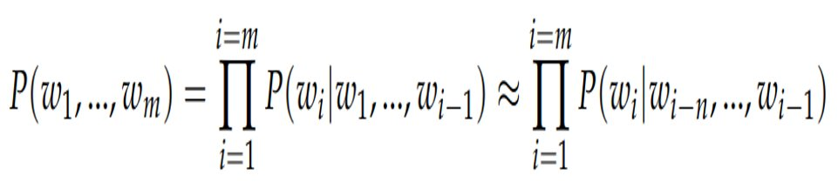
1. Language Models
Language models compute the probability of occurrence of a number of words in a particular sequence
How to compute this probability?

Slide 4
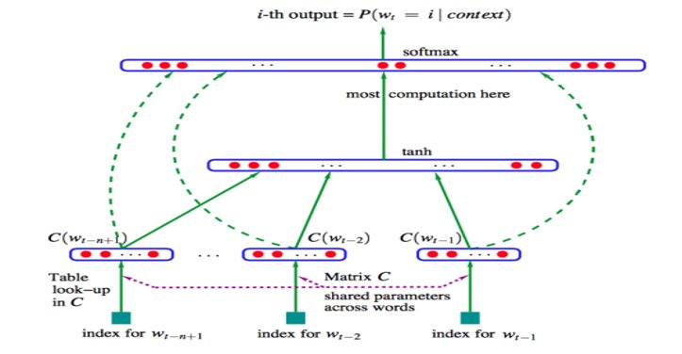
1. Language Models
The first deep neural network architecture model for NLP presented by Bengio et al.

Slide 5
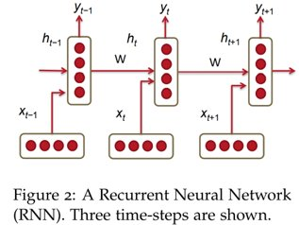
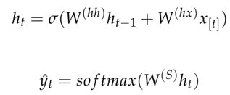
2. RNN
Unlike the conventional translation models, RNN are capable of conditioning the model on all previous words in the corpus

Slide 6


2. RNN
The loss function used in RNN is often the cross entropy error:
The cross entropy error over a corpus of size T is:

Slide 7
Lecture 6: Simple and LSTM Recurrent Neural Networks
Presenter: Chu Đình Đức

Slide 8
Lecture Plan
Vanishing Gradient & Gradient Explosion Problems
Deep Bidirectional RNNs
Application: RNN Translation Model
Long Short Term Memories (LSTM)
Gated Recurrent Units (GRU)

Slide 9
1. Vanishing Gradient & Gradient Explosion Problems
Vanishing Gradient: gradients get smaller when going down to the lower layers
Exploding Gradient: in the other case, gradients get bigger in BP progress

Slide 10
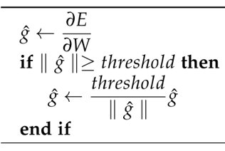
1. Vanishing Gradient & Gradient Explosion Problems
Solution:
Exploding Gradient:
Vanishing Gradient:
Instead of initializing Whh randomly, start off from an identify matrix initialization
Use ReLU instead of the sigmoid function: gradient would flow through the neurons whose derivative is 1 without getting attenuated

Slide 11
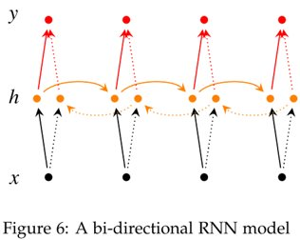
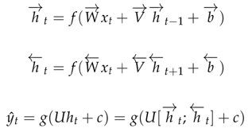
2. BiRNN
It is possible to make predictions based on future words by having RNN model read through the corpus backwards

Slide 12
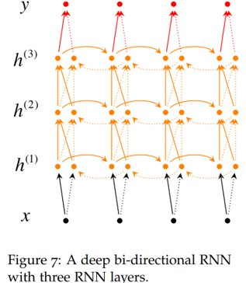
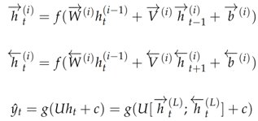
2. Multi-layer BiRNN

Slide 13
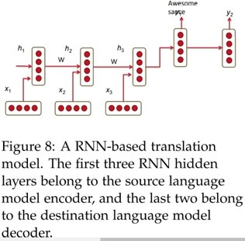
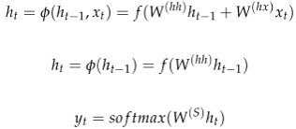
3. Application: RNN Translation Model
The first three hidden layer time-steps encode the German language words into some language word features (h3)
The last two time-steps decode h3 into English word outputs

Slide 14
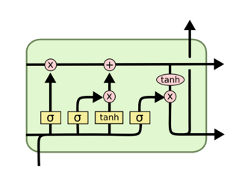
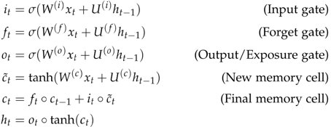
4. LSTM
How to capture long-term dependencies?

Slide 15
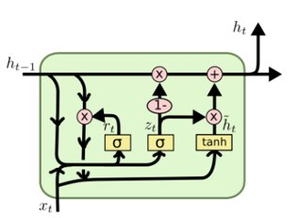
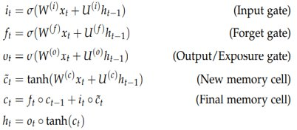
5. GRU
Capture long-term dependencies simply

Slide 16
THANK YOU!
Any question

