Slide 1
Lecture 10: More about Transformers and Pretraining
Presenter: Chu Đình Đức

Slide 2
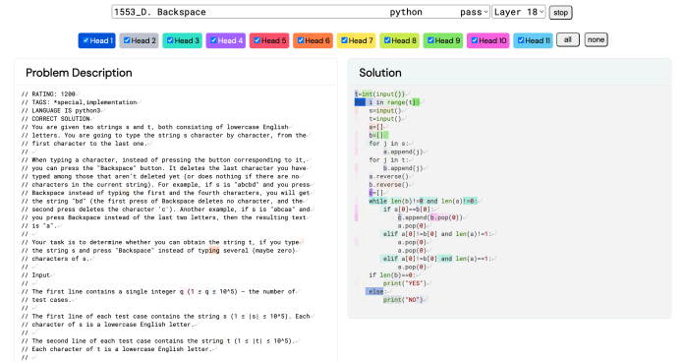
Breaking (Transformer) news
AlphaCode (a pre-trained Transformer-based code generation model) achieved a top 54.3% rating on Codeforces programming competitions

Slide 3
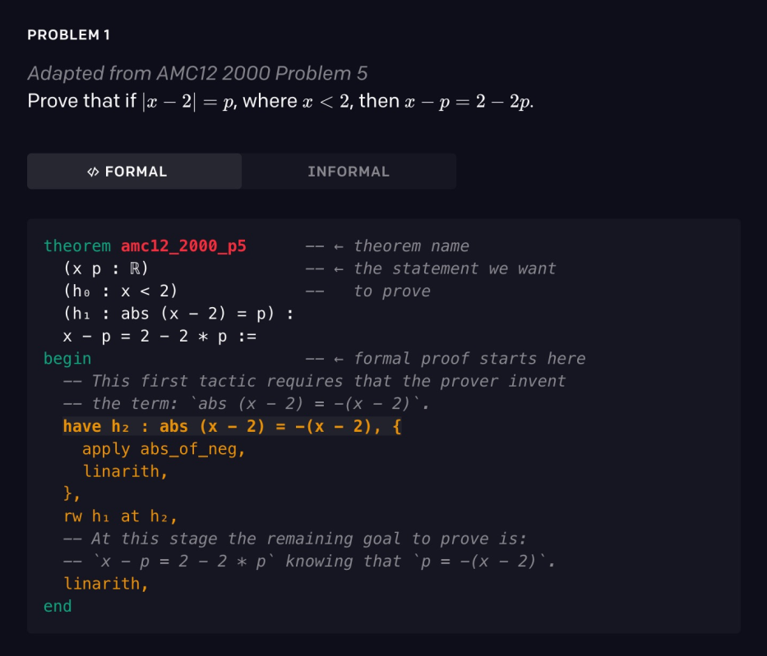
More Breaking (Transformer) news
Pre-trained Transformer-based theorem prover sets new state-of-the-art (41.2% vs. 29.3%) on a collection of challenging math Olympiad questions (miniF2F)

Slide 4
Lecture plan
Quick review of Transformer model
Brief note on subword modeling
Motivating model pretraining from word embeddings
Model pretraining three ways
Decoders
Encoders
Encoder-Decoders

Slide 5
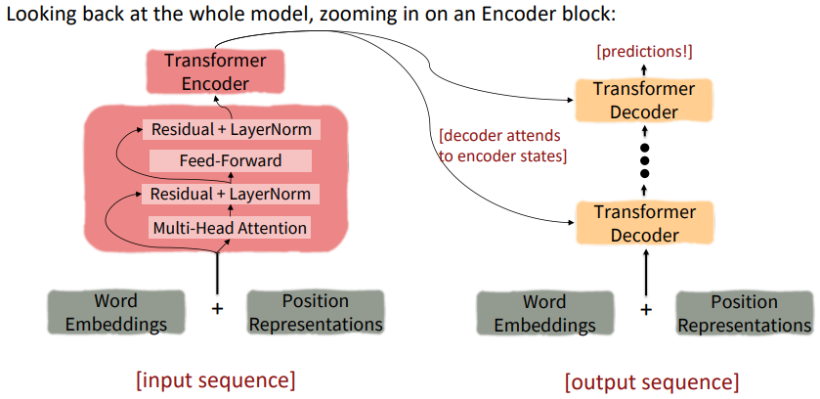
1. Quick review of Transformer model

Slide 6
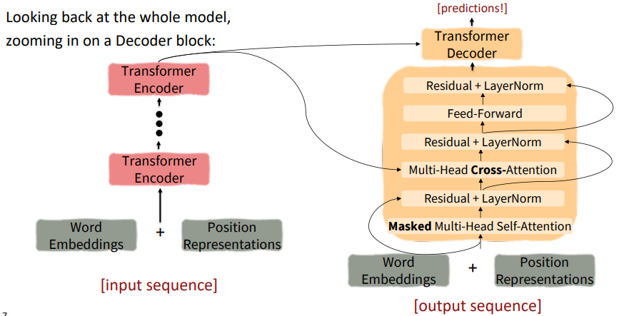
1. Quick review of Transformer model

Slide 7
2. Brief note on subword modeling
We assume a fixed vocab of tens of thousands of words, built from the training set. All novel words seen at test time are mapped to a single UNK
However, finite vocabulary assumptions make even less sense in many languages
Example
low, lower, lowest, strong, stronger, strongest – low, strong, er, est
Our goal is to save sequences of characters which appear with high frequency, let see BPE algorithm!

Slide 8
2. Brief note on subword modeling
Subword modeling in NLP encompasses a wide range of methods for reasoning about structure below the word level (parts of words, characters, bytes)
The dominant modern paradigm is to learn a vocabulary of parts of words (subword tokens)
At training and testing time, each word is split into a sequence of known subwords
BPE (Byte-Pair Encoding)
Start with a vocabulary containing only characters and an "end-of-word" symbol
Using a corpus of text, find the most common pair of adjacent characters "a,b"; add subword "ab" to the vocab
Replace instances of the character pair with the new subword, repeat until desired vocab size

Slide 9
2. Brief note on subword modeling
BPE example:
("hug", 10), ("pug", 5), ("pun", 12), ("bun", 4), ("hugs", 5)
vocab: h u g p n b s
("h" "u" "g", 10), ("p" "u" "g", 5), ("p" "u" "n", 12), ("b" "u" "n", 4), ("h" "u" "g" "s", 5)
"u" followed by "g" occurs 10+5+5=20 times, "ug" is add to the vocabulary
vocab: h u g p n b s ug
("h" "ug", 10), ("p" "ug", 5), ("p" "u" "n", 12), ("b" "u" "n", 4), ("h" "ug" "s", 5)
"u" followed by "n" occurs 12+4=16 times, "un" is add to the vocabulary
vocab: vocab: h u g p n b s ug un
"h" followed by "ug" occurs 10+5=15 times, "hug" is add to the vocabulary
vocab: vocab: h u g p n b s ug un hug
("hug", 10), ("p" "ug", 5), ("p" "un", 12), ("b" "un", 4), ("hug" "s", 5)
repeat until desired vocab size

Slide 10
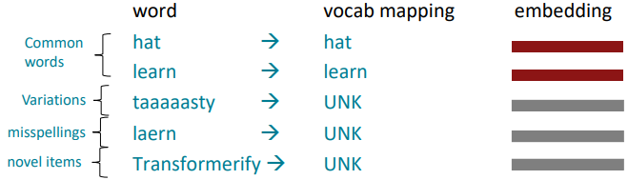
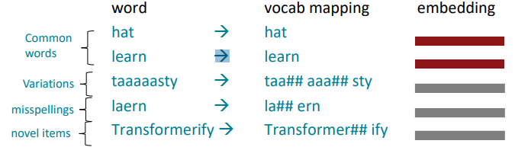
2. Brief note on subword modeling
Result

Slide 11
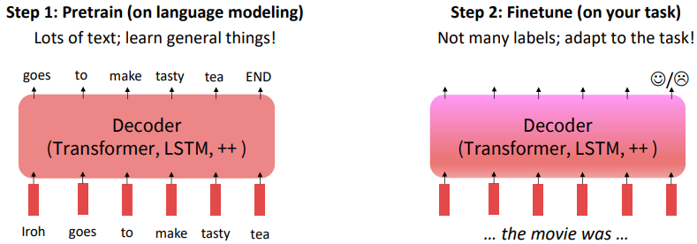
3. Motivating model pretraining from word embeddings
Recall the language modeling task:
Model P(w_{t}|w_{1:t-1}), the probability distribution over words given their past contexts
There's lots of data for this (In English)
Pretraining through language modeling
Train a neural network to perform language modeling on a large amount of text
Save the network parameters
Pretraining can improve NLP applications by serving as parameter initialization

Slide 12
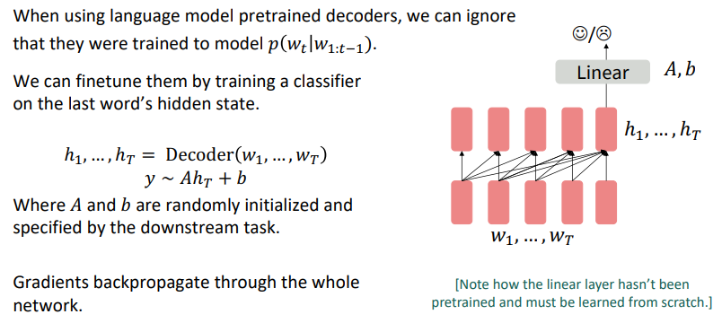
4.1 Pretraining decoders

Slide 13
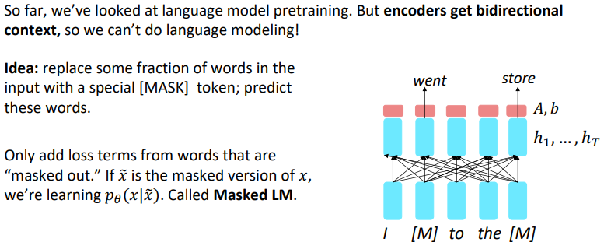
4.2 Pretraining encoders

Slide 14
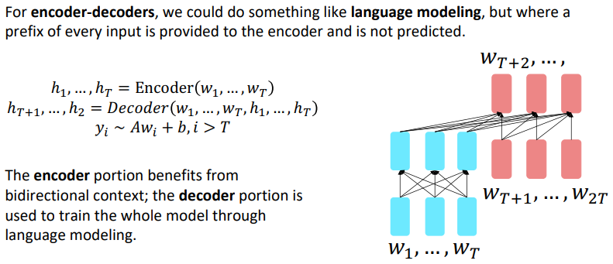
4.3 Pretraining encoder-decoders

Slide 15
THANK YOU
Any question?

