Slide 1
Lecture 11: Question Answering
Presenter: Chu Đình Đức

Slide 2
Lecture plan
1. BiDAF model
2. BERT model

Slide 3
Neural models for reading comprehension
Problem formulation
Input: C = (c₁, c₂, …, c_{N}) Q = (q₁, q₂,…, q_{M}), c_{i} q_{i} ∈ V
Output: 1 ≤ start ≤ end ≤ N
2 models
BiDAF (LSTM-based)
BERT

Slide 4
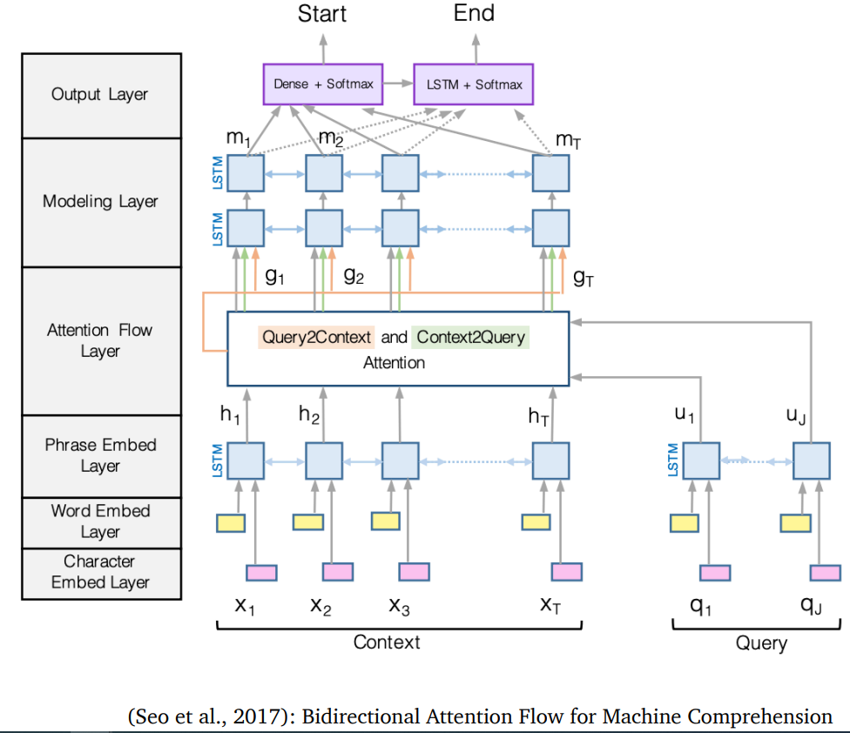
1. BiDAF: the Bidirectional Attention Flow model

Slide 5
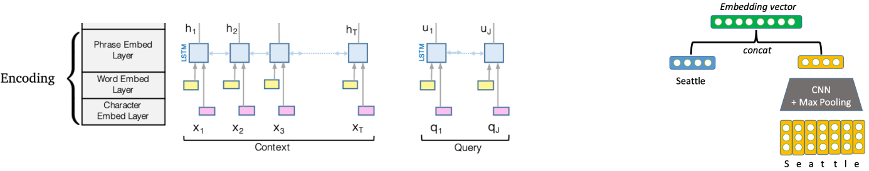
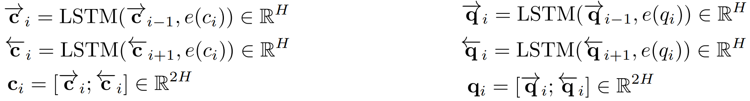
BiDAF: Encoding
Use a concatenation of word embedding (GloVe) and character embedding (CNNs over character embeddings) for each word in context (C) and query (Q)
e(c_{i}) = f([GloVe(c_{i});charEmb(c_{i})]) e(q_{i}) = f([GloVe(q_{i});charEmb(q_{i})])
Then, use two BiLSTMs separately to produce contextual embeddings for both context and query

Slide 6
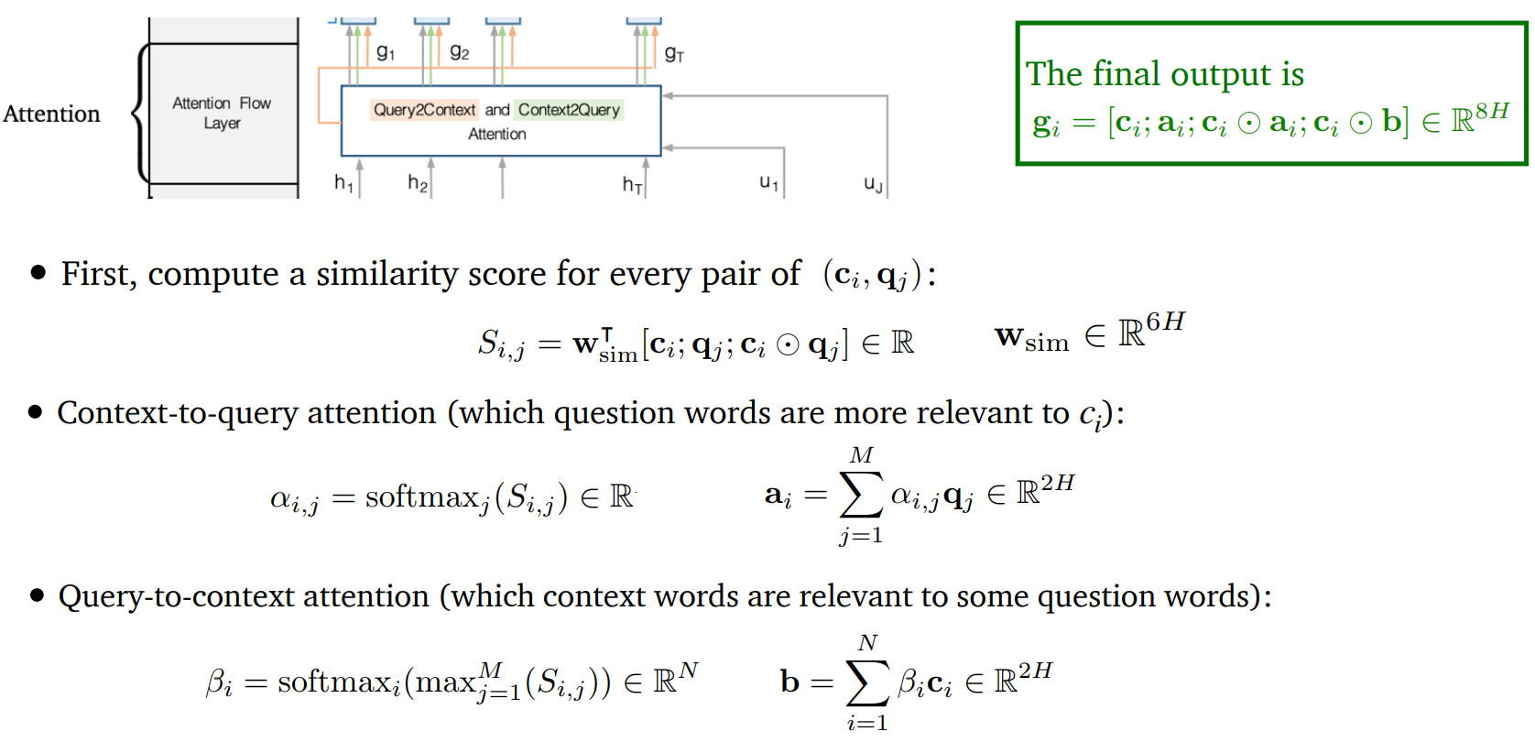
BiDAF: Attention

Slide 7
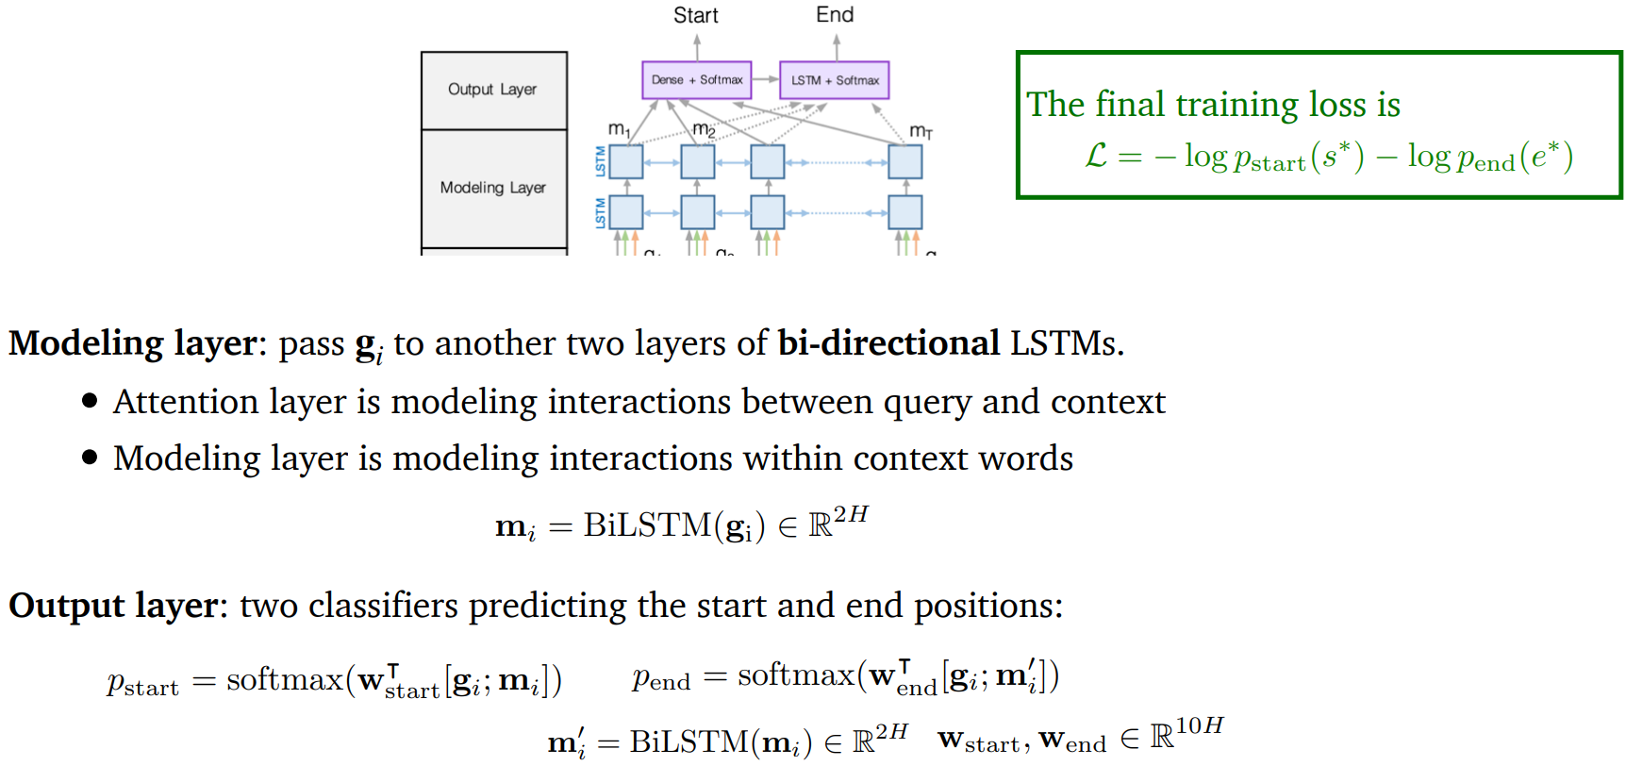
BiDAF: Modeling and output layers

Slide 8
2. BERT
BERT – Bidirectional Encoder Representations from Transformers
BERT is a deep bidirectional Transformer encoder pre-trained on large amounts of text (Wikipedia + BooksCorpus)
BERT is pre-trained on two training objectives:
Masked language model (MLM)
Next sentence prediction (NSP)
BERT_{base} has 12 layers and 110M parameters, BERT_{large} has 24 layers and 330M parameters

Slide 9
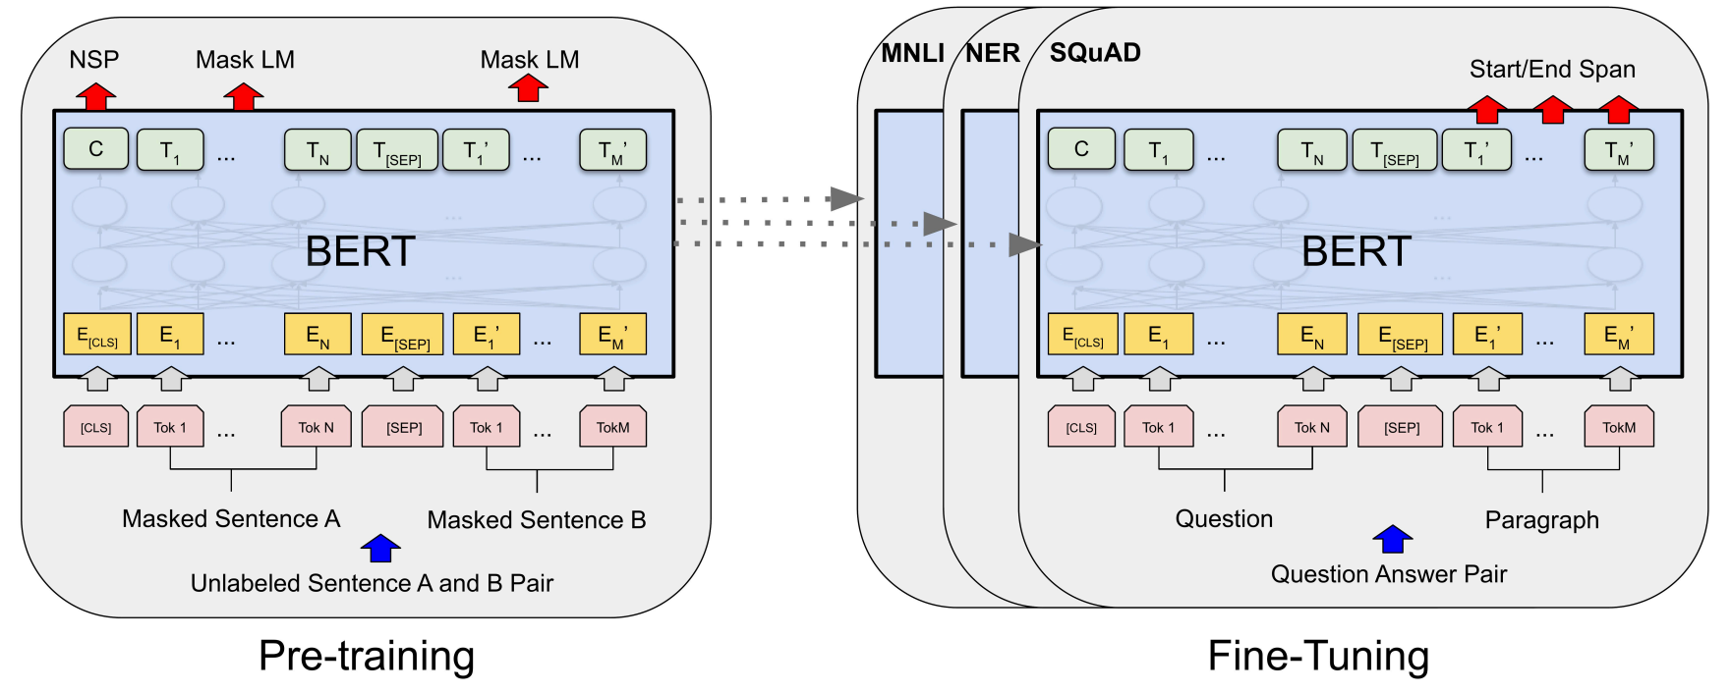
BERT

Slide 10
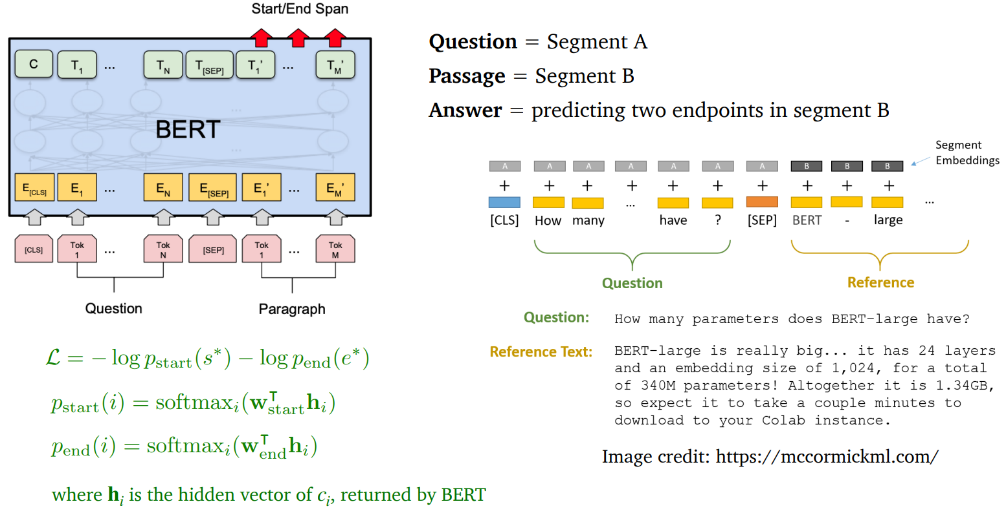
BERT for reading comprehension

Slide 11
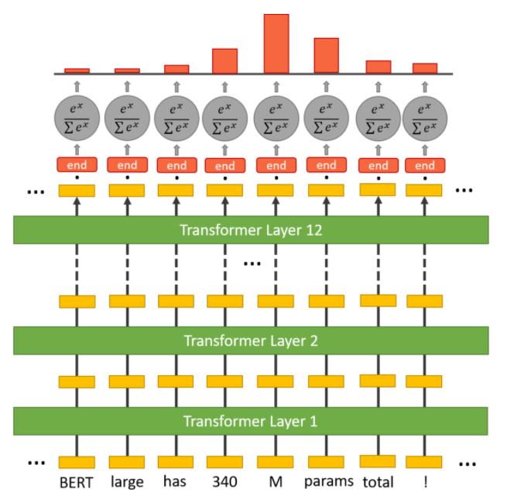
BERT for reading comprehension

Slide 12
THANK YOU
Any question?

