Slide 1
Lecture 4: Dependency parsing
Presenter: Chu Đình Đức

Slide 2
Lecture plan
Dependency Parsing
Greedy Deterministic Transition-Based Parsing
Neural Dependency Parsing

Slide 3
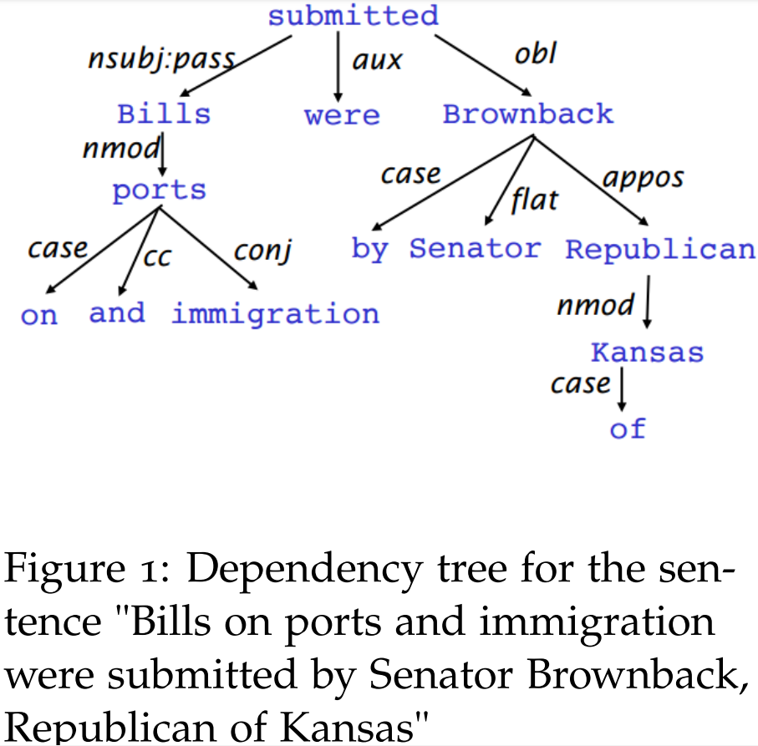
1. Dependency Parsing
Dependency parsing is the task of analyzing the syntactic dependency structure of a given input sentence S
Formally, the dependency parsing problem asks to create a mapping from the input sentence with words S = w₀w₁...w_{n} (where w₀ is the ROOT) to its dependency tree graph G
Model:
Learning: Given a training set D of sentences annotated with dependency graphs, induce a parsing model M that can be used to parse new sentences
Parsing: Given a parsing model M and a sentence S, derive the optimal dependency graph D for S according to M

Slide 4
2. Greedy Deterministic Transition-Based Parsing
This transition system is a state machine, which consists of states and transitions between those states
State:
For any sentence S = w₀w₁...w_{n}, a state can be described with a triple c = (σ, β, A)
a stack σ of words w_{i} from S
a buffer β of words w_{i} from S
a set of dependency arcs A of the form (w_{i}, r, w_{j}), where w_{i}, w_{j} are from S, and r describes a dependency relation
It follows that for any sentence S = w0w1...wn
initial state: ([w₀]_{σ}, [w₁, ..., w_{n}]_{β}, ∅)
terminal state: (σ, []_{β}, A)
Notes:
INPUT OUTPUT

Slide 5
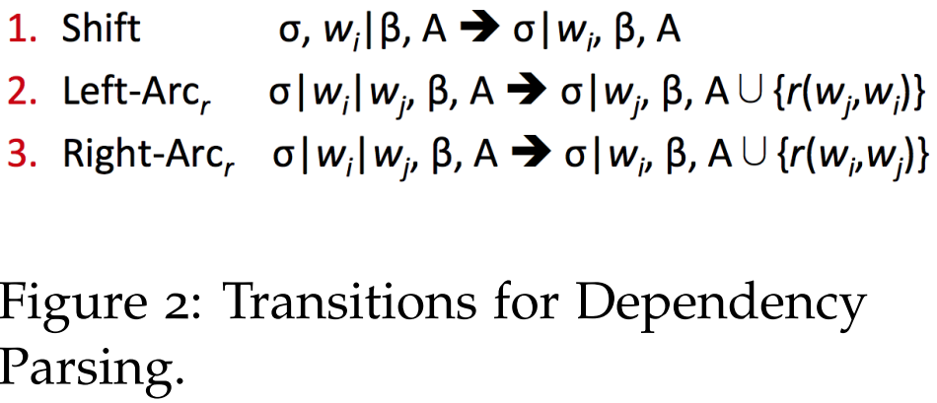
2. Greedy Deterministic Transition-Based Parsing
The model induces a sequence of transitions from initial state to
terminal state
Transitions: 3 types of transitions between states
SHIFT: remove the first word in the buffer and push it on top
of the stack (pre-condition: buffer has to be non-empty)
LEFT-ARC_{r}: add a dependency arc (w_{j}, r, w_{i}) to the arc set A, where w_{j} is the word at the top of the stack, w_{i} is the word second to the top of the stack. Remove w_{i} from the stack (pre-condition: the stack needs to contain at least two items and w_{i} can't be the ROOT)
RIGHT-ARC_{r}: add a dependency arc (w_{i}, r, w_{j}) to the arc set A, where w_{j} is the word at the top of the stack, w_{i} is the word second to the top of the stack. Remove w_{j} from the stack (pre-condition: the stack needs to contain at least two items)

Slide 6
3. Neural Dependency Parsing
The primary distinction from previous models is the reliance on dense rather than sparse feature representations
The model employs the arc-standard system for transitions, as presented in section 2
Ultimately, the aim of the model is to predict a transition sequence from initial configuration c to a terminal configuration
As the model is greedy, it attempts to correctly predict one transition T ∈ {SHIFT, LEFT-ARC_{r}, RIGHT-ARC_{r}} at a time, based on features extracted from the configuration c = (σ, β, A)

Slide 7
3. Neural Dependency Parsing
The model we will describe employs the arc-standard system for transitions, as presented in section 2. Ultimately, the aim of the model is to predict a transition sequence from initial configuration c to a terminal configuration
Feature Selection: the features for a given sentence S generally include some subset of:
S_{word}: vector representations for some of the words in S (and their dependents) at the top of the stack σ and buffer β
S_{tag}: Part-of-Speech (POS) tags for some of the words in S. POS tags comprise a small, discrete set P = {NN, NNP, NNS, DT, JJ, …}
S_{label}: the arc-labels for some of the words in S. The arc-labels comprise a small, discrete set, describing the dependency relation: L = {amod, tmod, nsubj, csubj, dobj, …}

Slide 8
3. Neural Dependency Parsing
Feature Selection Example:
S_{word}: the top 3 words on the stack and buffer: s₁, s₂, s₃, b₁, b₂, b₃. The first and second leftmost/rightmost children of the top two words on the stack: lc₁(s_{i}), rc₁(s_{i}), lc₂(s_{i}), rc₂(s_{i}), i = 1, 2. The leftmost of leftmost/rightmost of rightmost children of the top two words on the stack: lc₁(lc₁(s_{i})), rc₁(rc₁(s_{i})), i = 1, 2. The total S_{word} contains n_{w} = 18 elements
S_{tag}: the corresponding POS tags for S_{tag} (n_{t} = 18)
S_{label}: the corresponding arc labels of words (n_{l} = 12)

Slide 9
3. Neural Dependency Parsing
We use a special NULL token for non-existent elements
For each feature type, we will have a corresponding embedding matrix (E^{w}, E^{t}, E^{l}), mapping from the feature's one hot encoding to a d-dimensional dense vector representation, then concatenate these vectors into our inputs [x^{w}, x^{t}, x^{l}]

Slide 10
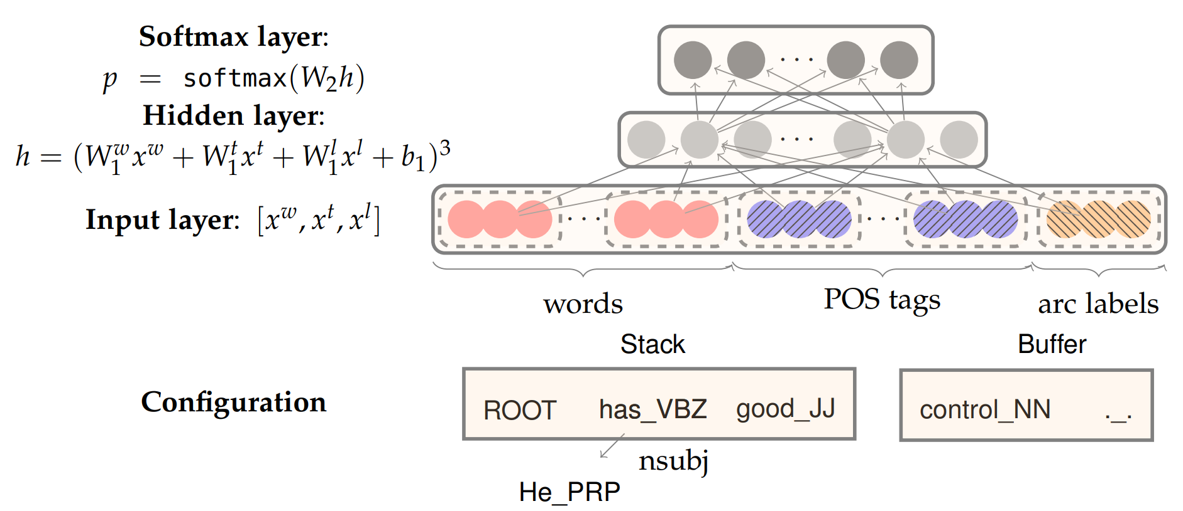
3. Neural Dependency Parsing
Notes:
TAI SAO TU INPUT RA OUTPUT, Y NGHIA BEN TRONG

Slide 11
Note
Relation set: here
Example:
nsubj:pass: passive nominal subject
nmod: nominal modifier
case: case marking
cc: coordination
conj: conjunct
aux: auxiliary
obl: oblique nominal
flat: flat multiword expression
appos: appositional modifier

Slide 12
THANK YOU
Any question?

